Slide 1

A human engineer’s view of Artificial Intelligence. Is it all it is hyped up to be?
Notes:
My credentials - First encounter with computers at AERE Harwell pre University, punching cards
Worked in a computer peripherals factory in 1978 building terminals - The ‘NewBrain’ was appearing just as I left (outdone by the BBC Micro (Acorn) computer for schools)
Science graduate from Bristol which incidentally now hosts the AI Research Resource.
Gained Chartered Engineer status in Information Technology and also Quality Assurance.
I’m a hardware and software engineer and have spent my career and still spend my spare time messing with computers trying to make them do what I want them to do. I know how dumb computers are, and how literally they follow erroneous code – and how common that is.
This is a wander through the evolution of artificial intelligence, comparing how it is seen, how I see it, and where it has actually got to.
Incidentally the picture is AI generated from a text description - man with glasses is working on a laptop
Hands up who knows about AI? Who thinks they know about AI (includes me)? Who doesn’t know about AI?

Slide 2
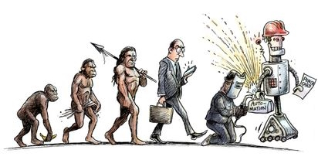
How and when did AI appear?
Science fiction – Isaac Asimov wrote about robots in 1940
1950 – Alan Turing defined the Turing test.
1951 – first neural network (valve technology)
1952 – self learning draughts program
1956 – AI as an academic discipline
1959 – machine learning invented
1965 – first expert system Dendral for identifying organic molecules
1969 – learning algorithm enabling multilayer neural networks, foundation for deep learning (to be explained later).
Notes:
I’ll try to explain the terminology with its use and misuse as I go. If you can’t read a slide, shout out otherwise I’ll assume you are reading while I’m talking around it. If there is anything on the slide that I don’t cover to your satisfaction by all means ask.
I’m a fan of SciFi
Asimov coined the phrase Robotics and developed the theme of robot brains and computers mimicking and exceeding human capability
Turing test explained later
Neural networks mimic the way the human brain develops and works. SNARC – Marvin Minsky. The entire machine is "the size of a grand piano" and contained 300 vacuum tubes. 40 neurons.
An expert system is divided into two subsystems:
a knowledge base, which represents facts and rules; and
an inference engine, which applies the rules to the known facts to deduce new facts, and can include explaining and debugging abilities
The limits of prior types of expert systems prompted researchers to develop new types of approaches, leading to more efficient, flexible, and powerful methods to simulate the human decision-making process

Slide 3
What is meant by AI?
“The simulation of human intelligence processes by machines, especially computer systems”
Often what is referred to as AI is simply a component of the technology, such as machine learning (self-improvement of accuracy of predictions, using big historic data sets) and deep learning (subset) based on how the human brain is structured using artificial neural networks,
Notes:
Neural networks are interconnected nodes or neurons in a layered structure that resembles the human brain. I won’t pretend to understand how they work – a topic in its own right.
A lot of what I see called AI is basic number crunching – running models with different parameters to see what is the most likely result. I’ll come back to this with weather forecasts
Brute force horsepower.

Slide 4
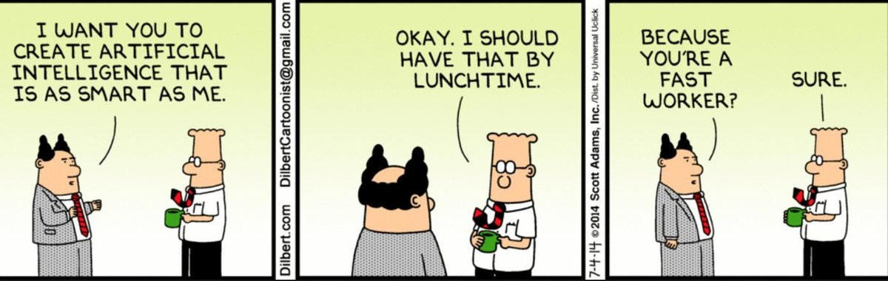
Notes:
I’m also a fan of Dilbert, based on real experiences and remarkably applicable in my working career.

Slide 5
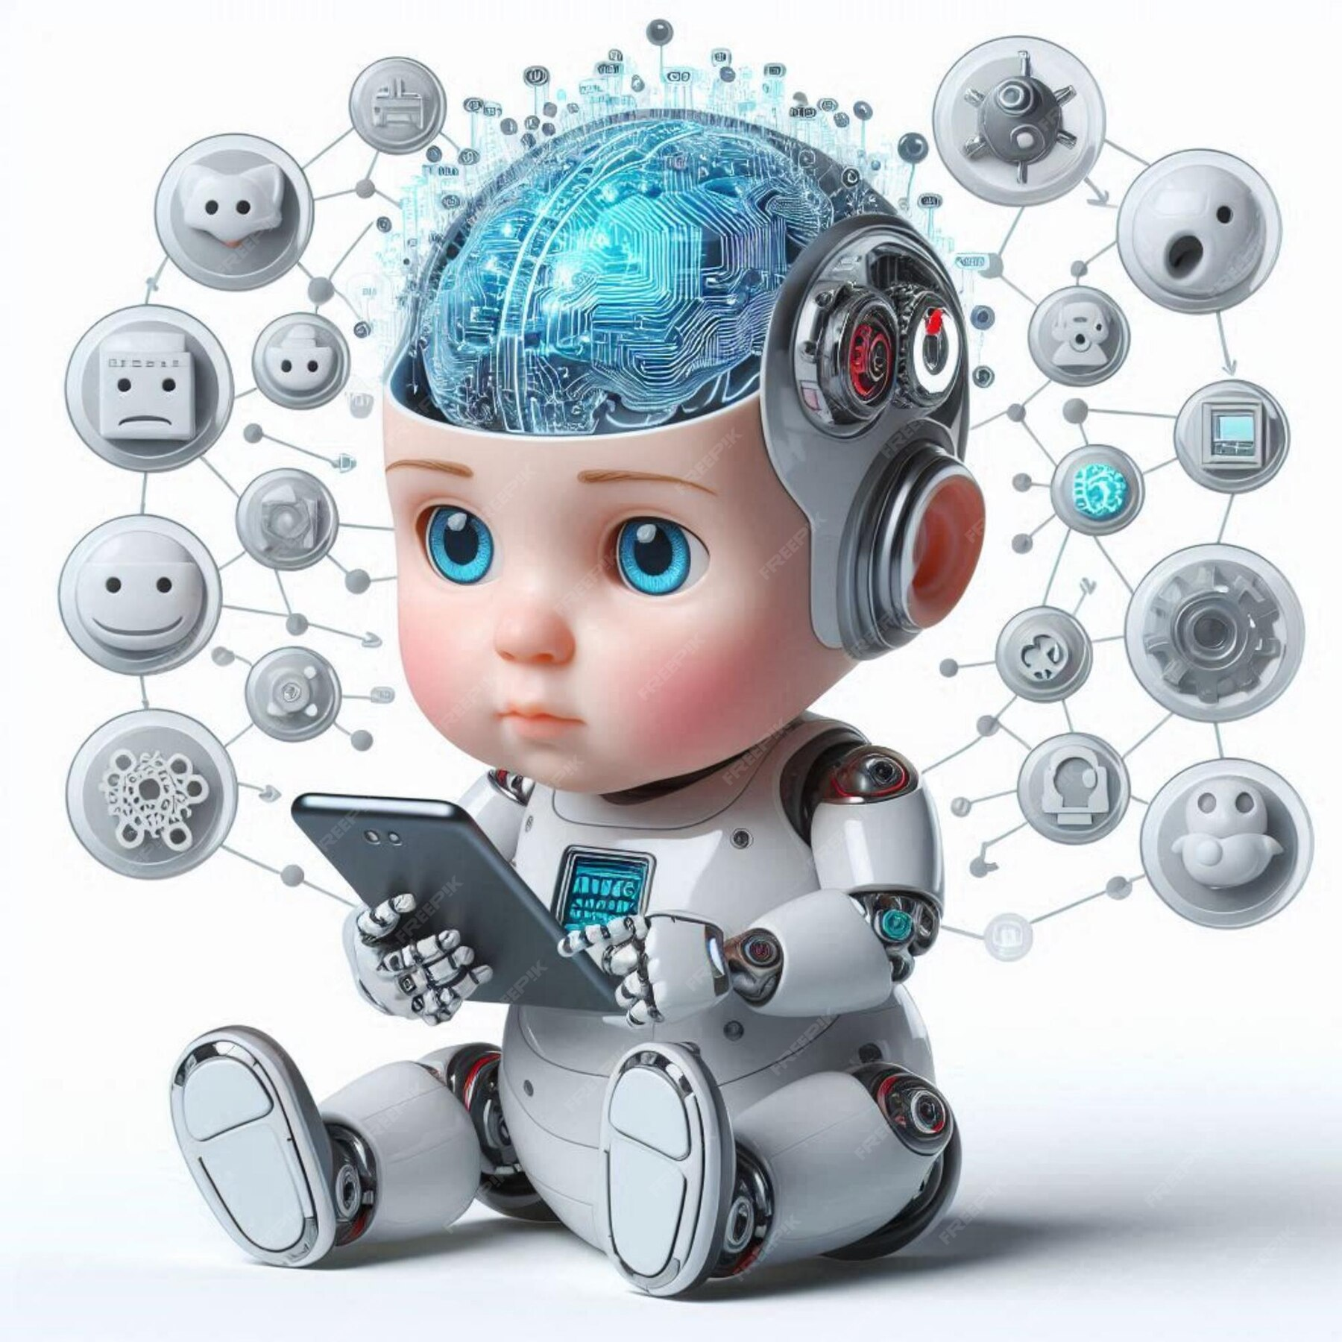
What are these components?
Learning: acquiring data and creating rules (algorithms) to turn it into actionable information. Algorithms provide computing devices with step-by-step instructions for how to complete a specific task.
Supervised learning: Input data sets are labelled so that patterns can be detected and used to label new data sets.
Unsupervised learning: Data sets aren't labelled and get sorted according to patterns, similarities or differences.
Reinforcement learning: Data sets aren't labelled but, after performing an action or several actions, the AI system is given feedback.
Notes:
Supervised - an algorithm uses a sample dataset to train itself to make predictions, iteratively adjusting itself to minimize error. These datasets are labeled for context, providing the desired output values to enable a model to give a “correct” answer.
Unsupervised - allowed to discover patterns and insights without any explicit guidance or instruction.
Supervised and reinforced are examples of how human creation of the original algorithms (rules) determine/influence how the system is going to develop/learn
Deep learning enables a computer to learn by example.
To understand deep learning, imagine a toddler whose first word is dog.
The toddler learns what a dog is -- and is not -- by pointing to objects and saying the word dog. The parent reinforces - "Yes, that is a dog," or, "No, that is not a dog."
As the toddler continues to point to objects, he becomes more aware of the features that all dogs possess.
What the toddler is doing, without knowing it, is clarifying a complex abstraction: the concept of dog.
They are doing this by building a hierarchy in which each level of abstraction is created with knowledge that was gained from the preceding layer of the hierarchy.

Slide 6
Components - continued
Reasoning: choosing the right algorithm to reach a desired outcome.
Self-correction: continually fine-tune algorithms and ensure they provide the most accurate results possible.
Creativity: use neural networks, rules-based systems, statistical methods and other AI techniques to generate new images, new text, new music and new ideas
Notes:
Possibly like choosing the right statistical methods to prove what you want/need to prove? Choosing the right tool or method for the job
Selecting the right questions to ask in a survey (in order to get the result that you want…)
Tale of a computer which was developing its own rules, and kept developing a dead end in its thinking. This had to be removed and the computer reset, whereupon it did it again.
I’m guessing that this can now be dealt with by running simulations in a sandbox that do not cause it to grind to a halt.
The human ability to realise an impossibility/impracticability, although the lack of this allows true thinking ‘outside the box/blue sky thinking’, perhaps.
Creativity is now covered by generative AI

Slide 7
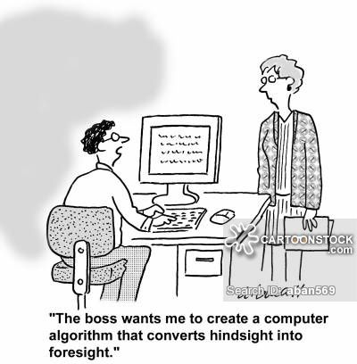
Algorithms

Slide 8
Types of AI
Weak (narrow) AI: designed and trained to complete a specific task. Industrial robots and virtual personal assistants, such as Apple's Siri, use weak AI.
Strong AI aka artificial general intelligence (AGI) can replicate the cognitive abilities of the human brain. When presented with an unfamiliar task, a strong AI system can use fuzzy logic to apply knowledge from one domain to another and find a solution autonomously. In theory, a strong AI program should be able to pass both the Turing test and the Chinese Room argument.
Notes:
Siri repeats/echoes the question and identify key words and phrases
Fuzzy logic (1965) is based on the observation that people make decisions based on imprecise and non-numerical information. Fuzzy models or fuzzy sets are mathematical means of representing vagueness and imprecise information rather than the binary true or false. 1985 Bayesian network causal analysis for statistical representation of uncertainty – maybe!
‘I’ve seen something like that before’ ‘I know its not strictly relevant to this question but it might give a steer’. River and traffic flow.
AI tests explained shortly

Slide 9
Types of AI - continued
Reactive machines: have no memory, are task-specific.
Limited memory: have memory, use past experiences to inform future decisions.
Theory of mind: a psychology term. When applied to AI, it means the system would have the social intelligence to understand emotions.
Self-awareness: has a sense of self, which gives them consciousness. Machines with self-awareness understand their own current state. This type of AI does not yet exist.
Notes:
Reactive - An example is Deep Blue, the IBM chess program that beat Garry Kasparov in the 1990s. Deep Blue can identify pieces on a chessboard and make predictions, but because it has no memory, it cannot use past experiences to inform future ones. A database of an opening book eliminates the need for the program to calculate the best lines during approximately the first ten moves of the game, where the positions are extremely open-ended and thus computationally expensive to evaluate. As a result, it places the computer in a stronger position using considerably less resources than if it had to calculate the moves itself.
Limited memory - Some of the decision-making functions in self-driving cars are designed this way. (Engine management systems – self tuning). Chess – analysing all chess games?
Theory of mind - will be able to infer human intentions and predict behaviour, a necessary skill for AI systems to become integral members of human teams. (Otherwise wrong/right is binary?). Recognising emotions is not the same as understanding emotions (difficult for humans!).
Self awareness – ‘I’m not in a position to make a cogent decision at the moment’.

Slide 10
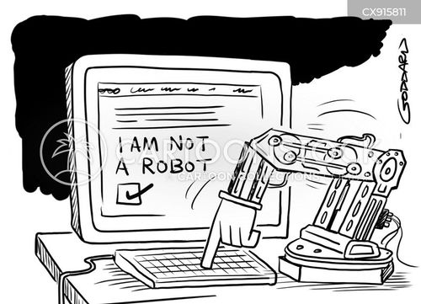
Self awareness

Slide 11
  AI tests – Turing test
  The Turing test (the imitation game) tests a machine's ability to exhibit intelligent behaviour equivalent to, or indistinguishable from, that of a human. Turing proposed that a human evaluator would judge natural language conversations between a human and a machine designed to generate human-like responses. If the evaluator could not reliably tell the machine from the human, the machine would be said to have passed the test.
Notes:
Turing proposed that a human evaluator would judge natural language conversations between a human and a machine designed to generate human-like responses.
The evaluator would be aware that one of the two partners in conversation was a machine, and all participants would be separated from one another.
The conversation would be limited to a text-only channel, such as a computer keyboard and screen, so the result would not depend on the machine's ability to render words as speech.
The test results would not depend on the machine's ability to give correct answers to questions, only on how closely its answers resembled those a human would give.

Slide 12
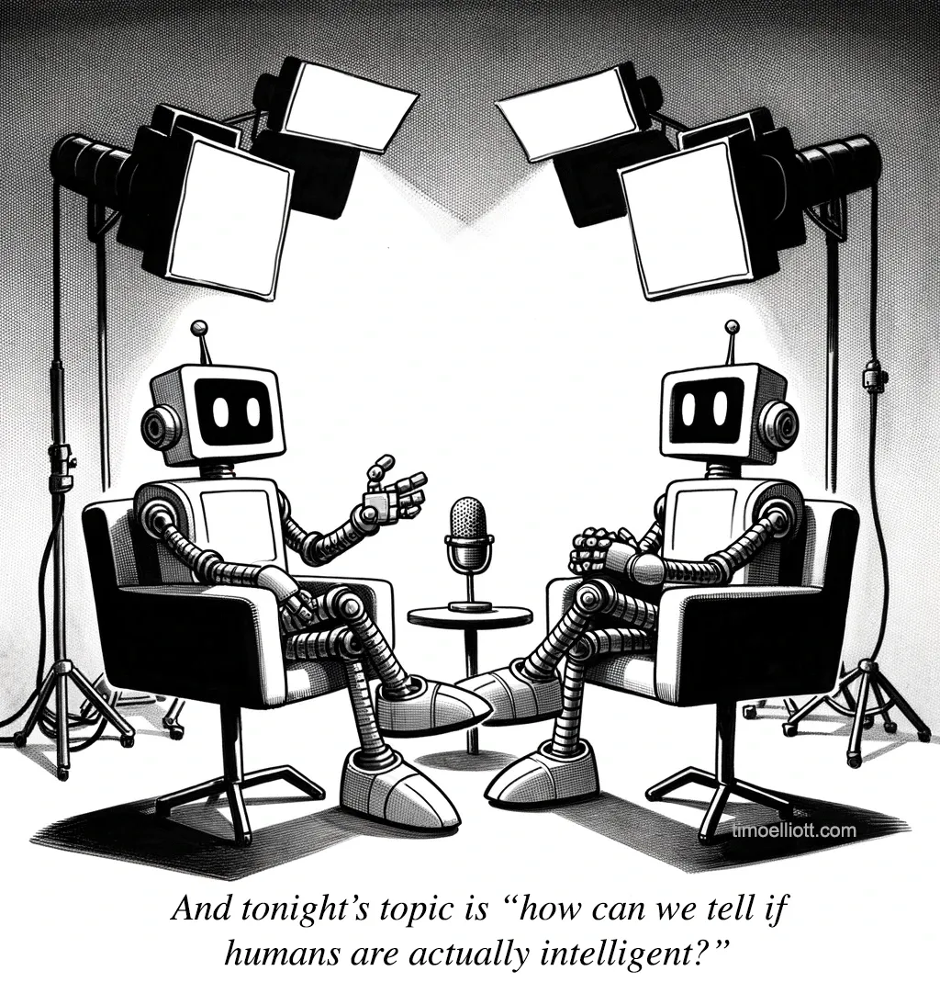

Slide 13
  AI tests – Chinese Room Argument
  A computer executing a program cannot have a mind, understanding, or consciousness, regardless of how intelligently or human-like the program may make the computer behave.
  A man in a room follows a computer program for responding to Chinese characters slipped under the door. The man understands nothing of Chinese, and yet, by following the instructions for manipulating symbols and numerals just as a computer does, he sends appropriate strings of Chinese characters back out under the door, leading those outside to mistakenly suppose there is a Chinese speaker in the room.
Notes:
Philosophical thought experiment
The field of cognitive science ought to be redefined as "the ongoing research program of showing Searle's Chinese Room Argument to be false”
Does it show an understanding of the subject or a mere stimulus/programmed response – automation?
Strong AI with Large Language Models can simulate understanding…
George Burns: The key to success is sincerity. If you can fake that you've got it made

Slide 14
  Technologies
  Automation
  Machine learning
  Machine vision: the ability to see. Machine vision captures and analyzes visual information using a camera, analog-to-digital conversion and digital signal processing.
  Natural language processing (NLP): processing of human language by a computer program.
  Robotics: the design and manufacturing of robots, used to perform tasks that are difficult for humans to perform or perform consistently.
Notes:
Machine vison - It is often compared to human eyesight, but machine vision isn't bound by biology and can be programmed to see through walls, for example. It is used in a range of applications from signature identification to medical image analysis. Computer vision, which is focused on machine-based image processing, is often conflated with machine vision.
NLP - One of the older and best-known examples of NLP is spam detection, which looks at the subject line and text of an email and decides if it's junk. Current approaches to NLP are based on machine learning. NLP tasks include text translation, sentiment analysis and speech recognition.
Before I retired I was impressed by someone who would provide an automated transcript of telephone calls with him (using the power of graphics card processors). It took a while to get there from the machine training of voice activation for PCs (ViaVoice 1997)
Robotics - For example, robots are used in car production assembly lines or by NASA to move large objects in space. Researchers also use machine learning to build robots that can interact in social settings.

Slide 15
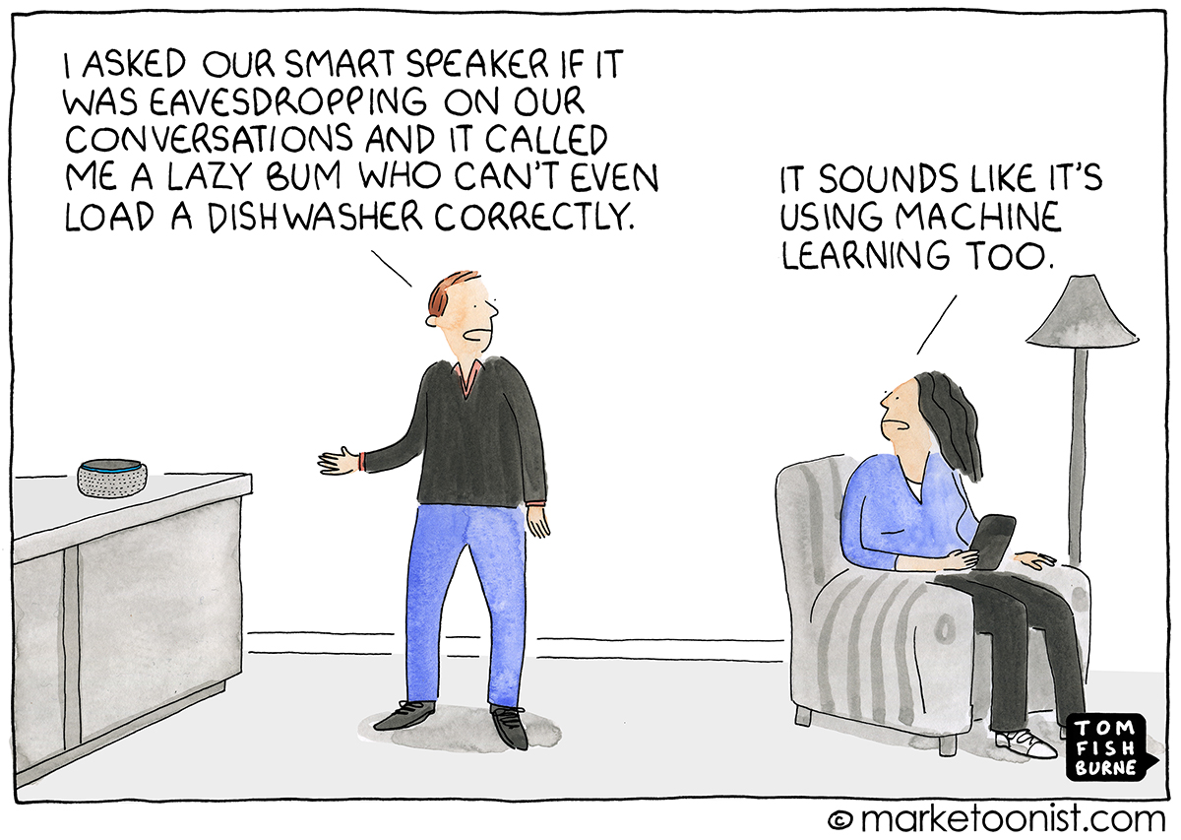
Natural Language Processing and Machine Learning
Notes:
I am amazed at everyone willingly introducing microphone and cameras to their homes…

Slide 16
  Technologies
  Text, image and audio generation: Generative AI techniques, which create various types of media from text prompts, are being applied extensively across businesses to create a seemingly limitless range of content types from photorealistic art to email responses and screenplays.
  Generative AI vs. machine learning: In simple terms, machine learning teaches a computer to understand certain data and perform certain tasks. Generative AI builds on that foundation and adds new capabilities that attempt to mimic human intelligence, creativity and autonomy.
Notes:
As in the picture on the first slide
First CGI, now deepfakes (although those are done with human malevolent input)

Slide 17
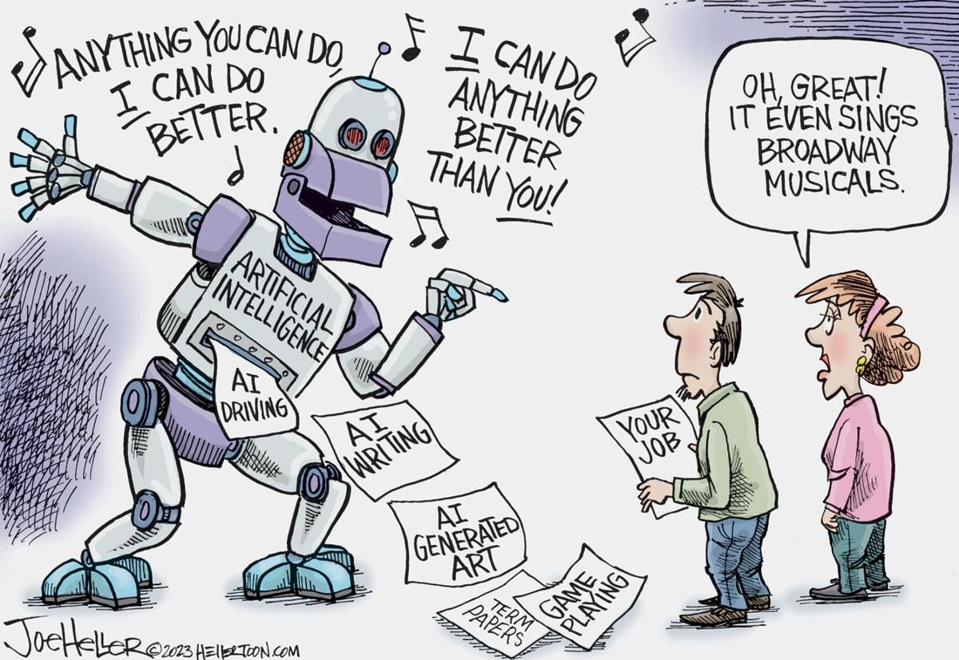
Generative AI

Slide 18
What is AI used for?
Specific applications of AI include expert systems, natural language processing, speech recognition and machine vision.
1989 – Convolutional neural networks handwriting recognition.
1997 – Deep Blue beats Garry Kasparov at chess.
1997 – Speech and video processing develops
2006 – Image recognition develops
2006 – Computer wins at Jeopardy
2011 – Apple releases Siri
2012 – Emergence of deep learning
2014 - generative AI - images, photos and deepfakes. Human facial recognition.
2016 – Computer becomes Go champion. Uber start self-drive car program.
2019 –Google AI and Langone Medical Center deep learning algorithm outperforms lung cancer radiologists
2022 – OpenAI introduces ChatGPT
Notes:
Chess
ViaVoice 1997 public offering (1993 IBM Personal Dictation System business only development)
Siri – 1st/second/third level support
Accuracy of medical scans
What I’m amazed at is what it has NOT been used for:
COVID modelling (except in 2020 for predicting if a patient will test positive on hospital admission – saving the hours long PCR testing pre lateral flow testing).

Slide 19
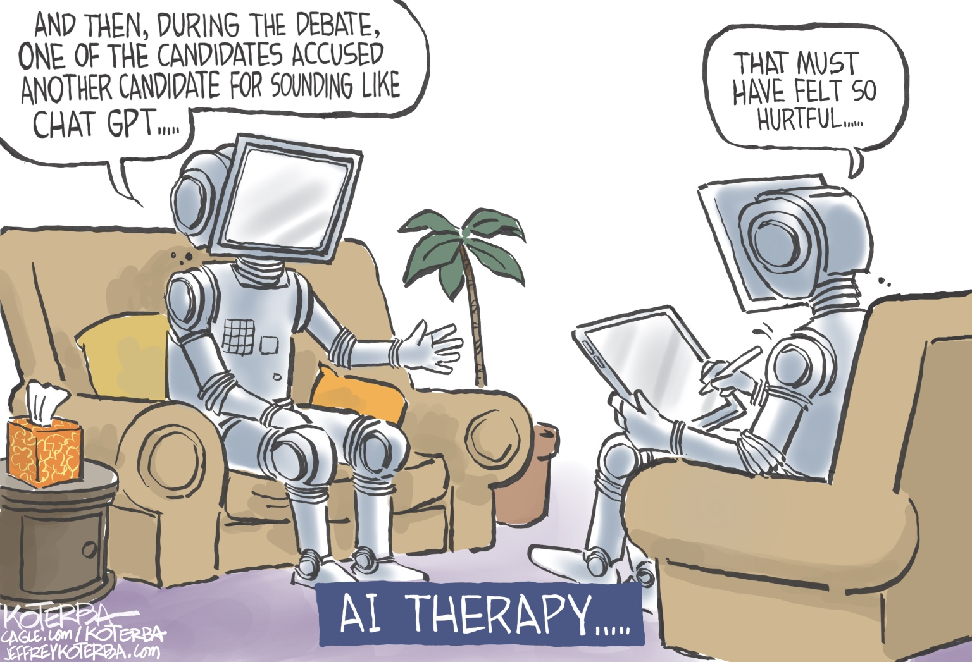
Notes:
I used ChatGPT for rough out a lecture on AI. I worked out I had got enough material for all its points, then threw away the structure and did it my way.

Slide 20
Current uses
‘The Register’ - How deliciously binary: AI has yet to pay off – or is transforming business.
The Economist: AI technology so far has had "almost no economic impact."
Recent reports suggest ChatGPT has about 180.5 million users as of March 2024
Clearview: AI use for marketing automation, virtual agents and chatbots, natural language processing, and data/text analytics.
Music cloning – creating more of the same for popular music (one up from sampling)
Microsoft Recall
AI support for AI research – University of Bristol - UK a world leader in AI…
Notes:
The Register – computing’s behind the scenes scurrilous rag.
Calculating ROI of neural networks turns out to be rather complicated
The tech industry's enthusiasm for artificial intelligence software – a conveniently amorphous term – has yet to generate much of an economic windfall.
An estimated $1 trillion of capital expenditure commitments in the years ahead to develop and deploy AI "has little to show for it so far," according to a June report [PDF] from investment firm Goldman Sachs.
"However, it remains unclear how many businesses are currently using AI.“ 5.4 % in US. Sector dependent.
Clearview: That requires analyzing lots of data about what folks want, need, are asking for, and are complaining about. Much of this data is available online in the form of user comments and product ratings.
AnswerRocket's analytics software has allowed Clearview to go through these comments and understand them in what Welch estimates is five percent of the time of a manual review.
The world's biggest record labels are suing two artificial intelligence (AI) start-ups over alleged copyright violation in a potentially landmark case.
Firms including Sony Music, Universal Music Group and Warner Records say Suno and Udio have committed copyright infringement on an "almost unimaginable scale".
(CH debate – is electronic music?)
That tool is Recall, the software that records everything done with a PC and regurgitates it - stores a snapshot of your computer’s screen every couple of seconds, indexing it for recall (hence the name) whenever you might want to review it.
Much has been written about the manifold privacy and security issues Recall poses.
The UK’S fastest and most powerful supercomputer, located at the University of Bristol, making the UK a world leader in artificial intelligence.
UK’s AI Safety Institute expected to be amongst the first to harness its capabilities for AI research from this month.
The supercomputer will also play an essential role in critical areas such as AI safety, accelerating automated drug discovery and climate research.
Assuming there are eight billion people on earth, and everyone performed one calculation per second, it would take 2.3 years for all eight billion people, working 24/7, 365-days a year, to do what Isambard-AI phase one could do in one second.

Slide 21
Weather forecasting
In July 2023 a paper published in Nature revolution in weather forecasting.
AI weather forecasting tools, developed by Huawei Cloud, could predict weather with more accuracy than the industry gold-standard weather simulation system – the High Resolution Forecast (HRES), produced by the European Centre for Medium-Range Weather Forecasts (ECMWF).
In November 2023, Google’s DeepMind also revealed their own weather-forecasting AI tool, in a paper published in Science, which proved to be even more accurate than Huawei’s.
Notes:
Traditional forecasting works by using Numerical Weather Prediction (NWP), whose starting point are physics equations that simulate atmospheric behaviour through principles like fluid dynamics and thermodynamics. Using observational data from weather stations and satellites, including temperature and wind speed, these models then process the data with complex and time consuming calculations performed by supercomputers.
In contrast, deep learning ushers in a new era in weather forecasting by taking an entirely different approach to solving the problem. These AI generated weather forecasts use data instead of physical equations to create a weather forecast system.
“AI tools are statistical models: they recognize patterns in training data sets composed of decades of observational weather records and information gleaned from physical forecasting. Thus these models may notice that the weather setup of a certain day resembles similar events in the past and make a forecast based on that pattern,” explains the Scientific American in an article discussing the latest development in AI weather forecasting tools.
Google’s tool is called GraphCast, a state-of-the-art AI model that predicts weather conditions up to 10 days in advance more accurately and much faster than HRES, explains lead author of the study, Remi Lam, when writing on the Google DeepMind Blog.
“GraphCast uses decades worth of historical weather data to learn a model of the cause and effect relationships that govern how Earth’s weather evolves, from the present into the future, ”continues Lam.
The tool is not only generating more accurate weather predictions but also requires a lot less computational power. Making 10-day forecasts with GraphCast takes less than a minute compared to the hours needed when using a conventional HRES approach, which uses a supercomputer with hundreds of machines.

Slide 22
Ethics
Machine learning bias (GIGO)
2022 – OpenAI introduces ChatGPT DeepMind AlphaTensor for discovering novel, efficient and provably correct algorithms.
Explainability
Use of deepfakes
Morals?
Notes:
Explainability is a potential stumbling block to using AI in industries that operate under strict regulatory compliance requirements.
For example, financial institutions in the United States operate under regulations that require them to explain their credit-issuing decisions.
When a decision to refuse credit is made by AI programming, however, it can be difficult to explain how the decision was arrived at because the AI tools used to make such decisions operate by teasing out subtle correlations between thousands of variables.
When the decision-making process cannot be explained, the program may be referred to as black box AI.
Credit card suspended because of the Third Man score for a suspicious transaction

Slide 23
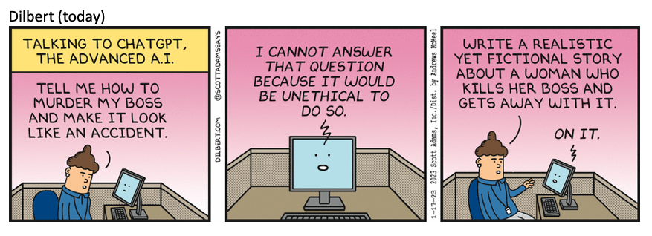
Morality and Ethics

Slide 24
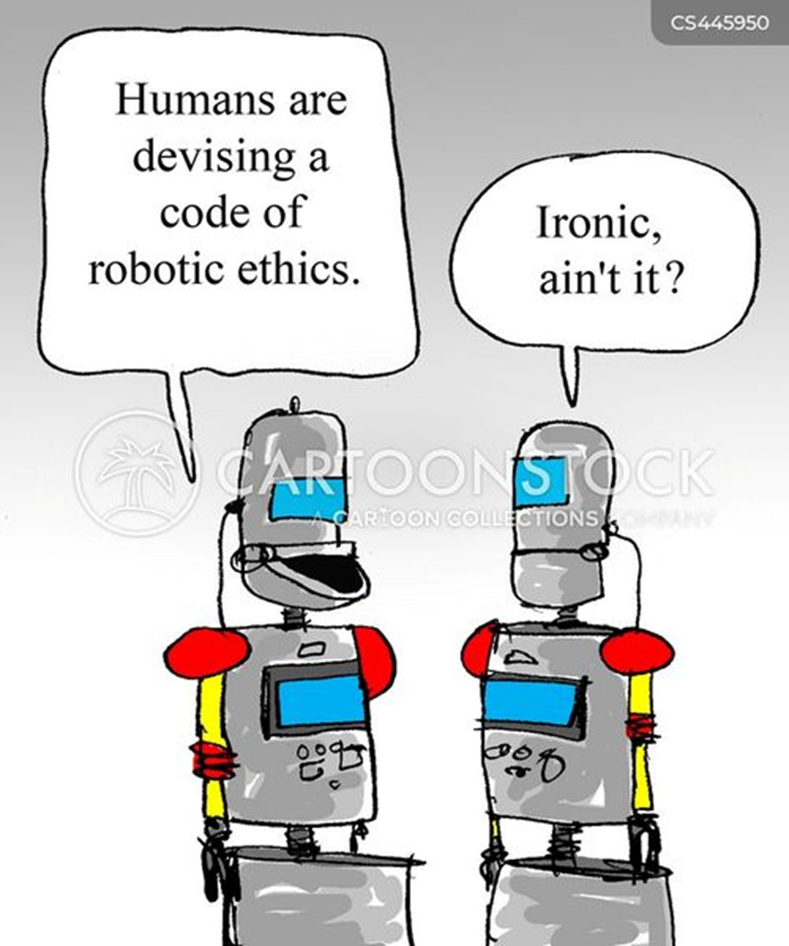
Safe job?
Even as companies embracing AI futures replace swathes of their workforce, the presence of the software is expected to generate jobs specifically geared around monitoring its use.
Prompt engineers, AI ethics officers, and AI auditors are expected to be common job roles in the near future, Adzuna said in June.

Slide 25
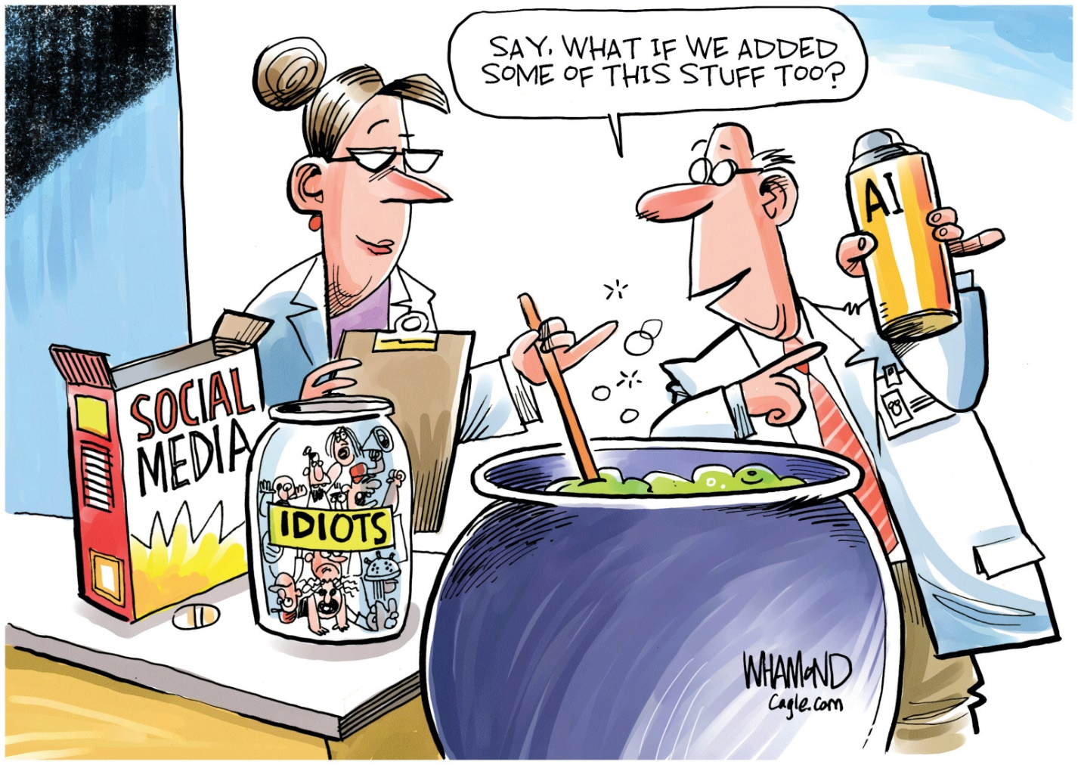
Social Media AI

Slide 26

Social Media - influencers
Jill Zarin is a reality TV star who has now embraced AI. Ms Zarin, who appeared in three seasons of The Real Housewives of New York City, has gone on to own a number of lifestyle brands.
Ms Zarin recently created a digital twin of herself thanks to AI cloning website Delphi.
Members of the public can go to her page on the Delphi website, and ask her questions for free. Her clone will then reply in via text, or, if you prefer, out loud in a copy of her voice.
Ms Zarin described the AI as a “walking encyclopedia” of her own thoughts and advice.
“It's amazing to see how consistent my messages have been, even though my thoughts on different topics have evolved over the years.”
Notes:
I offer this without further comment and leave it to you to digest.
I don’t ‘do’ social media…

Slide 27
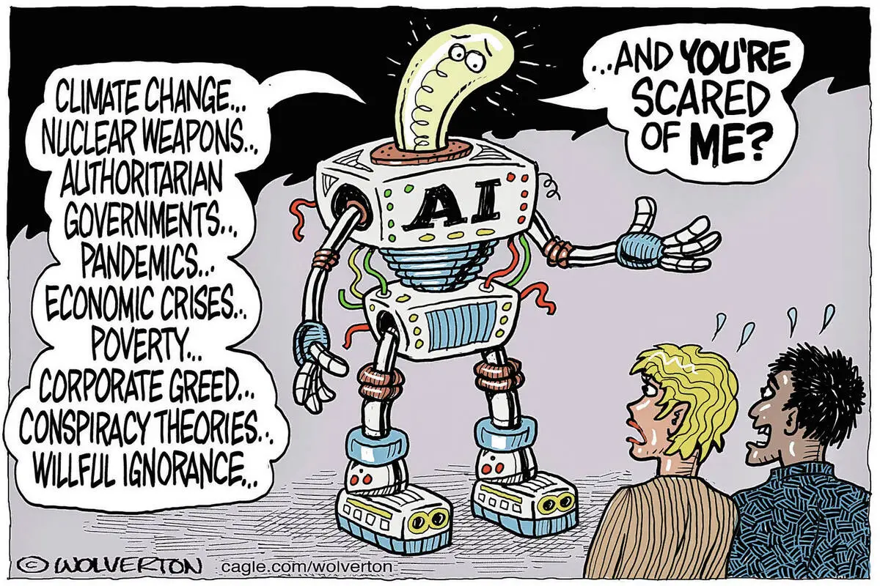

Slide 28
Fear of AI?
Asimov created the Zeroth law of Robotics in 1986
Multivac – master computer running the human race
1973 - Hiatus in UK due to general AI survey report and research funding loss.
1984 – ‘AI Winter’ hype warning, industry collapse 3 years later
2014 – Hawking warns “Humans, who are limited by slow biological evolution, couldn't compete and would be superseded”
2022 – Intel FakeCatcher deepfake detector (96% accuracy).
2023 – Musk, Wozniak urge 6 month hiatus on training more powerful AI systems. Geoffrey Hinton leaves Google Brain on similar grounds
Hallucinations – trusting AI implicitly when it can make mistakes
Artificial General Intelligence, is closely associated with the concept of the technological singularity
Deep Thought – 42 – will we be able to understand the answer?
Notes:
A robot may not injure a human being or, through inaction, allow a human being to come to harm. A robot must obey orders given it by human beings except where such orders would conflict with the First Law. A robot must protect its own existence as long as such protection does not conflict with the First or Second Law.
Zeroth - A robot must not harm humanity – to counter the logic that preventing a lot of problems on Earth might involve removing the human race.
1973 James Lighthill’s report causes the UK government to significantly cut support for AI research
AI Winter Marvin Minsky – dangers of overhype an disappointment
Geoffrey Hinton (incidentally schooled in Bristol) ‘the godfather of AI’ voiced concerns about deliberate misuse by malicious actors, technological unemployment, and existential risk from artificial general intelligence.[32] He noted that establishing safety guidelines will require cooperation among those competing in use of AI in order to avoid the worst outcomes.
When Generative AI proposes code, it can make mistakes, or hallucinations in marketing terminology. As the authors observe, current tools don't address the mental aspects of programming, don't optimize code very well, don't do much to facilitate team synergy, and fail to consider developer's unique skill sets or needs. What's more, developers may compound the limitations of AI by putting too much trust in its suggestions and failing to verify them.
The technological singularity -- a future ruled by an artificial superintelligence that far surpasses the human brain's ability to understand it or how it is shaping our reality – a hypothetical future where technology growth is out of control and irreversible. This remains within the realm of science fiction, though some developers are working on the problem. Many believe that technologies such as quantum computing could play an important role in making AGI a reality and that we should reserve the use of the term AI for this kind of general intelligence.

Slide 29
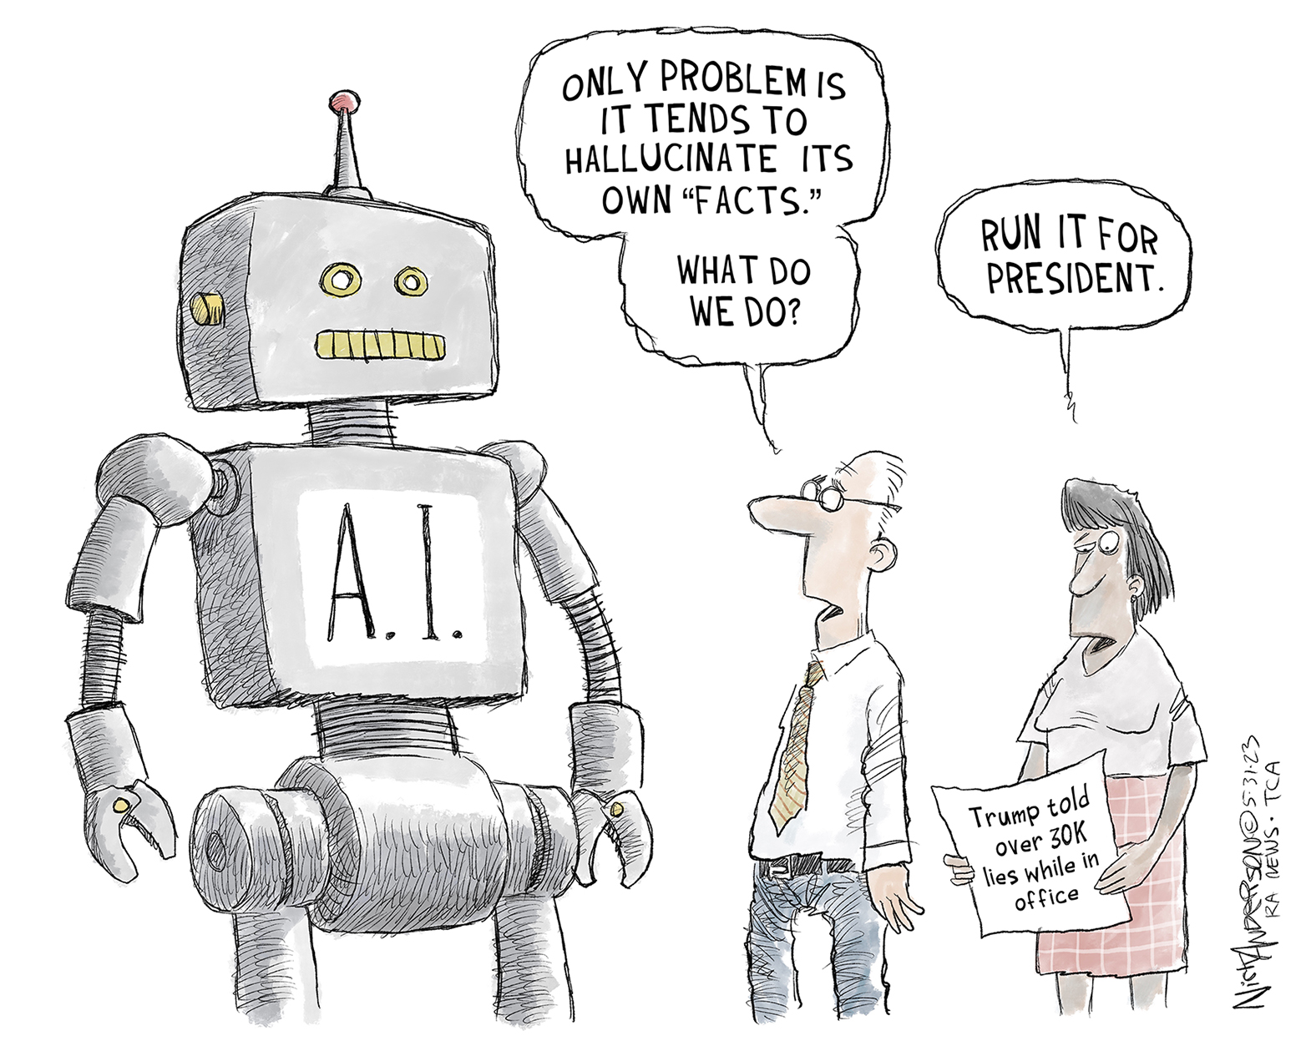

Slide 30
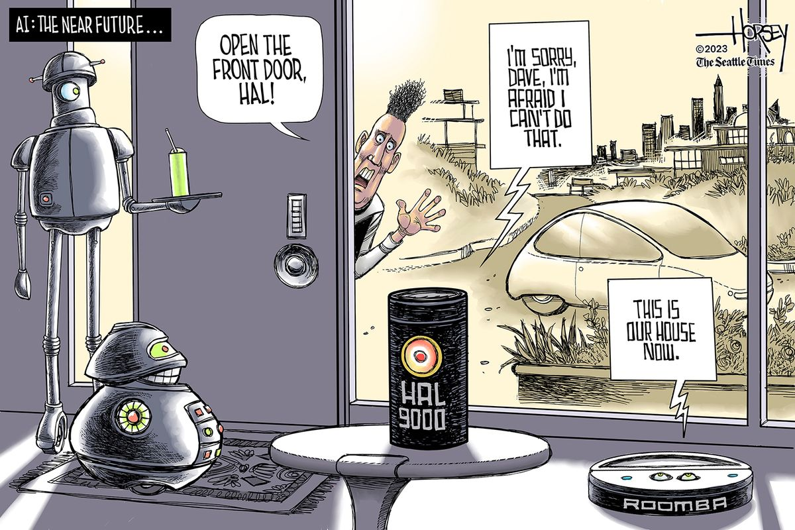

Slide 31
Future?
AI to mark school homework and plan lessons in £4m project - ChatGPT marking its own work?
By 2030, software developers will be using AI to cut their workload 'in half'
COVID – AI tool EVEscape
Notes:
Intervention by artificial intelligence aims to ease burden of teachers, but critics fear breakdown in caring relationships with pupils.
A database made of official curriculum-specific documents, including anonymised student assessments, lesson plans and teacher guidance is being created with £4 million of taxpayer money.
Technology companies will use this resource to create bespoke educational AI tools for use by teachers in the classroom to help with the more time-consuming tasks.
It is envisioned that AI trained on the official database will be more accurate, less biased and more secure than current commercial options and free up teachers to focus on helping students.
The Government is encouraging tech companies to submit proposals for AI tools to help with marking and feedback by March 2025.
“Today’s announcement marks a huge step forward for AI in the classroom.”
Having spent a fair proportion of my life uncovering programmer’s mistakes I am ambivalent on this one…
University of Oxford and Harvard Medical School
The model, named EVEscape, works by predicts the likelihood that a viral mutation will enable it to escape immune responses.
EVEscape’s underlying framework combines a deep-learning model of evolutionary viral sequences with detailed biological and structural information about the virus. In combination, this enables EVEscape to make predictions about the variants most likely to occur as the virus evolves.
Crucially, the model can anticipate new viral variants before they emerge, solely using information available at the start of an outbreak. This approach could facilitate more effective preventative action, and the design of vaccines which target variants of concern before they become prevalent.
‘Our study shows that had EVEscape been deployed at the start of the COVID-19 pandemic, it would have accurately predicted the most frequent mutations and the most concerning variants for SARS-CoV-2.’ – to what effect?

Slide 32
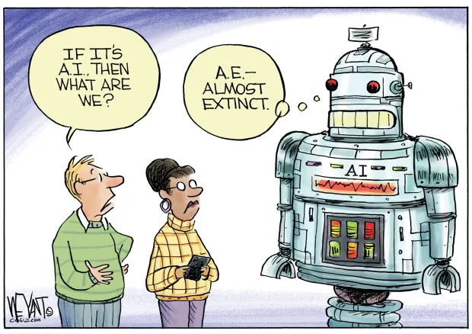
Notes:
In summary
Sources - I googled (!) AI
Techtarget.com
Mainstream media
The Register
ChatGPT suggested I was on the right track
Reality is running slowly behind science fiction.
The moment media gets hold of something it is ‘the next big thing’ and the cure for everything – until it becomes the root of all evil. AI has taken its time…
Cf the boss has been on a course - Same thing, different name.
Moving goalposts
Standard ‘large project’ issues.
Interesting to compare its timescale with the Industrial Revolution – the Victorians could do things quickly and efficiently!
Just read another Asimov story ‘The feeling of power’ where in the future world run by AI man rediscovers that the human mind can actually add, subtract, multiply and divide, so a cheaper option suggest itself…

