Slide 1
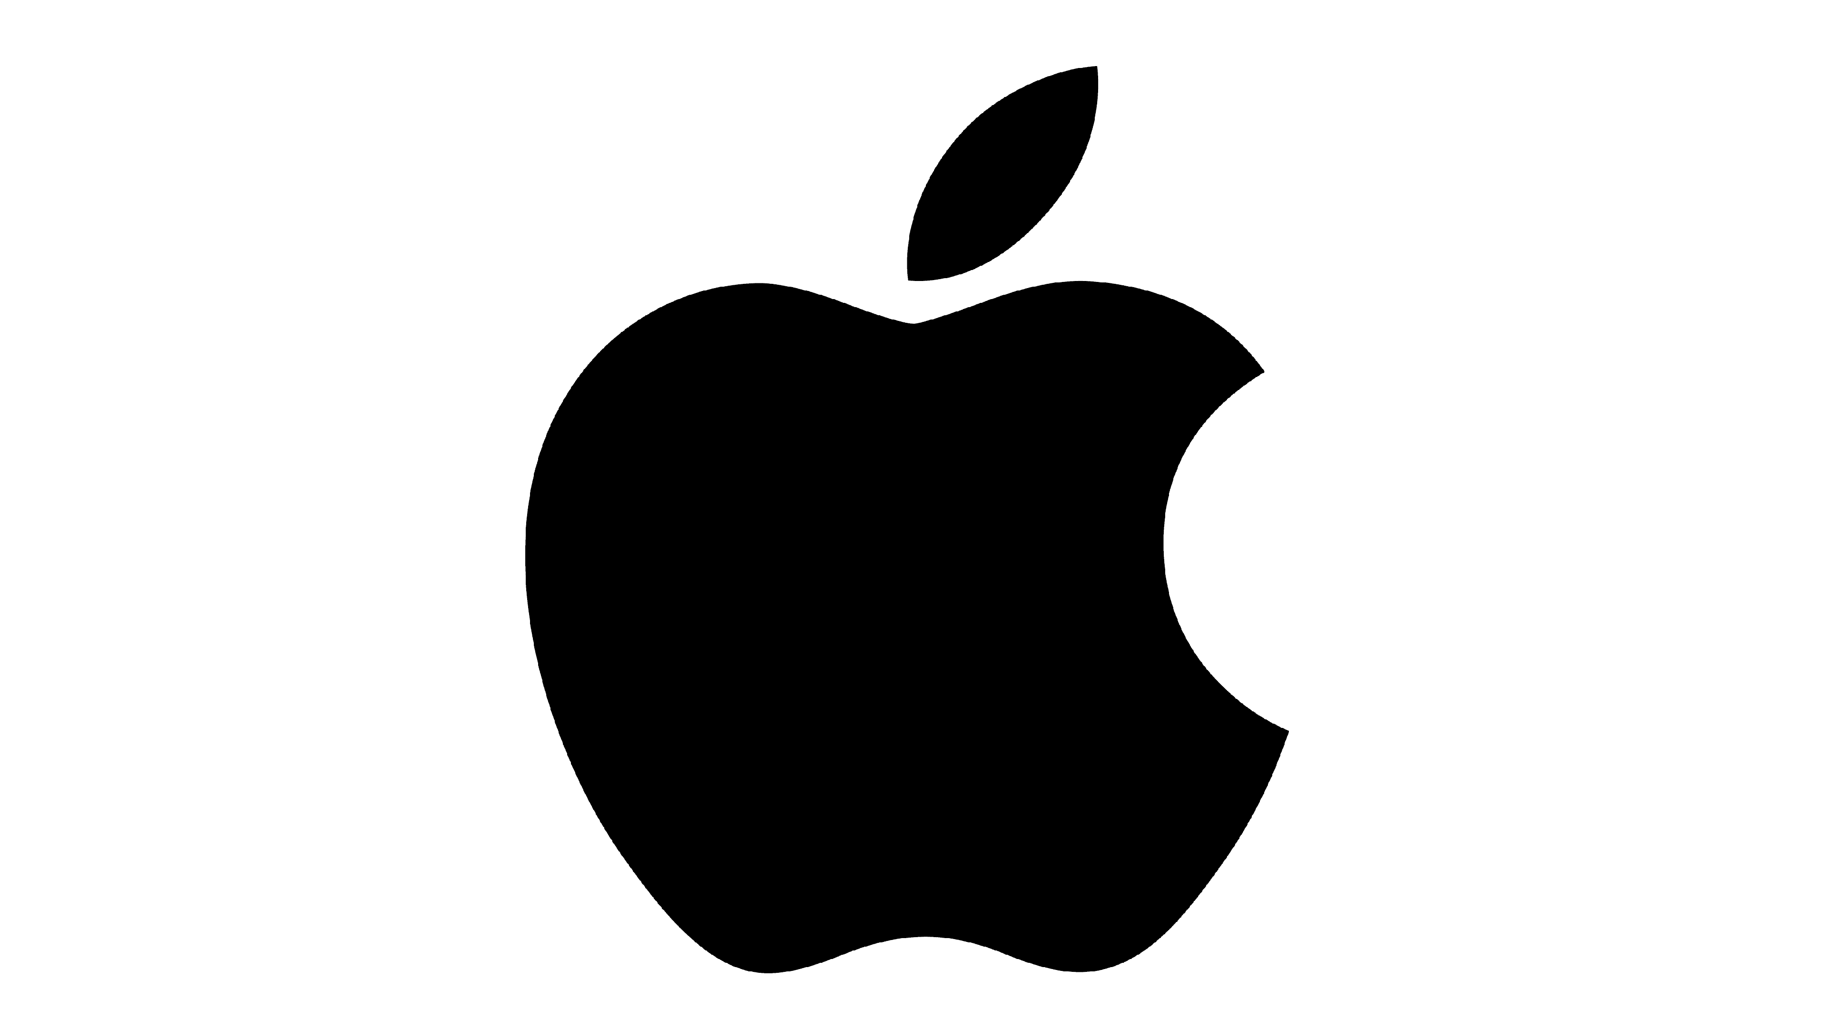
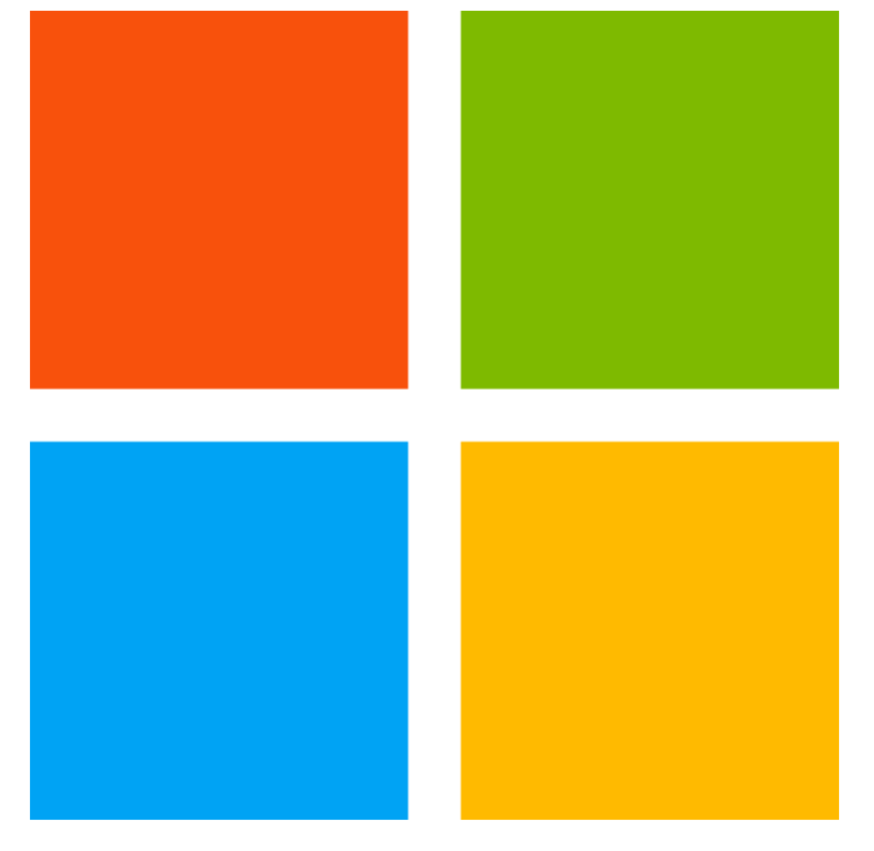

APPLE vs MICROSOFT
A brief history and comparison

Slide 2
Hardware Design Differences
Major difference between Apple and Microsoft computers is Apple computer parts are all built by and for a single manufacturer: Apple. Conversely, a Windows PC may use hardware from a dozen different manufacturers. Because of this, the pros are that Macs tend to run a bit more smoothly since all the hardware components were made to work with each other and with nothing else.
Cons: you can’t just buy parts for Macs and modify, customise or build your own computer to suit you own needs.
This was the undoubtedly the main reason Apple Macs did not become the most popular PC in the market place as resulting in Windows PCs enjoying an over 70% share of the marketplace.
You probably have noticed that in the media world of film and television specially everybody uses a Mac.

Slide 3
Which Came First Apple or Microsoft?
Microsoft came first, founded in Albuquerque, New Mexico on April 4, 1975.
Apple followed nearly exactly a year later on April 1, 1976 in Cupertino, California.

Slide 4
What is better an Apple or Microsoft computer?
In many cases, the two operating systems are at parity, but overall Windows comes out ahead. Nevertheless, you'll have your own priority weights based on your OS needs. For example, if gaming is everything to you, then Windows is a no-brainer. If you're a creative type, then you're likely better off with a Mac. You will probably have noticed that the media, tend to use Macs more often. Stability.

Slide 5
What is the Difference between Apple and Microsoft?
Apple created and developed the Mac operating system. Microsoft, on the other hand, created and produced the Windows operating system. The Mac operating system's intuitive interface and charming design are well known. Windows is praised for being tough and working with a variety of software functionalities.
As the Mac OS is a ‘closed system’ the Mac is generally much more secure than a
Windows PC.
.

Slide 6
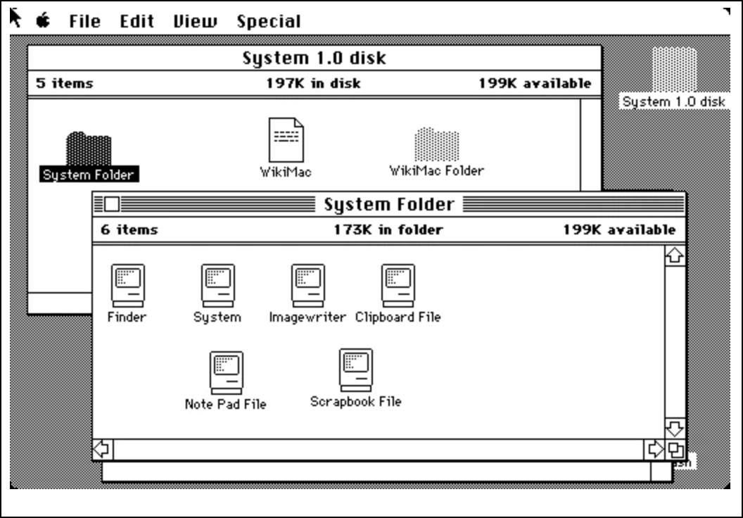
Early Mac Operating Systems
In 1984 Apple introduced the Macintosh which was the first commercial computer to feature a ‘graphical user interface’ and mouse, with a menu bar at the top opening up boxes (windows).
Microsoft still using MS DOS, - limited to a command line interface.

Slide 7
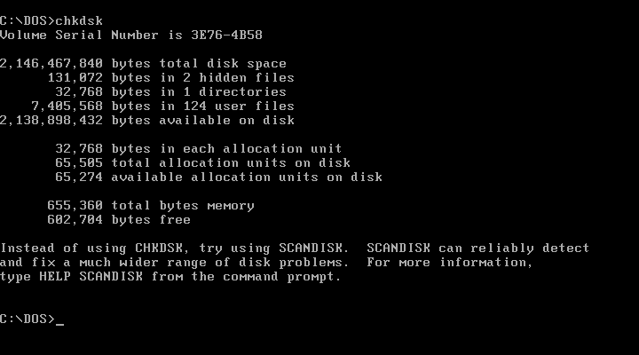
Early Microsoft Operating Systems
At this time Microsoft were using MS DOS which Bill Gates had purchased for a song. In a contract selling it to IBM Gates retained the option to use DOS on any other MS computers.
Although MS-DOS enjoyed enormous popularity in the 1980s and early 1990s, the technology did not always keep pace with its competition. The system lacked the multitasking, multiuser capabilities of the MAC operating system; MS-DOS was limited to a command line interface, in contrast to the user-friendly
graphical user interface (GUI) of the early Macintosh computer.
It was soon after that Bill Gates realised the potential of this easier user-friendly system and came up with a pretty much ‘copy-cat’ operating system which is now known as ‘Windows’

Slide 8
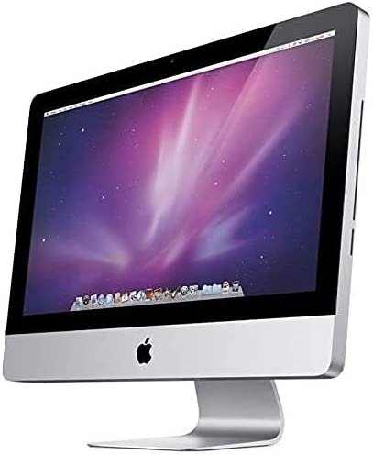
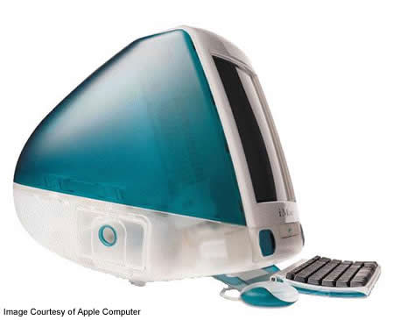
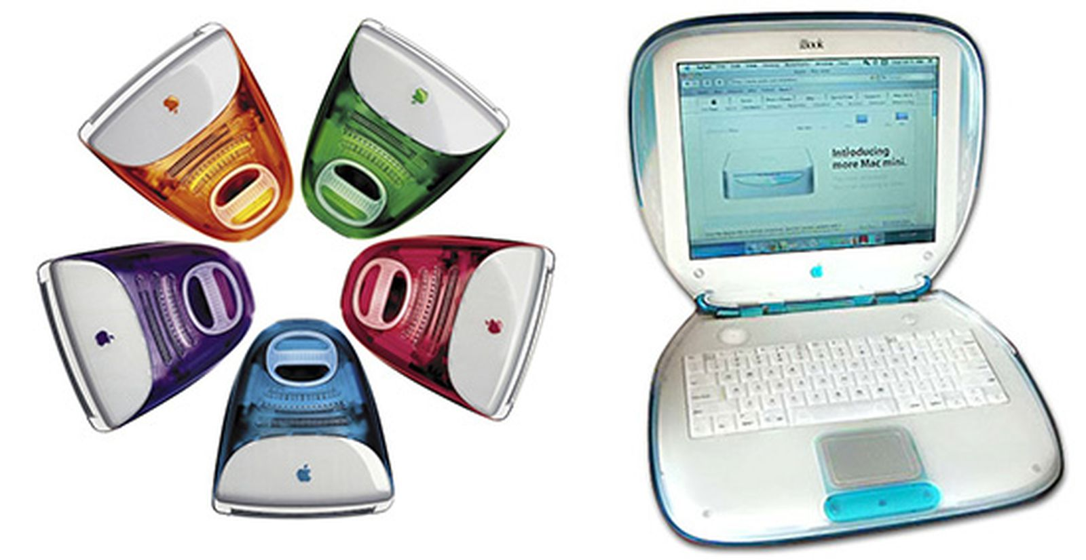
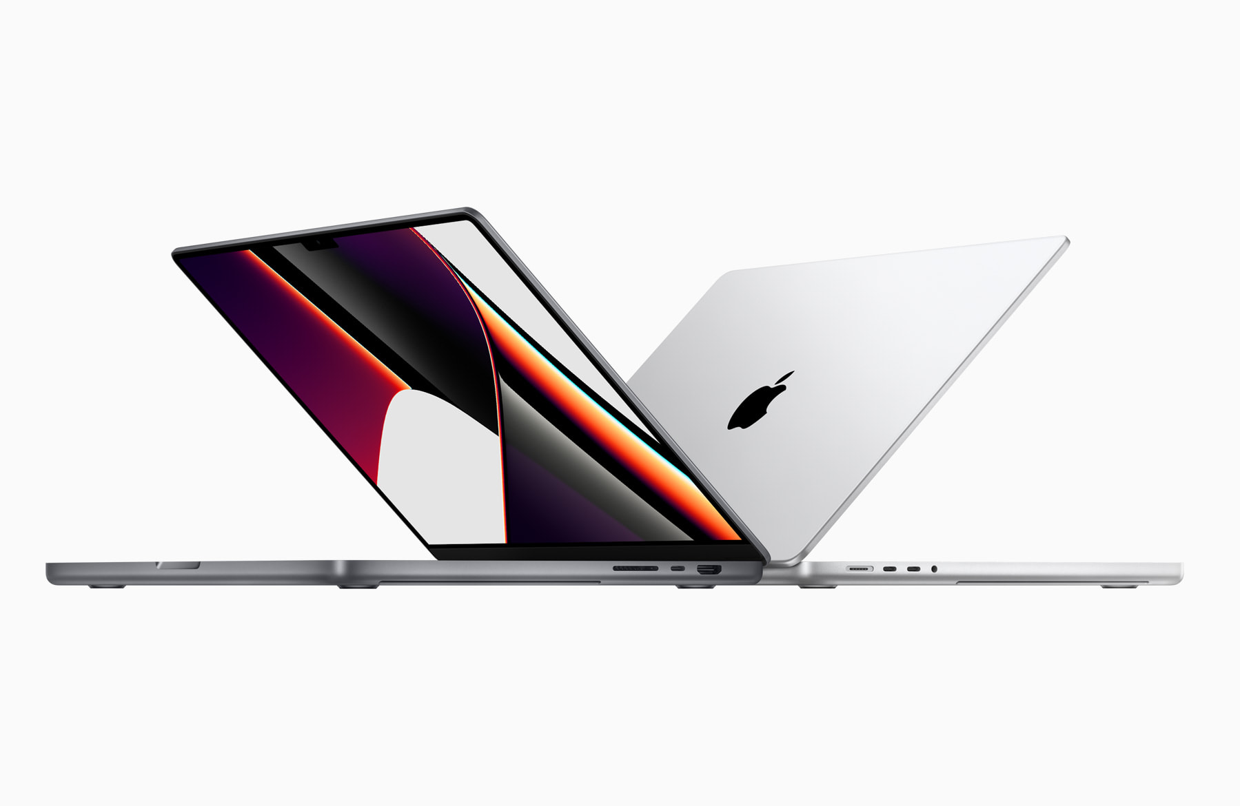
Apple OS Advantages
Basically the Mac interface made the machines much easier to use and more accessible to people who may not be interested in technology. In fact, Apple's goal was to create a computer with appliance like simplicity.
And with that goal in mind, Steve Jobs, co-founder, chairman, and former CEO of Apple is considered to one of the most important pioneers of the personal computer revolution of the 1970s and 1980s, along with his early business partner and fellow Apple co-founder Steve Wozniak.
.

Slide 9
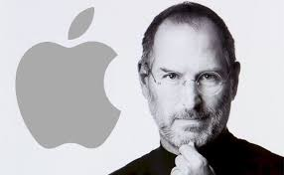
Personal Computer Pioneer
To underline this man’s importance …In 1985, Steve Jobs departed Apple after a long power struggle with the company's board and its then-CEO. He returned in 1997 when Apple was on the brink of bankruptcy and through his vision and creativity Apple developed a line of products that had larger cultural ramifications, beginning with the "Think different" advertising campaign and leading to the Apple Store, App Store (iOS), iMac, iPad, iPod, iPhone, iTunes, and iTunes Store. He was very particular about the ‘look’ of the products as well as the functionality, hence the ‘cool styling’ associated with Macs and apple products. His return resulted in Apple becoming the world's largest technology company by revenue, with US$394.3 billion in 2022 .
He was not always regarded as one of the ‘nicest’ people in the world with a few personal issues but extremely well respected for his creativity and vision. He died in 2011 and at least up until that time all the major advances and innovations in computer technology were pioneered by Apple… the concept of a mouse being just one example.

Slide 10
Why choose Apple over Microsoft?
Because there are fewer Apple products compared to PCs, there are fewer viruses created for OS X.
In addition, because Apple tightly controls the software on its devices, there is much less bloatware installed
on new systems. Apple's customer service is well known for being better.
Why is Apple so much better than Windows?
In general, Macs are known for their user-friendliness and approachability. They are considered to be more intuitive than Windows. While the way your iPad/iPhone and MacBook work may differ slightly, they are very similar, so it would be easy to adjust to the computer.
What is one disadvantage of using an Apple over a PC?
Despite the many advantages that a MacBook offers, there are also some disadvantages that should be considered. Price: MacBooks are usually more expensive compared to other laptops
Which is easier to use Mac or Windows?
The OS on a Mac computer is highly intuitive and user-friendly, with a sleek design that makes navigation simple. Mac computers often run applications more smoothly than Windows PCs since Apple designs its hardware and operating system, creating a smooth user experience through perfect integration.
Why do people buy Macs?
Many people enjoy buying MacBooks because they can handle heavy workloads, such as using video editing software. The fewer crashes you'll experience will enable you to get your work done quicker. Plus, you'll have more fun during the creative process.

Slide 11
What can Mac’s do that PCs can’t?
Run iPhone and iPad Apps. ...
Edit Currently Open Files. ...
Type to Speak in Video Calls. ...
Use iMessage on a Computer. ...
Copy and Paste Between Apple Devices. ...
Use AirDrop. ...
Make a Screen Recording With VoiceOver. ...
Use Your iPhone as a Wireless Webcam.

Slide 12
What makes iPhone different from others?
iPhones are famous for their privacy and security systems. They offer security features like facial or fingerprint authentication to protect your personal information. The iPhone even stops apps from tracking your activity online because of a limited Operating System and platform.

Slide 13
What makes iPhone different from Android?
Android devices run on open operating systems, while Apple devices run on closed systems. If it's important to you to be able to make changes to your phone's software, then you might prefer an Android phone.

Slide 14
What is the advantage of iPhone over Android?
One major advantage of iPhones over android phones is their integration with other Apple products, such as Mac computers, iPads, and Apple Watches.
With features like AirDrop, Continuity, and Handoff, users can seamlessly
switch between their devices and share content between them.

Slide 15
Which phone is more user-friendly iPhone or Android?
The iPhone has a reputation for a simple and intuitive interface, while Android offers a more customizable and flexible experience.
The iPhone’s user interface is consistent across all of its devices, making it easy
for users to navigate their way through the system.

Slide 16
Is Samsung or iPhone better?
Apple's iPhone and Samsungs's Galaxy have different strengths and weaknesses, so which one is better depends on your needs. Samsung phones tend to have better cameras, battery life, and display quality, even on budget models. However, iPhones do offer better software support and data security.

Slide 17
What makes iPhones so popular?
The simplest answer to the question, “Why are iPhones so popular?”
is that they're better.
They're faster, have better hardware integration, are more intuitive, and offer better support and security.

Slide 18
Why do people buy Apple products?
Buying Apple means you're getting a product with a beautiful design and software that's easy to use, and you can use it for years to come.
Apple isn't perfect, but it makes quality gear that'll last you for the long haul. Even if you're not an iPhone user, you can't deny
there's a lot to love about Apple.

