Slide 1
ChromeOS Flex Operating System - why Google has acquired and launched it
Previously licensed as CloudReady, now owned and run by Google from this year. A basic version of Chrome OS.
Offered free to targetted users: schools and businesses wanting to share data. Personal users are not excluded, but scope for gaming, video or image editing, very limited.
Pointers: renaming Google Mail as Google Workspace, providing many apps to facilitate video conferencing, making presentations and visually appealing lectures/lessons. These, latter files can only be shared amongst Chrome users.
The alternative, non - Flex, regular Chrome operating system allows access to apps from Google Playstore - so more creative and leisure activities, but certain business/teaching apps only offered to “enrolled” Chrome users.
Alternative apps to all MS Office software, frequently with additional speech-to-text options, are usually pre-loaded.

Slide 2
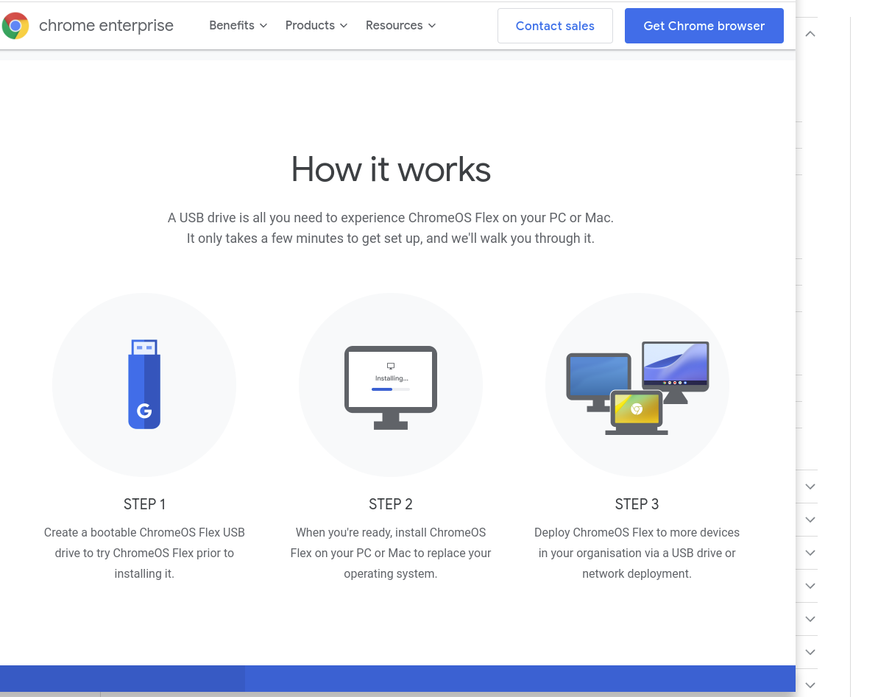
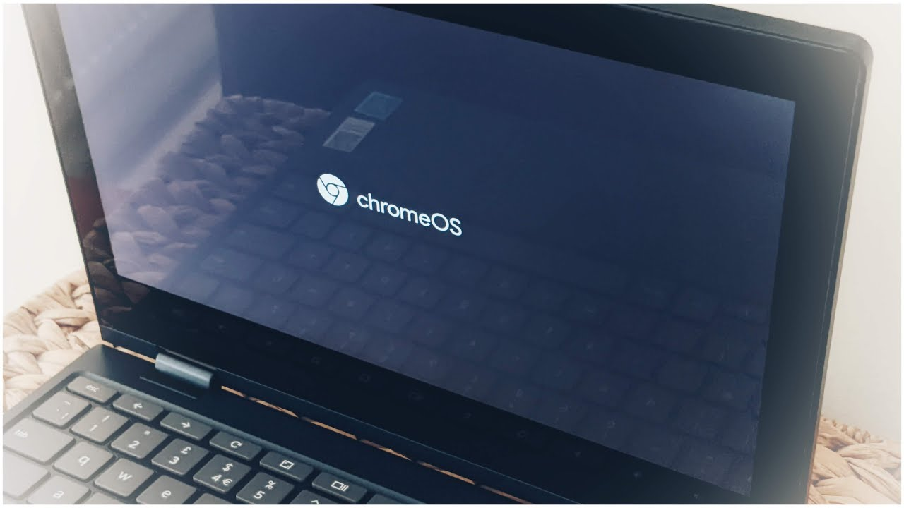
Notes:
The operating system loading page - shown left - is “ChromeOs Flex” for the free version

Slide 3
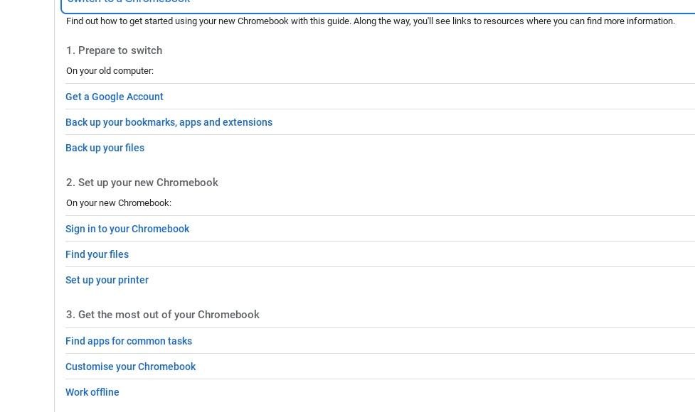

Notes:
If you’re trying it out, no need to back up. However, it’s worth finding out how to upload your files to Drive and copy your browser favourites from MS to Chrome

Slide 4
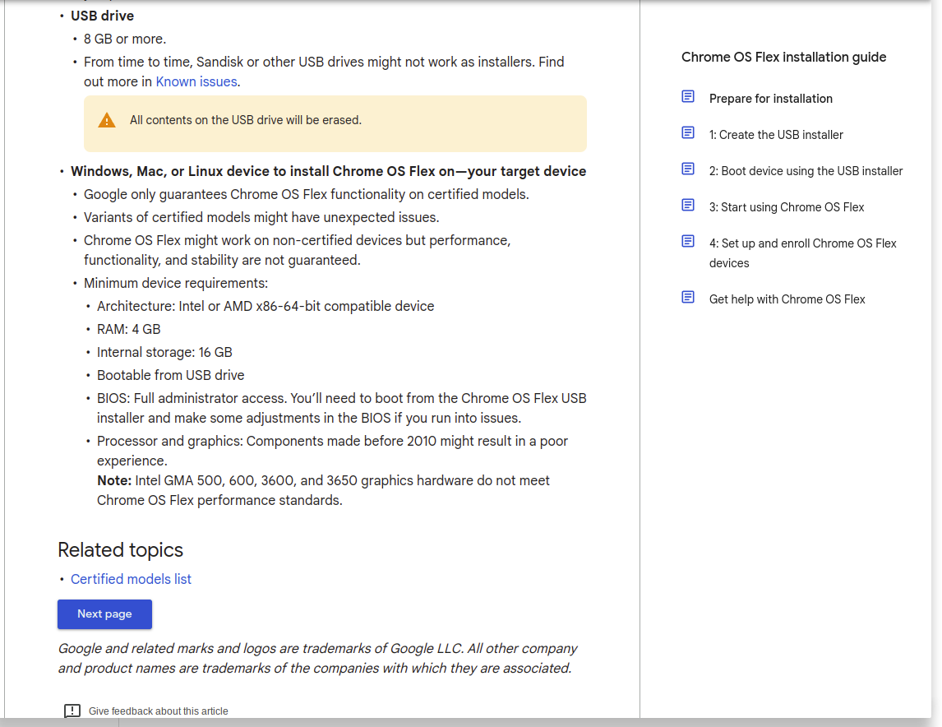
Your target device ie old PC, should not be so old that it doesn’t have a reasonable processor etc. But try it anyway!
Notes:
My old PC is at least 12 years old, but it had the minimum requirements. However, it doesn’t handle all peripherals within all apps fully within Chrome.

Slide 5
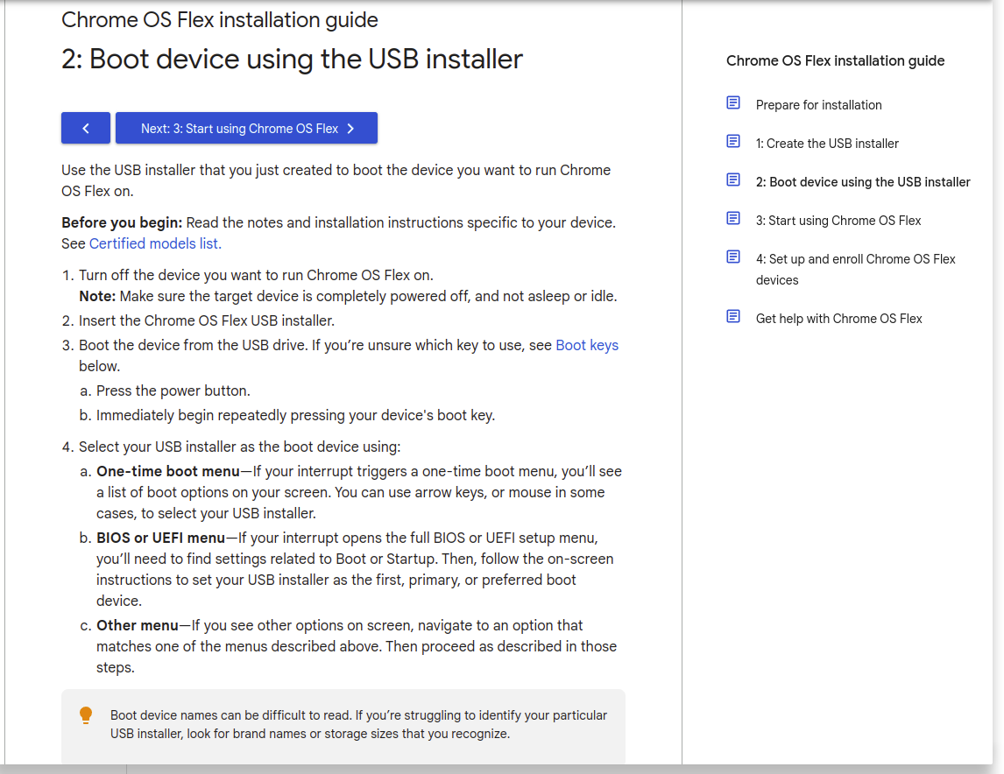
After creating (on a Chromebook) a copy of the OS on a 32Gb memory stick, then boot it on the target device ie your ancient desktop PC.
Notes:
I had already modified my boot options to a USB stick some time ago. Many PC’s require you to hit a function key repeatedly. But see next slide.

Slide 6
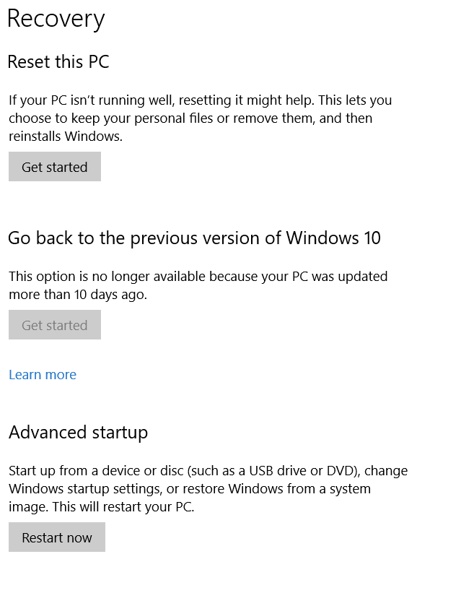
You override the PC’s default boot from its own hard drive, usually by pressing one particular key repeatedly as soon as the power key is pressed.
If that doesn’t work, boot into Windows on the PC. Go to /Settings/Recovery/Advanced Startup, then, with the USB Stick in place, click “Restart Now”

Slide 7
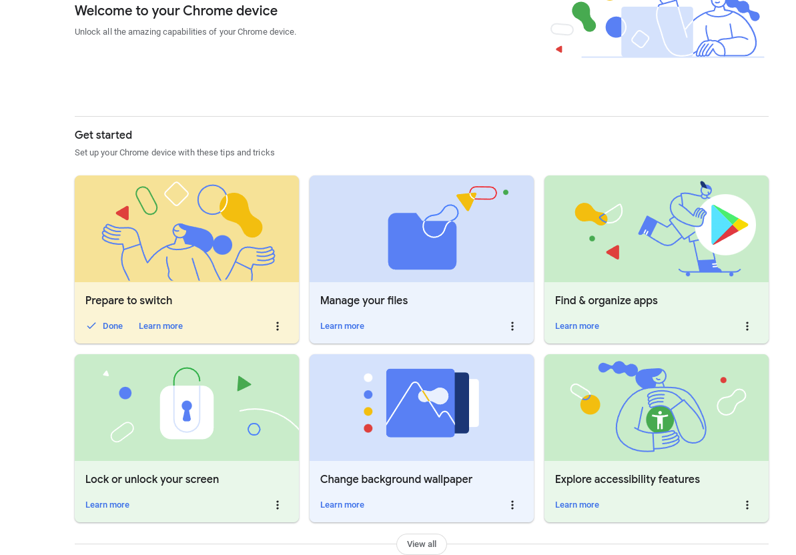
On first booting up, you will be asked to sign into your Google account, to accept syncing and “essential” data collection, and prompted to review security.
MAKE SURE YOU OPT FOR TRIAL USE, NOT PERMANENT INSTALLATION OF THE OS
Then the Welcome pages will guide you.

Slide 8
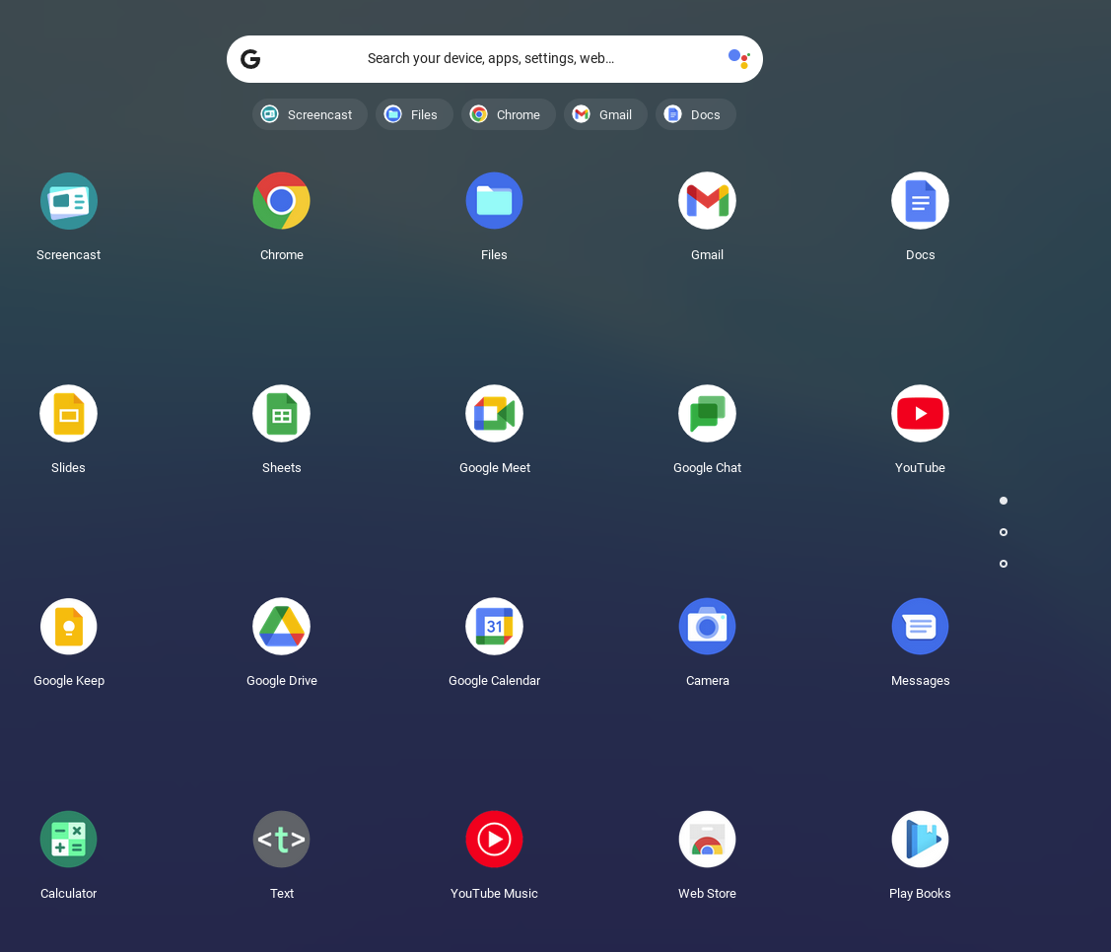
Clicking the Launcher (bottom left of homepage) reveals the pre-loaded apps
Chrome Flex will only accept apps from the Chrome Webstore (not Google Play)
Notes:
Chrome webstore is pre-loaded - see arrow.

Slide 9
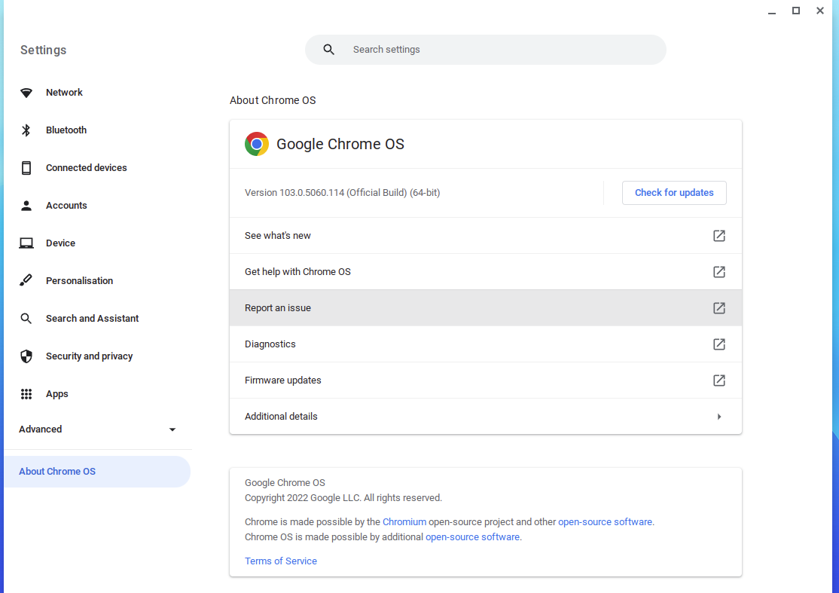

In Settings, found on the bottom RHS of homepage as
/About Chrome OS, general help issues and diagnostics are to be found.

Slide 10
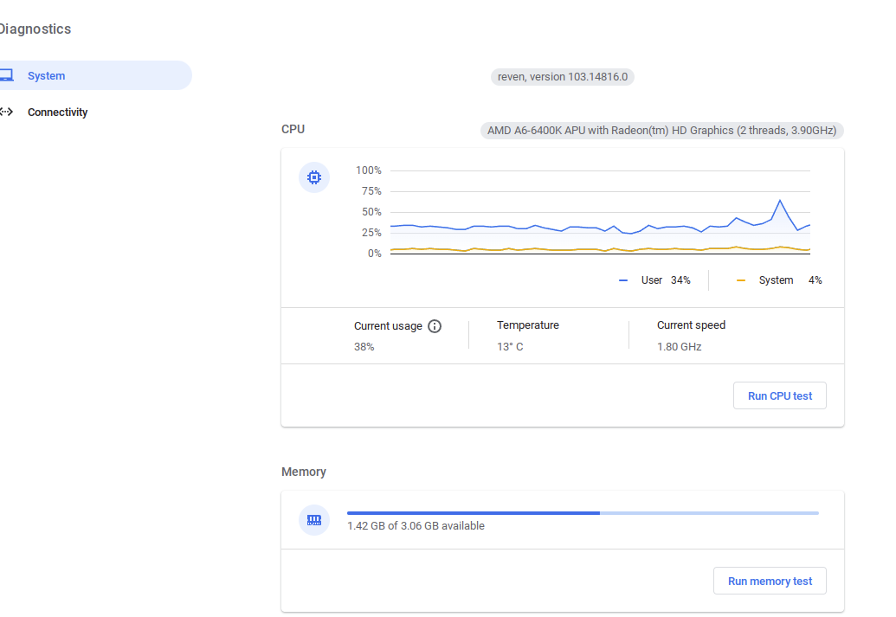
In Diagnostics, check how much extra memory you now have available, even when the old MS OS is still on the hard drive!
1Gb is ample as files are saved largely in the cloud.

Slide 11
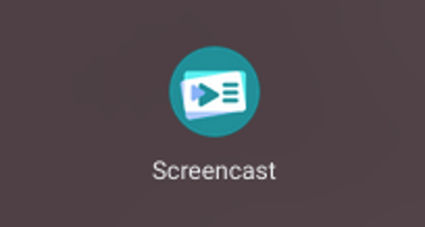
Final thought: Tempting for U3A subject presenters??
Make a presentation from live video, images, sound, straight from your computer screen (if you wish) or saved images/ slides. Add titles and text, which are searchable, with voice-to-text.
(Can only be shared via Google Drive, and played on devices running recent Chrome release.)
Notes:
If I can cast my chromebook screen to the projector, (using the Chrome Dongle and Location On this time!) I can show a 5 minute example presentation to demonstrate this impressive app in September…

