Slide 1
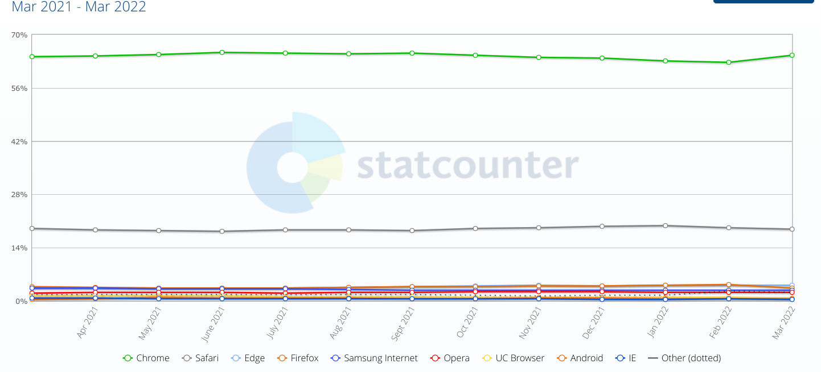
Chrome - market leader in browsers
MS Edge
Size of Chrome download: HEFTY - 345MB. Browsers can’t be uninstalled very cleanly.
Try out some Google apps to see if you prefer them to MS in the first instance?

Slide 2
Chrome Browser Security
For Windows users:
Close all Chrome windows and tabs on the desktop, then relaunch Chrome to apply the update. (Log out and back in… my advice)
With Chrome as default browser:
In chromebook, it updates frequently on sign out. I would expect the same on shutdown and reboot for MS.
IF you suspect that malware has been introduced… easy reset to initial state without loss of bookmarks (favourites), passwords (if password manager used), or history - so last tabs can be re-opened.

Slide 3
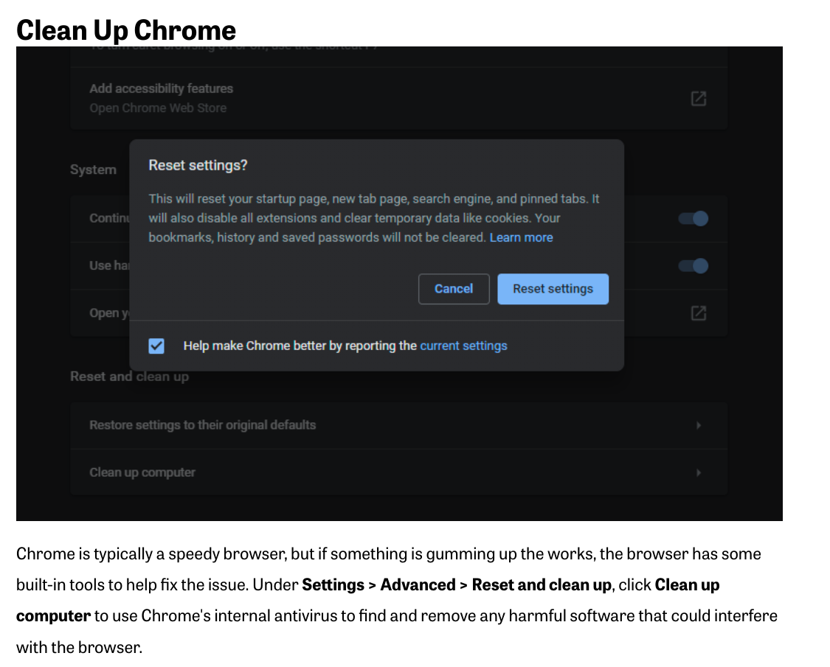
Notes:
This is Chromebook… if it isn’t offered within an MS setting, then you won’t see it.

Slide 4
What do you need in a Browser?
New Tabs are opened with every Search result…. Google Search is the leader
Easy and quick access to favourite pre-loaded Apps and your choice of Extensions and 3rd party Apps, through Short Cuts ie quick links.
Easy and quick access to your Bookmarks (Favourites). Ordering them in Folders which can be opened on dropdown menus.
If you restore your previous desktop (browser homepage) with lots of tabs open when you sign in, you’ll want ways to order your open tabs.
Chrome offers a lot of extras including fast and detailed search amongst your Drive saved files, plenty of free storage in the cloud, history that allows easy restore of closed tabs, incognito Windows (no history), password manager, an App for every conceivable need and plenty you don’t need!
Chromebook laptops are Chrome-on-stilts and super-fast for browsing and apps.

Slide 5
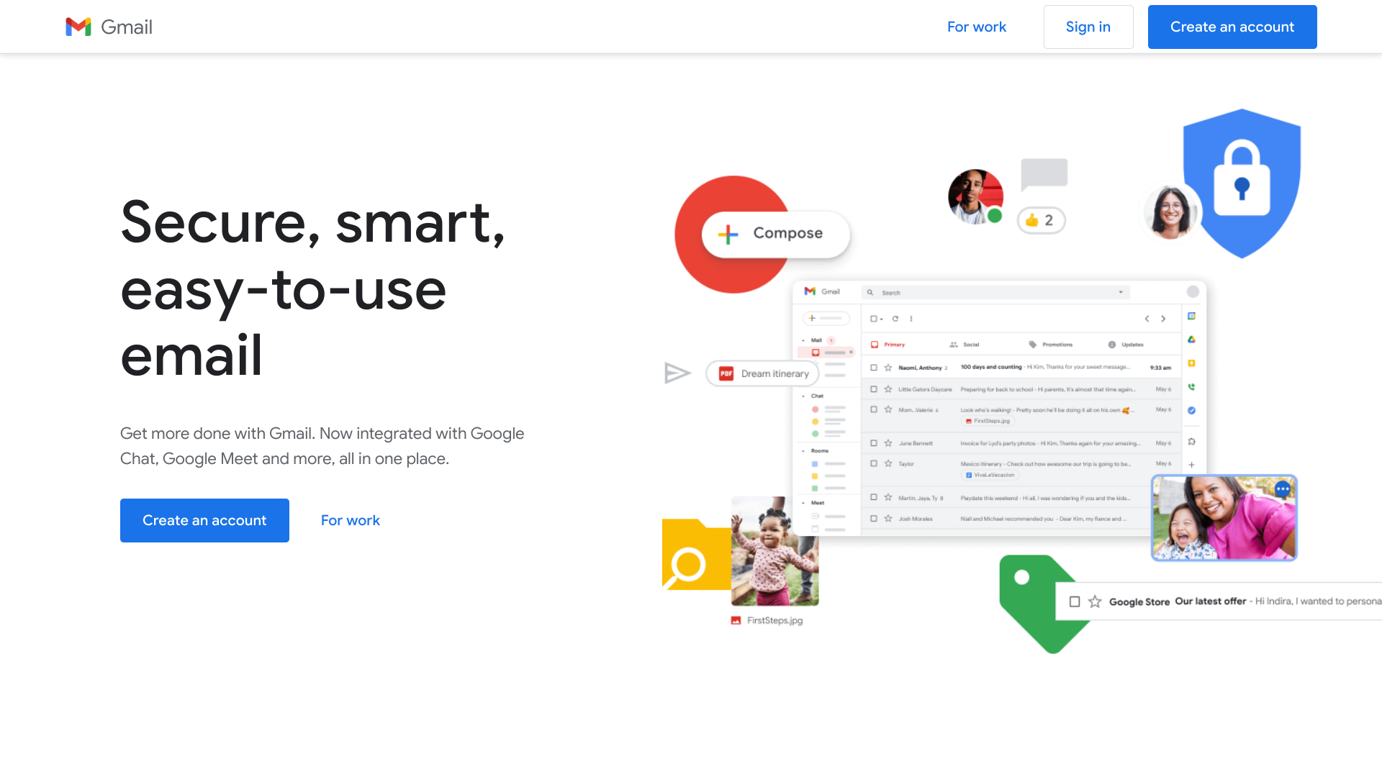

By opening a Google Account you can try out some Google Apps, set privacy, & establish a general Chrome/Google password. If you have an Android phone already set to a Google Account, use that one if you wish to share data with it on your computer.
Notes:
Gmail needn’t be your default email. A second gmail account can share data within your chosen apps, rather than everything.

Slide 6
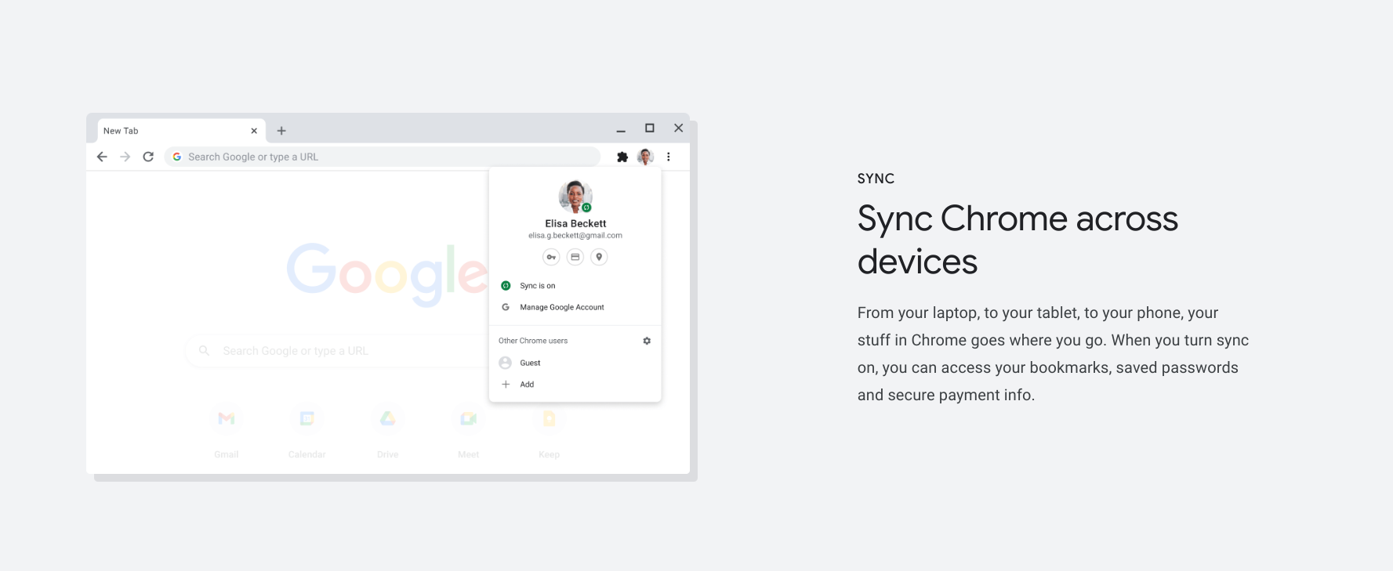
To Sync or Not to Sync. Bookmarks, History, Passwords across devices
If Sync is turned off in Google Account : you’ll need to log in (sign in) for every app opened and advertising still occurs but “impersonal”. It makes no difference to the uploads to Drive, which is part of Chrome apps. Syncing only refers to data that could be useful to Google!

Slide 7
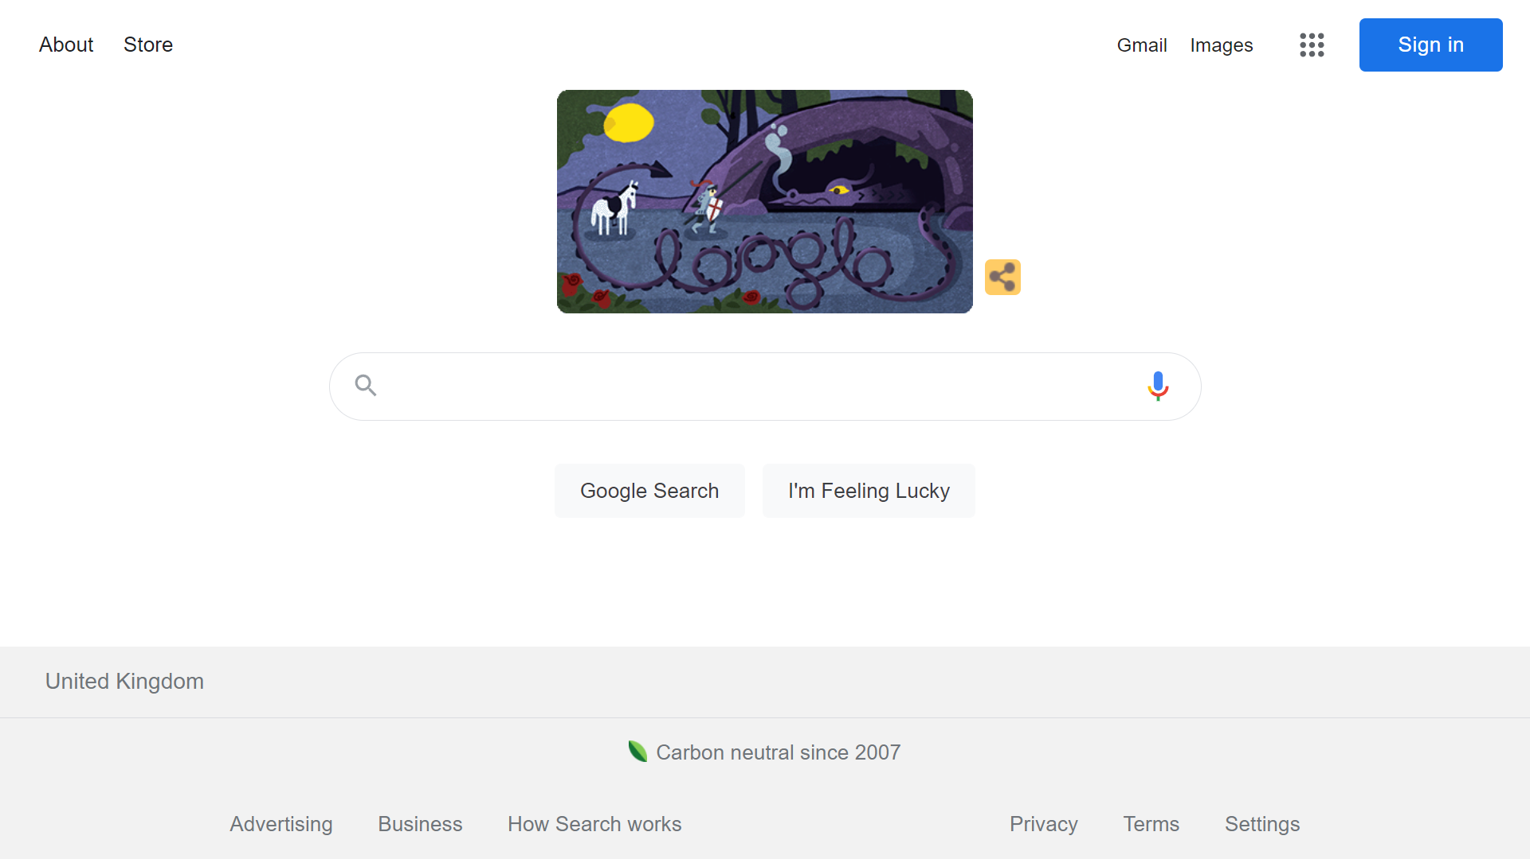
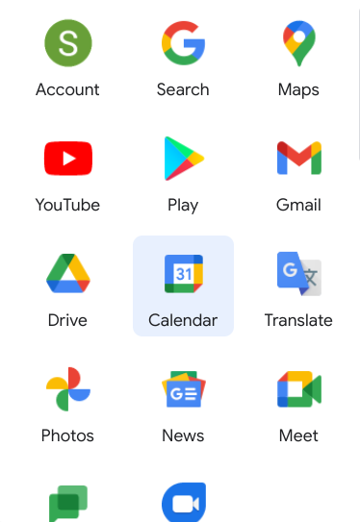
The icons of Google’s official apps drop down after clicking chequerboard. Sign in is required before using any if Chrome not installed
Notes:
3rd party apps, downloaded from Google Play Store, are at the bottom of the list. Pre-loaded Google apps do not have advertising within them.

Slide 8
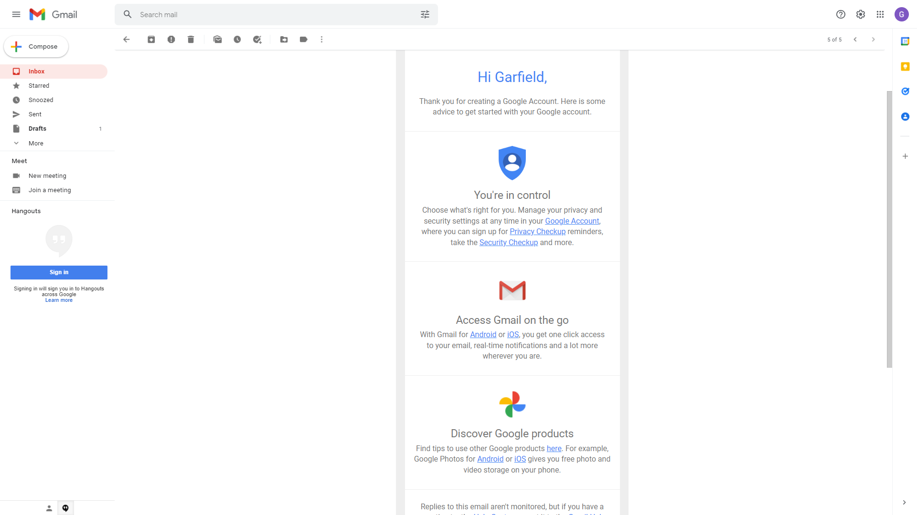
First time of signing in gives links and help to set up your Google account
But it is all available at any time by clicking on your profile icon.

Slide 9
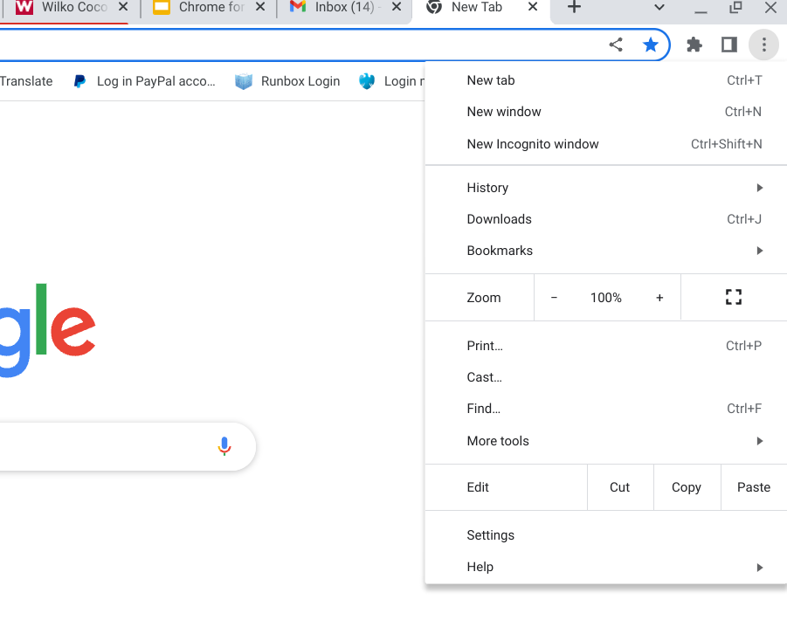
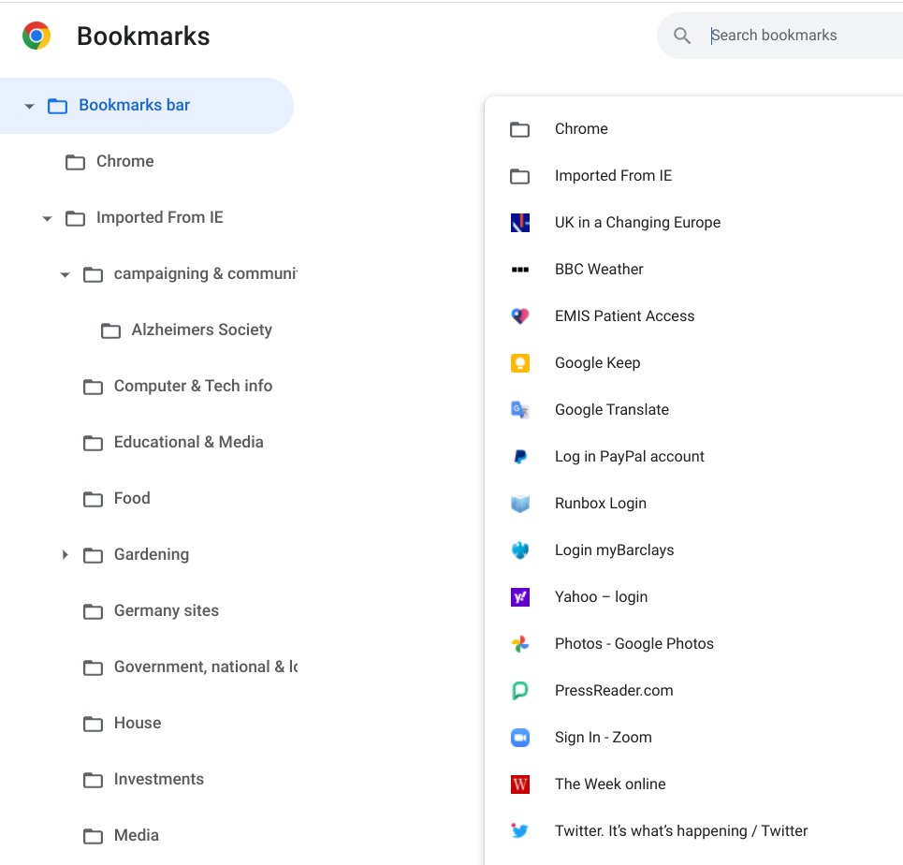
Get Bookmarks organised
Click drop down menu icon, go to bookmarks Then create folders with Bookmarks Manager.
Notes:
Once you have downloaded Chrome and it is your default browser. MS will protest all the way! You can see the bookmarks bar on the left. Mention the STAR button

Slide 10
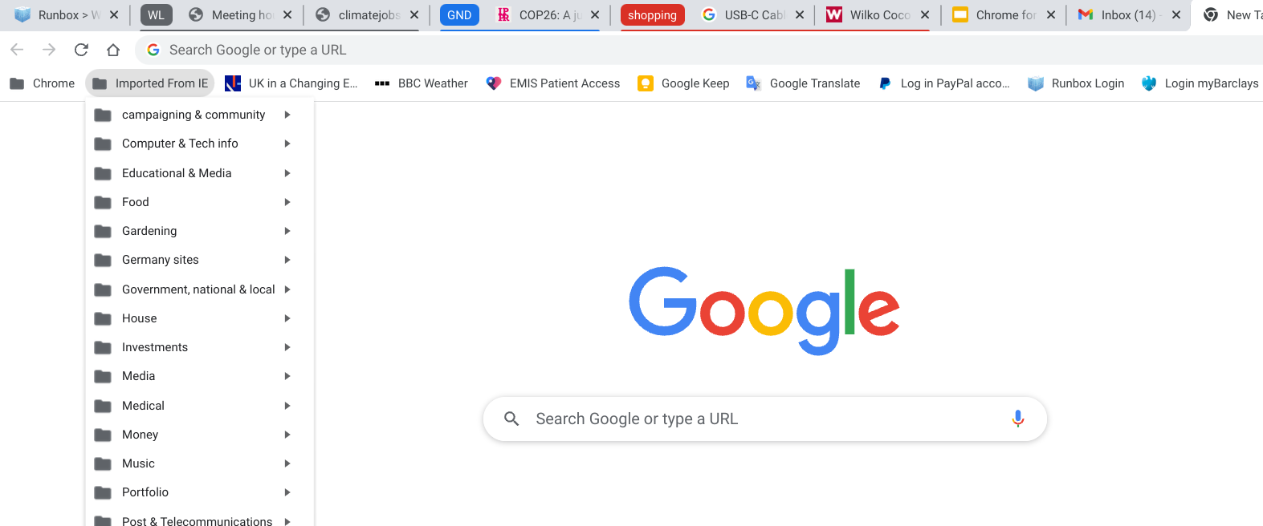
Favourites (bookmarks) can be imported from MS browser, when the subfolders will be shown under one large folder. Google remembers recently used folders and offers those first when bookmarking a new site.

Slide 11
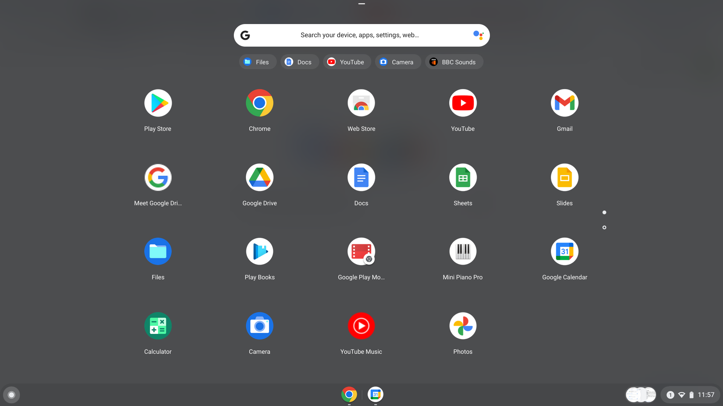
Find Apps
Under chequerboard icon or 2. Launcher (in chromebook)

Slide 12
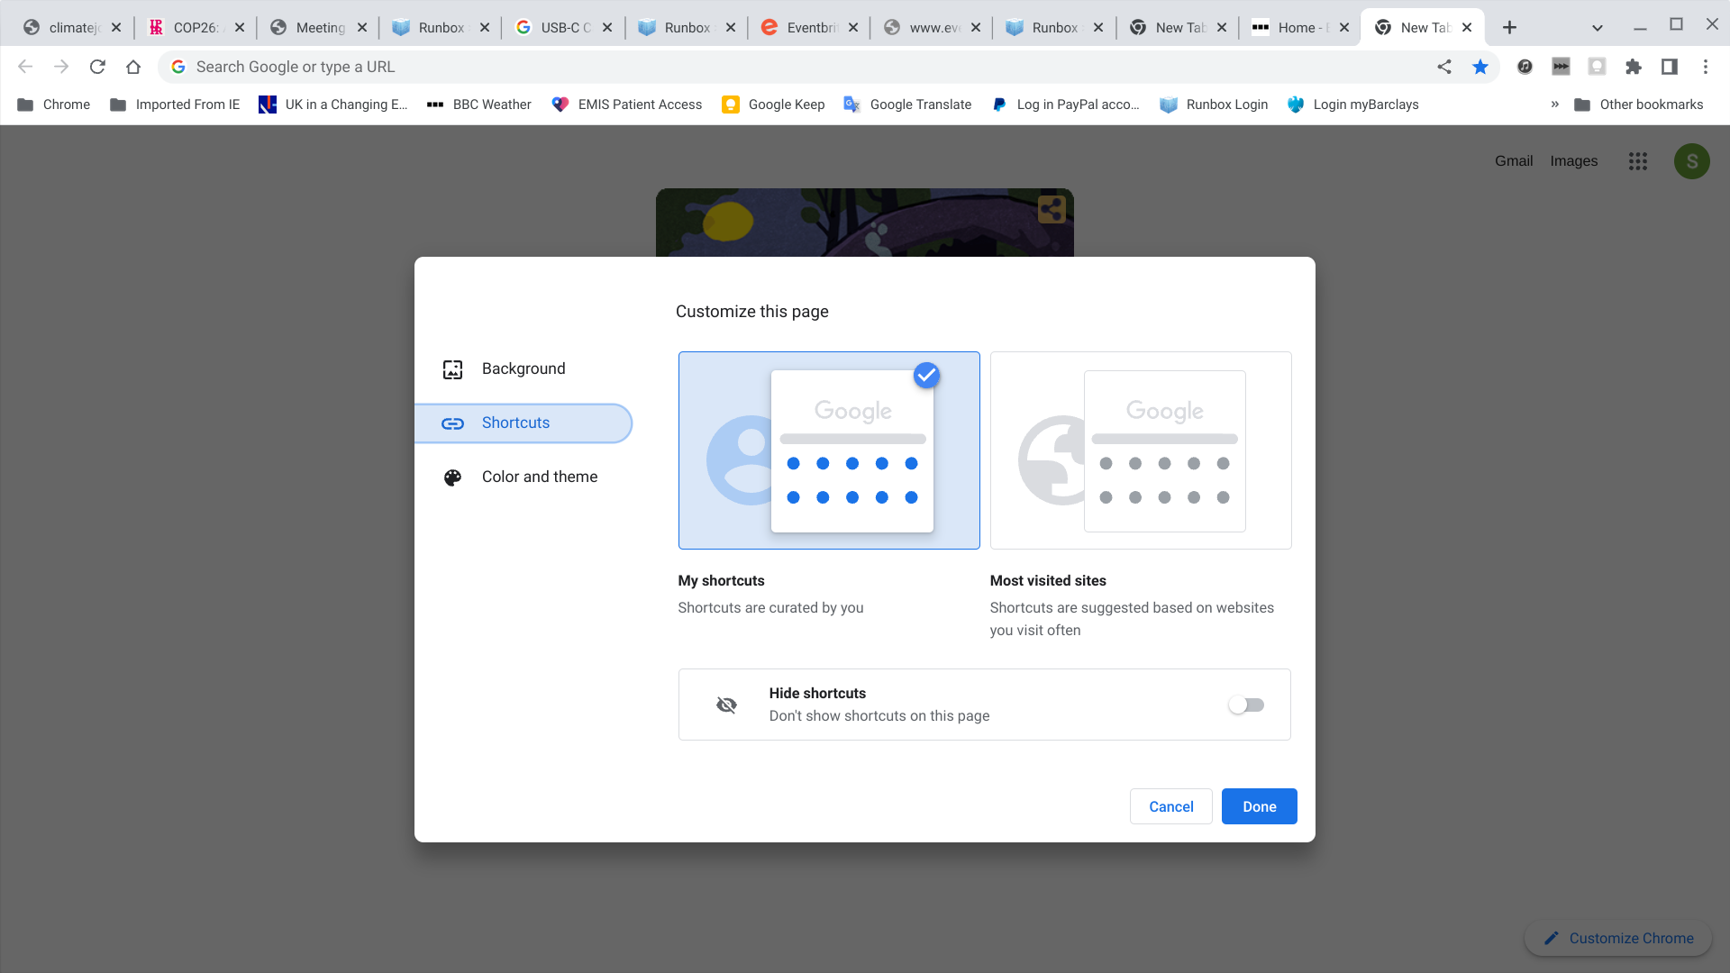
Or 3. Shortcuts to apps can be added when customising your default tab

Slide 13
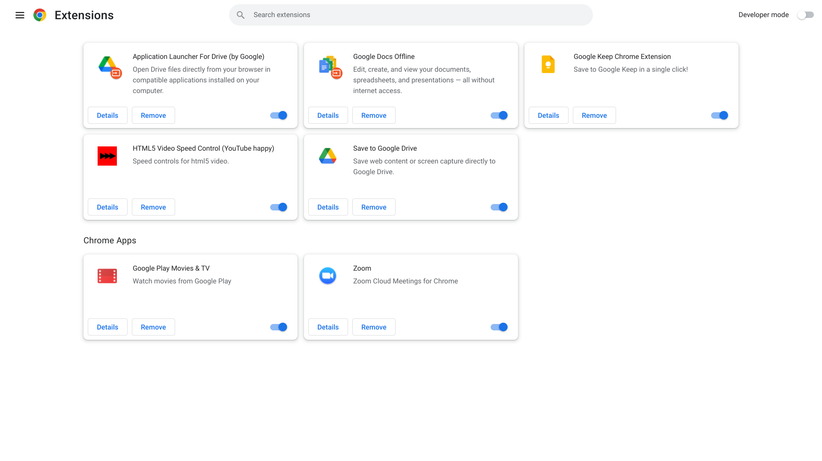
Extensions are types of apps that increase the adaptability of your browser & pre-loaded apps and are licensed by Chrome
Notes:
Zoom is an extension! Google Docs offline is limited, but useful (as you have to leave your chromebook signed in and “paused”)

Slide 14
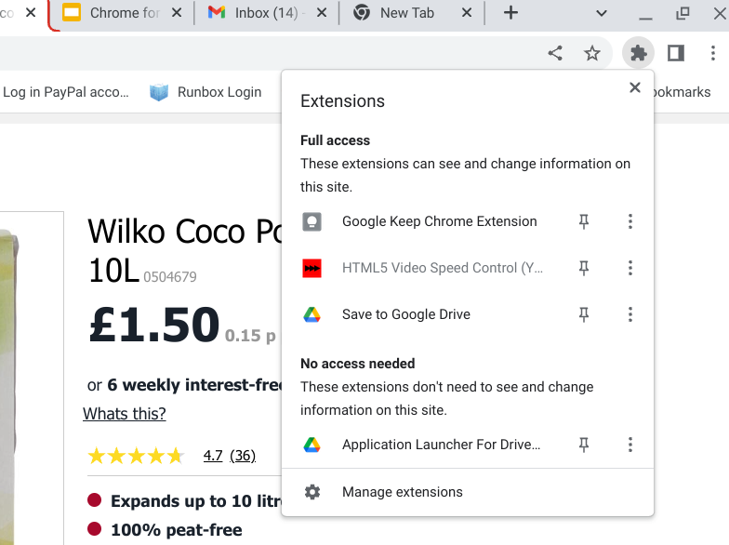
Access extensions from the jigsaw icon (Top Right)
It will show those relevant to the tab.

Slide 15
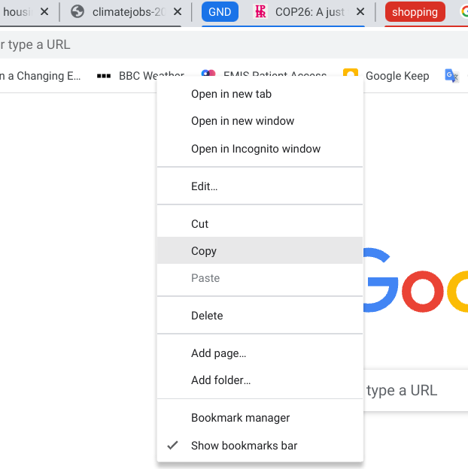
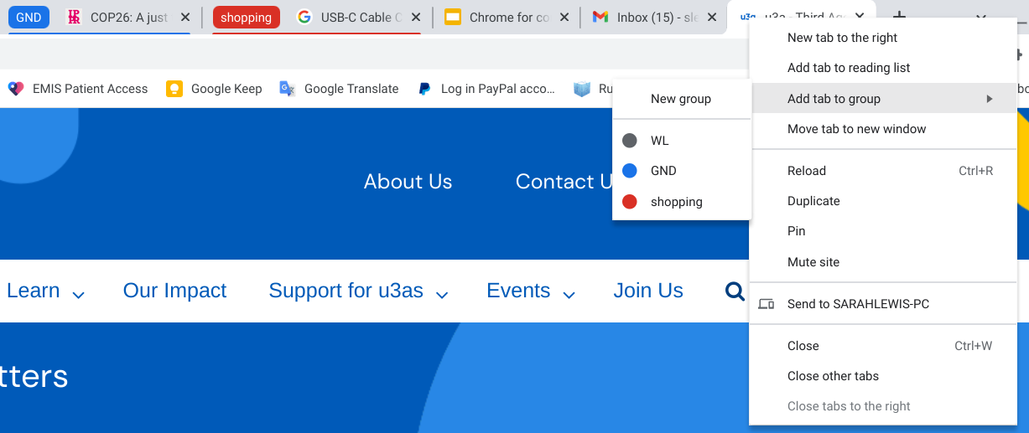
Open tabs, new windows, groupings
Rt Click on bookmark for new window Rt click on icon to left of tab heading for groups

Slide 16
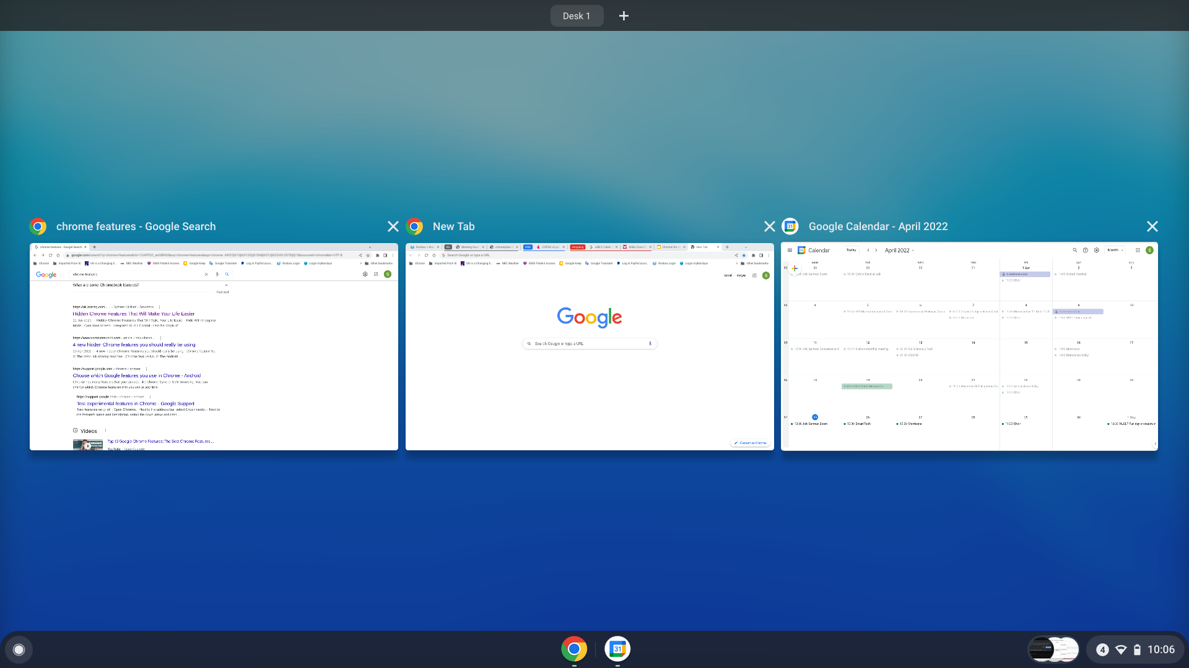
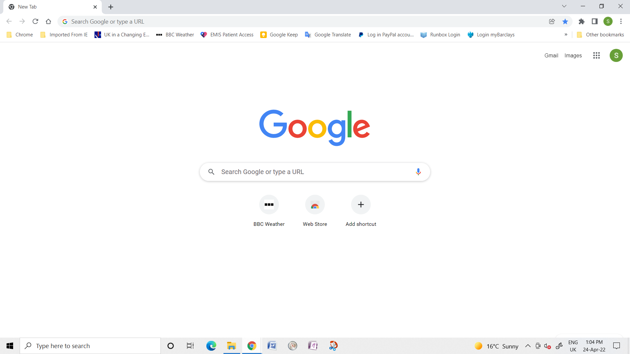
On a chromebook Track your open windows. In MS
Hover mouse over the Chrome icon in the task bar (underlined in blue when active) to see very small images of open windows.

Slide 17
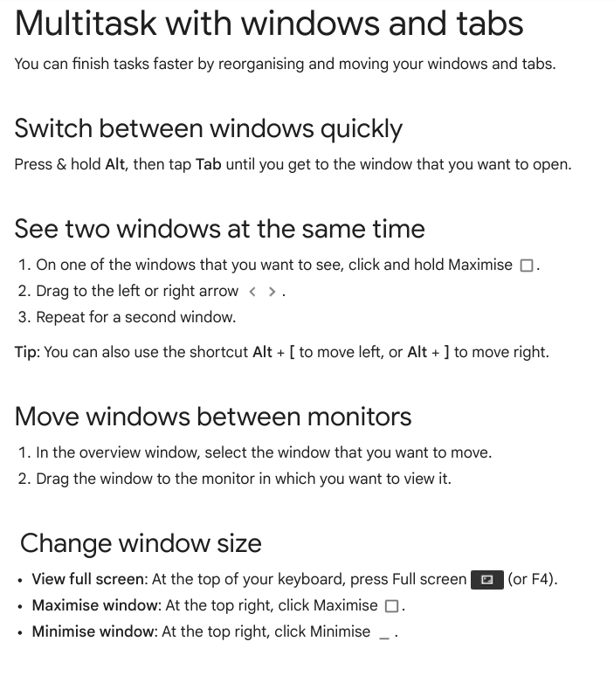
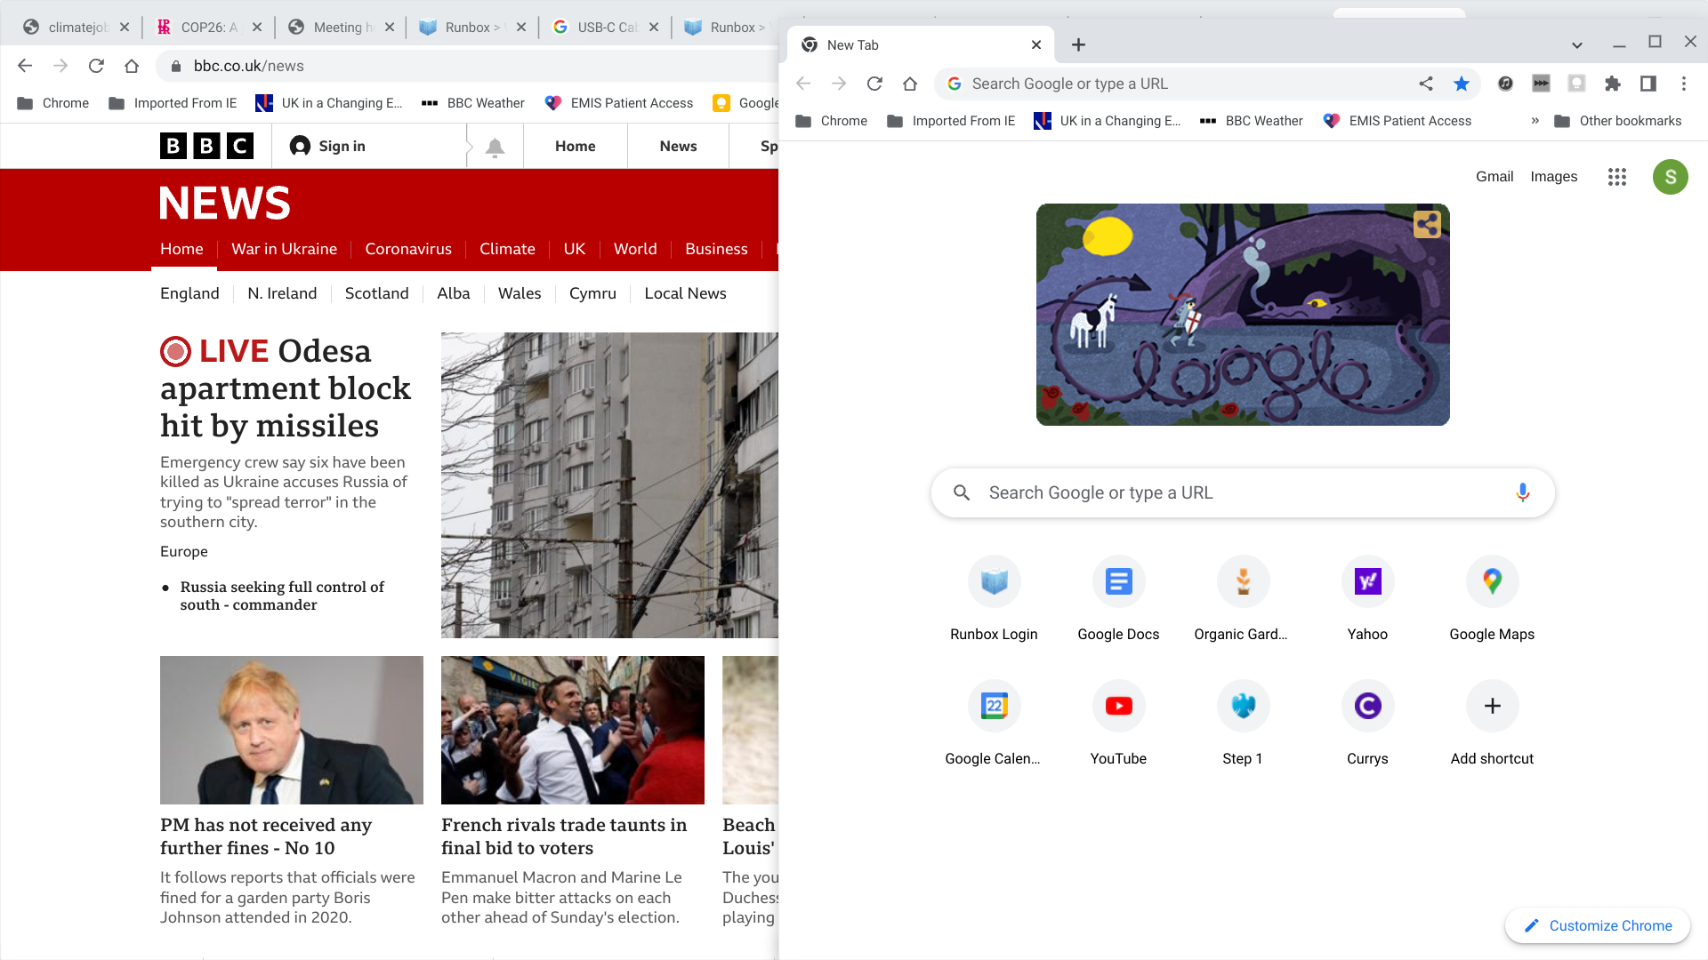
Arrange Windows side by side for easy cross-reference

Slide 18
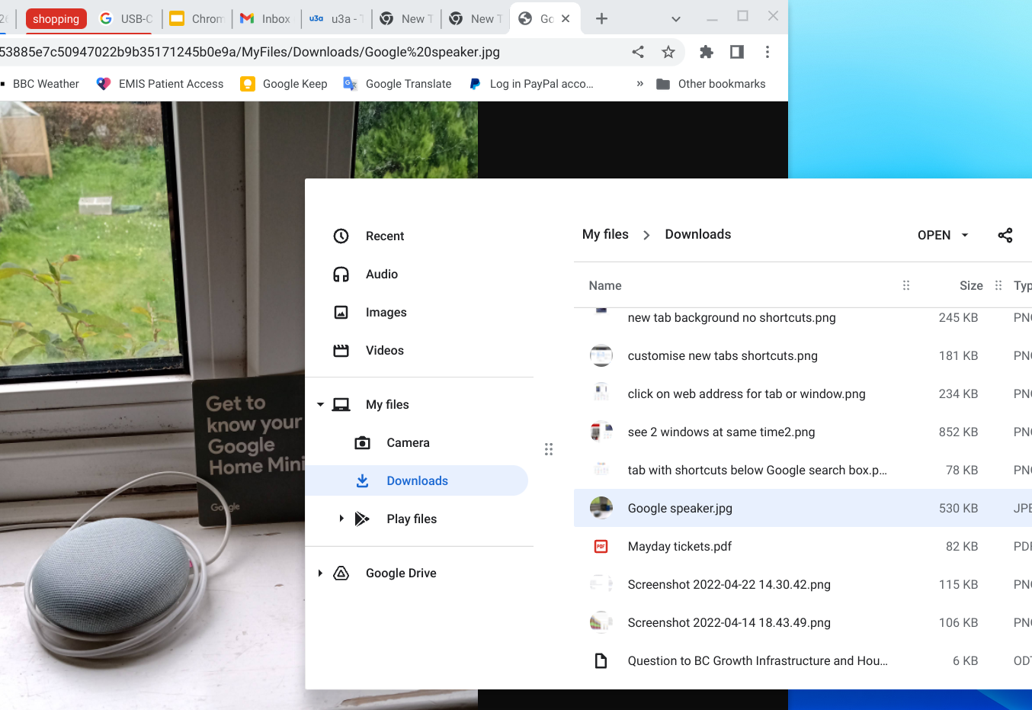
A tip enabled by window-alongside-window
Drag an image from downloads (or Drive) into an adjacent new tab in the Browser to open it quickly. It isn’t a copy and paste, just a quick way of previewing.

Slide 19
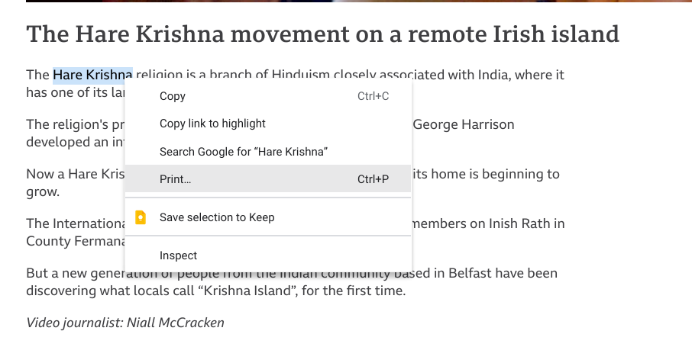
Tip for looking up a word/term in a text article: highlight and rt click for instant Google search

Slide 20
Conclusions
If you are comfortable with using cloud storage for your files and being dependent on broadband:
User History: Chrome was “here” before Windows Explorer and they share some of the same programming.
So, Chrome has had a lot more time to refine what users want and develop programmes that are integrated in the browser. Windows 11 trying to catch up.
Google search database is probably the biggest in civil history and its results must be the best:
“The Google Search index contains hundreds of billions of webpages and is well over 100,000,000 gigabytes in size.”
If you use it a lot, then chrome browser can store and retrieve that information much more easily than MS.
Advertising is a fact of life across the web. Certain commercial websites are terrible whether viewed from Chrome or Edge. (NB some 3rd party chrome apps won’t work with ad-blockers on. If you like them, pay for an ad-free upgrade instead.

