Slide 1

How your device tries to dictate your Browser, Apps & Cloud
Operating System | Browser | Cloud
Microsoft | Edge | One Drive
Android | Chrome | (My) Drive
Apple |  | i-Cloud
Samsung | Samsung Internet | Samsung Cloud

Slide 2







If you principally use a mobile and tablet- choose your Cloud for compatibility with your
devices and email addresses!
 | Browser | Cloud Storage | Search Engine | Company
 | Chrome | (My) Drive | Google | Google/Alphabet
 | Edge | OneDrive | Bing | Microsoft
 |  |  | Coming: GPT chatbot | Samsung
Transfers from one to another usually involve a download and an upload

Slide 3
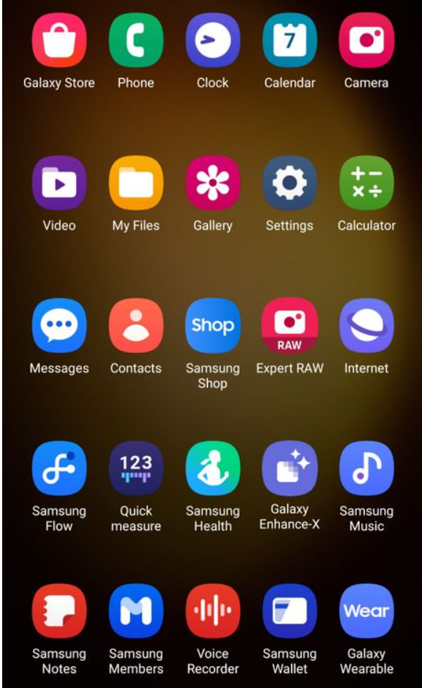
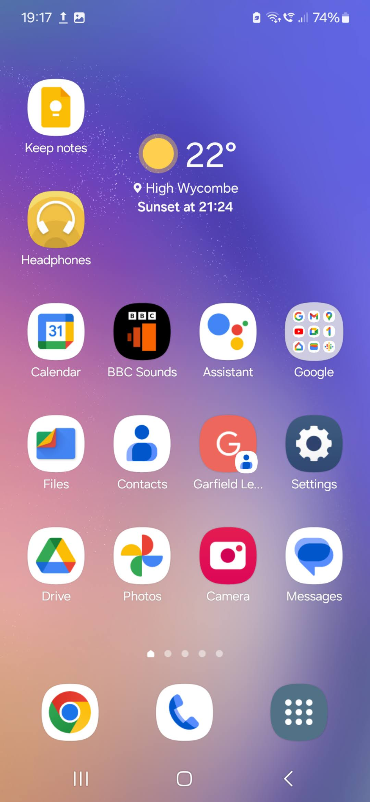
Samsung apps
Google generic apps
Most have the red/blue/green/yellow designs

Slide 4
Why does it matter which Photos apps (and associated sync’ed cloud) I use?
By far the easiest and quickest way of transferring images/docs/text from a phone to a device (tablet or computer) is via their shared cloud.
If your devices are disparate (eg i-Pad and android phone), then, often, another way must be found.
i-Cloud is exclusive to itself, (but there is now access to i-Cloud from a Windows app)
Windows cloud (One Drive) and apps will occasionally “talk” to Samsung cloud/apps
Google/Chrome cloud (Drive) will occasionally talk to Samsung cloud/apps
Windows/Apple won’t talk to Google/Chrome (either apps or cloud)

Slide 5
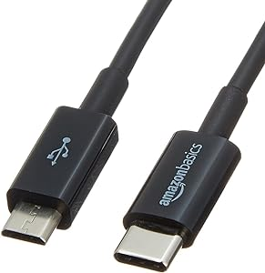
Solutions for disparate devices
Direct transfer
Directly access the folder in your phone for images. (DCIM)
A tablet file explorer app needs to be instructed to look for hidden files.

Slide 6

Solutions for disparate devices
2) Find and share a “neutral” cloud
Dropbox (free for low usage)
There are other, subscription based clouds

Slide 7
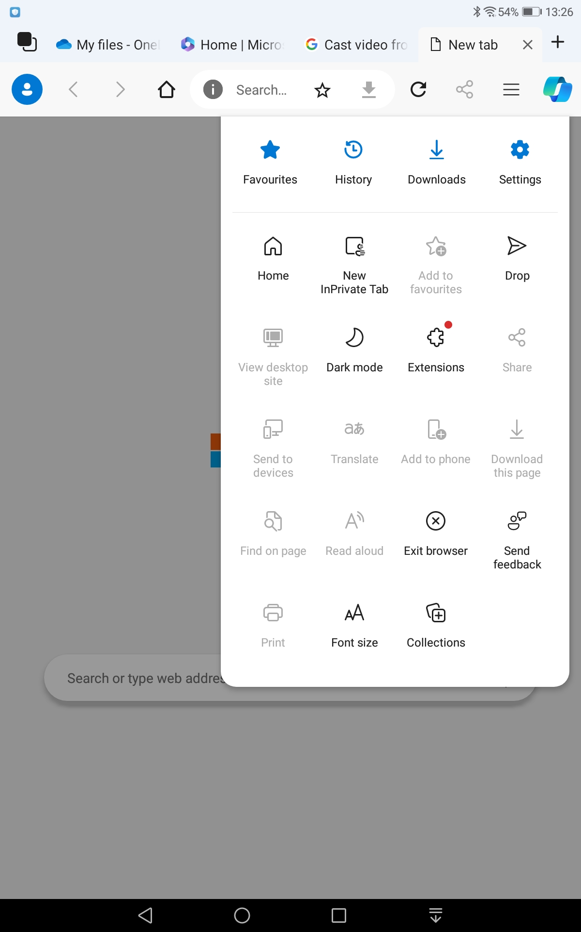
Solutions for disparate devices
3) MS “Drop” app
(These will use the host cloud that allows small file transfers from rival clouds and demand that “their” browser is installed:
MS Drop is part of Edge browser. A side panel opens showing the transferred file.
You may be compelled to make Edge the default browser on both devices ie phone and tablet.

Slide 8
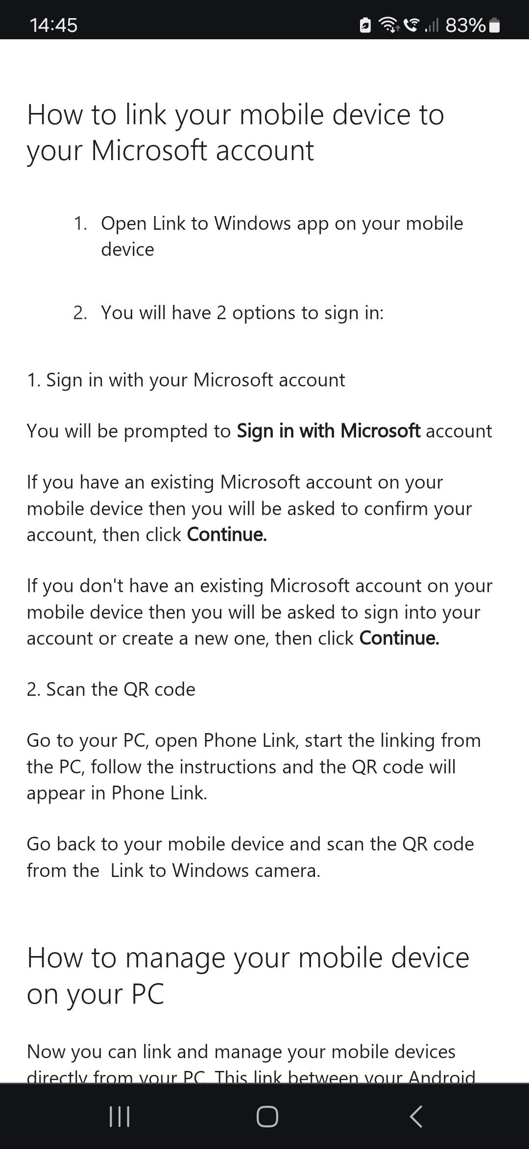
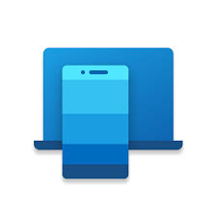
For those of us who like laptops..
Link to Windows app, on certain smartphones (Samsung + 2 others), will enable you to view your mobile and use all its apps, directly on your MS laptop. (It is “Cloud to Cloud” communication)

Slide 9
For those of us who like laptops.. continued
Breaking News: MS Phone Link app on your laptop (which pairs with Link to Windows app on your mobile - see previous slide) is now known as “Cross Device Experience Host” app & has advanced.
I can now click-and-drag photos, screenshots via the Settings route ( ie Downloaded images) to my laptop’s Home (File Explorer) ie transfer the files without the usual download/upload. None of the Google apps (ie Files or Photos) will cross transfer to Windows
(Likely that the Samsung software for viewing files on my phone (ie the Settings app) is more compatible with MS.)

Slide 10

Solutions for disparate devices
3) Blue tooth
Quick Share will transfer by Blue-tooth to nearby devices. Android in origin, it will, however, transfer to Windows computers…. One image at a time and very slowly! (Android to Android is much quicker but why not then use (My)Drive cloud, when a whole folder of images is quickly transferable via Google Photos). Also said to work for Apple.
Other paid-for apps for transfers from/to Apple:
https://www.theknowledgeacademy.com/blog/how-to-transfer-photos-from-android-to-iphone/

Slide 11
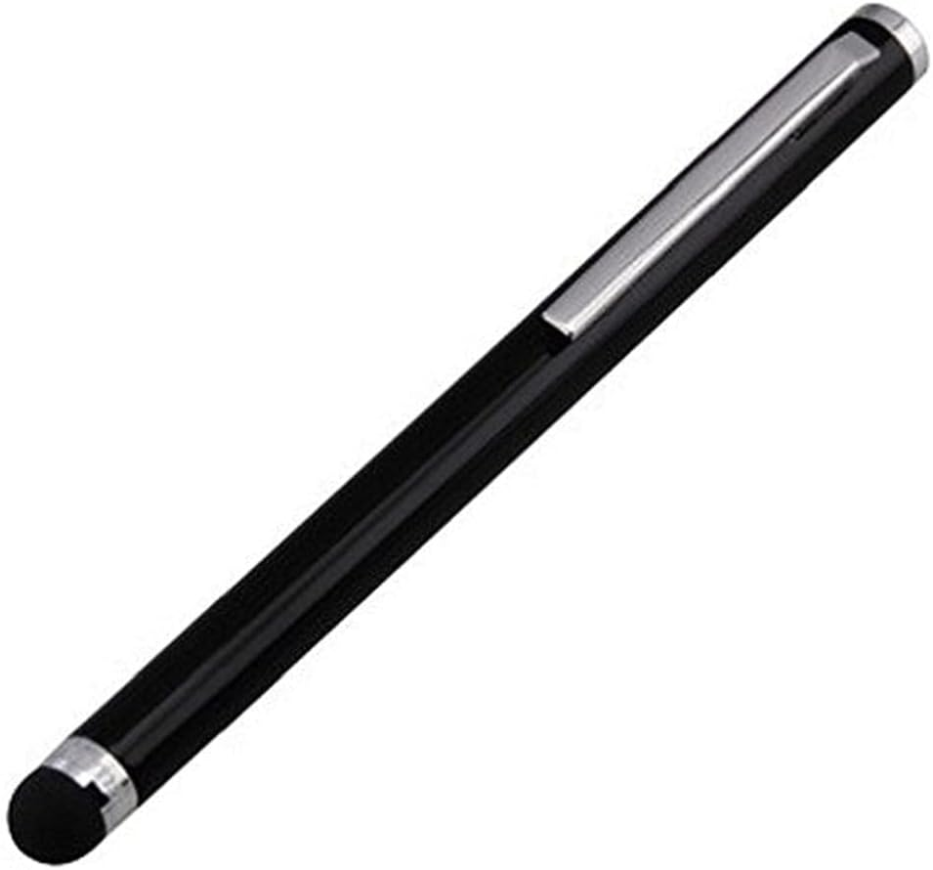
Another Alternative: use a web-based slides app on your phone and avoid having to transfer images to a tablet or if you dislike uploading to/from a cloud!
Free, web-based (Android) Google slides app is the same app for both phones and Tablet. Some tips…
Open the Google Docs app in a different tab on your phone. Compose your text for the text boxes you want to insert later onto your Google Slides. Then copy and paste into the text box as it first appears (ie the width of the slide).
Adjust the textbox width and final position with
a stylus pen

Slide 12
Sort & label pics & screenshots
2) Upload or transfer a folder’s worth
6) Ruthlessly prune slides & comments for allocated time
3) Research your topic and copy some key phrases
4) Open your chosen Slides app. Copy & paste your pics and titles/phrases into slides (!)
5) Speak your way through them, and add speaker comments

Slide 13

Organise… Organise your pics and thoughts about your topic
There’s nothing like doing a presentation for learning more about your interests.

Slide 14


For organising and transferring pics, the following slides are unapologetically Google apps orientated: Google Photos, Google Drive. MS Apps for photos, anyone?

Slide 15
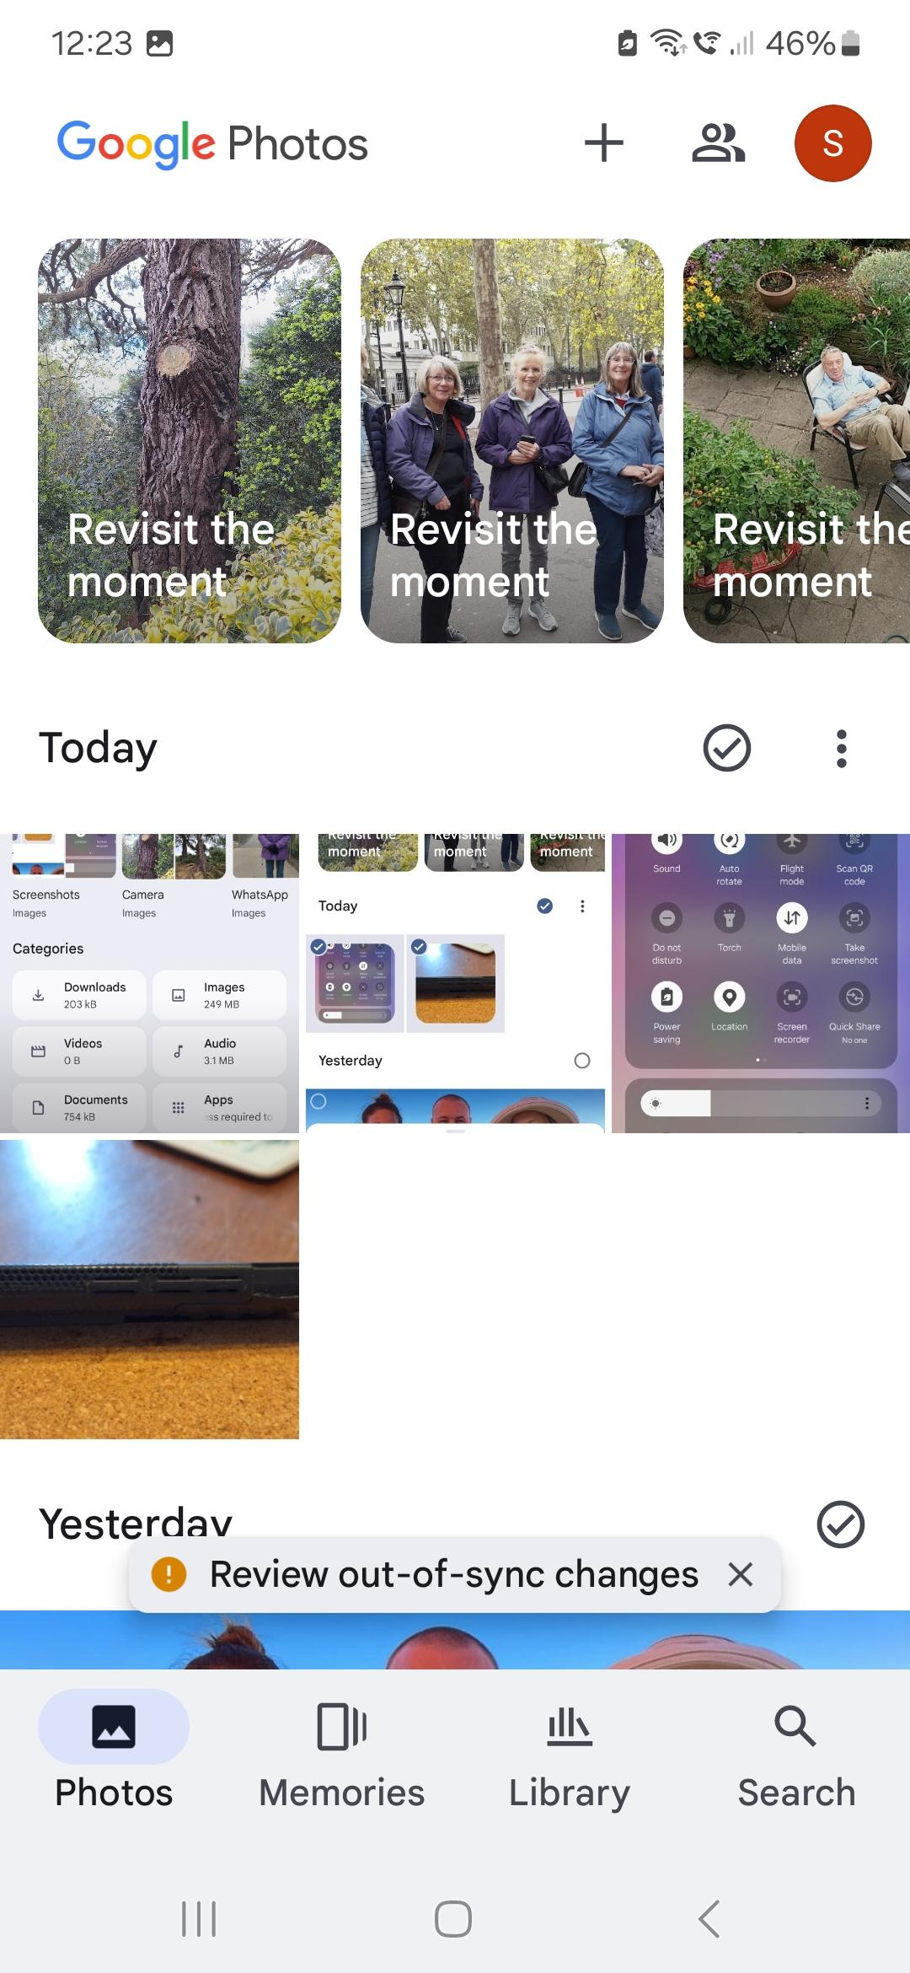
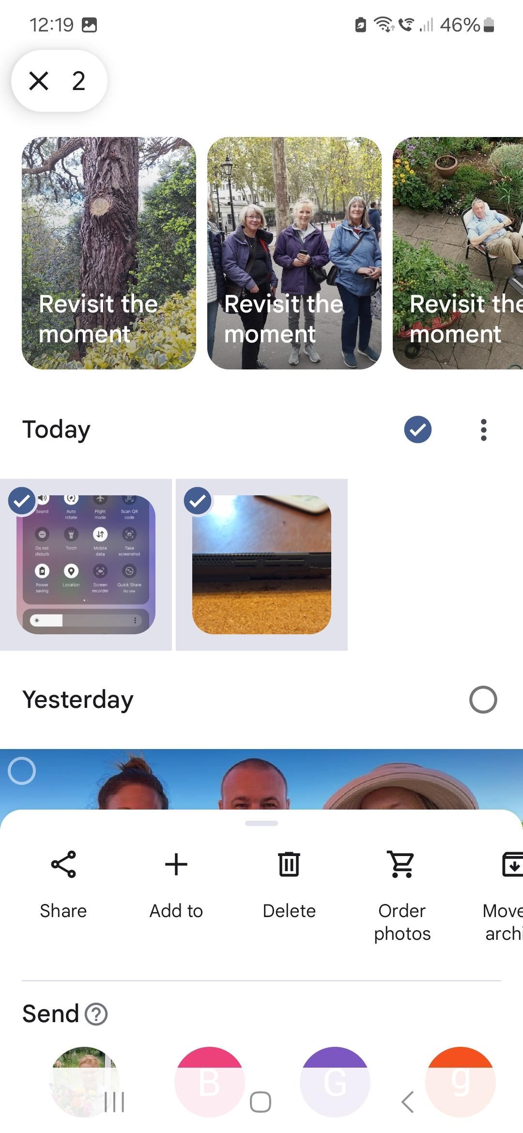
In Google Photos, images are in date order.
Clicking the Tick option will select Today’s images
And then offer you options of what to do with them. Select Share.
And then Drive to upload to the cloud (Drive)

Slide 16
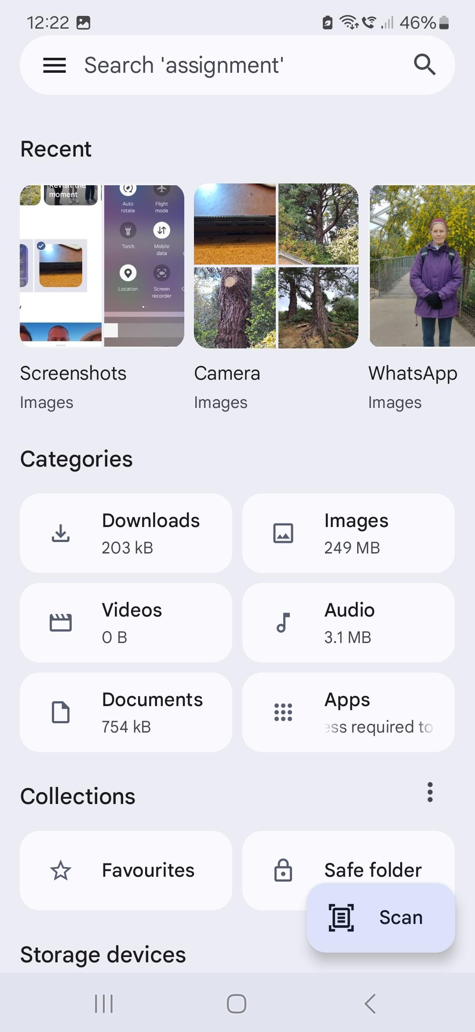
Alternatively, if you are using Google Files ( or your phone’s default file app), you can search the recent images , which are categorised into type of image - choose Screen shots and select them in a similar way,
then Share to Drive

Slide 17
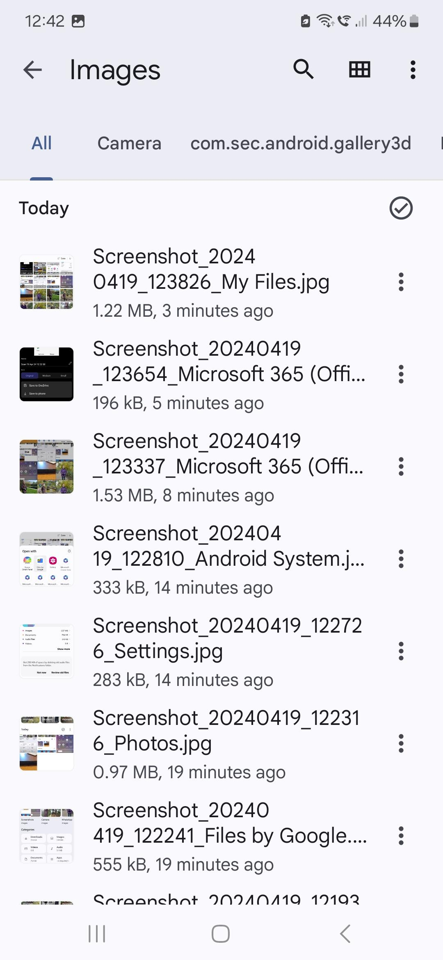
No need to rename your screenshots (if using Google apps and Drive Cloud to utilise them ) because you will be able to view these thumbprint images in most Google apps (such as Google Slides)

Slide 18
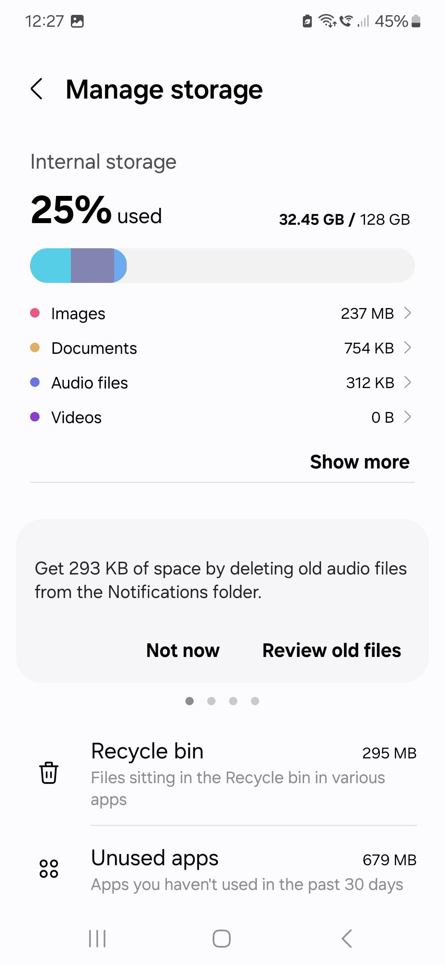
Another way of finding your screenshots:
Go into your phone’s Settings (or Downloads)
Then submenu (which may be for reducing your memory and storage use)
Click on Images

Slide 19
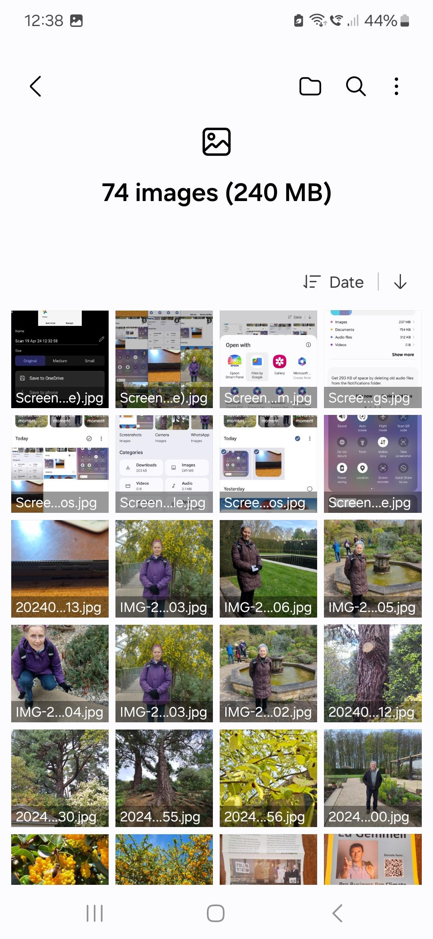
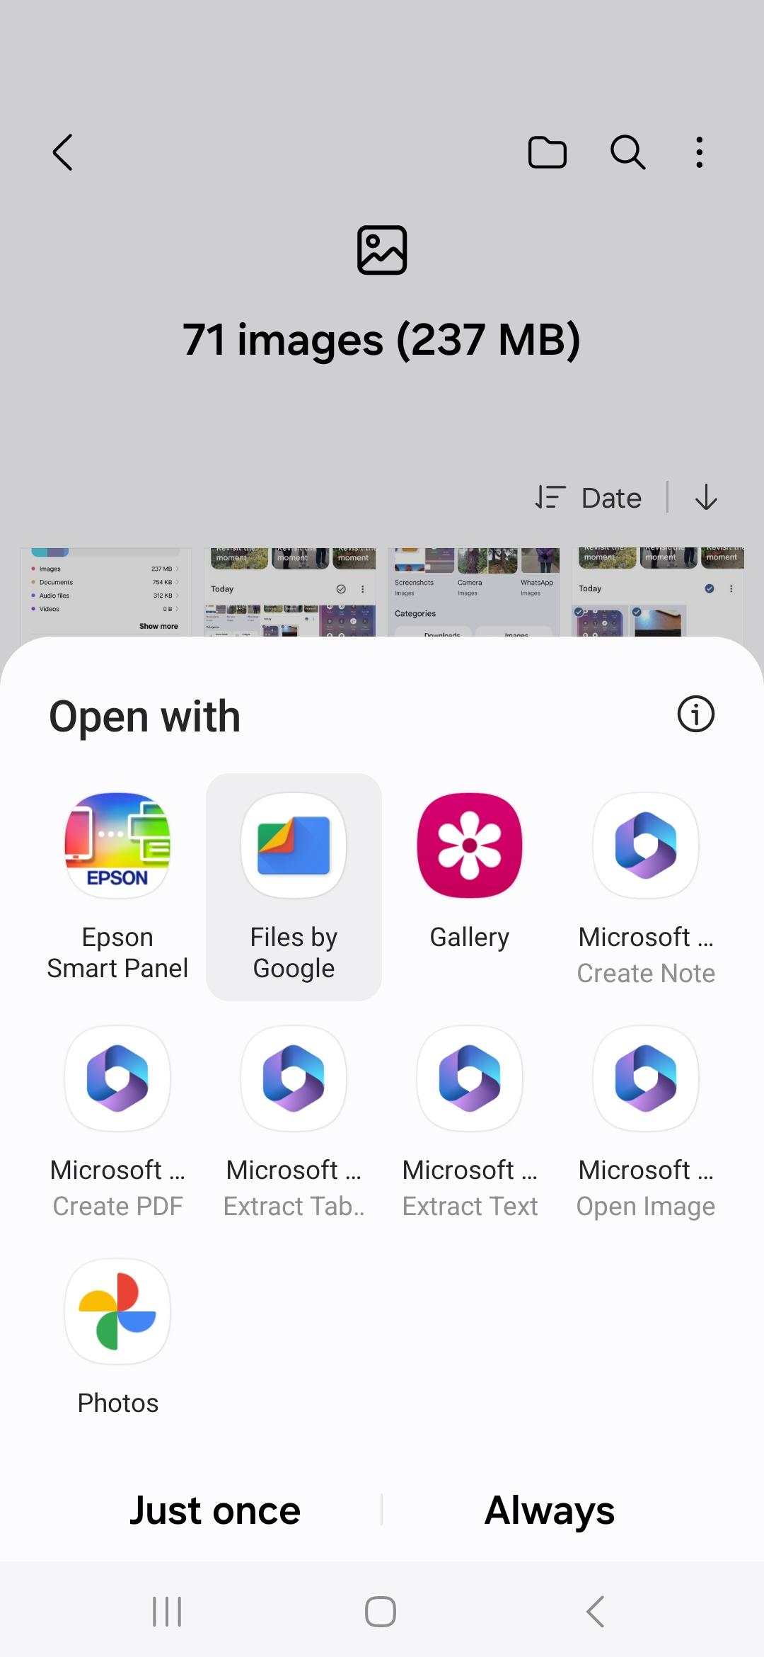
Downloaded images shown. Only organised by time!
Click Edit and select tickboxes to highlight the screenshots that are relevant.
Then click which app you want to handle them.
Or Share (to a cloud)..most screenshots are 0.5Mb
Some Microsoft apps are available because of pre-loaded MS apps and links.
One is MS Create PDF

Slide 20
OK, these slides (apart from the “flowchart” one) were prepared on a laptop using the more sophisticated Google Slides app. But the tablet/phone app would get you there…
If you’re amongst friends, the odd bodge really doesn’t matter and you are communicating what you have learnt or experienced about a subject that interests you all..

