Slide 1
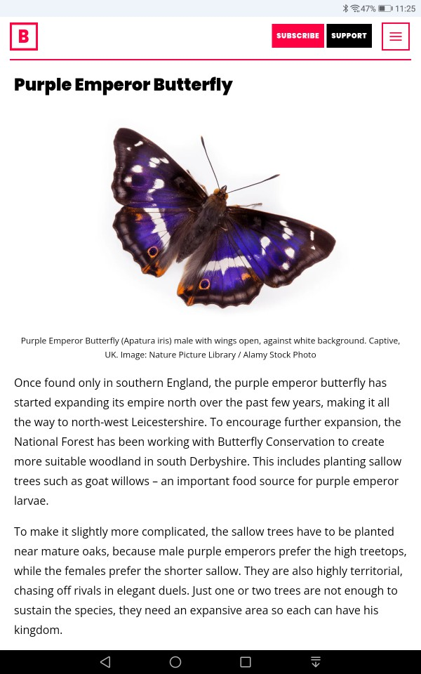
SEARCHING BBC. Co. UK FOR ECO FACTS

Slide 2
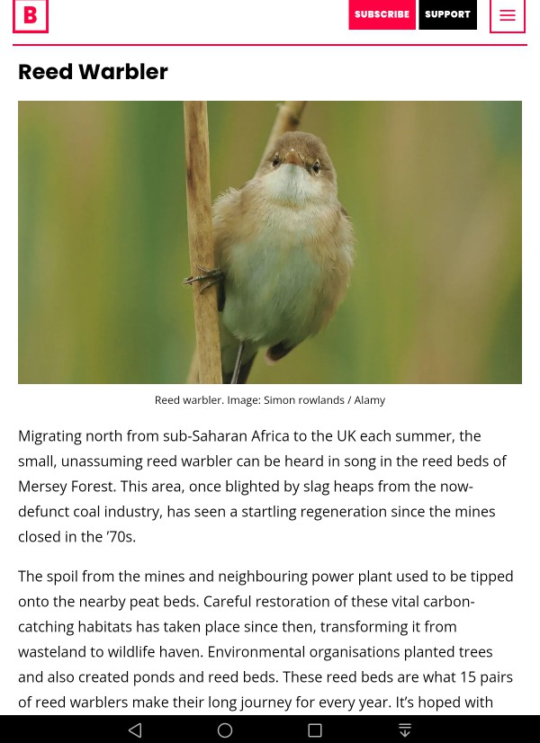
SHIFT THE IMAGE DOWN FOR A QUICK WAY OF TRIMMING IT OF TEXT.

Slide 3
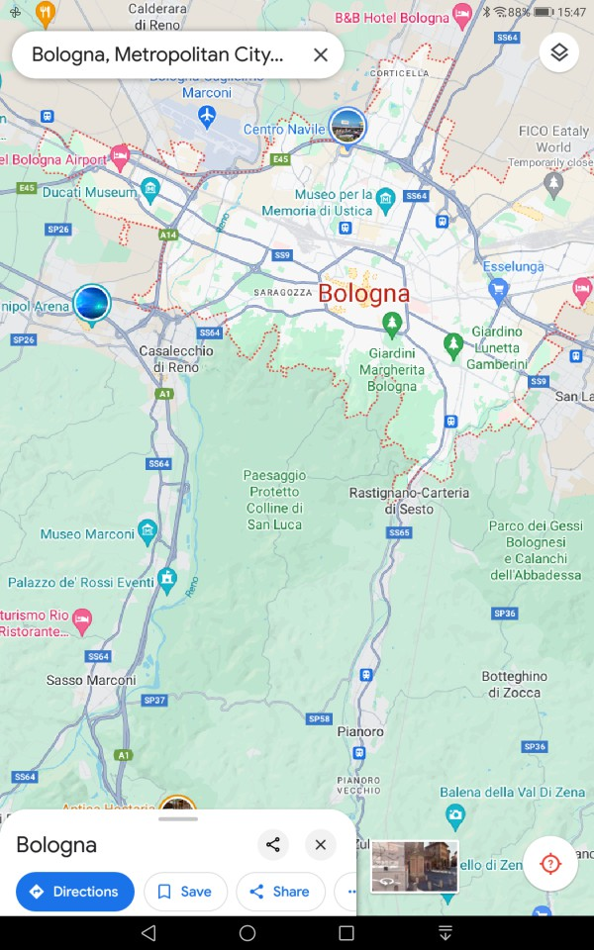
BUILD YOURSELF A TRAVEL JOURNAL STARTING W. GOOGLE MAPS

Slide 4
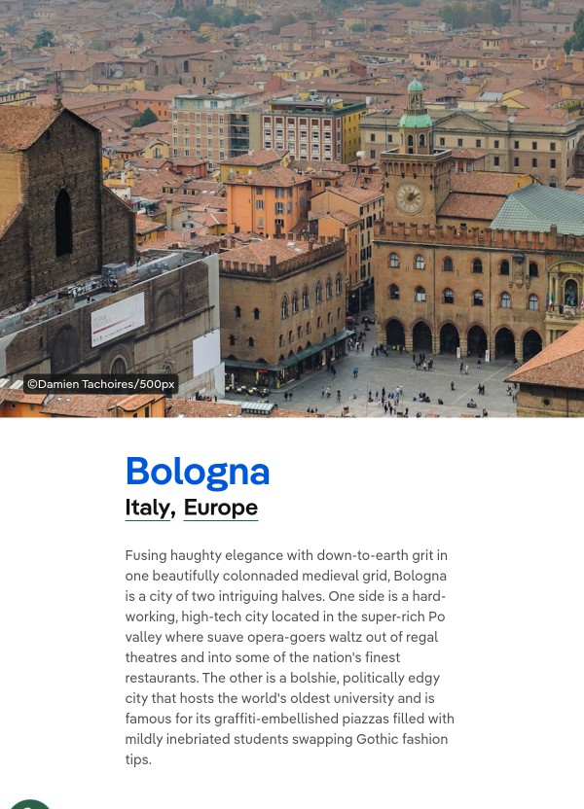
SCREENSHOT FROM A TOURIST WEBSITE

Slide 5
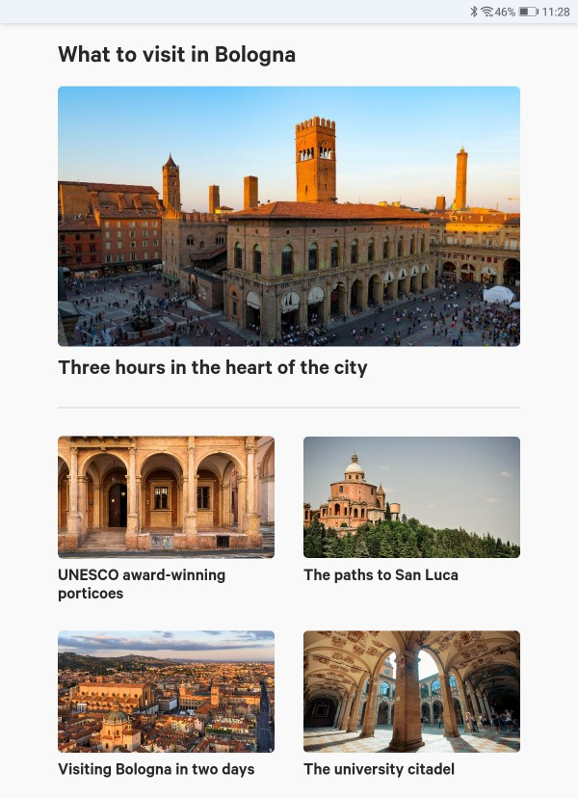
SCREENSHOT FROM A TOURIST WEBSITE

Slide 6
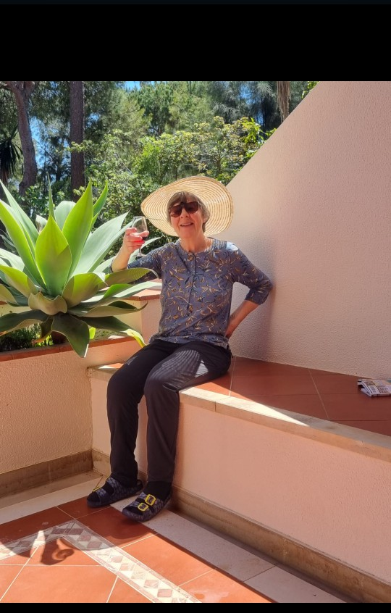
CLASSIC WHATSAPP SHOT FROM A BIRTHDAY GIRL CAN ADD DETAIL TO A XMAS ROUND-ROBIN

Slide 7
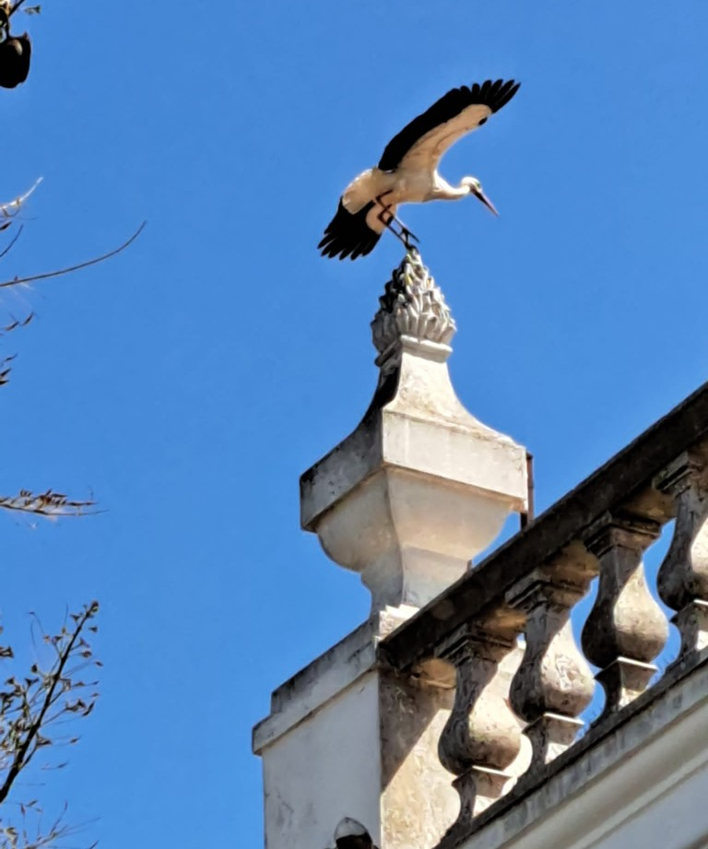
GUESS?

Slide 8
PHOTO CAN ILLUSTRATE A PRACTICAL QUESTION
TO REVEAL A FIBRE CONNECTION TO YOUR ROUTER

Slide 9
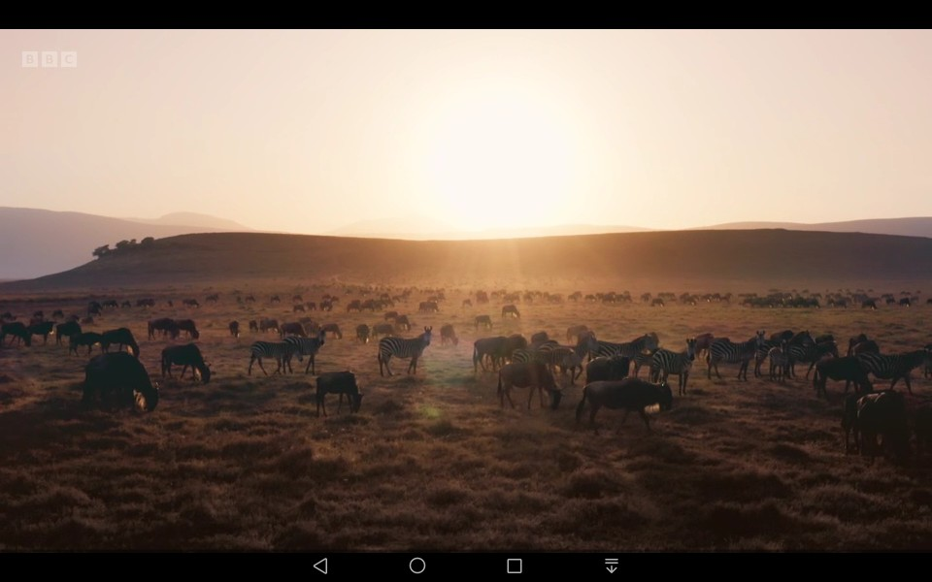
PAUSE BBC I-PLAYER & TAKE SCREENSHOT

Slide 10
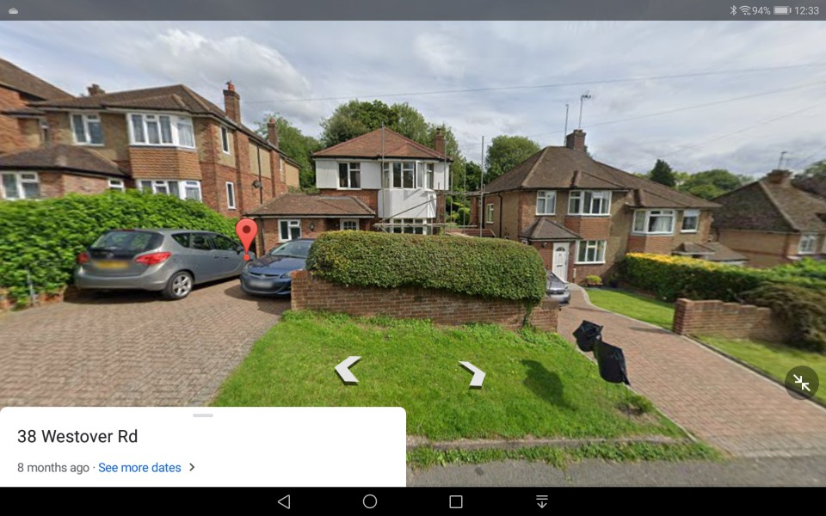
GOOGLE MAPS WILL SHOW YOU STREET VIEW WHEN TAPPED ON A LOCATION & OFFER A SHOT TO DOWNLOAD

Slide 11

A PHOTO OF A FULL PAGE FROM A PRINT PUBLICATION

