Slide 1
Folders & Files

Slide 2



Folders and Files
Much of the following is applicable to all of our devices.

Slide 3

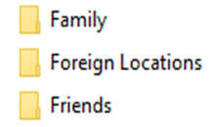

Folders and Files – Apple, Android & Computer
You can save time and learn how to organize digital files with a few best practices. The key is to decide on a system and be consistent.
There is definitely an argument for saving everything just in case, especially finance-related documents. But if you have duplicate files or documents you’ll never refer to again, delete them. Delete files before you start filing so you don’t waste time organizing them, just to delete them later. If you’re not sure whether to keep them, put them in a folder titled Archive.
The best way to organize files on a device will vary based on your family and its needs. Decide whether it makes sense to organize files by name, date, event, or category. After that, folder structure best practice is to start with the broadest categories for your main folders, and then get more specific with subfolders. Here’s what that could look like.
Organizing by date and subfolders by name:

Slide 4

Create New Folders in Files App on iPhone & iPad
The Files app for iPhone and iPad provides access to the iCloud Drive and every file or folder contained within it, whether for individual apps or things you have uploaded to the iCloud Drive. If you want to re-organize your files in the iOS Files app, you can easily create new folders within this app.
The Files app on iOS behaves the same on iPhone and iPad, but it may look slightly different to accommodate the different screen sizes. These screenshots are based on the iPad, but the behaviour to create a new folder in the Files app is the same for an iPhone too.
Open the “Files” app in iOS
From the Locations section, choose “iCloud Drive”

Slide 5
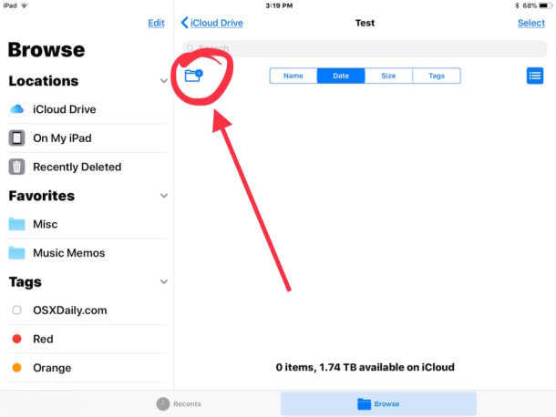
Create New Folders in Files App on iPhone & iPad
Once in iCloud Drive, navigate to where you want to create your new folder (it can be in the iCloud Drive directory, or a sub directory)
Click the little folder icon with a (+) plus button on it to create a new folder

Slide 6
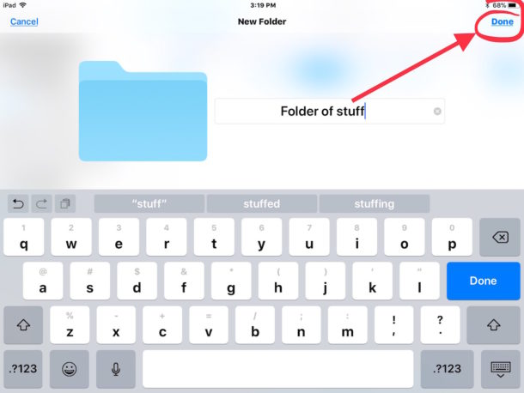
Create New Folders in Files App on iPhone & iPad
Give the new folder a name, then click the “Done” button in the corner

Slide 7
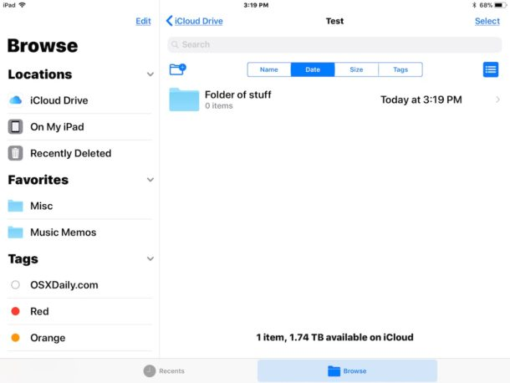
Create New Folders in Files App on iPhone & iPad
You can create as many new folders as you want this way.
You may find this useful if you want to create a folder for particular files, pictures or data.
If a file is accessed frequently, then you can add the folder to the Favourites list in iOS Files app for quicker access.

Slide 8
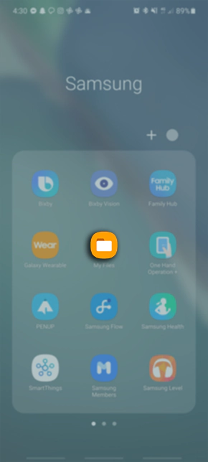
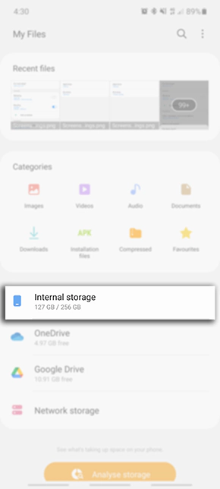
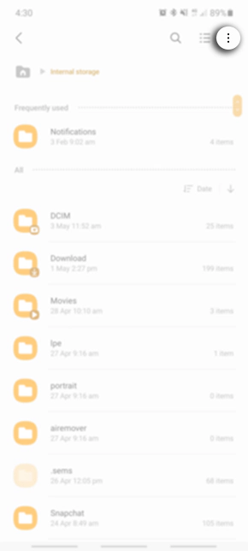
New Folders and Files on a Samsung phone & Pad
1. Launch the My Files app
2. Tap on Internal Storage
3. Tap on the 3 dots

Slide 9
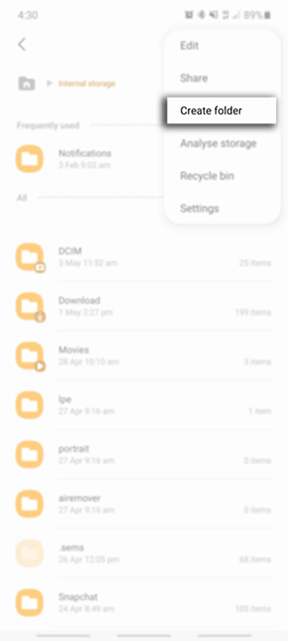
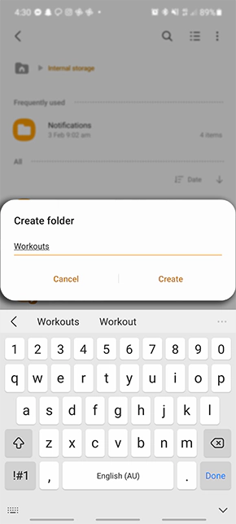
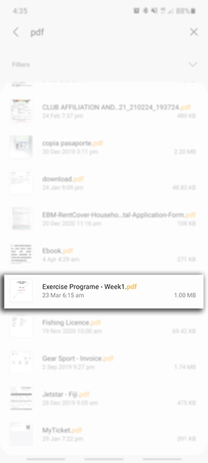
New Folders and Files on a Samsung phone & Pad
4. Select Create folder
5. Name your folder then tap on Create
6. Move / copy the doc or photo file to new folder

Slide 10
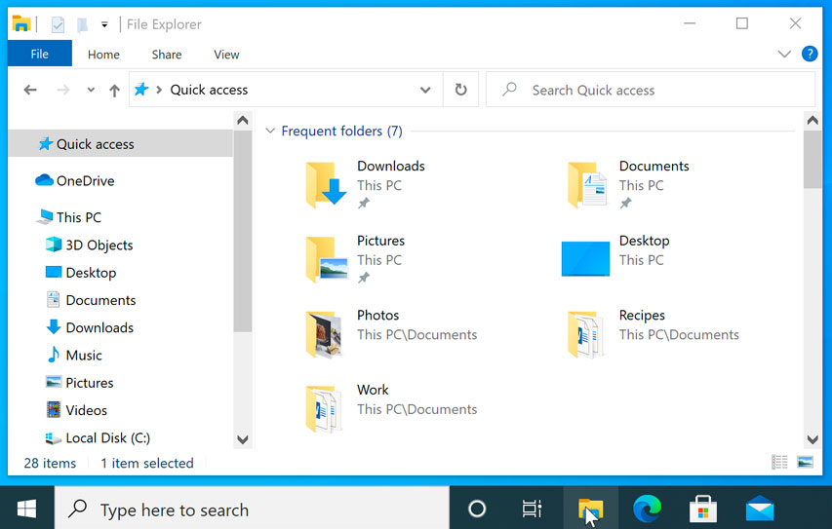
Folders and Files – Desktop & Laptop Computers
To open File Explorer, click the File Explorer icon on the taskbar, or double-click any folder on your desktop. A new File Explorer window will appear. Now you can start working with your files and folders.
From File Explorer, double-click a folder to open it. You can then see all of the files stored in that folder.

Slide 11
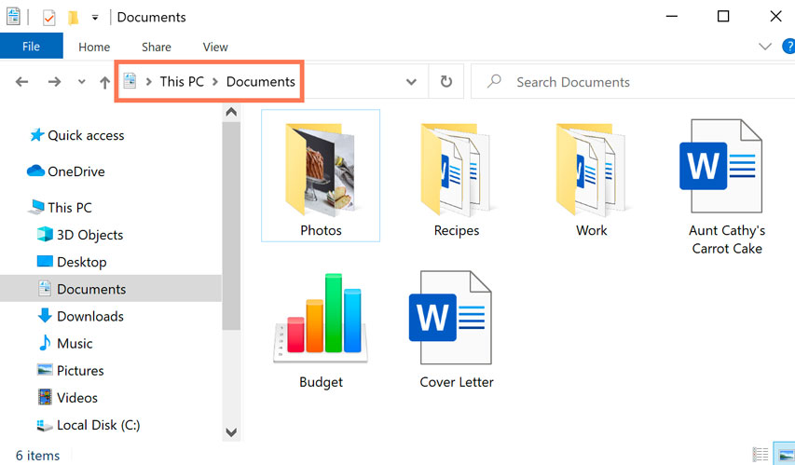
Folders and Files – Desktop & Laptop Computers
Notice that you can also see the location of a folder in the address bar near the top of the window.

Slide 12
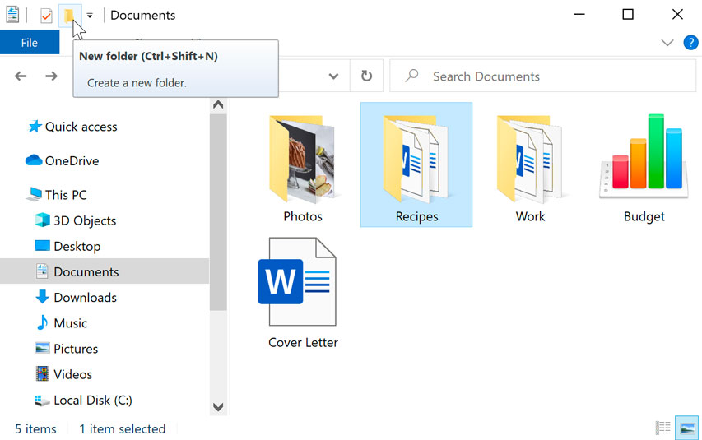
Folders and Files – Desktop & Laptop Computers
Within File Explorer, locate and select the New folder button. You can also right-click where you want the folder to appear, then select New > Folder.

Slide 13
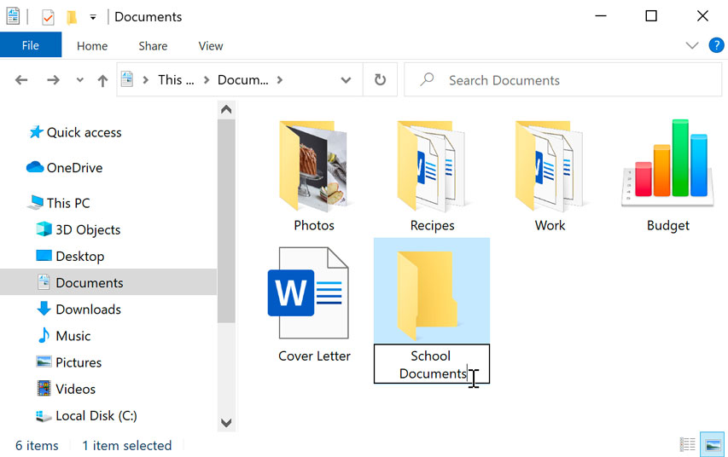
Folders and Files – Desktop & Laptop Computers
The new folder will appear. Type the desired name for the folder and press Enter. In this example, School Documents.

