Slide 1
Getting Started with Google Apps from a Microsoft Computer
Either use Chrome Browser (as an alternative to Edge) Or Search for Google Docs (or Mail) webpage and set up your Google Account there.
Leave yourself signed in to your Google Account if you want to retain the Docs tab (or any other Google App) accessible on your Edge Browser
Suggestion: Upload a MS Word document or two to Google Drive, which is the Google App cloud storage and the equivalent of your Hard Drive, and get familiar with how the “filing system” works
Set your Google Account default language to English UK so that your Doc margins etc are in cm not inches, and the spell checker is correct. (In Personal Info section)
(If Google apps are unfamiliar to you, manage your Google Account for any security or privacy issues you want eg 2 step verification on unfamiliar devices. )
Notes:
Unlike many other generic android document apps sold with some tablets etc, Google Docs is completely interchangeable with MS Word (& .odt etc), and secure.

Slide 2
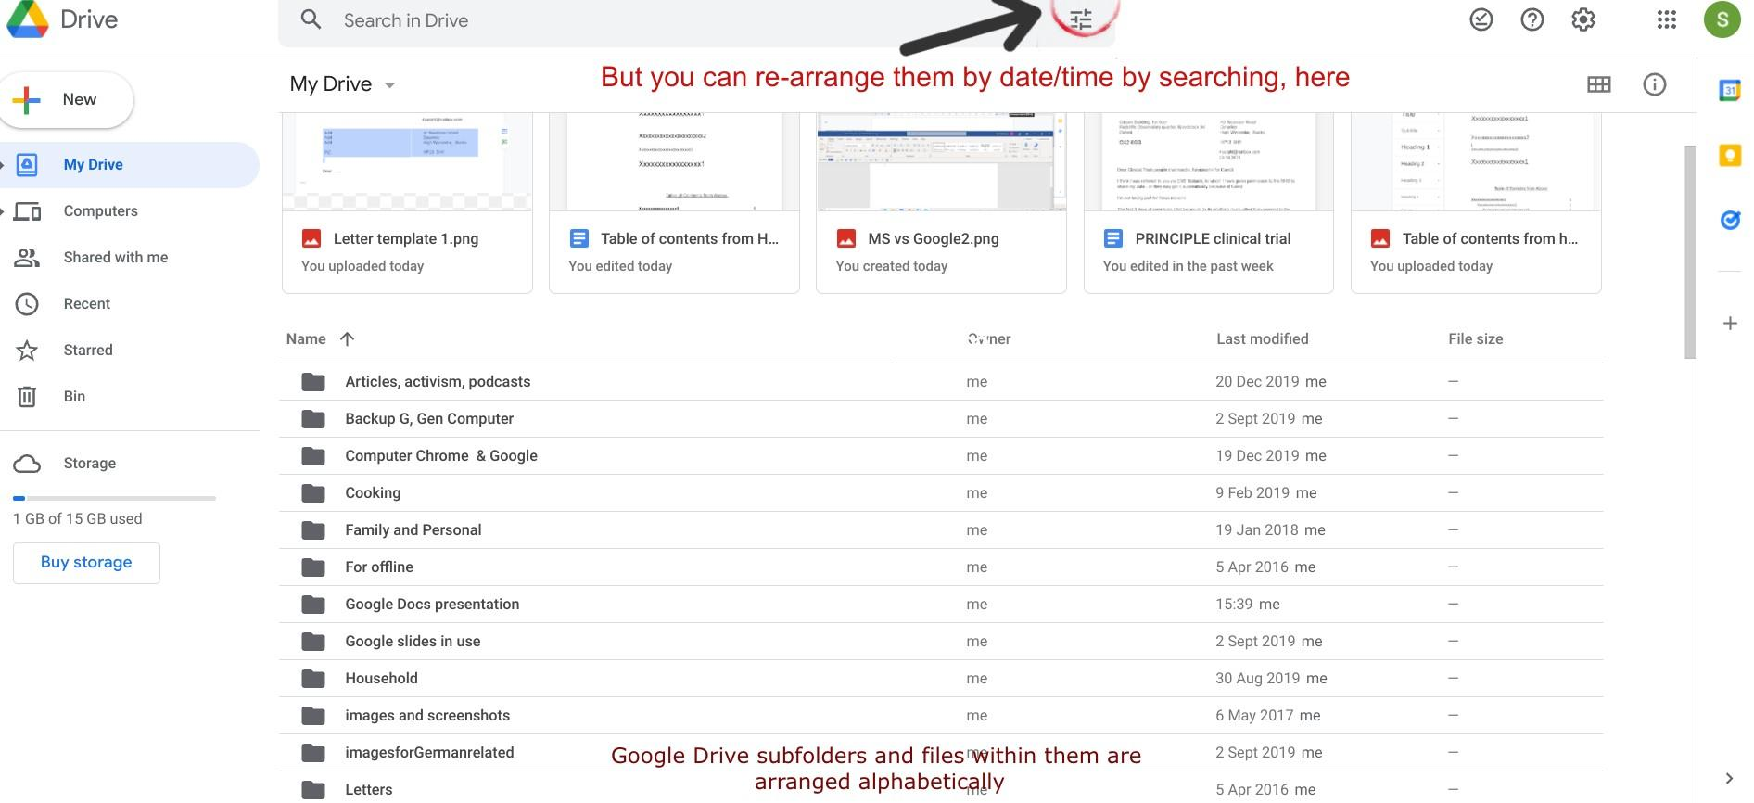
Notes:
Point out the Drive logo and the Google app “chequerboard” equivalent to the Task Bar

Slide 3
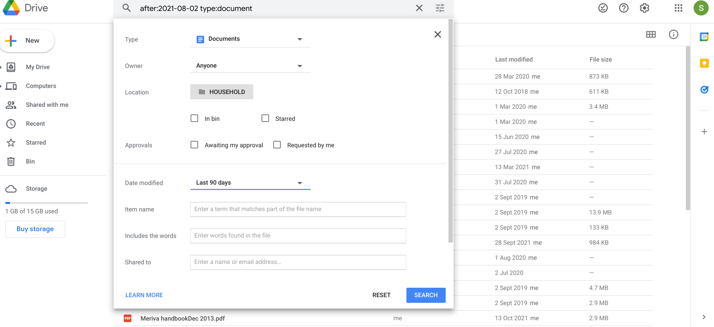
Notes:
Having clicked the “railway track” icon, can choose to search ie re-arrange in date order. Another useful clue is the file type icon next to each file for eg.pdf or .docx

Slide 4
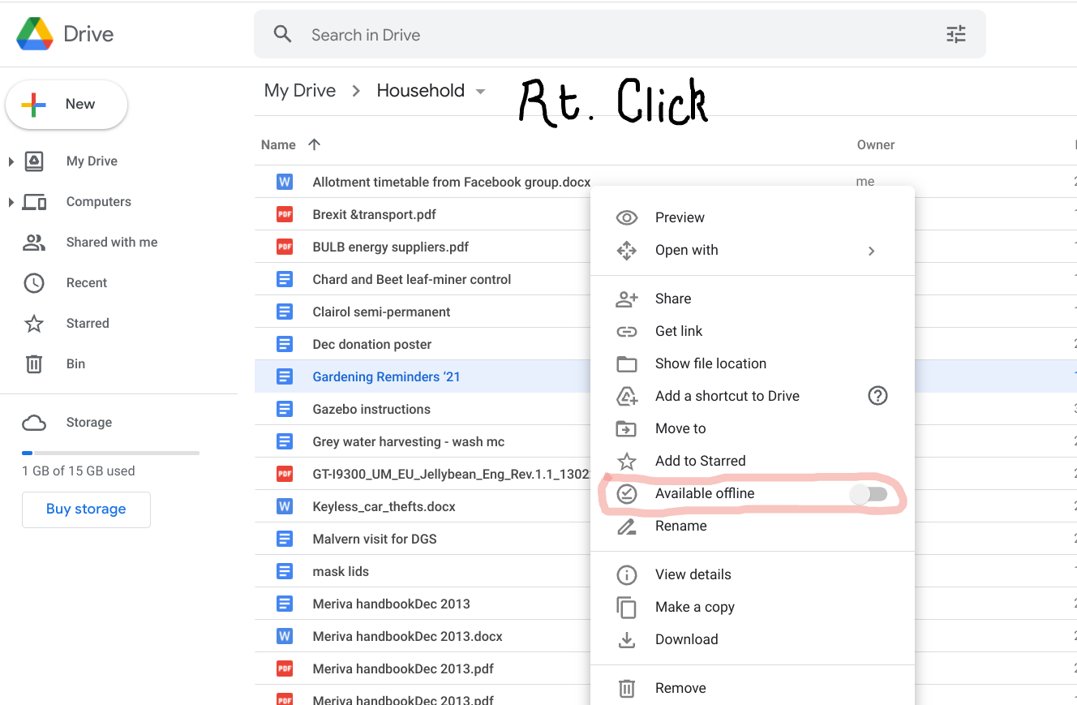
After switching the slider to “Available Offline”, and to work in Google apps when no WiFi/internet available, make sure you open the document before going offline and leave it open in a tab. Then, as soon as you are online again, it will be saved to Drive in the updated form.
Notes:
Default working is online. Limited facility to work off line by leaving Google account signed in and tab open. Can make all recent docs available offline in Settings

Slide 5
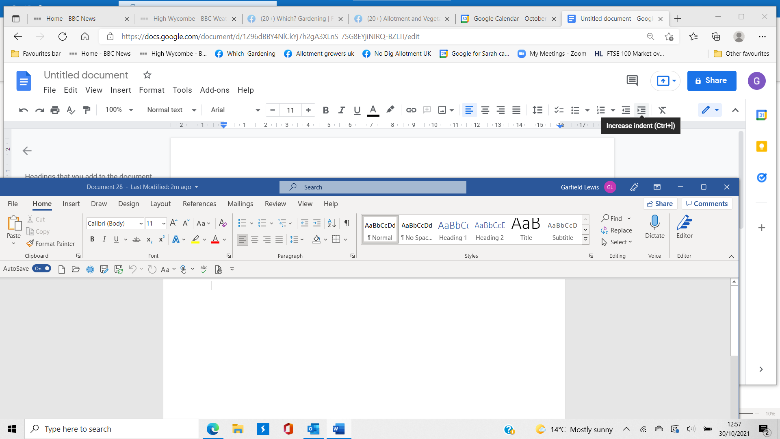
Most MS functions are available in Google Xpt ?Mailing. Additional features: - language sensitivity, collaborative editing & sharing, “RH column web preview” access to other Google apps eg Calendar, Keep
Notes:
Overlaying the MS Word window (below) on the Google Docs window (above) to show similarities.. But simpler! Shortcut keys to functions like copy (Ctrl C), paste, find, all very similar

Slide 6
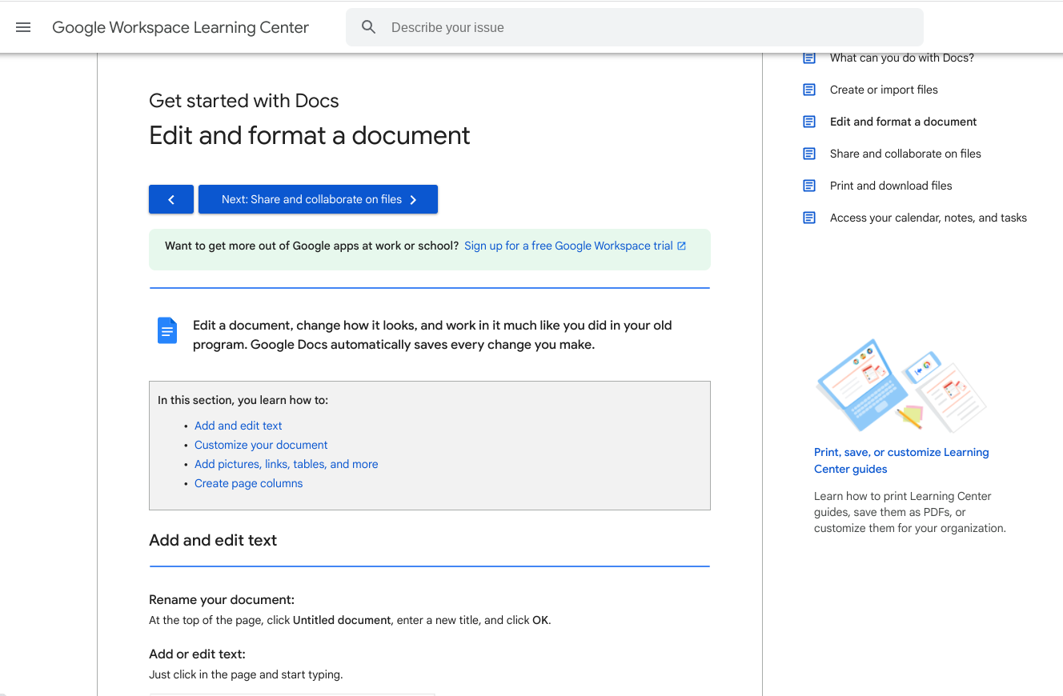
Find the Learning Center in Help
YES

Slide 7
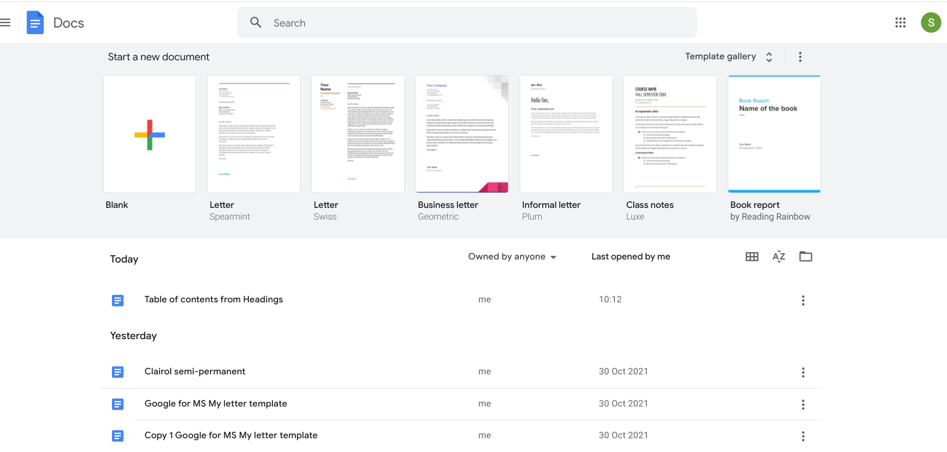

Webpage appearance on opening the Docs app and before selecting a document or starting a new one
Template gallery can be hidden - but then starting a blank document is unavailable.
Notes:
Within Docs, Files ARE in date order, not alphabetical. Letter templates offered by Google did not appeal to me.

Slide 8
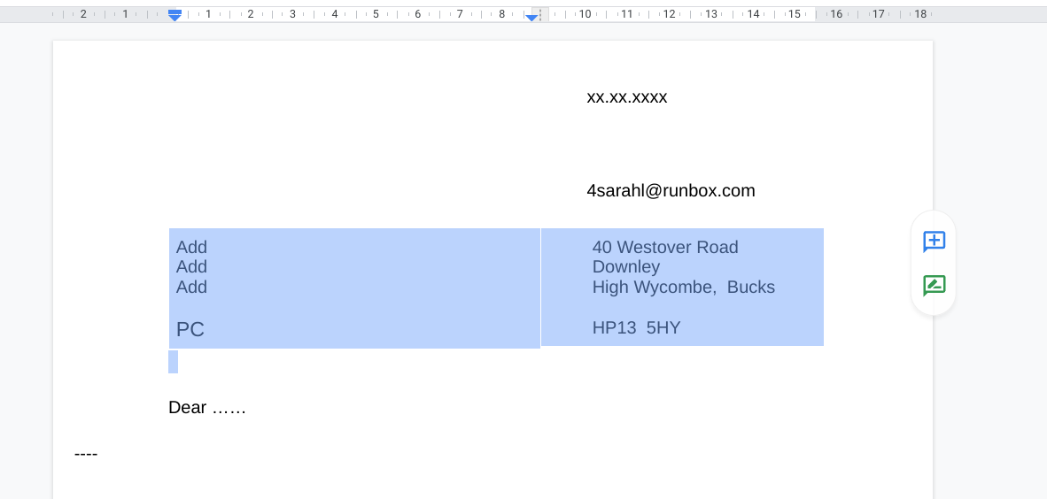
Inserting a table with just one row, two columns, to duplicate the window in a window-envelope while not wasting space adjacent to the address.
Notes:
Practical exercise: make my own letter “template”

Slide 9
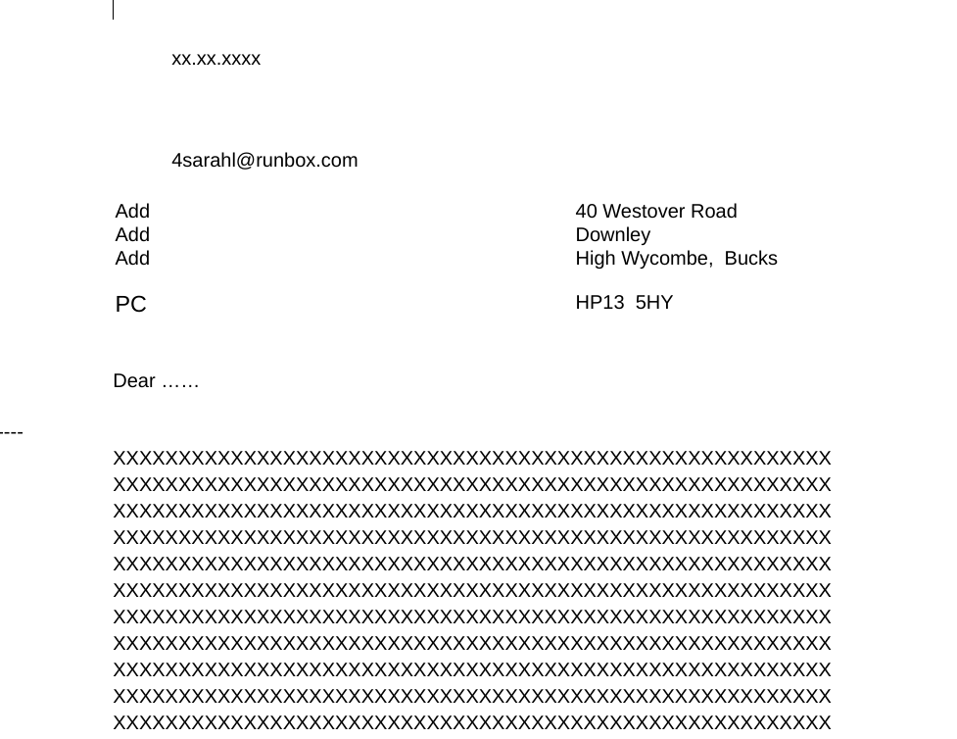
HOWEVER:
Downloading the Google Doc as a .docx and printing it to check the layout, it loses the left-tabbed date and email address, which then end up displaced. Pagination OK
Notes:
Can print out straight from Google Docs ie in Google format, but sometimes one attaches a Doc to an email and .docx format is then required.

Slide 10
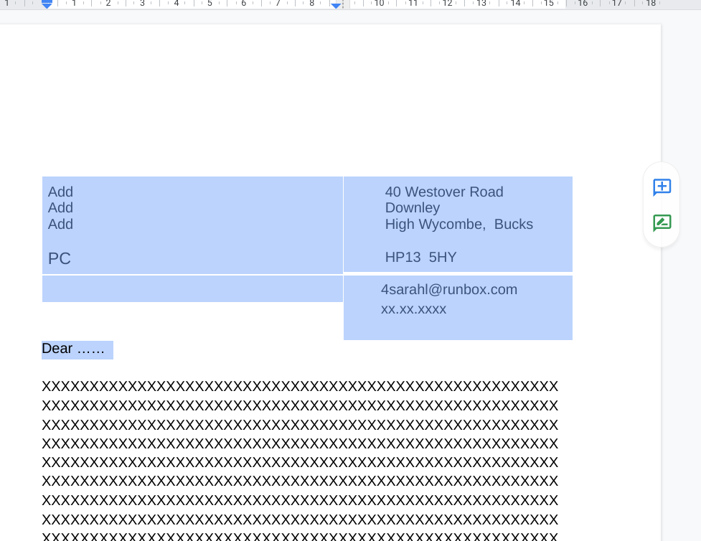
Solution - expand the inserted table into 2 lines, 2 columns and anchor the email address and date in it.
Finally - save multiple copies of the home-made template letter and then open one and save it with a new file name to use them.

Slide 11
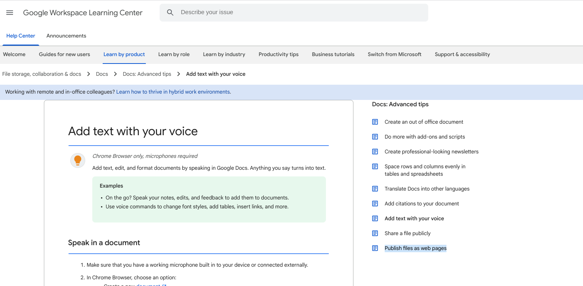
Useful insights into advanced features in the Learning Center - aimed squarely at the business world
Notes:
Add-ons are mini apps (independently developed by commercial organisations) which can make enhanced graphics, graph and table making, mail-merging and newsletters in non-standard ways.

Slide 12
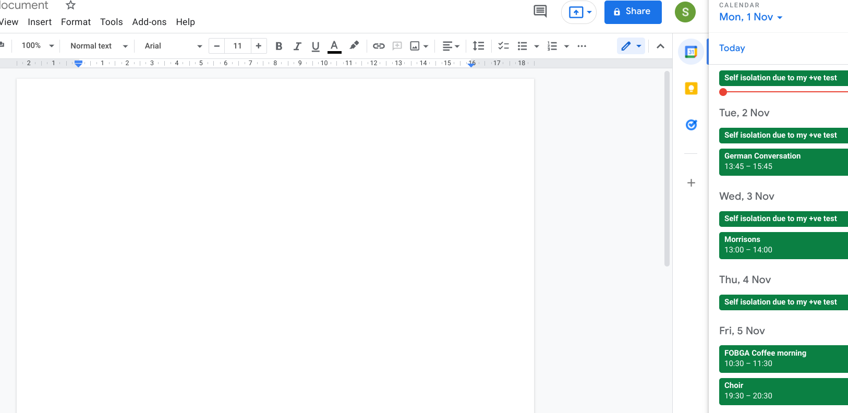

Import or consult material from other Google Apps in the Right Hand integral webpage window column
Calendar

Slide 13
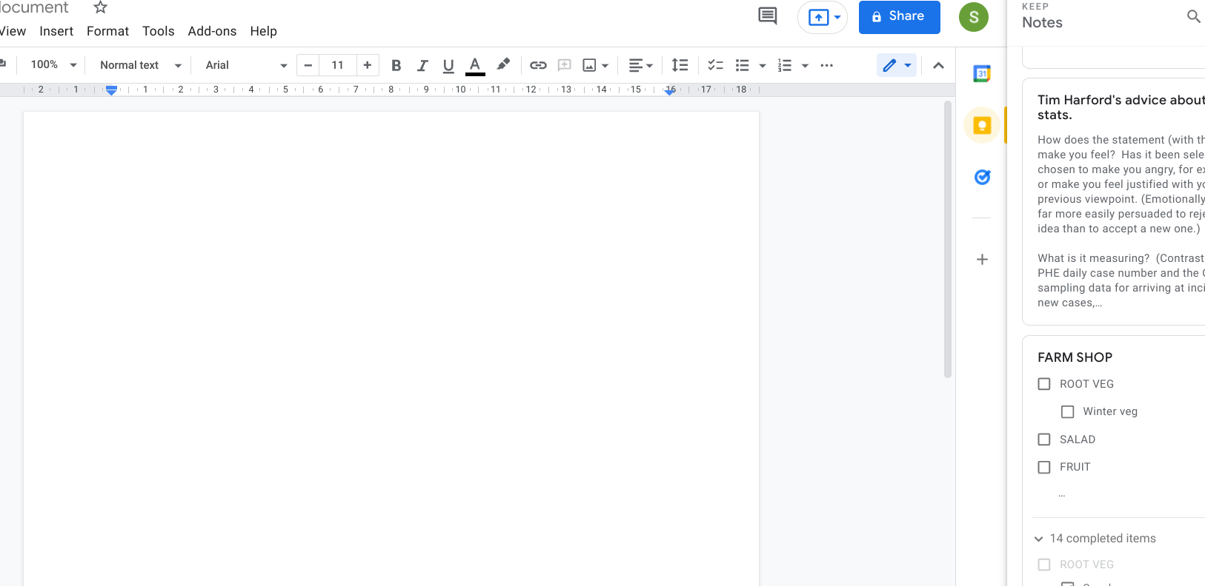
Interact with Keep Notes. This is also a useful way of using your phone or smart speaker to record voice messages (Google Assistant), then use the voice-to-text function to transcribe them into notes or lists, finally consult them here and copy/paste.
Notes:
I don’t use voice to text when I’m at my computer – too much correcting to do – but I do use voice notes when I’m out, on my smartphone.

Slide 14
Finally, Tasks is an app that is useful, no doubt for office work and deadlines but which I don’t use.
-------------------------------------------------------------------------------------------------------------------------------------------------------------------------------------------------------
Notes:
Emphasise that this column on the RHS is really a split window displaying one of the three Google apps denoted by these icons.

Slide 15
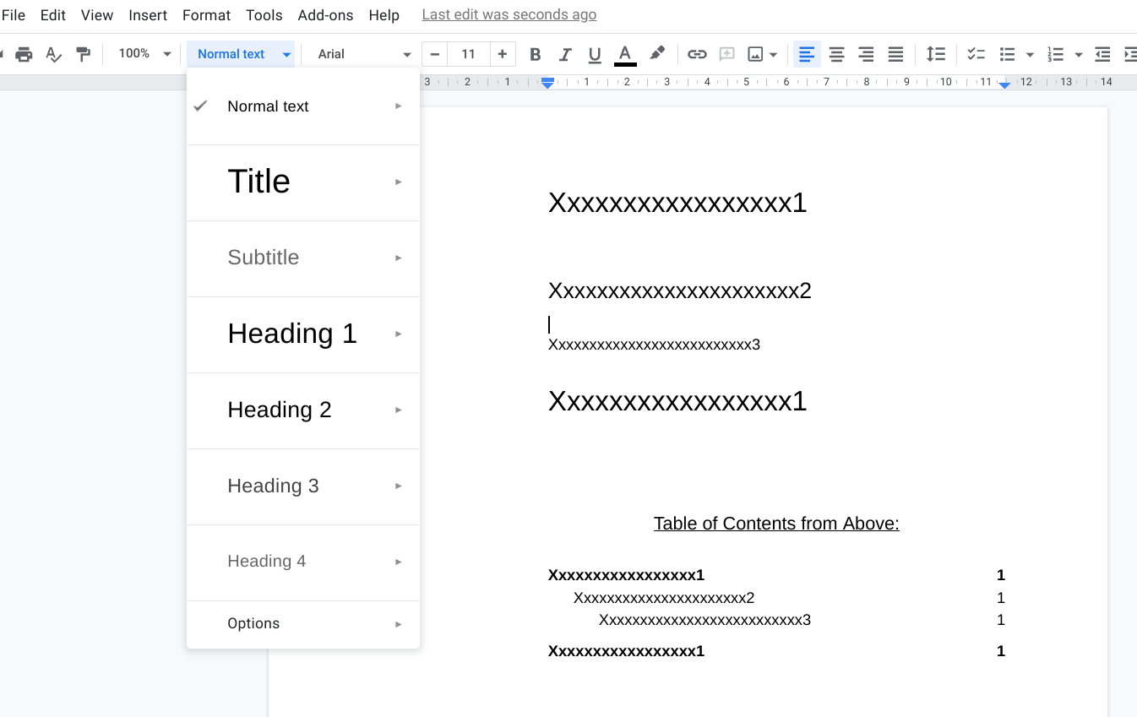
By formatting text lines in one of the 5 graded ways, A Table of Contents can automatically be extracted (in Insert).
Notes:
IF you are preparing a detailed, lengthy document, an index like this would be useful . (Citations and bibliography also available!!)

Slide 16
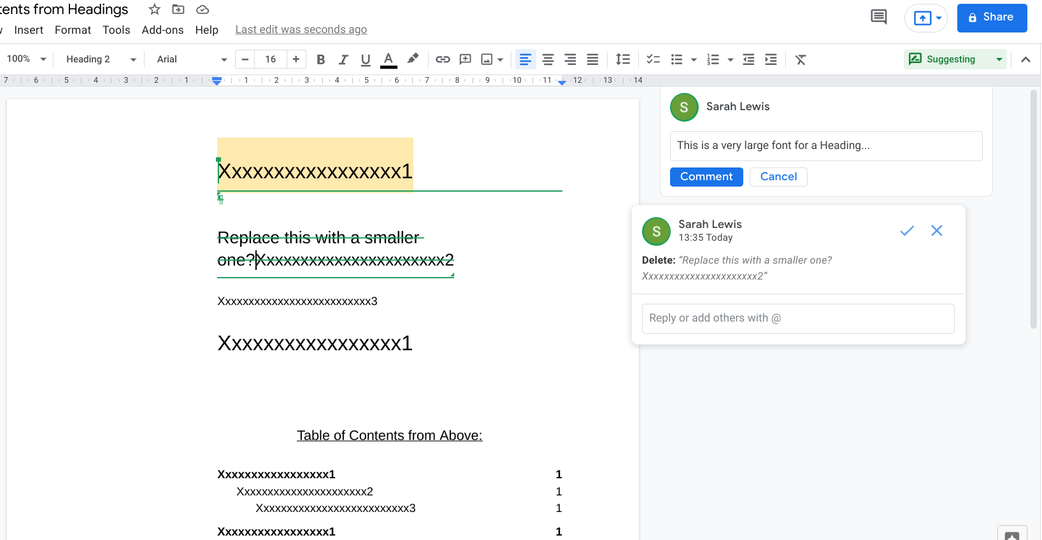
Collaborative working on a document is a big emphasis in Google - by sharing it. Here you can see the cursor has changed to a green symbol, text can be crossed through, comments made in the adjacent column and suggested revisions compared side-by-side (split screen) in two documents.

Slide 17
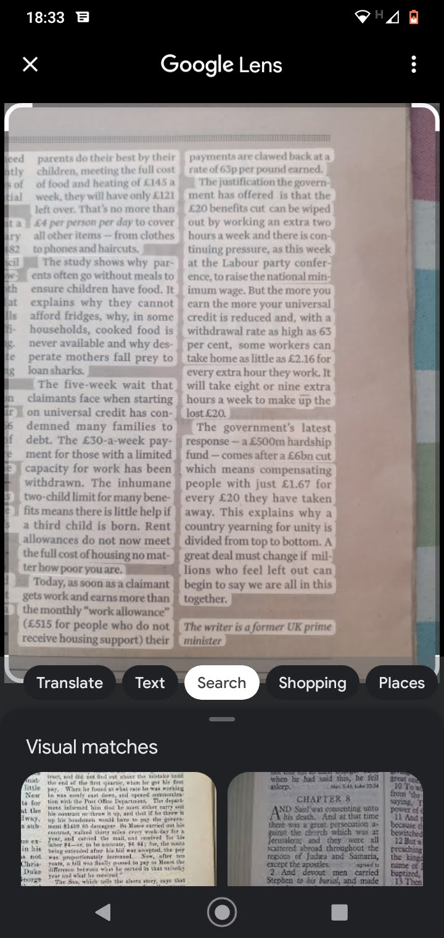
Can use the OCR facility within Google Lens (on smartphone) to copy text to clipboard and transfer it to a Google Doc.
Do it in a good light!
Then there is less editing needed.
Notes:
I use this quite frequently! Gets round copyright and pay-wall barriers. Do it on your phone and then email or share the document (if the google account is different from your computer google account)

Slide 18
Conclusions
Google docs completely interchangeable with .docx - download and upload .docx and interconvert… (but some spatial formatting may be lost.)
Security is high. (Unlike pre-loaded doc apps in some tablets/phones, which may not be.)
Still get 15Gb space free in the cloud (Drive) per google account. (My usage is 1Gb)
You can either become an Android app user/Drive cloud saver - OR MS OR Apple. MS and Apple have moved towards cloud based apps and away from hard drive apps, but Google got there first. (So more user-friendly)
Google apps are free.
Sharing between google accounts enables data to be entered on multiple devices, each with different google accounts. Eg sharing Calendar, Keep Notes
(For irreplaceable files - just download and save them to a stick occasionally if you like. Or share them.)
If you lose a device (your SSD crashes - it will!), your Drive files are all still there in the cloud to restore into a new device.

