Slide 1
Google Slides
(with a quick tour of Google Drive = Google’s Cloud)

Slide 2
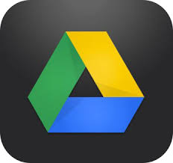

Google’s Cloud: “Google Drive” or just “Drive”
“Mobile Devices” Traditional computers
Smart phones with sufficiently fast internet
Tablets speeds - depending on
Notebooks patience!
Wifi dependent (or...3G/4G cellular data)
Notes:
Each Drive account is linked to a google mail address. Each Android mobile device is linked to a google mail Drive account ie associated with that address. More than one can be used on many mobile devices. You will need to remember the email address name and password!

Slide 3

PROGRAMS
APPS
Notes:
Apps are browser embedded programs, data is readily transferred between apps via Drive (cloud account). Within Android devices come pre-loaded apps. Others available (mainly free) from Google Play Store.

Slide 4
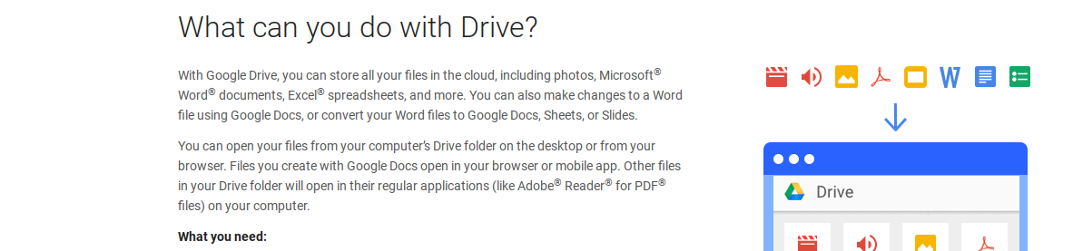
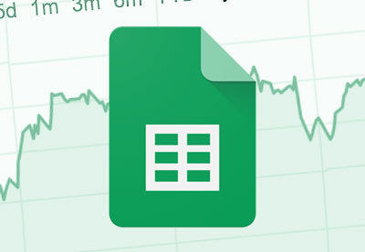
Left to right, the app symbols are:
Video player, Audio player, Image viewer, pdf reader, Google slides, MS Word reader, Google docs, Google form… (and, not shown here Google (spread) Sheets)
Notes:
It’s helpful to learn the symbol for each app - even if you don’t need it now. You can read all the MS, Adobe etc industry standard file types but not modify or create them.

Slide 5
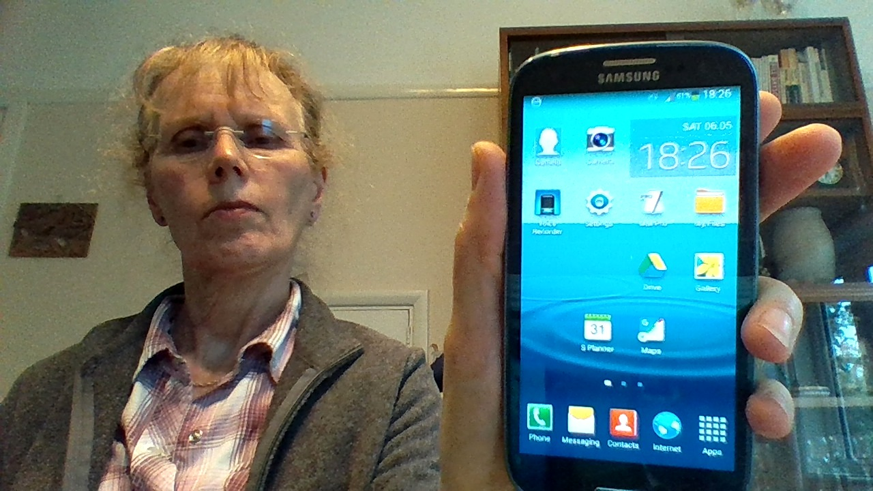
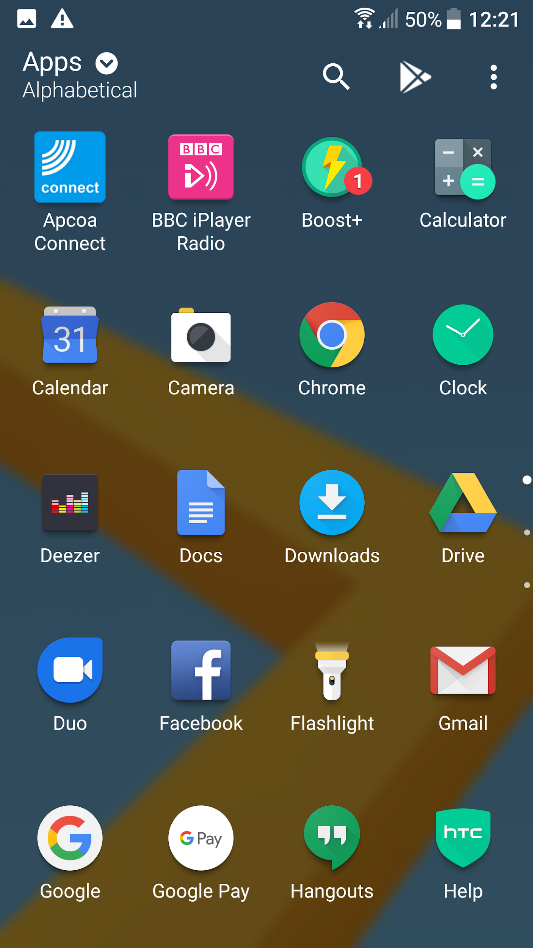
Samsung smartphone with Drive icon on home page (from apps)

Slide 6
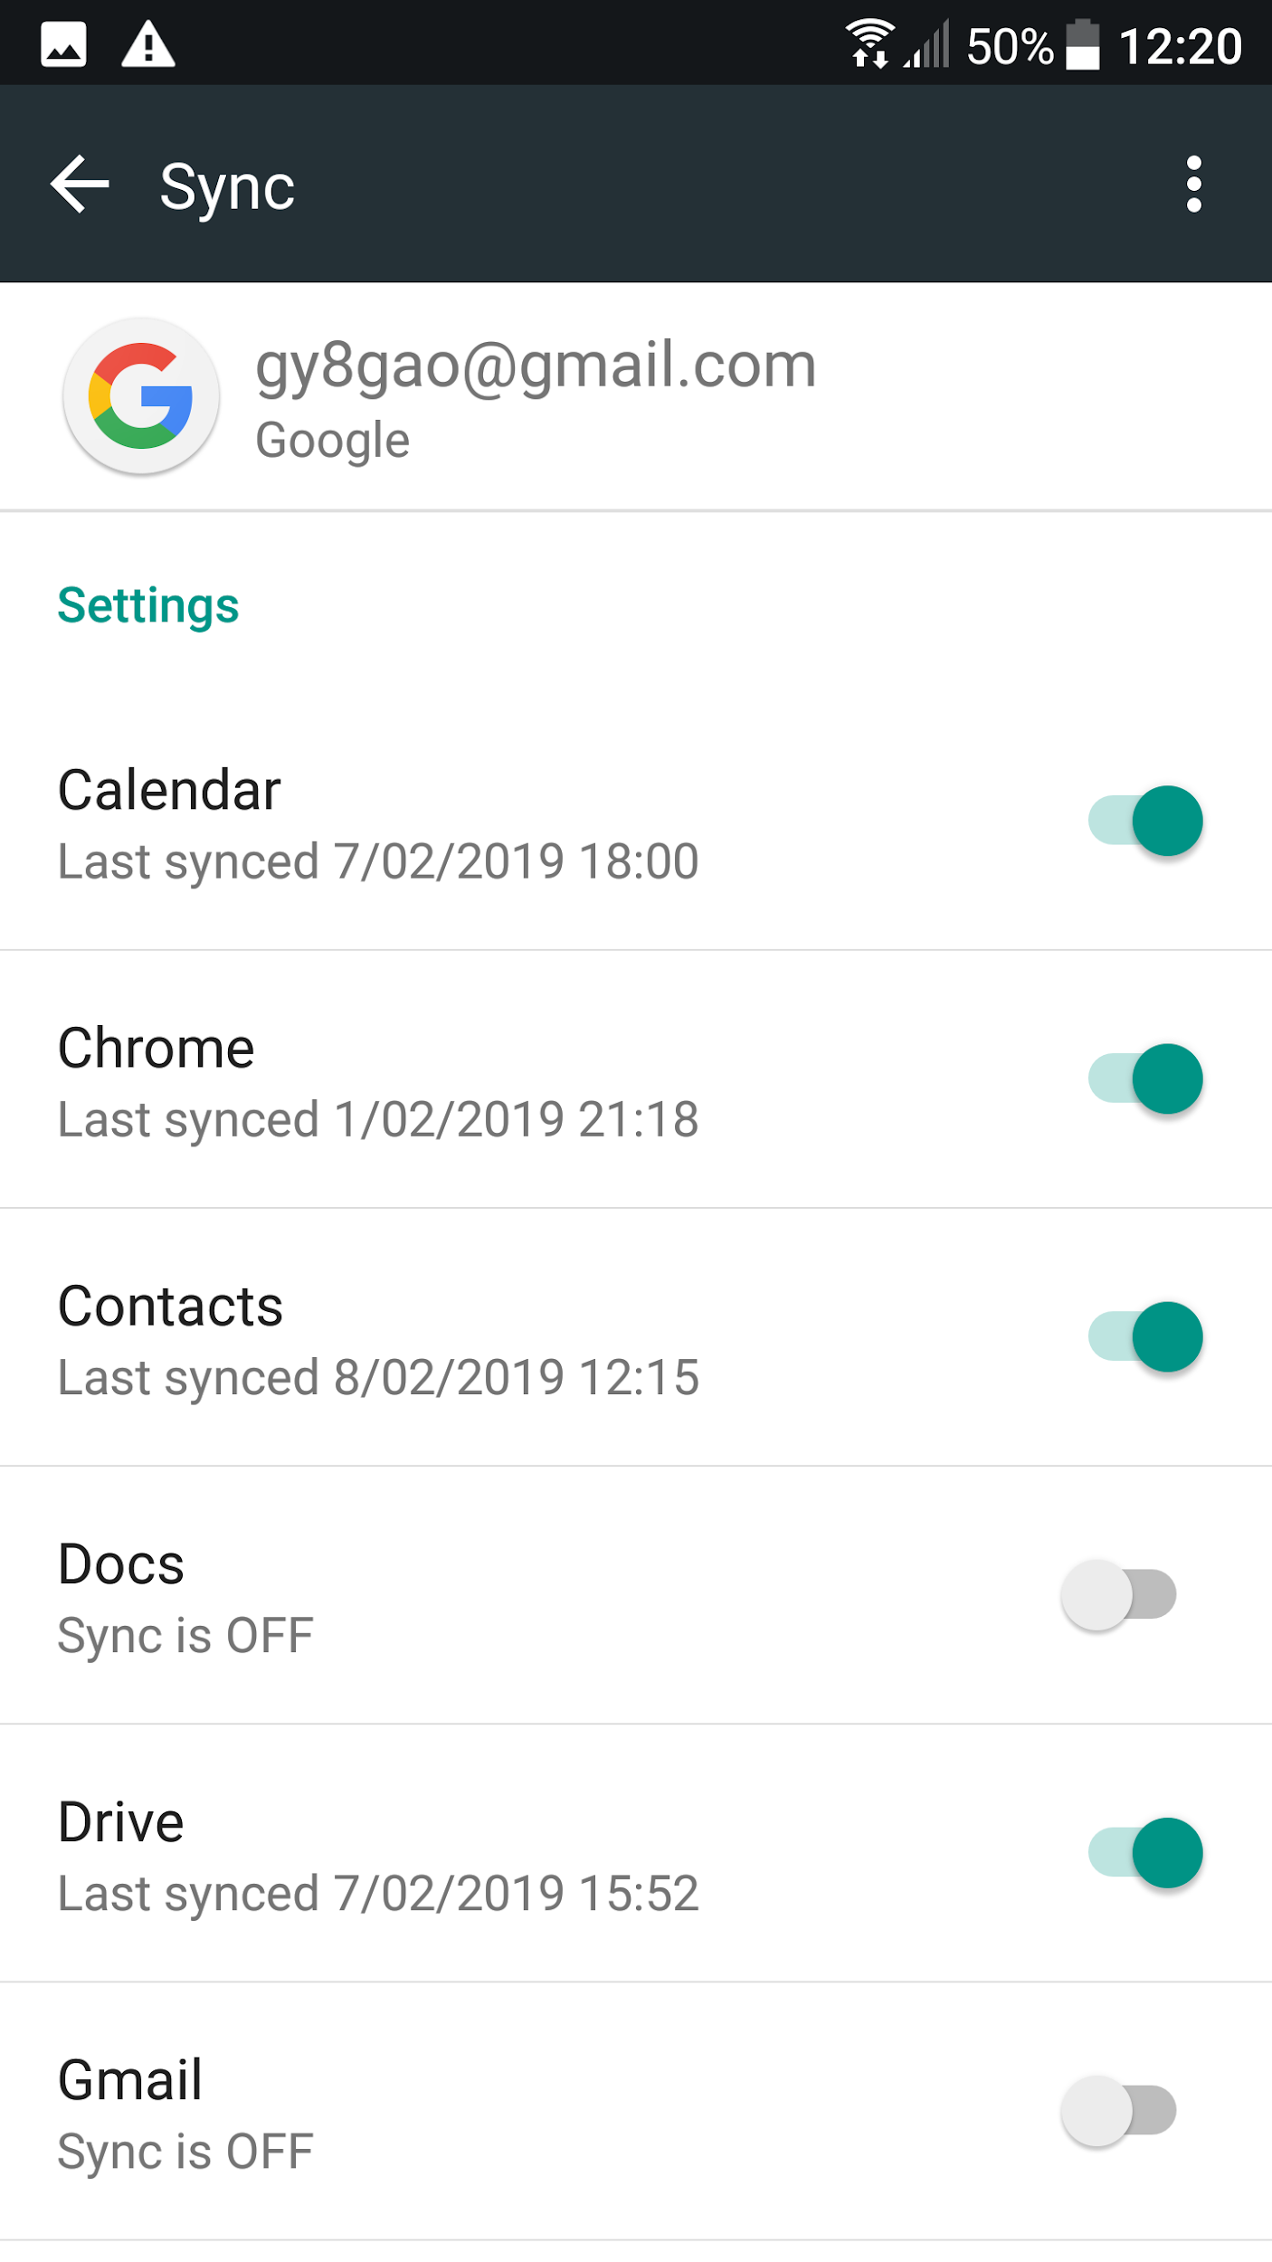
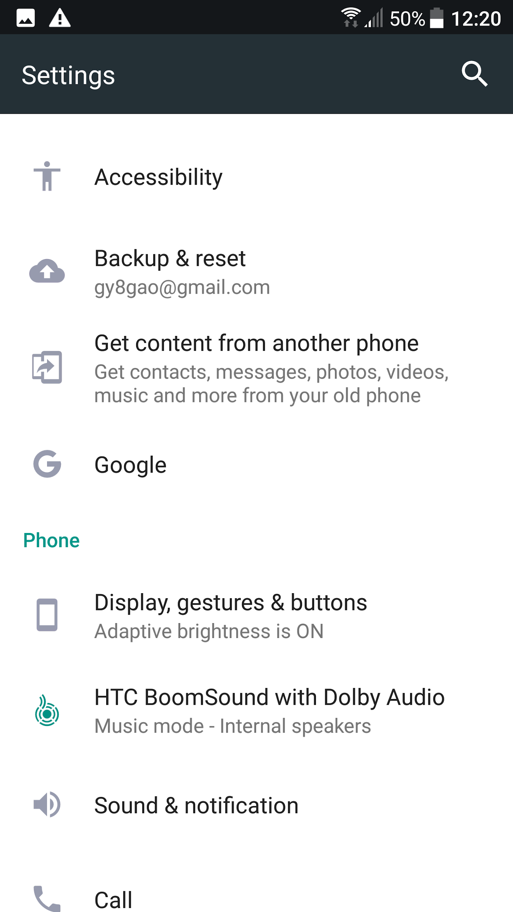
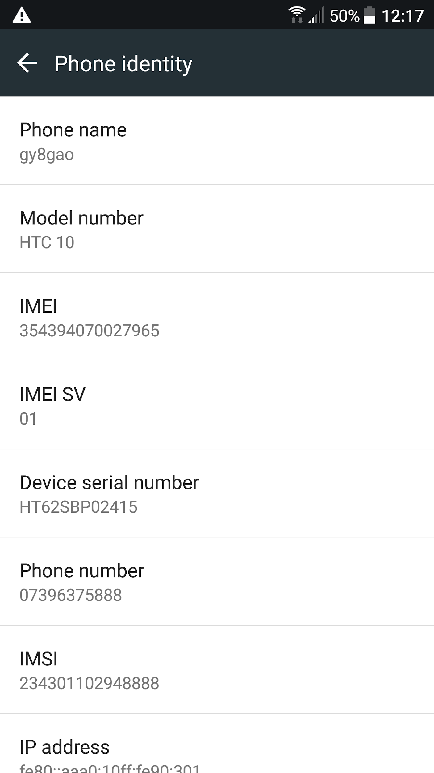

Slide 7
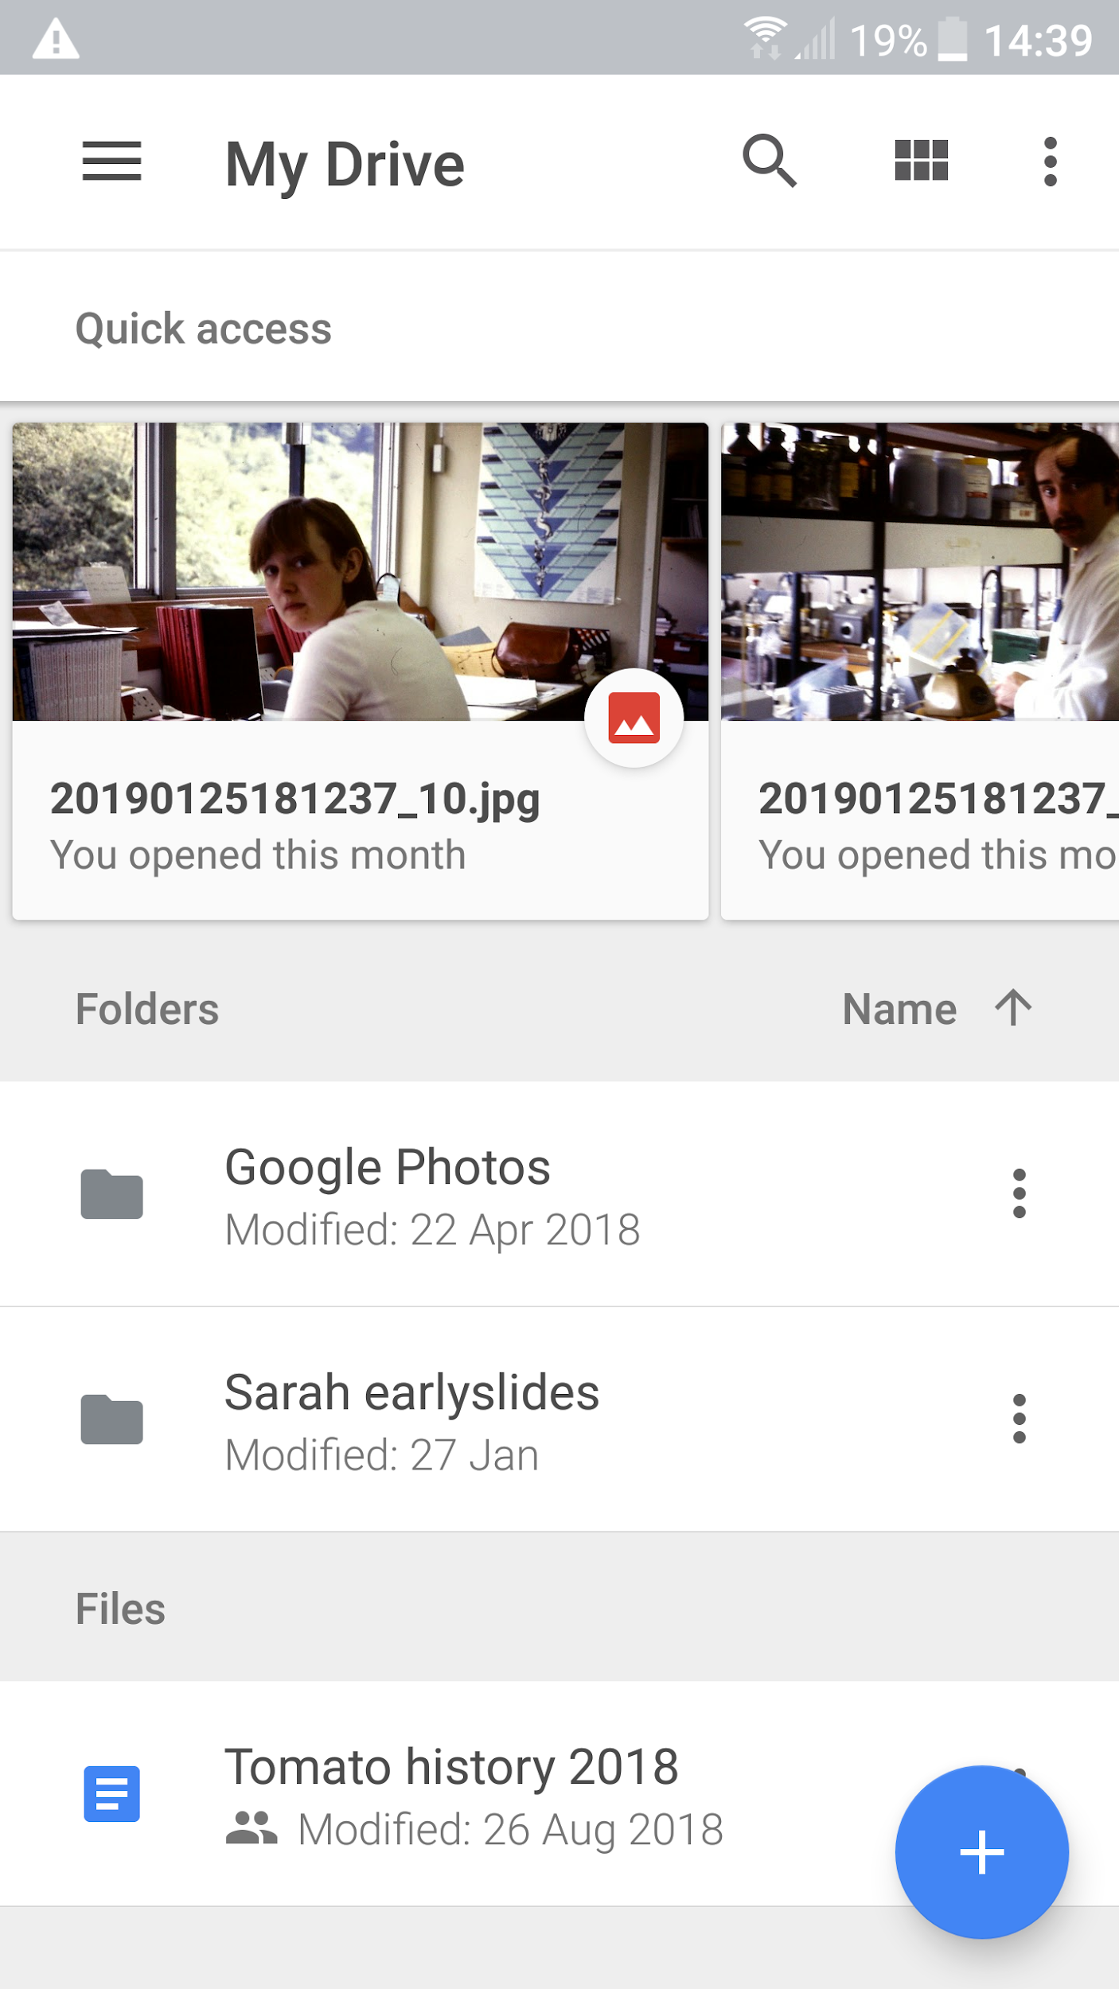
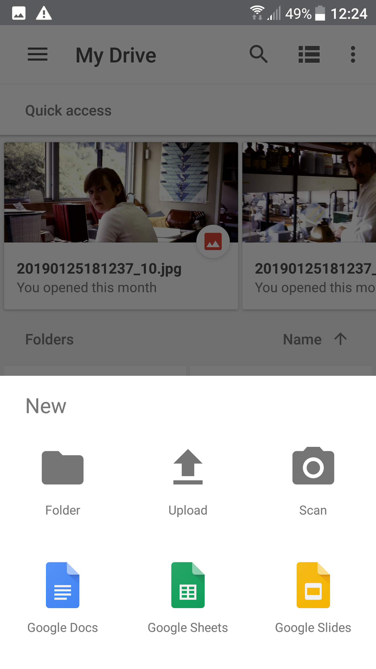
Smartphone example
Look for the bold +
Its position on the webpage will depend on the device….
Selecting it will highlight pre-loaded apps
Notes:
Always shows recent file uploads at the top of the page. Gmail account on my smartphone reserved for photos of low significance - synced to the Drive account, anyway. Security - very few contacts.

Slide 8
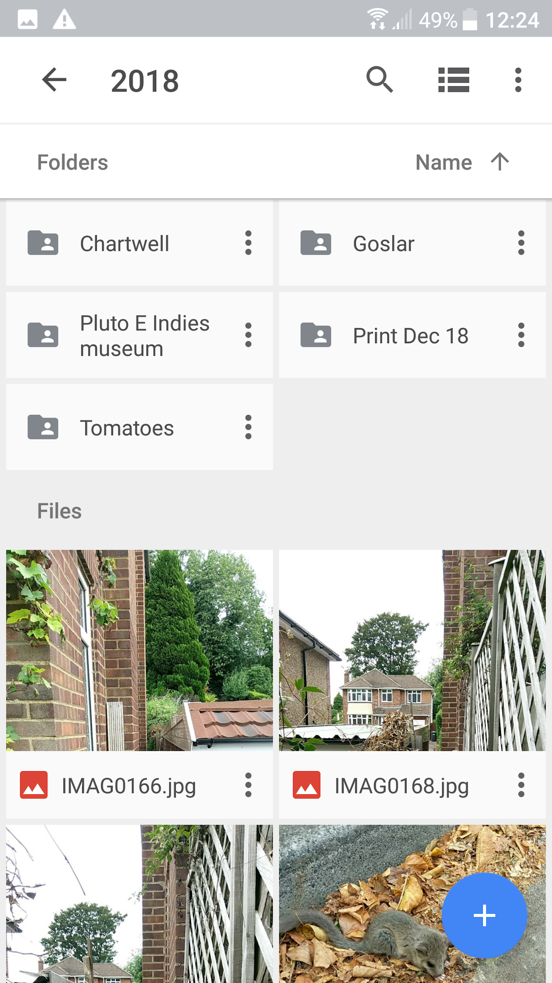
Images not saved in folders will be difficult to retrieve for your slide show. Once a folder with the appropriate images is used, the “Insert image” command will default to the same folder on the second occasion.
Thumbnails are very very small in the side panel of Google slides for your folder - you might want to rename them as well!

Slide 9
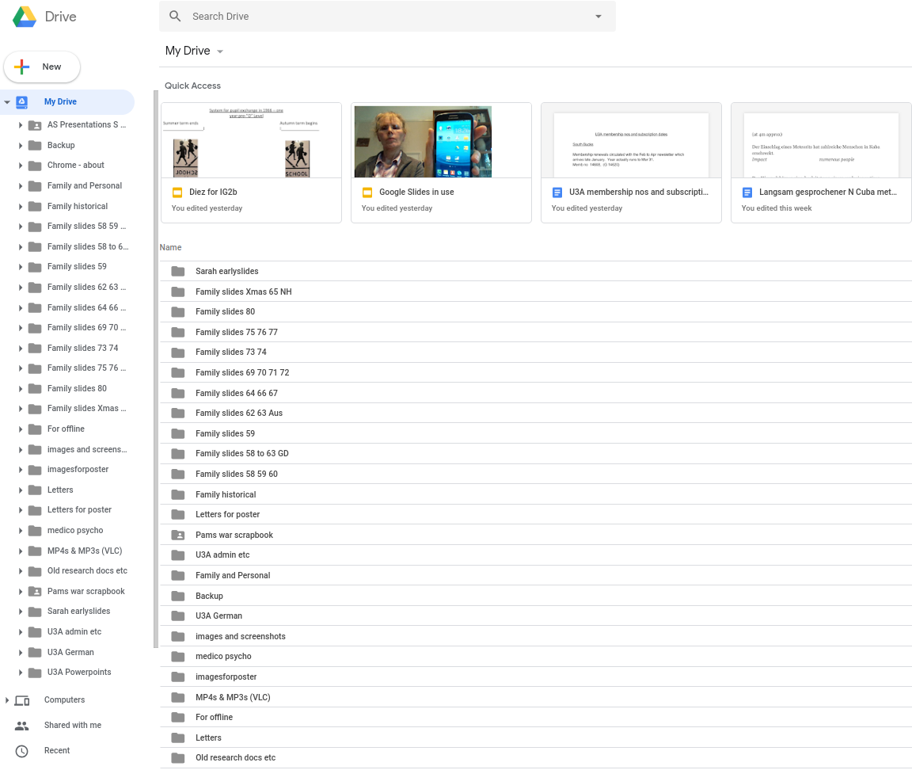
My Chromebook-specific gmail address linked Drive account shown here:
Despite holding several hundred images, some short videos and ten’s of slide shows - plenty of room left.
Transfer directly between one Drive account and another not possible - but sharing is.
Notes:
Explain off-line access. Held in cache. Work must be saved when Wifi restored or it will be lost...

Slide 10
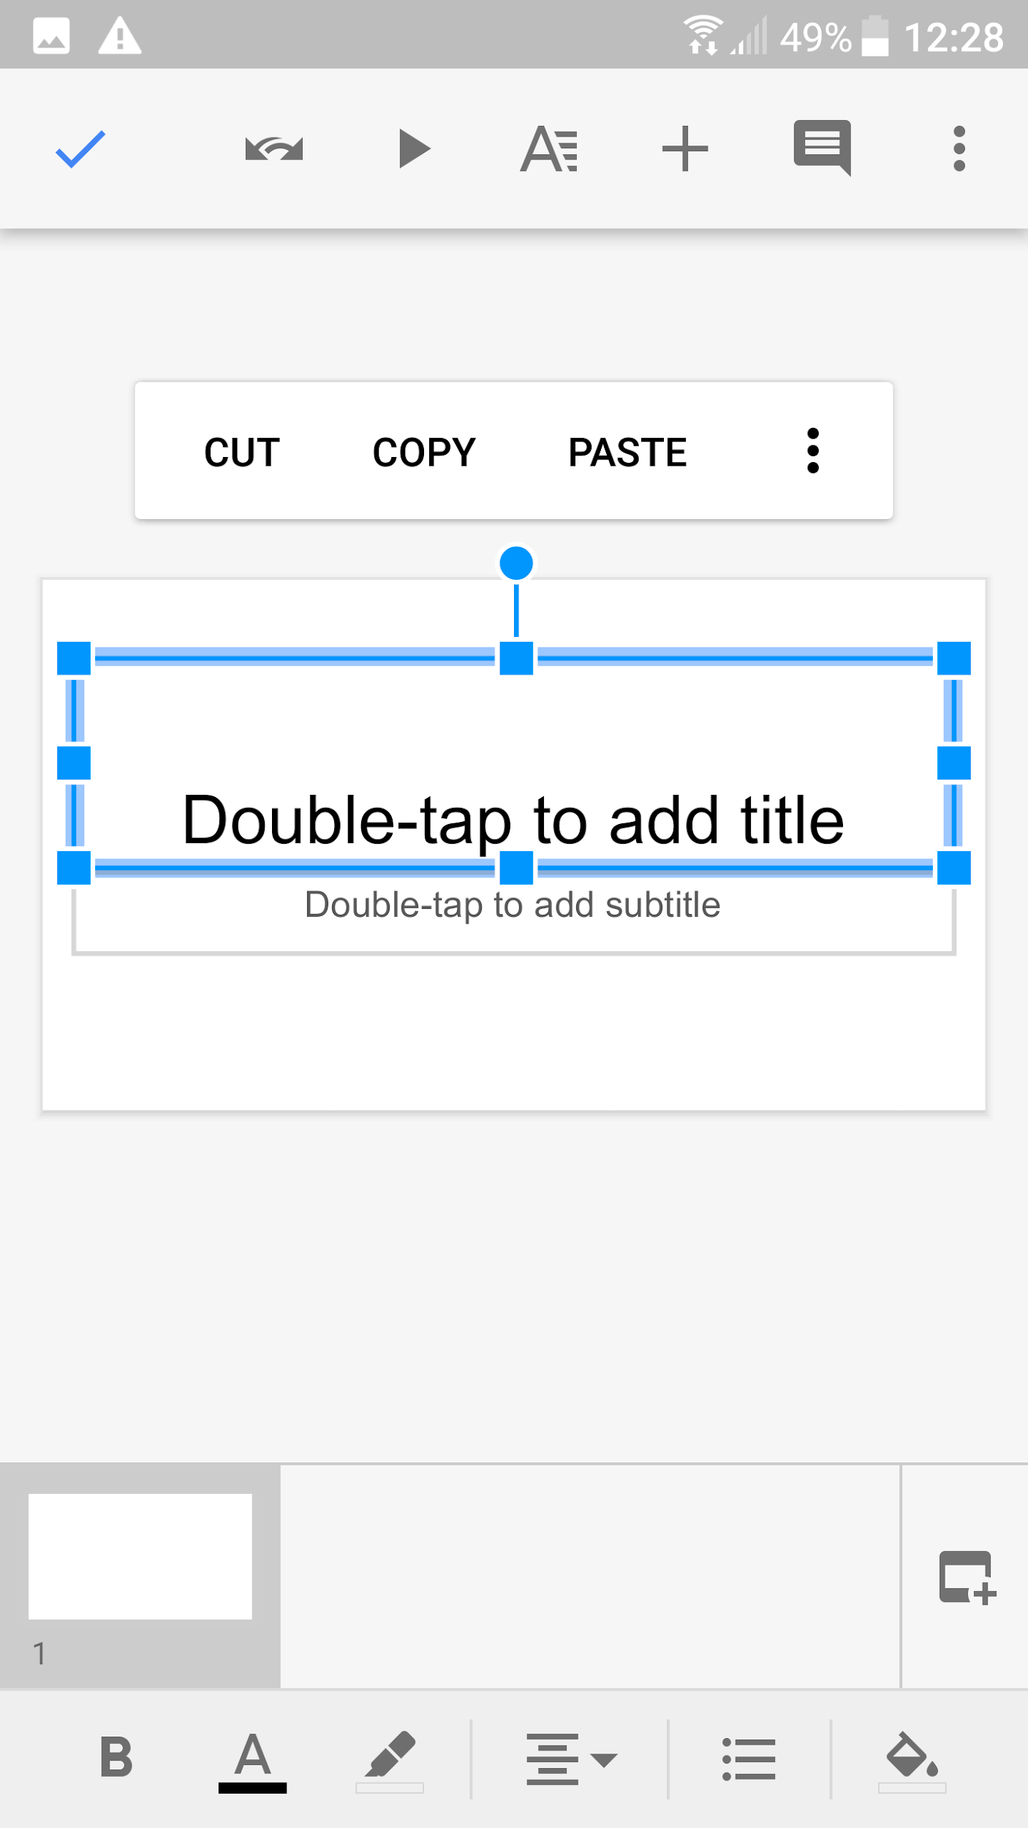
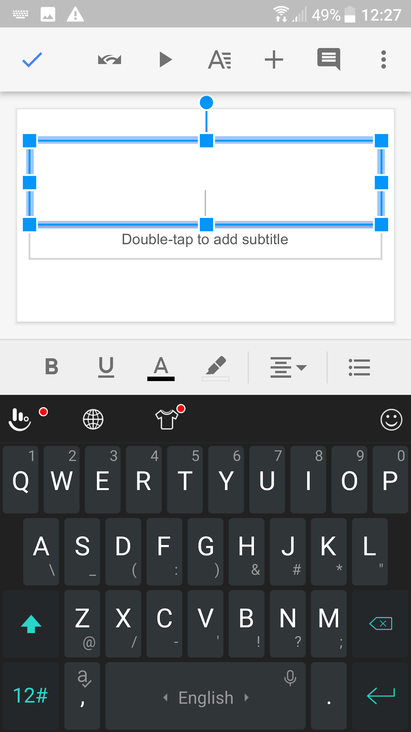
Notes:
Google slides app for Smartphone has to split the formatting and inserting menus - not enough room

Slide 11
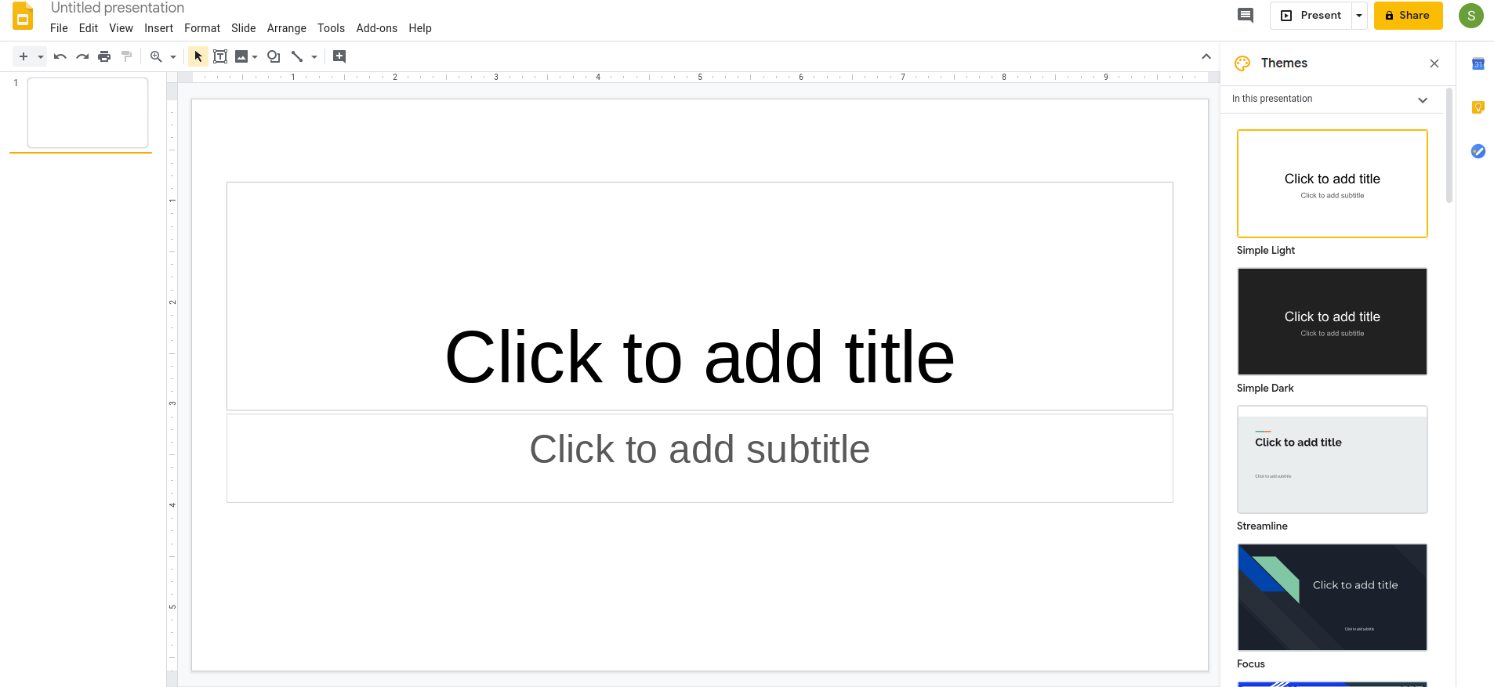
Google slides in a bigger edition for a notebook (Chromebook)
Notes:
This is the first screen you will see. Name the file straight away. It will save itself (and sync) only when the file has a name. If you re-open a file to modfiy it, add a subscript…

Slide 12
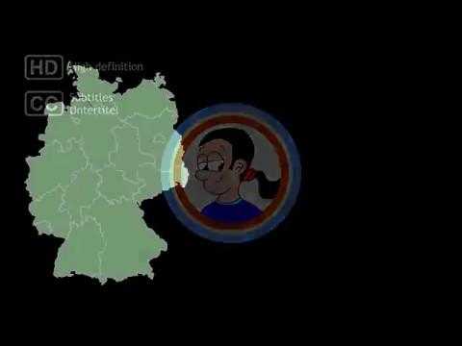
Despite not offering “Animatronic Effects”
Google slides allows you to insert :
Video (including direct from YouTube) in various formats
However, you need Wifi to play them!
A decent approximation to a laser pointer is available if you are on Wifi and presenting in the Google slides format.
Speech-to-text for your speaker notes’ panel.
Notes:
The extras require Wifi. But downloaded as Powerpoint, a normal slide show is all we really need… (at U3A, where our material is interesting).

Slide 13
You can pre-record your speaker notes as an audio memo which is transcribed as script in the speaker notes box below.
Much quicker than typing text with a mobile device!
Good for collaborating on a presentation, too?
Notes:
If for some reason you couldn't read your speaker notes or you wanted somebody else to do it for you because you weren't confident in front of an audience then this might be the way to do it

Slide 14
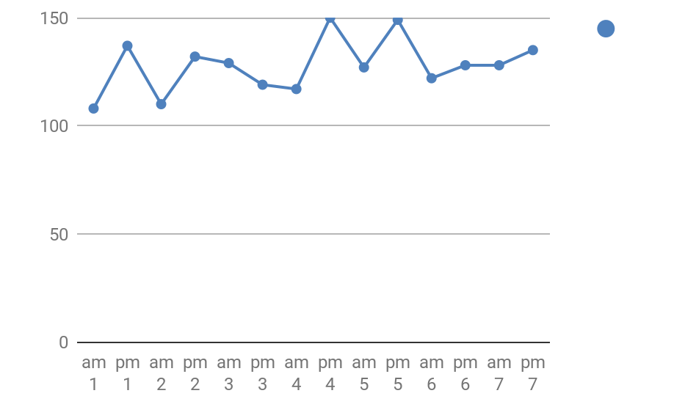
The “Insert chart” command searches on Drive for any Google sheet files. They don’t contain charts unless you have created them there first!
CHARTS

Slide 15
In summary - (before we use Wifi to make a few slides..)
Upload any images you may need from a hard drive or camera to the cloud ie Drive account, using Wifi (not cellular data or dongle - this is data-heavy)
Organise your images in a folder in the cloud ie in Drive- rename them to enable easy selection within the folder.
When your presentation is finished:
Download your presentation as Powerpoint if no Wifi available where you will present your slides
Run through your presentation and familarise yourself with the “laser pointer”, if Wifi is available.

