Slide 1
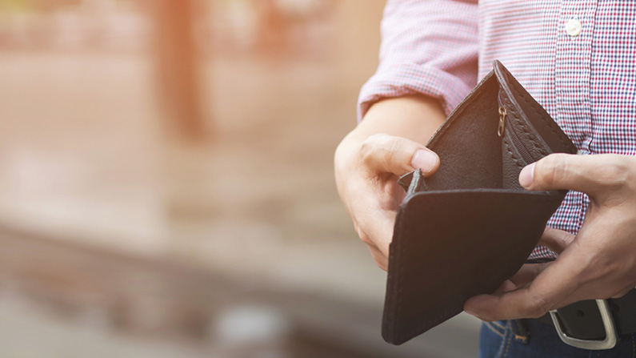
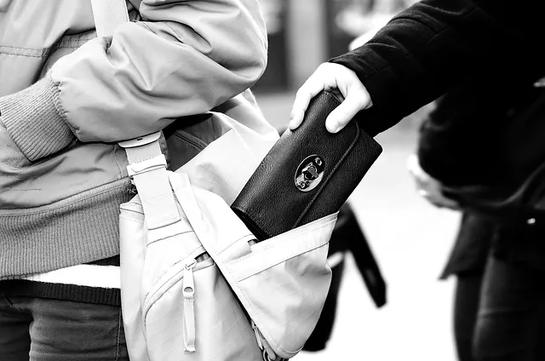
Doomsday holiday spoilers: Debit card lost or pinched….. Mobile phone lost or pinched… or both!

Slide 2
Use banking app to freeze or disable card. Set card, via app, to deny mega purchases in advance. | (OR Phone the bank if convinced card is stolen)
Lose my debit card
Lose my mobile phone
Lose both
“Find my Device” app | Wipe all data if phone still powered on. Or log out of account at least.
Husband loses his cards - “just ring the banks!”
Rely on partner/friend | “Find my Device” app shared Internet banking/ring bank

Slide 3
Setting up banking apps - logging on for first time
NB Each phone/tablet has to be set up separately and, if more than one device, activation codes may be needed
Barclays app - from app store | Choose New 5 digit code | Debit card and PIN (or activation code) | Mobile number (or activation text) | Encourages biometric login | Choose greeting phrase
HSBC | Activation code from digital banking username and PIN | Choose New 6 digit code/ (then can opt to prefer) biometric to use a number generator

Slide 4
Setting up banking apps - logging on for first time - cont.
NatWest | Activation code from digital banking user name and PIN | Choose new passcode | Mobile number or activation text | Encourages biometric login
Nationwide | Activation code after N’wide has manually checked …delay

Slide 5
Take Home Messages for setting up a banking app:
Use online banking occasionally - then you’re familiar with it
Use the same mobile number you set up in My Account details.
Accept that “dual authentication” is the norm, and that biometric ID is encouraged as one of them.
The log-in code you choose will probably be 5 or 6 numerals, so think of a way to remember it without noting it on the phone!

Slide 6
Once set up, the app will only require one log-on (biometric) but occasionally ask you for your log-on code too.
So, it’s quick and easy.
NB Contactless payments, with the phone itself - ie using it like a debit card directly - have been discontinued.
And setting up a new payee requires you have your debit card to hand.. Additional security.
Contrast this with using your phone’s web browser to log on to your bank via conventional internet banking:
Log on details: 1) either 12 digit member number or 12 digit card number & sort code
2) then, digital code generator (HSBC), or mobile app code generator (Barclays), to convert your PIN into an 8 digit code as PINs-entry with hand-held device (needs debit card) would not be available - remember, you’ve lost it!
Then a very small font to contend with

Slide 7
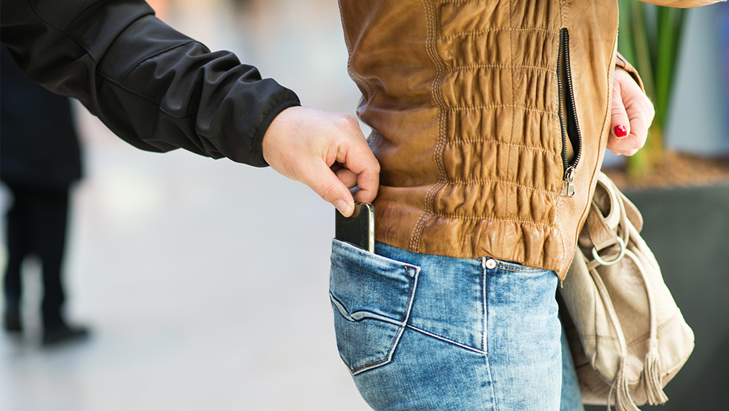
Phone lost (or stolen). Locate it on another device,either 1) friend’s phone with shared “Find my Device” app
2) via a device’s browser and then google account security

Slide 8
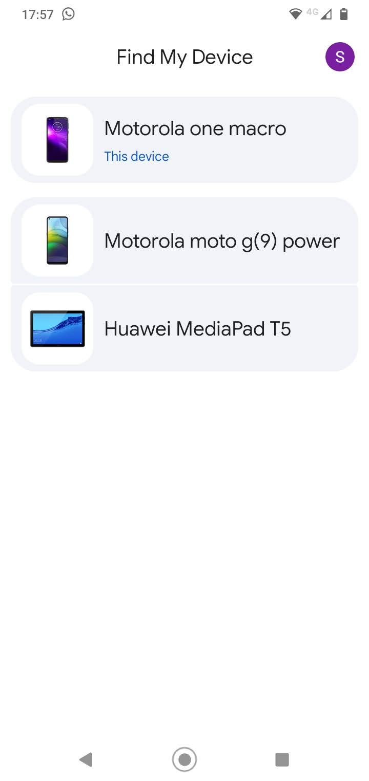
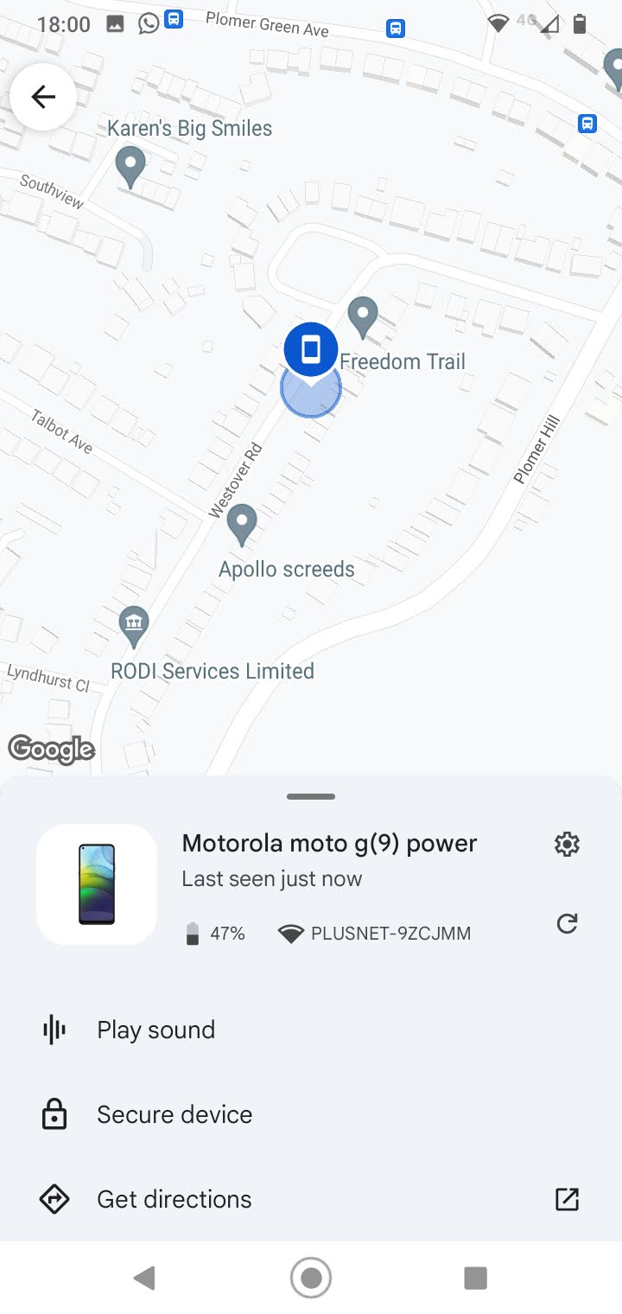
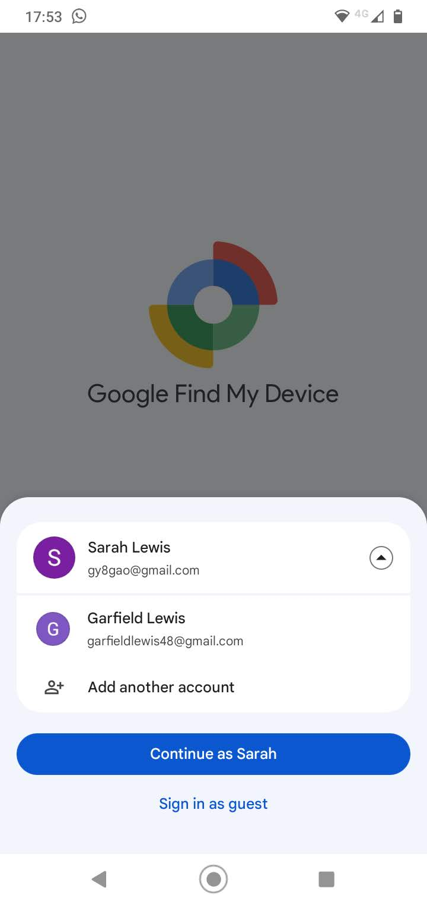
App installed, 2 google accounts - 2 phones Devices on my google a/c Locate the other phone
I can see his phone. On his phone, he can see mine. Both Google account passwords needed!

Slide 9
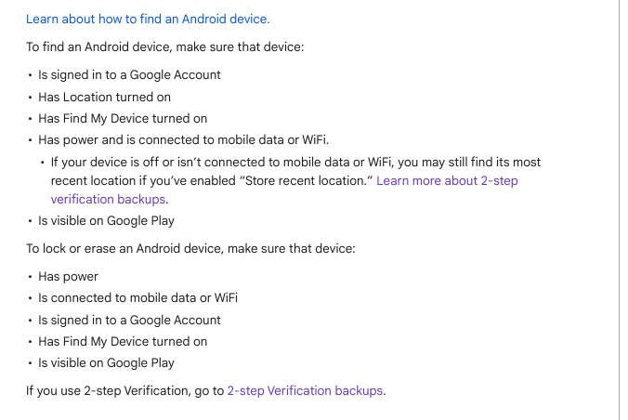
All new Android phone have Find My Device on by default

Slide 10
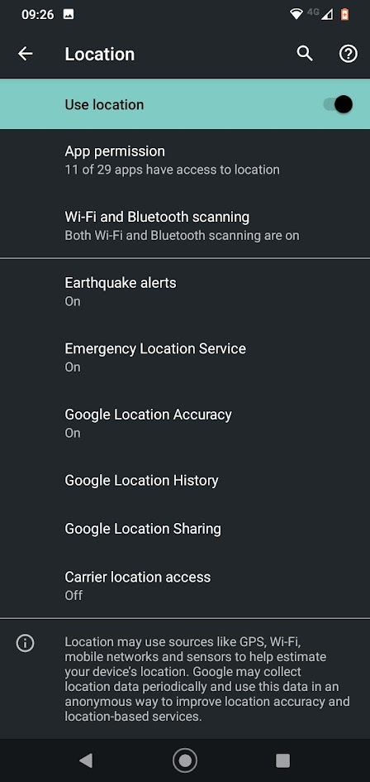
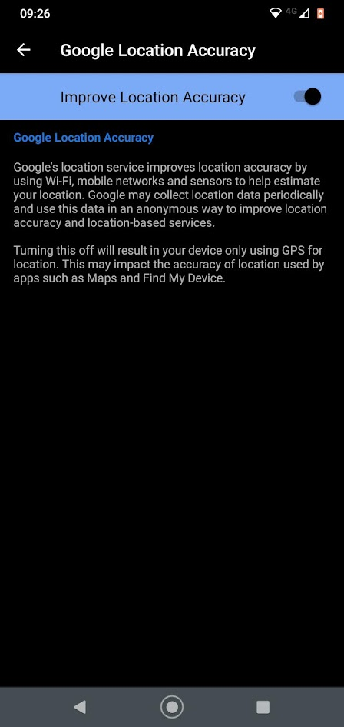
You can find the location settings in Settings/Location
TheThese 2 settings will enable “Find my Device” to use the last location the phone was powered up, if it is now off.

Slide 11
A lot of conditions (see previous slide) mean that it may not be possible to lock and erase your phone remotely, even if you can find it.
BUT
At least you can log out of your Google account remotely - denying access to email, contacts, any Drive files but not downloaded data or App data.
HOWEVER
You will need to log into your Google account on another device, with the usual 2-factor authentication, which is usually a text to your phone!!

Slide 12
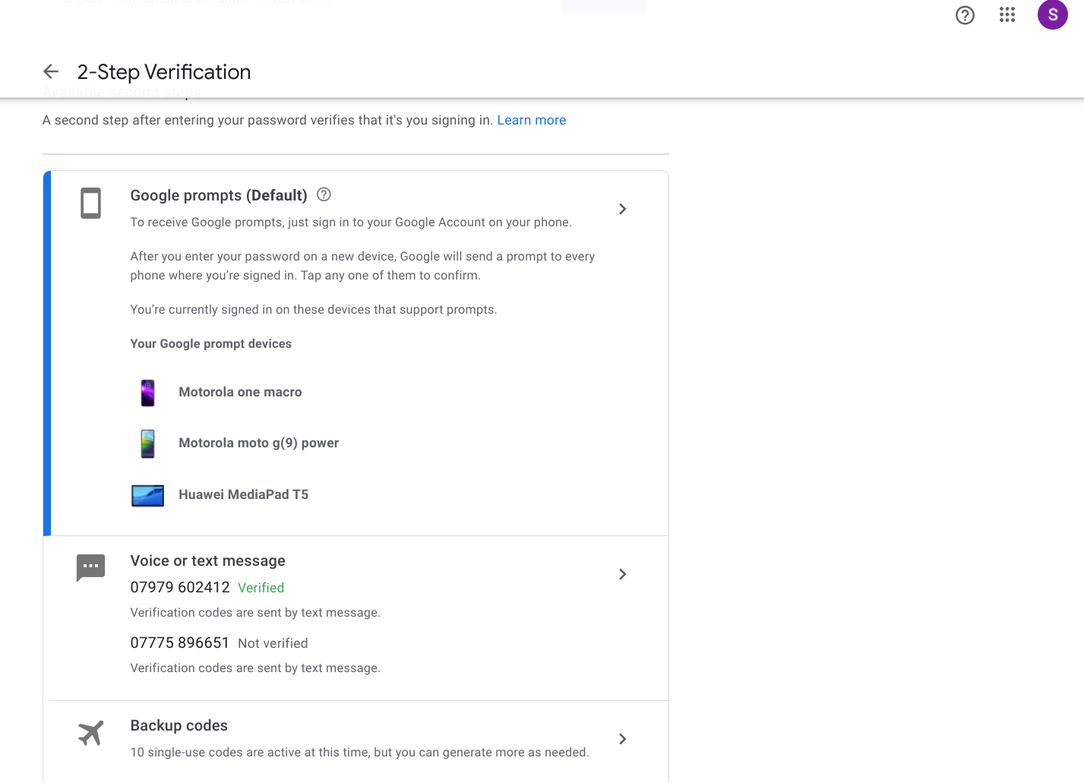
Logging into your Google account to freeze it when you have lost your phone…….
Back up codes get round the need for your 2nd verification to be a phone or an email address! Print some off before holiday.

Slide 13
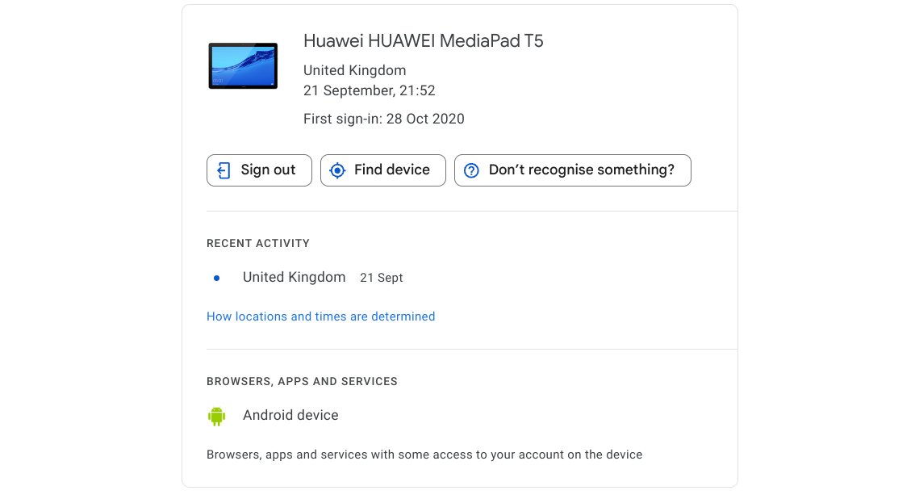
Once logged in to your Google Account, Manage my Account / Security/ Your Devices
Sign out the device, even if it is not powered up.
(Find Device will be disabled, however)

Slide 14
The “Find my Device” has another, powerful advantage when shared and installed on a friend/partner’s phone….
FIND MY FRIEND or PARTNER! (if they’re not responding to texts/calls)

