Slide 1
I’m a nonentity – get me out of here!
… or Personal Privacy versus Publicity Paranoia

Slide 2
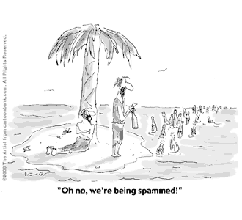

Slide 3
How did we get here?
It started with magazine competitions and junk mail -> marketing lists
Addresses (Mailing preference)
Telephone numbers (TPS)
Emails (Opt in rules). Anyone with your email in their contact list would publicise it if compromised. Use throwaway emails (Hotmail, Gmail) or ‘named’ emails for different firms eg: scammer@searingsolutions.com if you are techie.
Social media accounts (including Linked-in). ‘Number of ‘friends’ and ‘contacts’. Facebook sucks up contact lists.
Face tagging… Now I see why cameras are covered by DPA as your face can be used to identify you.
… Yet we resist identity cards!

Slide 4
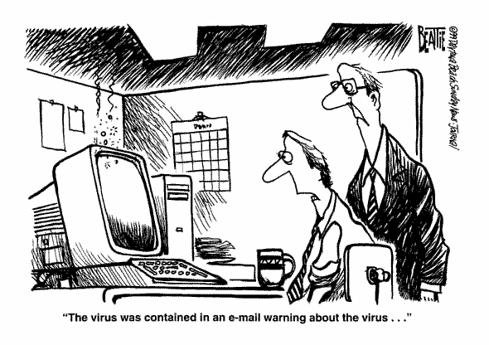

Slide 5
It’s all Marketing’s fault
Loyalty cards to analyse purchase patterns to identify new products and target customers and market niches
Tempt you to expand the ‘relationship’
Tokens for products you don’t currently buy but might do
Targeted adverts
‘Free’ products (to reel you in)

Slide 6
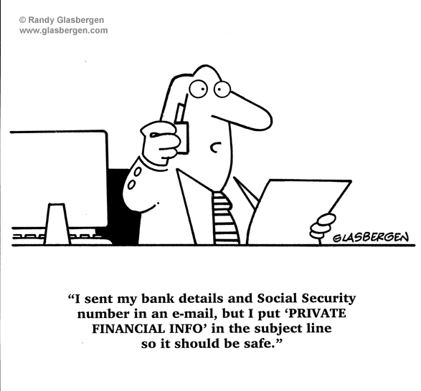

Slide 7
Unintended(?) consequences
Smart meters for tailored tariffs
  as yet unavailable – old Economy 7 anyone?
  Are you at home?
Credit card travel notification
Credit industry accumulation of data ‘for responsible lending’ (avoiding bad debts)
  Borrow more to improve your score
Data acquisition – metadata, combining many sources, despite data protection principles
  Every little helps…
‘Big data’ – supposedly anonymised
‘Big Pharma’ use of NHS data
  The useful sharing of records between NHS functions doesn’t work!
Covid tracking = Covid passports
  Duplication of systems and data

Slide 8
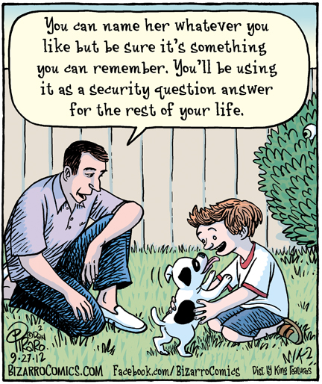

Slide 9
Security and scams
Identity theft – multi-factor authentication requires yet more personal data (Facebook experience)
No digital identifier as yet, but many similar unique identifiers (passport number, birth certificate, NHS number, National Insurance, Government gateway ID).
Telephone call recording – supposedly turned off for credit card and ID authentication details.
Are credit card details (verification number) written down when giving them over the phone?
  I was told my card was compromised because someone knew my account number!
Touch proximity cards
Use of mobile for everything…

Slide 10
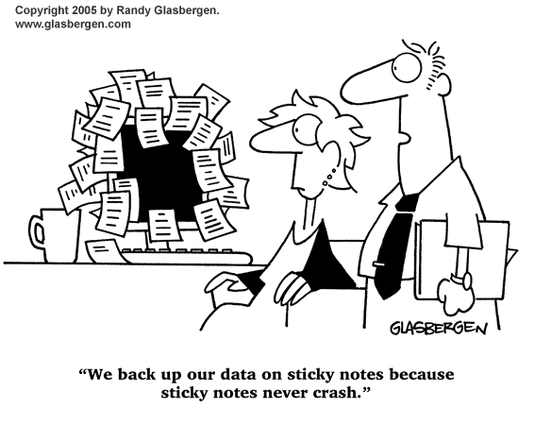

Slide 11
What can you do to stem the flow?
‘Free’ services: free, no comeback; if paid for, you get contractual rights
Google and Microsoft accounts – think of why the lunch is free
  Cloud storage – loss leader?
https://www.comparitech.com/blog/information-security/google-drive-secure/ Google has over the years perfected the art of surveillance capitalism—where your data is mined and sold to advertisers, which is then used to manipulate or influence your buying behavior. One thing to pay attention to if you’re going to use Google Drive to store confidential files is Google’s Terms of Service (ToS); and you have to be absolutely sure you are comfortable with it. Parts of section 11 of the ToS states thus:
“By submitting, posting or displaying the content you give Google a perpetual, irrevocable, worldwide, royalty-free, and non-exclusive license to reproduce, adapt, modify, translate, publish, publicly perform, publicly display and distribute any Content which you submit, post or display on or through, the Services. This license is for the sole purpose of enabling Google to display, distribute and promote the Services and may be revoked for certain Services as defined in the Additional Terms of those Services. You agree that this license includes a right for Google to make such Content available to other companies, organizations or individuals with whom Google has relationships for the provision of syndicated services, and to use such Content in connection with the provision of those services.”
Google Drive security revolves around protecting your Google account from unauthorized access and making sure that your sharing settings are right.
Be aware of Greeks providing free services! Microsoft and Google are old acquaintances, but not my best friends…

Slide 12
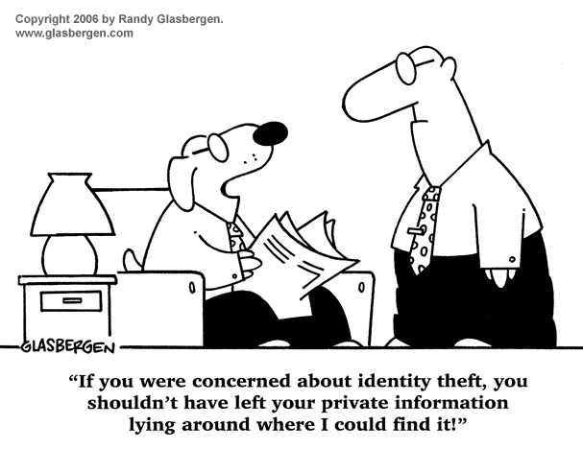

Slide 13
What websites can glean from you
Cookies
  https://www.cookiepro.com/blog/website-tracking/
  https://panopticlick.eff.org/
  https://privacy.net/analyzer/
  https://gizmodo.com/heres-all-the-data-collected-from-you-as-you-browse-the-1820779304
Private browsing?
  One thing that won't help is invoking Internet Explorer's InPrivate mode, or the corresponding privacy mode in other browsers. The purpose of private browsing is to let you surf the Web with no local record of browsing history. It doesn't affect the information your browser sends out.
Ad blockers
  Ghostery – also private browser
  Adblock plus
  Can affect website functionality
https://www.pcmag.com/how-to/how-to-stay-anonymous-online

Slide 14
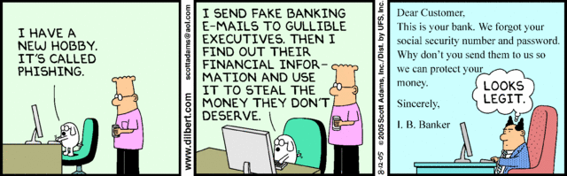

Slide 15
Scam checks
Antivirus and Internet Security
  Might save your bacon – alert you to scam sites, questionable downloads and their activities
Check the address of the sender/website
  Hover on links in preview
  However Nationwide.co.uk uses nationwide-communications.co.uk…
  Russelleandbromley.com versus russellandbromley.co.uk
getsafeonline.org/checkawebsite
  Russelleandbromley.com russellandbromley.co.uk
Don’t reuse/share passwords!
  Check your ‘favourites’ https://haveibeenpwned.com/Passwords
  How to create a secure password without writing it down
  Password managers? Eggs in one basket…

Slide 16
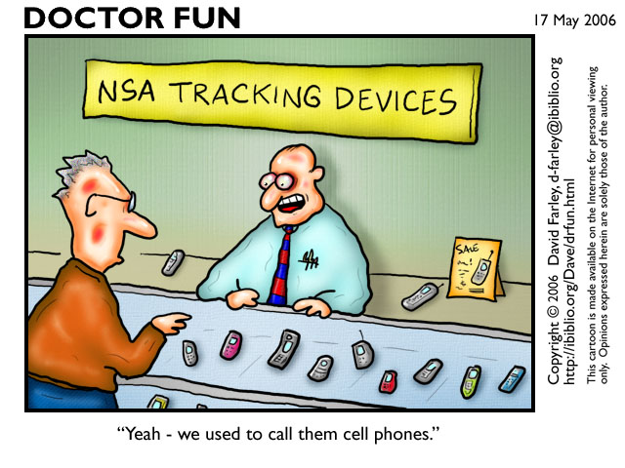

Slide 17
And of course the mobile phone is secure…
https://consoltech.com/blog/less-secure-apps/
When it comes to mobile app security, the statistics are shocking:
Almost three-quarters of apps would not pass even a basic security test.
83 percent of apps have at least one security flaw.
Mobile security vulnerabilities are found in 91 percent and 95 percent of IoS and Android apps, respectively.
https://ico.org.uk/media/your-data-matters/documents/1446/smartphone-securityv5.pdf
Use Google Play Protect to help keep your apps safe and your data private
https://support.google.com/accounts/answer/2812853?hl=en#zippy=%2Chow-google-resets-permissions-for-unused-apps

Slide 18
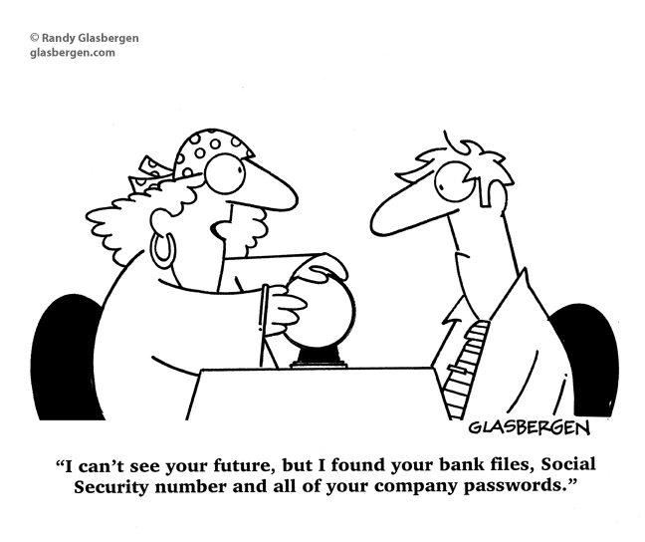

Slide 19
Are you listening, Moriarty?
We use free wifi in coffee shops without thinking
We click on QR codes
We use cheap Chinese cameras plumbed into our wifi (security details provided) and the pictures are passed to our phones via Chinese servers using a free service…
We happily have Siri, Alexa and Cortana listening to everything we say…!
“Alexa – why do have such a bad record with my relationships?”
“I’m Siri…”
Maybe we get what we deserve

Slide 20
