Slide 1
Shape of Things to Come: Competing Clouds and restriction of
associated free Apps?
Following the Apple and Google/Chrome examples, Microsoft are now playing the “exclusive” game….

Slide 2
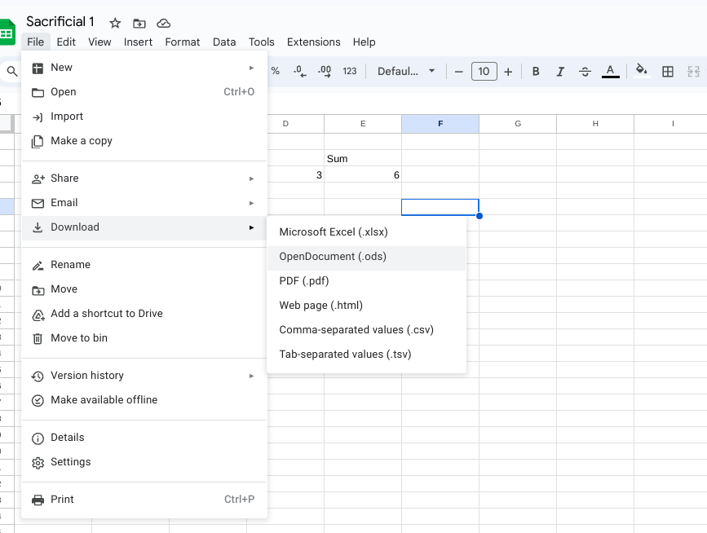
This is the symbol for Google Slides. It’s web-based and does not require an app
When I want to download a google format file to a USB stick or my Downloads, I choose the Microsoft version.

Slide 3

Why can't google format files be used for transmission?
Google's format files, such as Google Docs, Sheets, and Slides, are specifically designed for online collaboration and editing within the Google Workspace ecosystem. They are not intended to be transmitted directly between devices or used offline without the Google platform.
… If you want to work on the document offline, the best approach is to export the file in a standard format like Microsoft Word, Excel, or PowerPoint.

Slide 4
By Contrast, Microsoft has developed:
Modern File Formats:
Open XML formats: Microsoft adopted the Open XML format (DOCX, XLSX, PPTX) as the default for its Office applications, promoting interoperability with other software.
Cross-platform compatibility: Microsoft has been working to improve cross-platform compatibility of its file formats, making it easier to share files with users of different operating systems.

Slide 5
Download formats for common office file types
 |  | Apple( apps required on i-Pad) i-Cloud |  |  | (Google/Android) Drive
Documents | (.pages) | .docx (MS Word) |  | (gdoc) | .docx (MS Word)
 |  | .pdf |  |  | .pdf
 |  | .rtf ( Rich Text Format) |  |  | .rtf
 |  | .txt (V Basic text file) |  |  | .txt
 |  |  |  |  | .odt (OpenOffice document)
 |  |  |  |  | .html (zipped) (hypertext webpage language)
Spreadsheets | (.numbers) | .xlsx (MS Excel) |  | (gsheet) | .xlsx (MS Excel)
 |  |  |  |  | .pdf
 |  |  |  |  | .ods (OpenOffice spreadsheet)
 |  |  |  |  | .html
 |  |  |  |  | .csv (comma separated values) | Formats noted in red only available from Chromebook

Slide 6
Download formats for common office file types (cont.)
 |  | Apple( apps required on i-Pad) i-Cloud |  |  | (Google/Android) Drive
Presentations | (.key) | .pptx (MS Powerpoint) |  | (gslides) | .pptx (MS Powerpoint)
 |  |  |  |  | .pdf
 |  |  |  |  | .odp (OpenOffice Presentation)
 |  |  |  |  | .txt
 |  |  |  |  | .jpg (image)
 |  |  |  |  | .png (basic image)
Music | i-Tunes | .mp3 (MS music) |  | ?? | .mp3
 |  |  |  | Formats noted in red only available from Chromebook

Slide 7
 |  | MS Microsoft OneDrive D’loaded to Chrome browser | MS Microsoft OneDrive D’loaded to Edge browser
Documents | (.docx)
 |  | .pdf
 |  | .odt
Spreadsheets | (.xls)
 |  | .pdf
 |  | .csv
Presentations | (.pptx) |  | .pptx 😀
 |  | .pdf | .pdf
 |  | .odp | .odp
 |  | (& to MS Images)
 |  | NB: Without MS 365 subscription

Slide 8
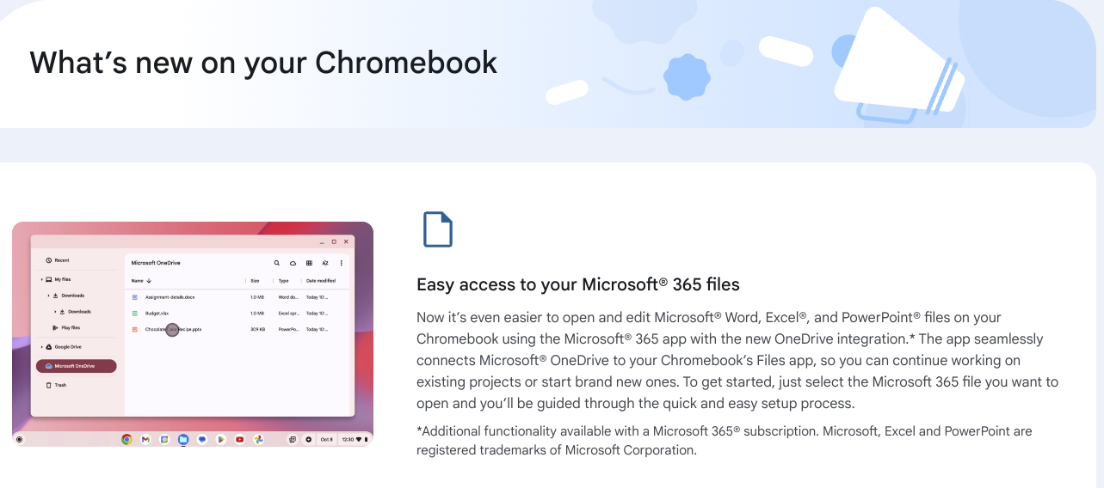

Slide 9
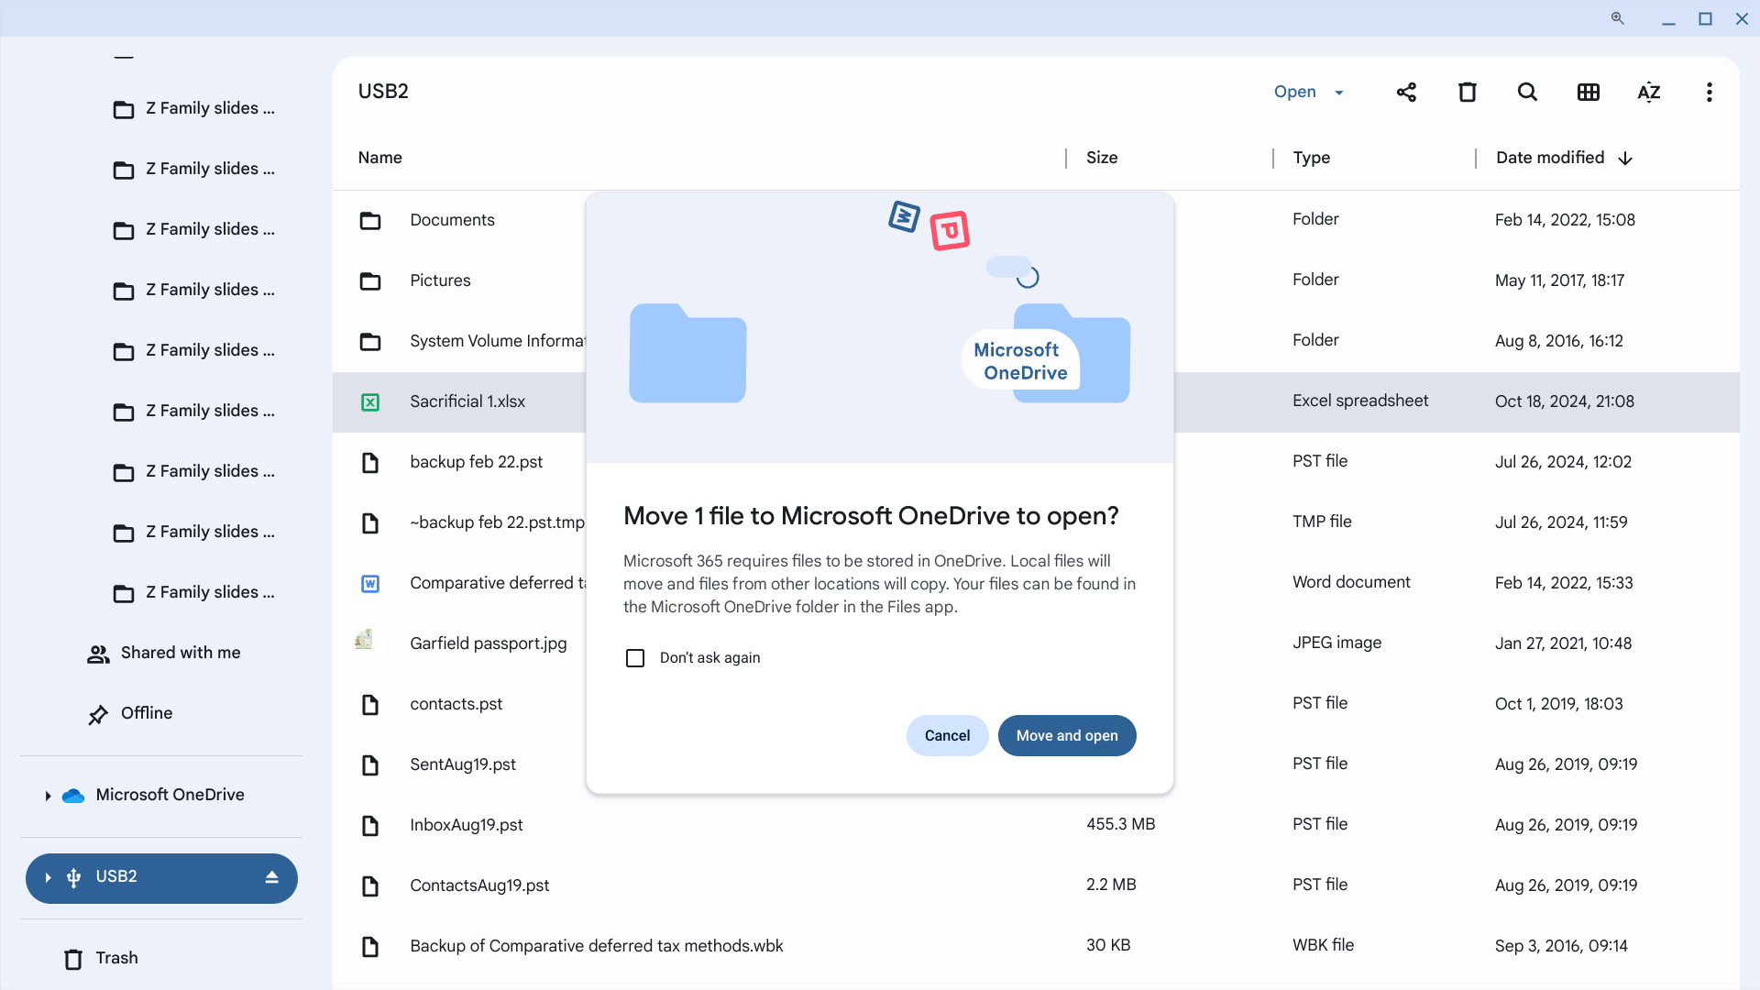
After the MS 365 integration, the Chromebook File Explorer shows…. MyDrive AND OneDrive files

Slide 10
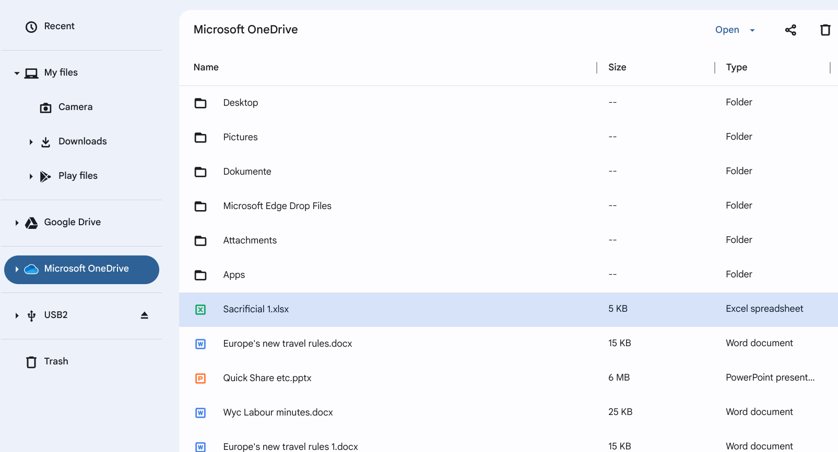

Slide 11
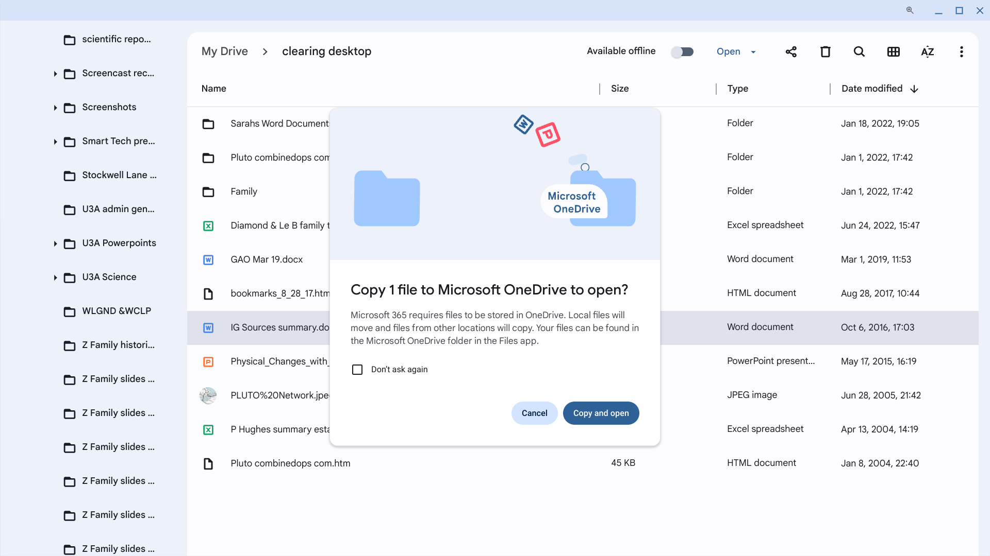

Slide 12
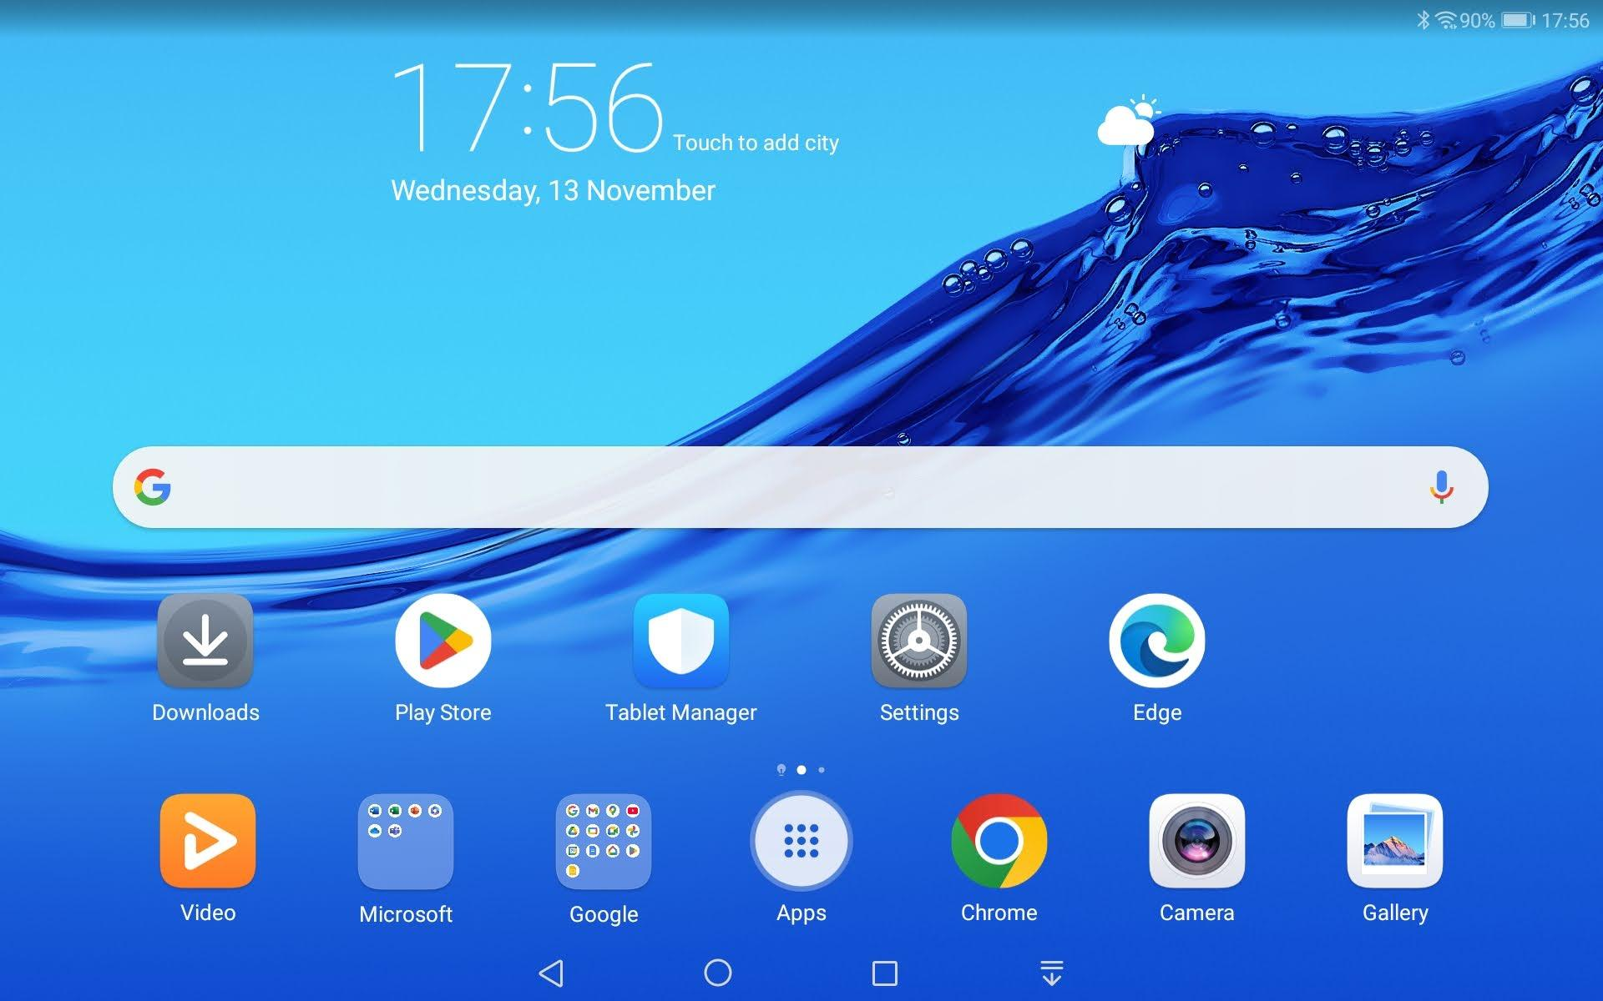
Google & MS apps downloaded
My Android tablet with optional browsers

Slide 13
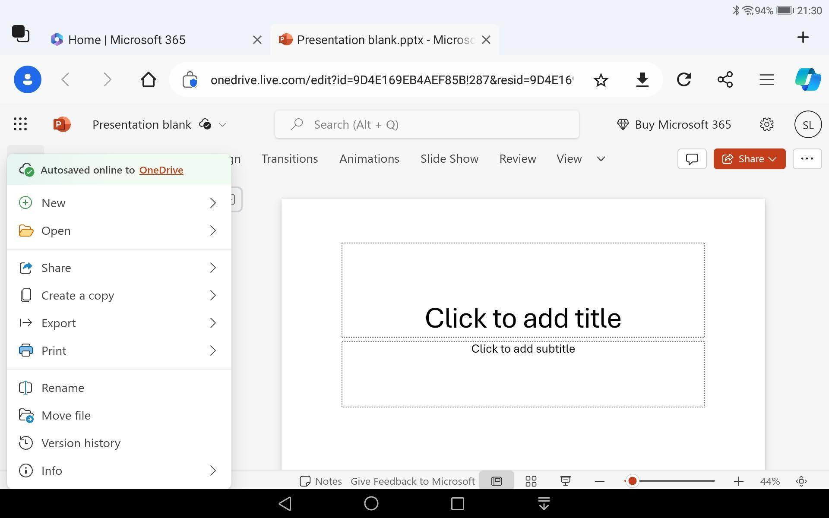
Creating a slideshow (.pptx) in MS 365 online at https:\\www.office.com
Using Edge browser on my tablet
Download available as .pptx
Clicking “File” on the MS ribbon gives a drop down menu, as usual

Slide 14
Opening MS 365 online (at www.office.com) in Chrome browser
Gets you to sign in to your MS account a second time to view the file webpage (where your OneDrive files are viewable)
AND
No Download option - only share as a .pdf or.odp file

Slide 15
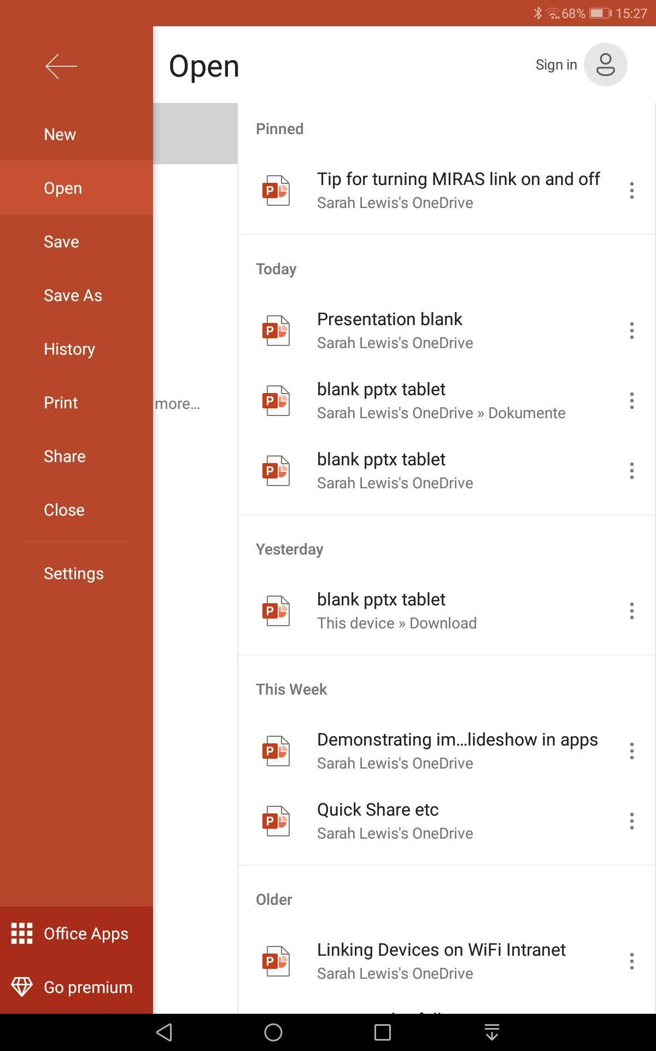
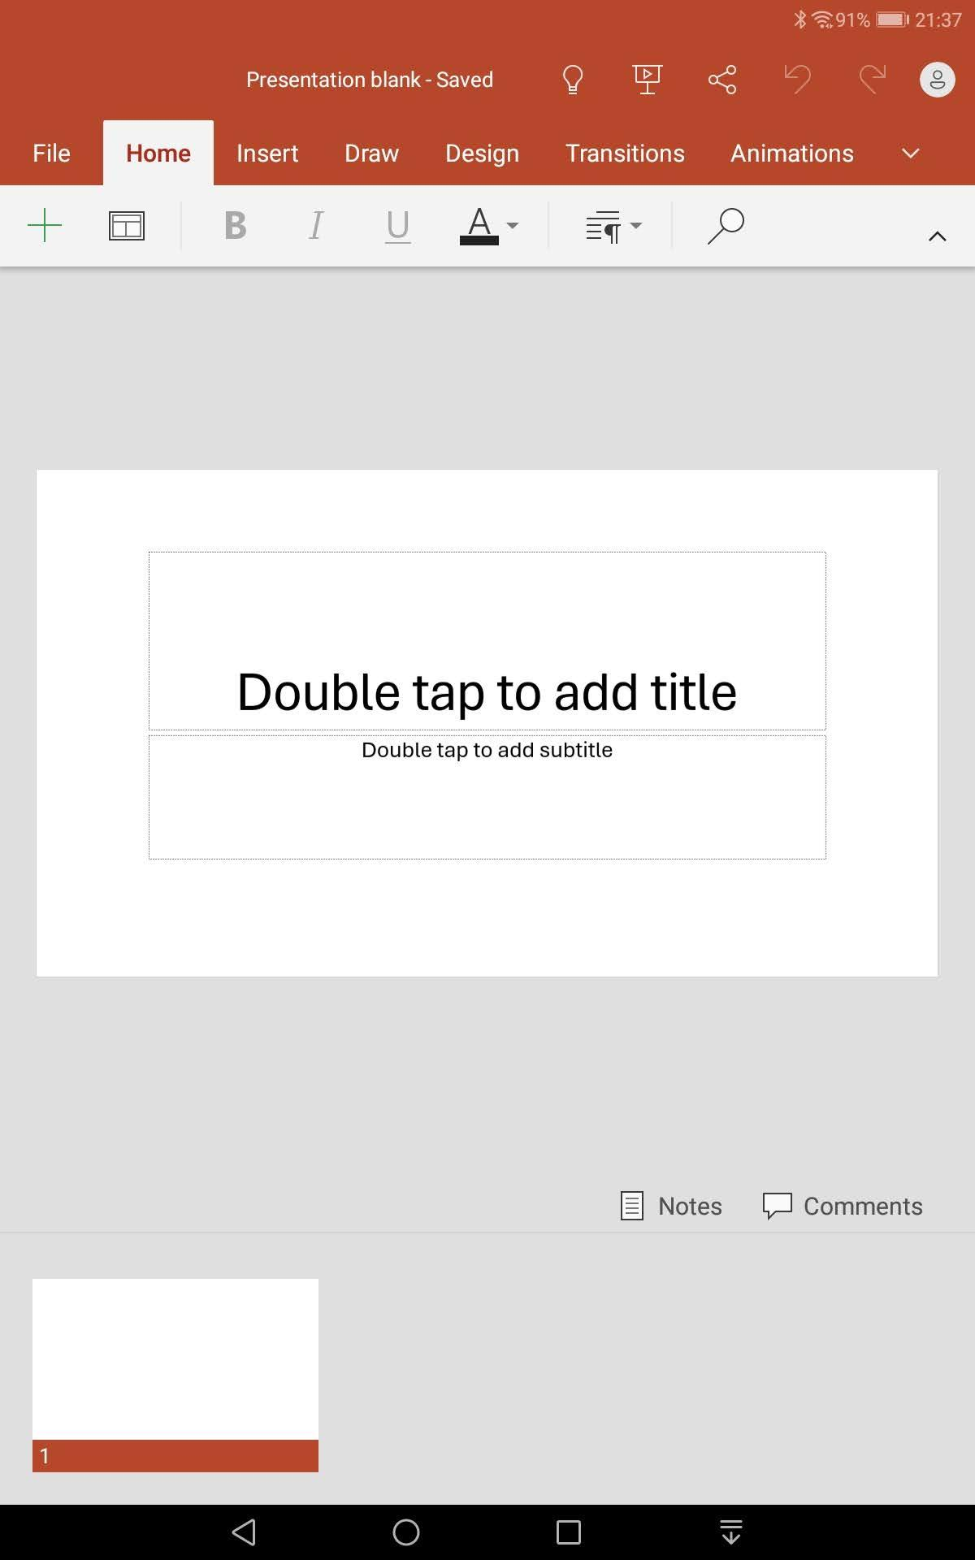
Opening the MS app version of powerpoint:
V Basic app version of .pptx, automatically saved in OneDrive
NO download option.
Clicking File redirects you to this new webpage

Slide 16
What about Uploads? (ie opening a .pptx previously downloaded to local drive)

Slide 17
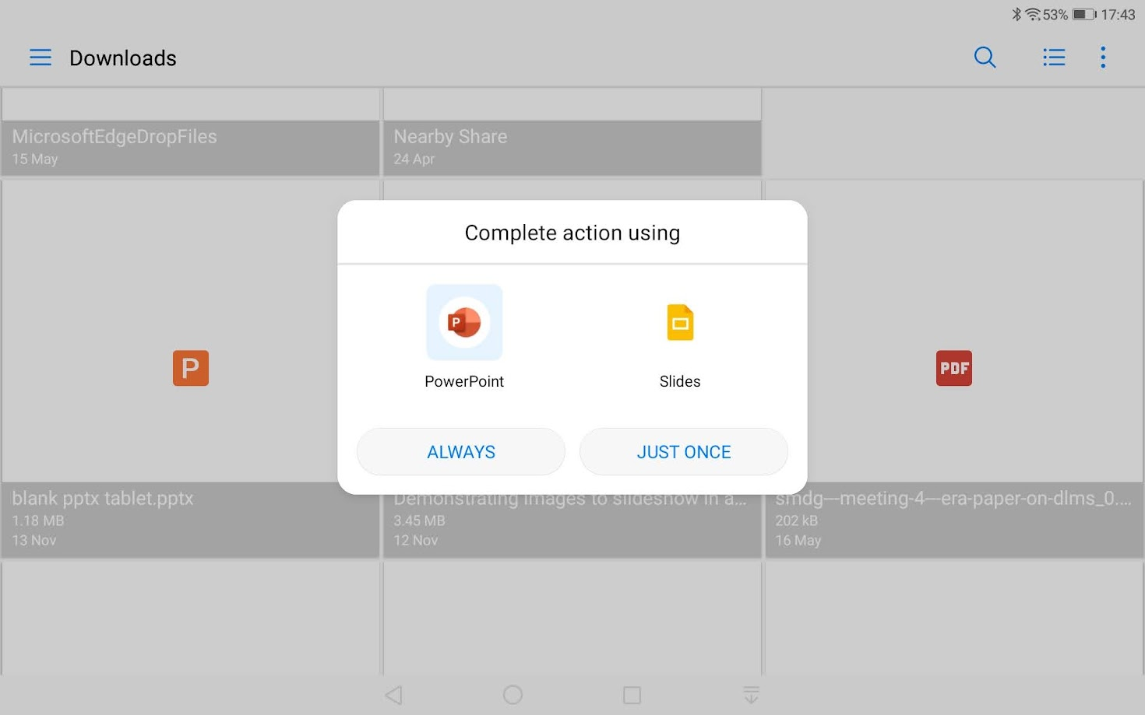
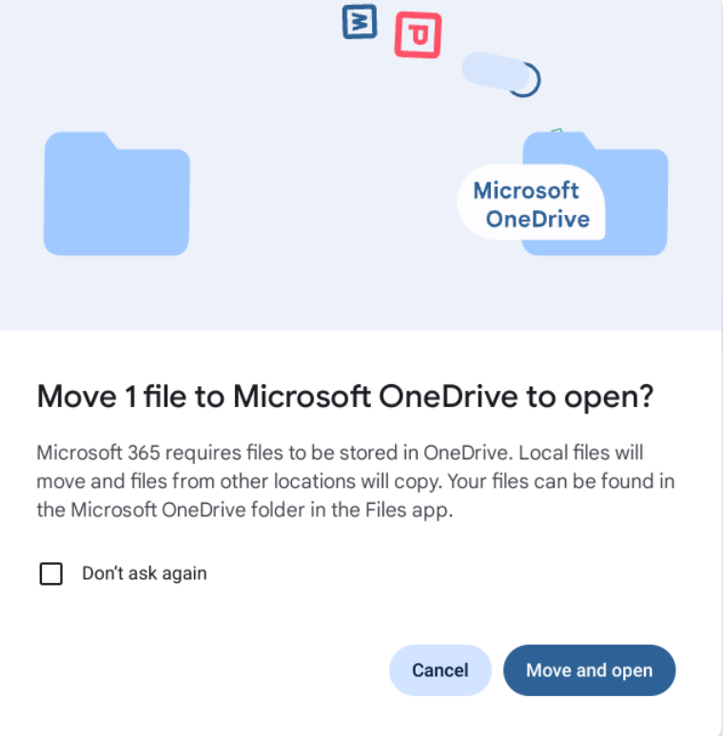
On the tablet - still available to open in either format without losing file. On Chromebook - No - the file will be deleted from Downloads, IF I double-click! But…. (see next slide)

Slide 18
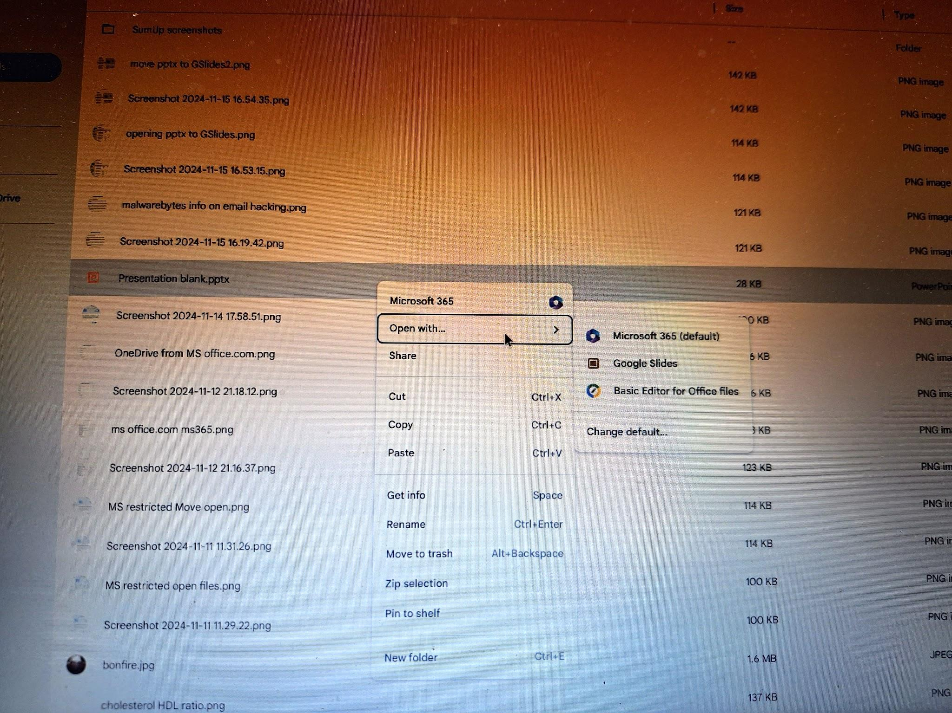
Right click on the MS .pptx file in Downloads and the option “Open With” offers Google Slides ie upload to Drive in Google format.
Goes for all other MS office files in Downloads where MS Edge installed on a chromebook

Slide 19
BUT just as Chrome(book) has been compelled to integrate Microsoft OneDrive into its File manager and opens MS Office files by moving them into OneDrive and sync’ing with the OneDrive cloud
SO Microsoft Windows has been compelled to allow Chrome’s My Drive into its File manager if you choose to download the app “Drive for Desktop” when files can then be directly opened and sync’ed to the My Drive Cloud.
(Loading “Drive for desktop” as follows for a MS Windows laptop… NB It is not available in Microsoft Store!)

Slide 20
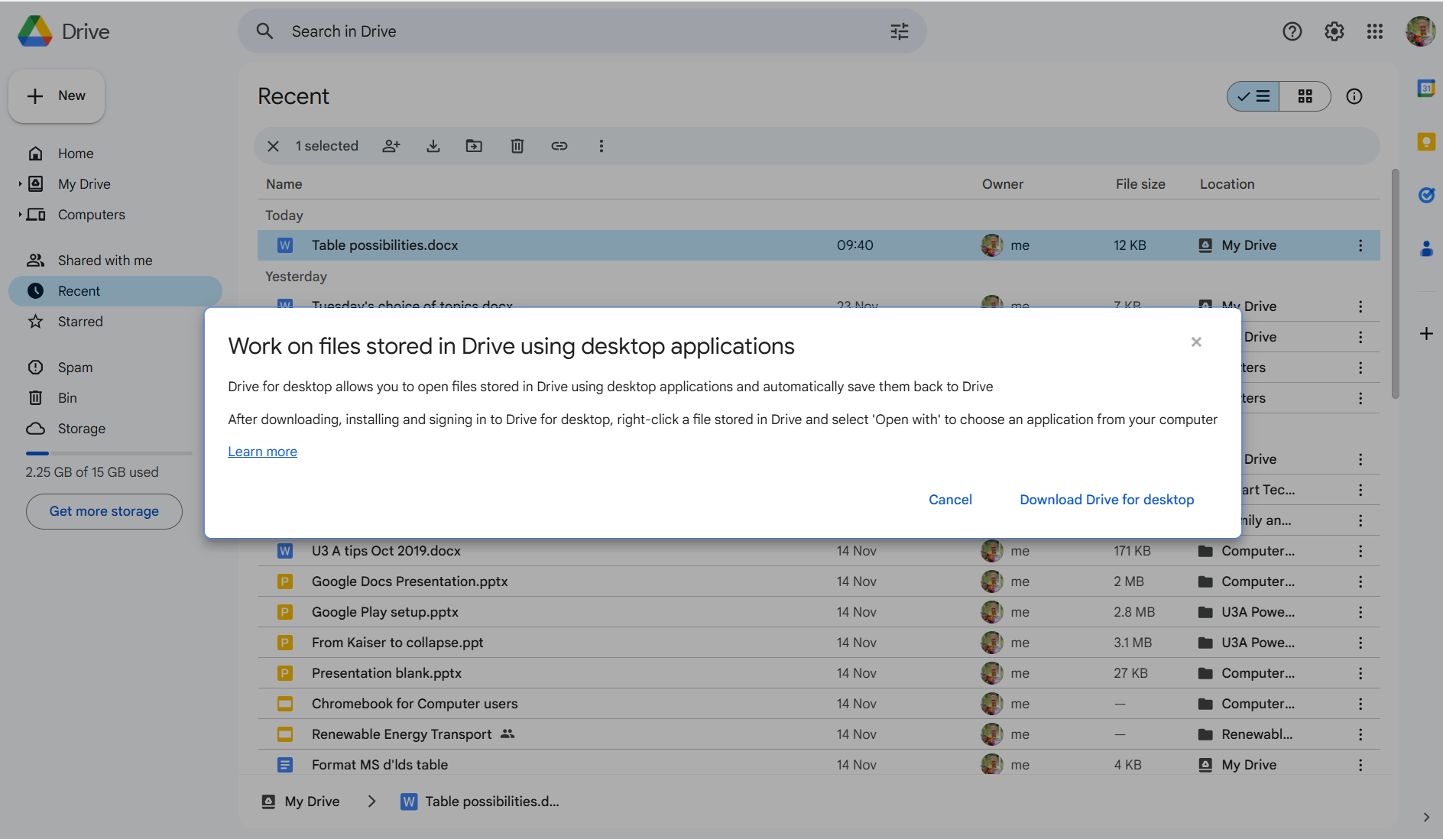
To get the .exe file, open a tab with a Google Chrome function - such as Search - and sign into your Google account (top right avatar). Select a MS file from your Drive list and Right Click. Choose “Open with/Apps on your computer” when this notice is shown.

Slide 21
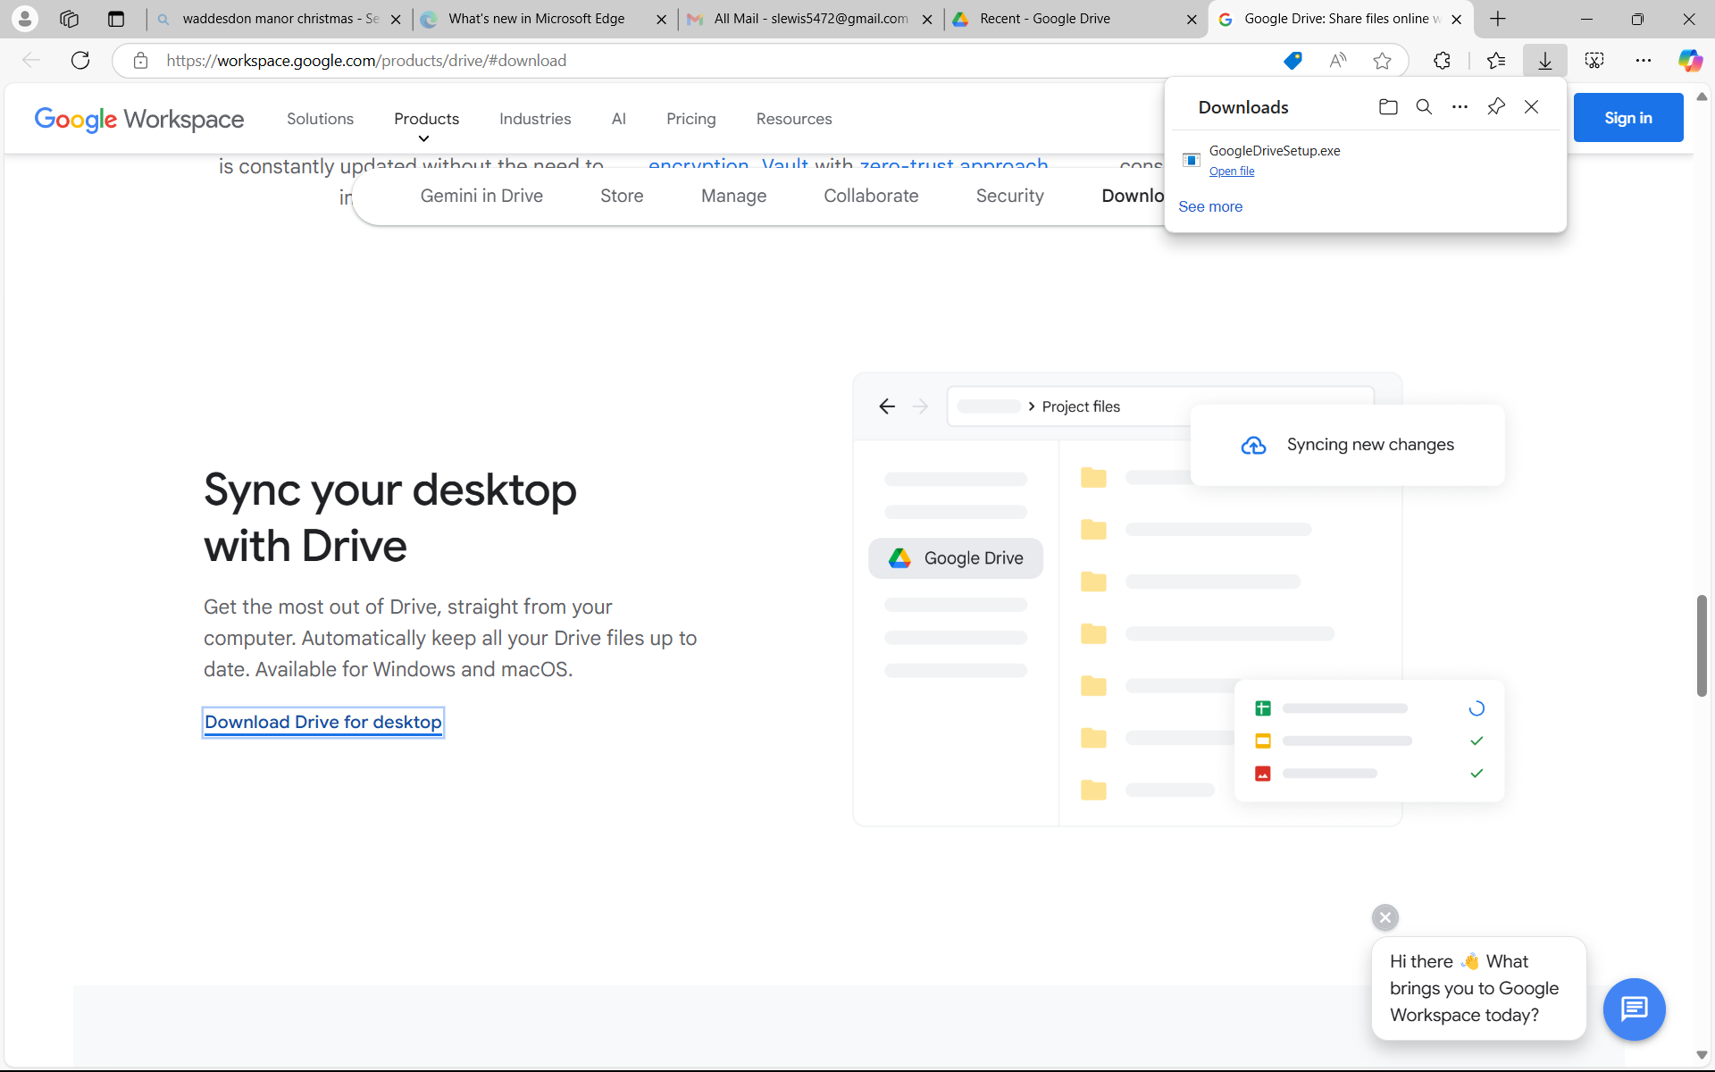

Slide 22
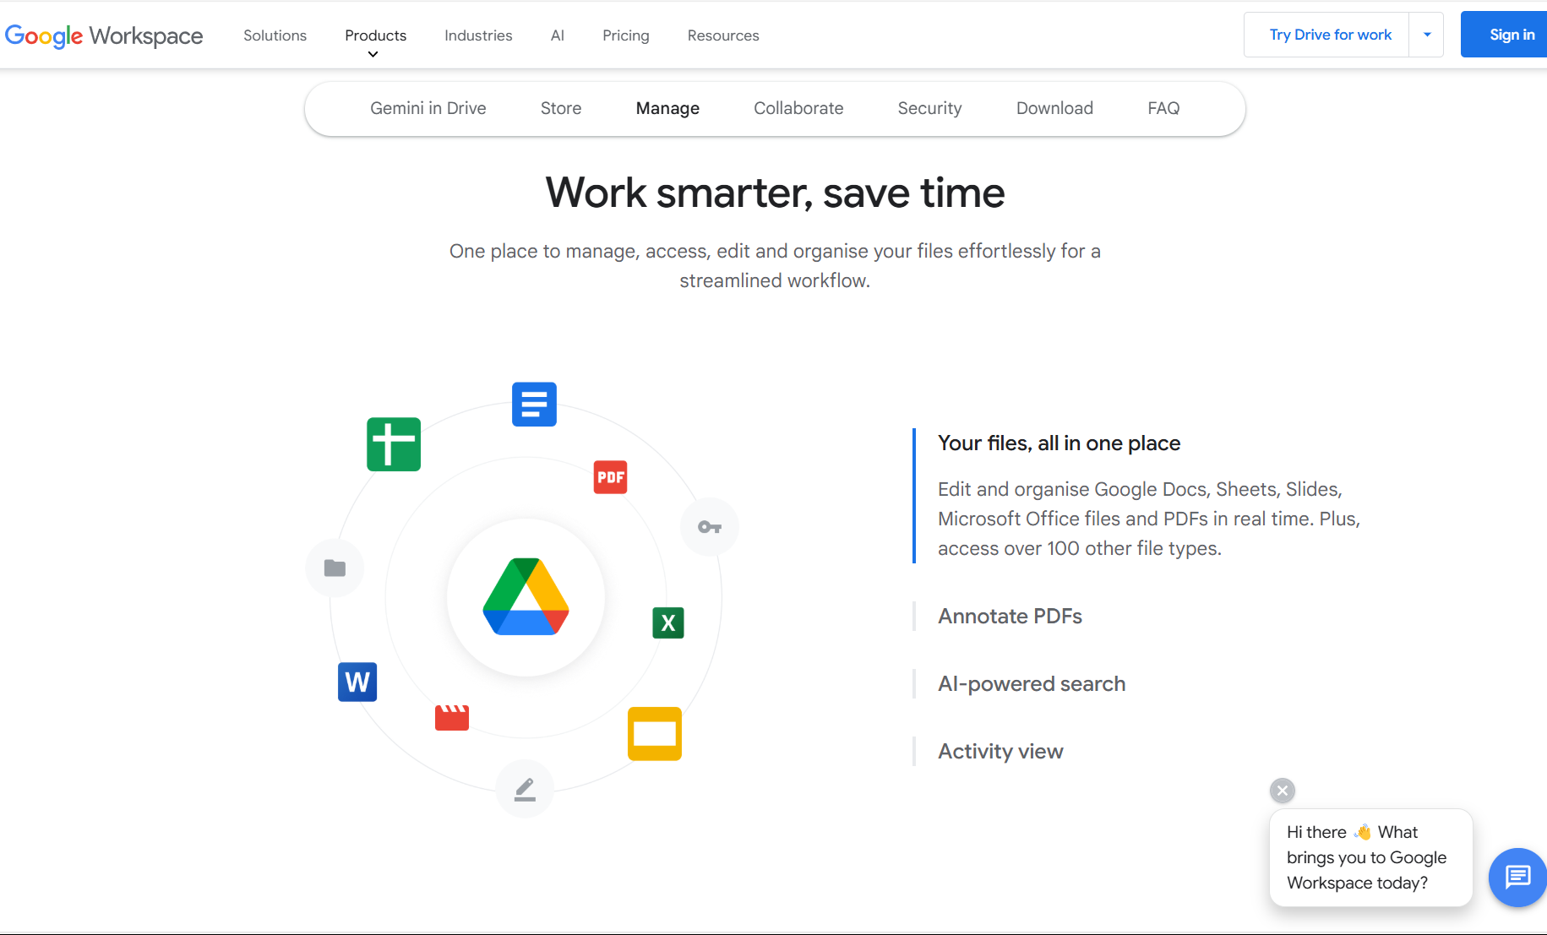

Slide 23
Conclusions:
Microsoft will make it increasingly troublesome to create or use their formats without either (or both)
Using MS Edge as browser
Paying for a MS 365 subscription (currently £60pa) for download manipulation ie creating and using their formats on your hard drive.
Google (Chrome) however, will encourage those with Windows laptops to use their free apps, additional functions and migrate to My Drive, (by downloading “Drive for desktop”) while maintaining users’ access to Microsoft apps and cloud.

