Slide 1
Document Apps for Android Tablet.
(Microsoft Word app in particular)
(for smartphones too… )

Slide 2
Degree of formality may be the key to the utility of a Documents App:
WhatsApp and text too trivial
email too often lost;
posted letter too formal (and not always available when eg away from home).
Sharing a document, via attachment to email or sending a cloud link to it means:
it can be downloaded or printed by the receiver
the sender (you) can always trace it and resend it, if necessary!

Slide 3
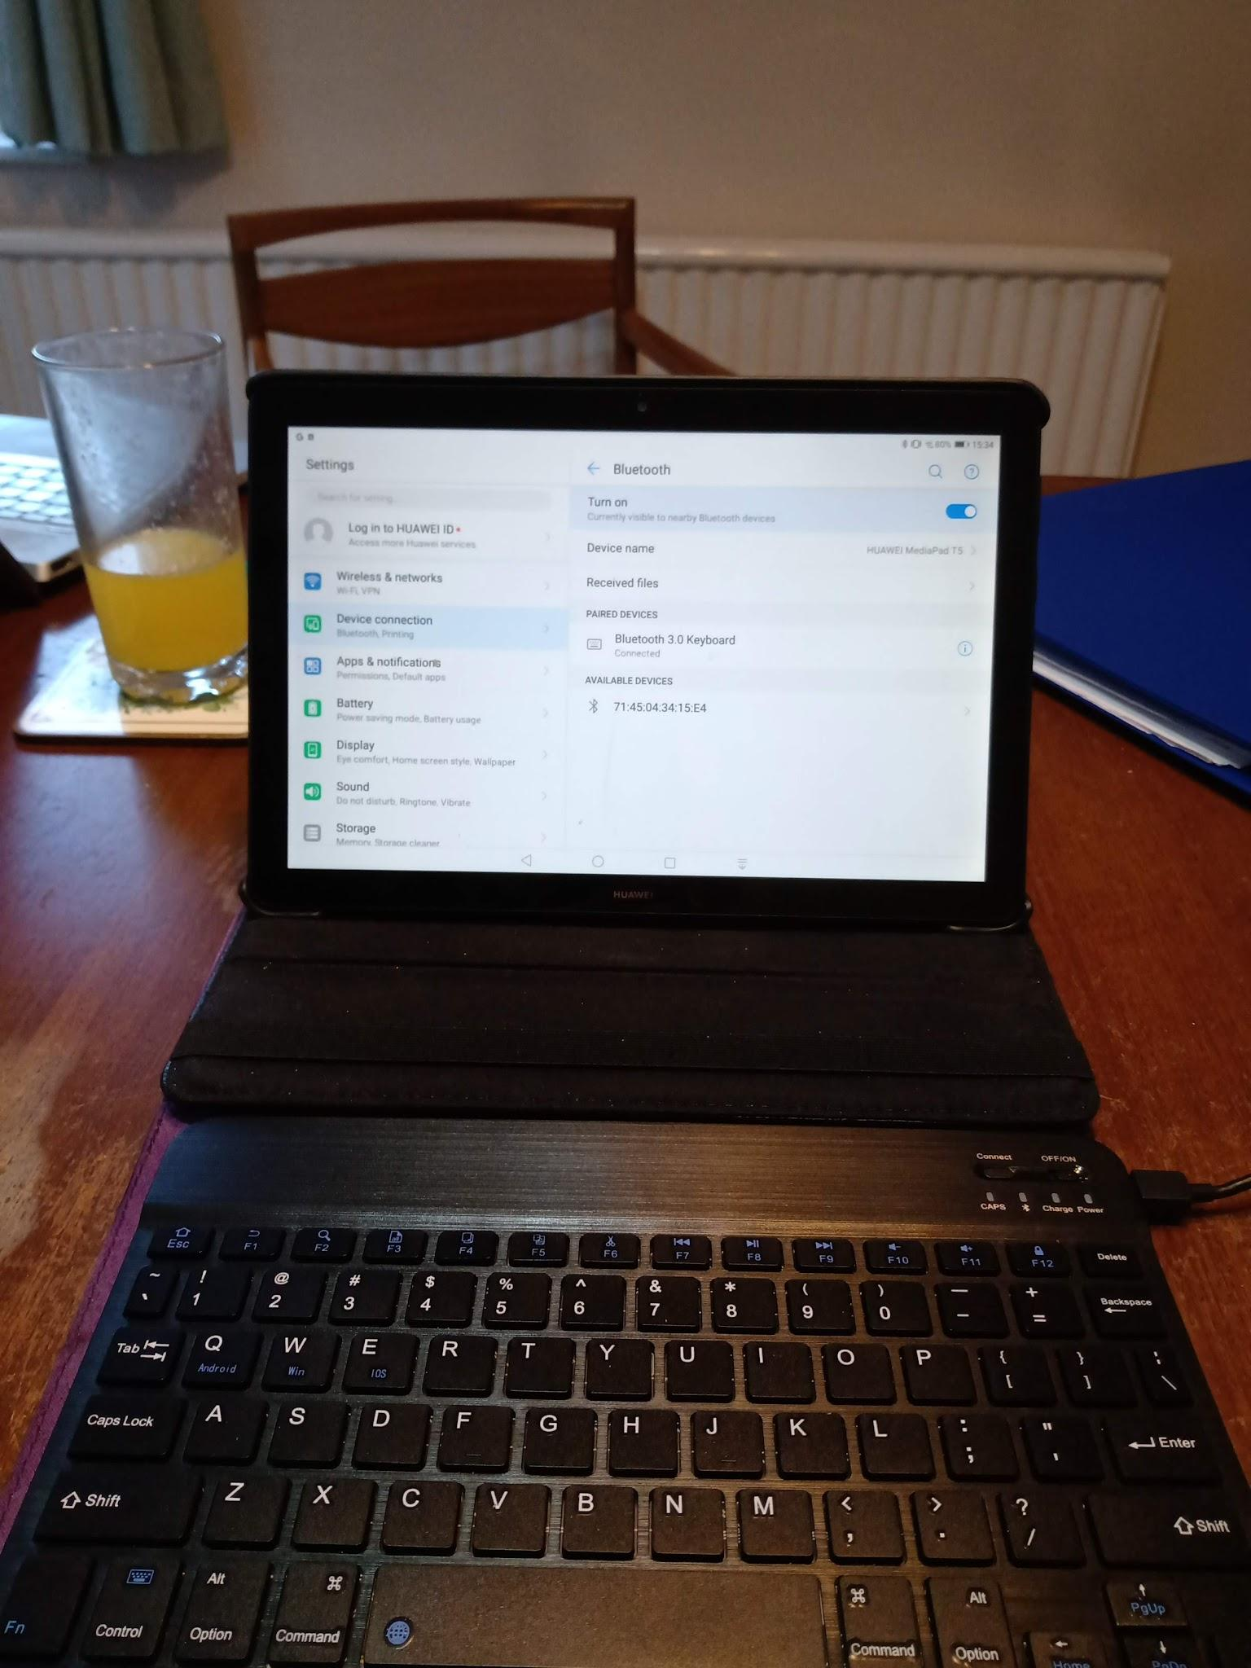
How comfortable will you be prodding/typing more than a few words on a touch-screen?
Turn your tablet into a mini laptop with a keyboard…. Connected by blue tooth, but needs charging independently (so ?power bank or charging point may be needed.)
A support case/stand for your tablet will hold it at the right angle (and must fit it).
Cost for the two … £20 -£30

Slide 4


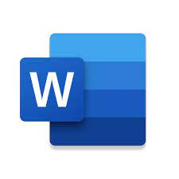
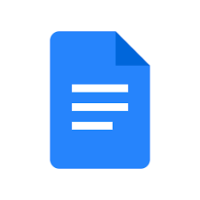
How will you retrieve the documents you make on your phone/tablet app?
“Your tablet” cloud One Drive cloud Drive cloud
Pre-loaded MS Word app Google Docs app
notes/docs app
Or just download them to your device memory card/ Download area for storage.
Drawback: file organisation

Slide 5
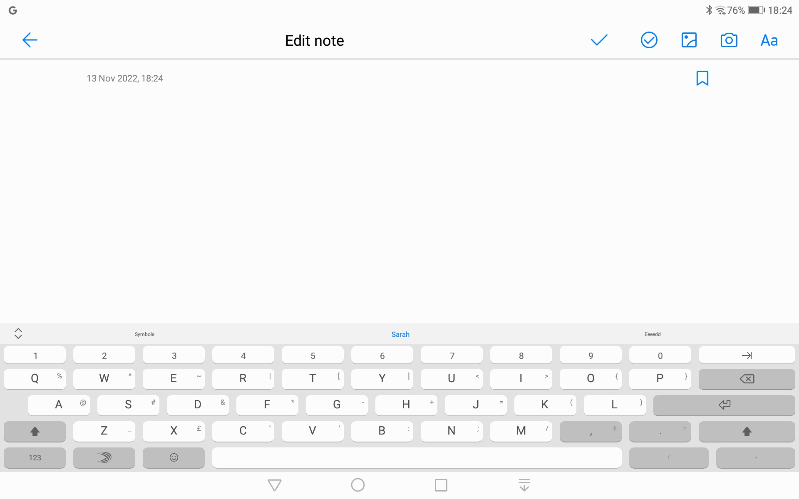
My tablet’s own note/doc app. Adequate but can only be shared via their cloud. (Huawei in my case!)

Slide 6
So, the MS Word App will be the natural choice if you use a MS Windows computer/One Drive as your main file reference “library”.

Slide 7
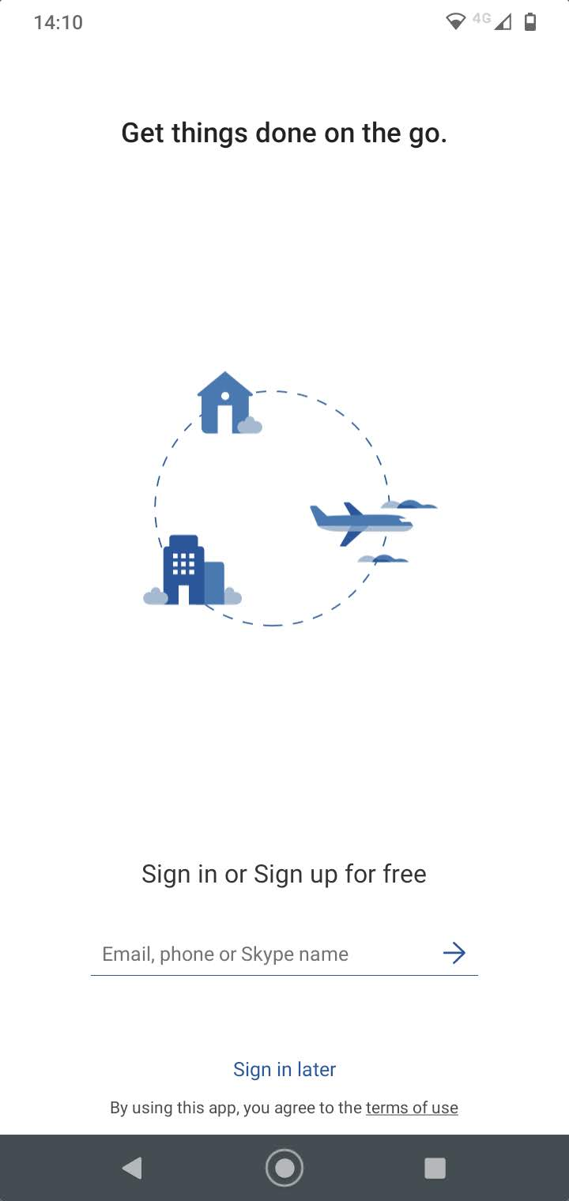
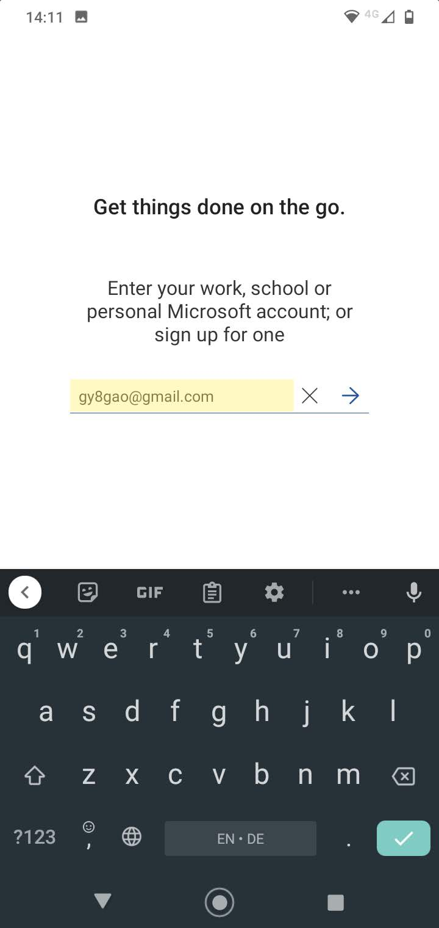
Install MS Word app from your Android “play store”. Basic version is free.
You will be required to set up a MS account. If you have a hotmail email address, the password will be the same…

Slide 8
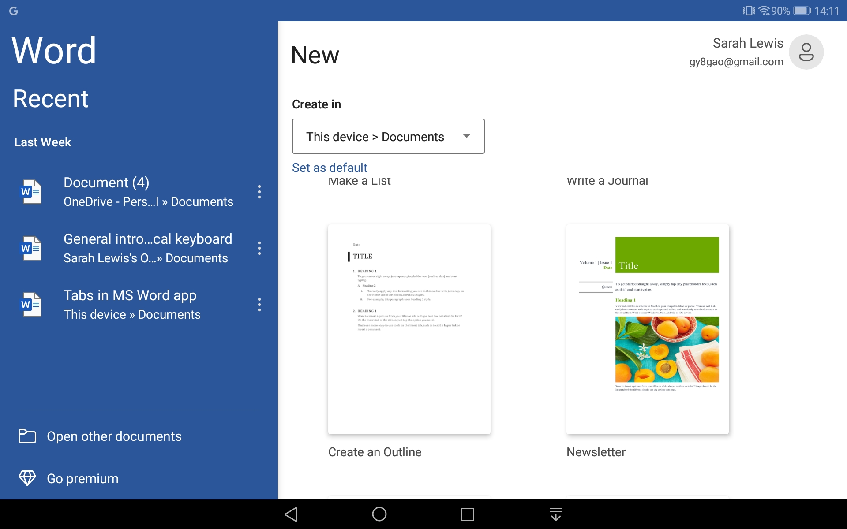
Can download, or sync your document to One Drive (default) or DropBox. Change the default here.

Slide 9
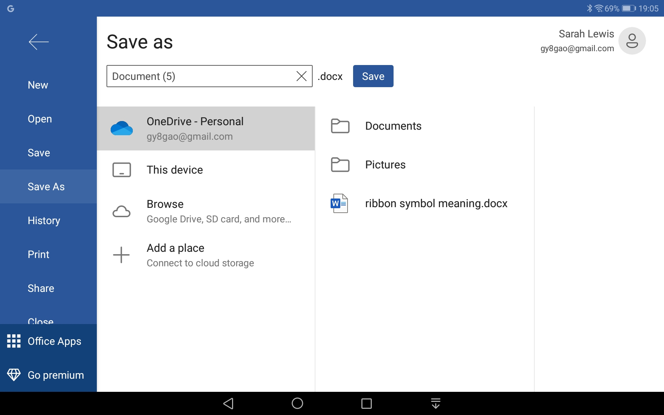
Use Save As/ This Device to download a particular document.

Slide 10
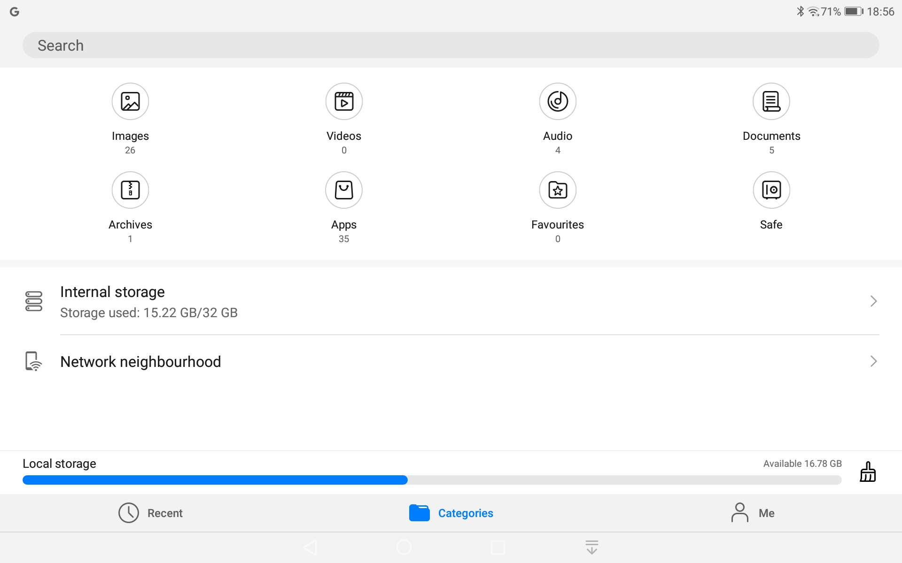
Tablet Downloads (Files app)
Good storage capacity, some listing capabilities, but no subfolders possible.

Slide 11
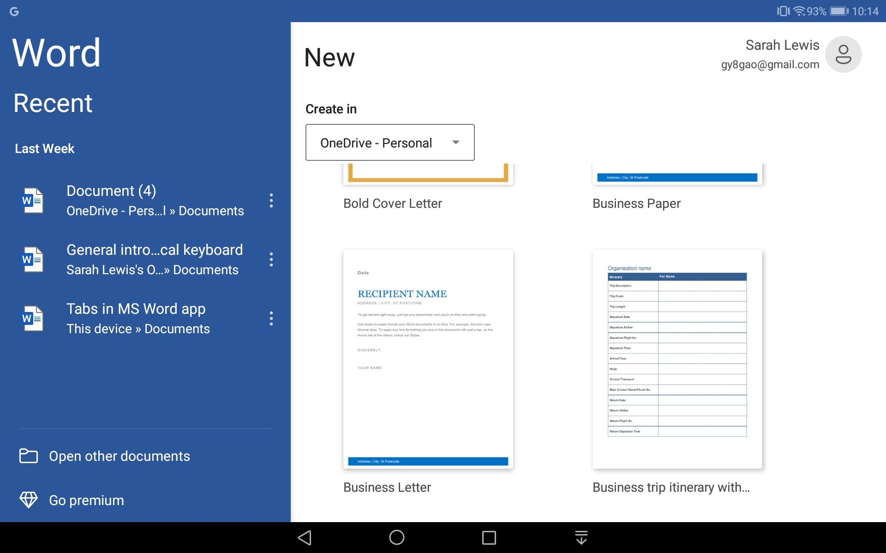
Formatting a document outline is limited within the app.
So eg the business trip itinerary template will be useful for tabulations etc

Slide 12
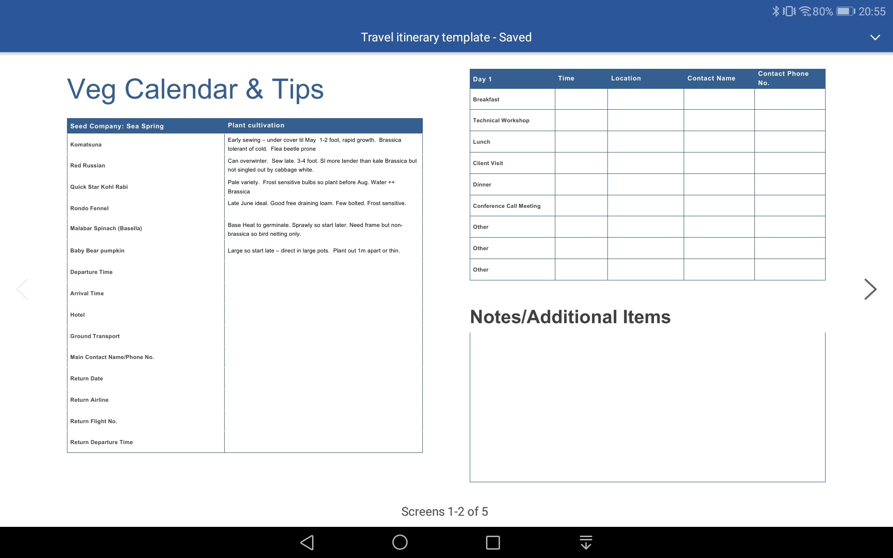

Slide 13
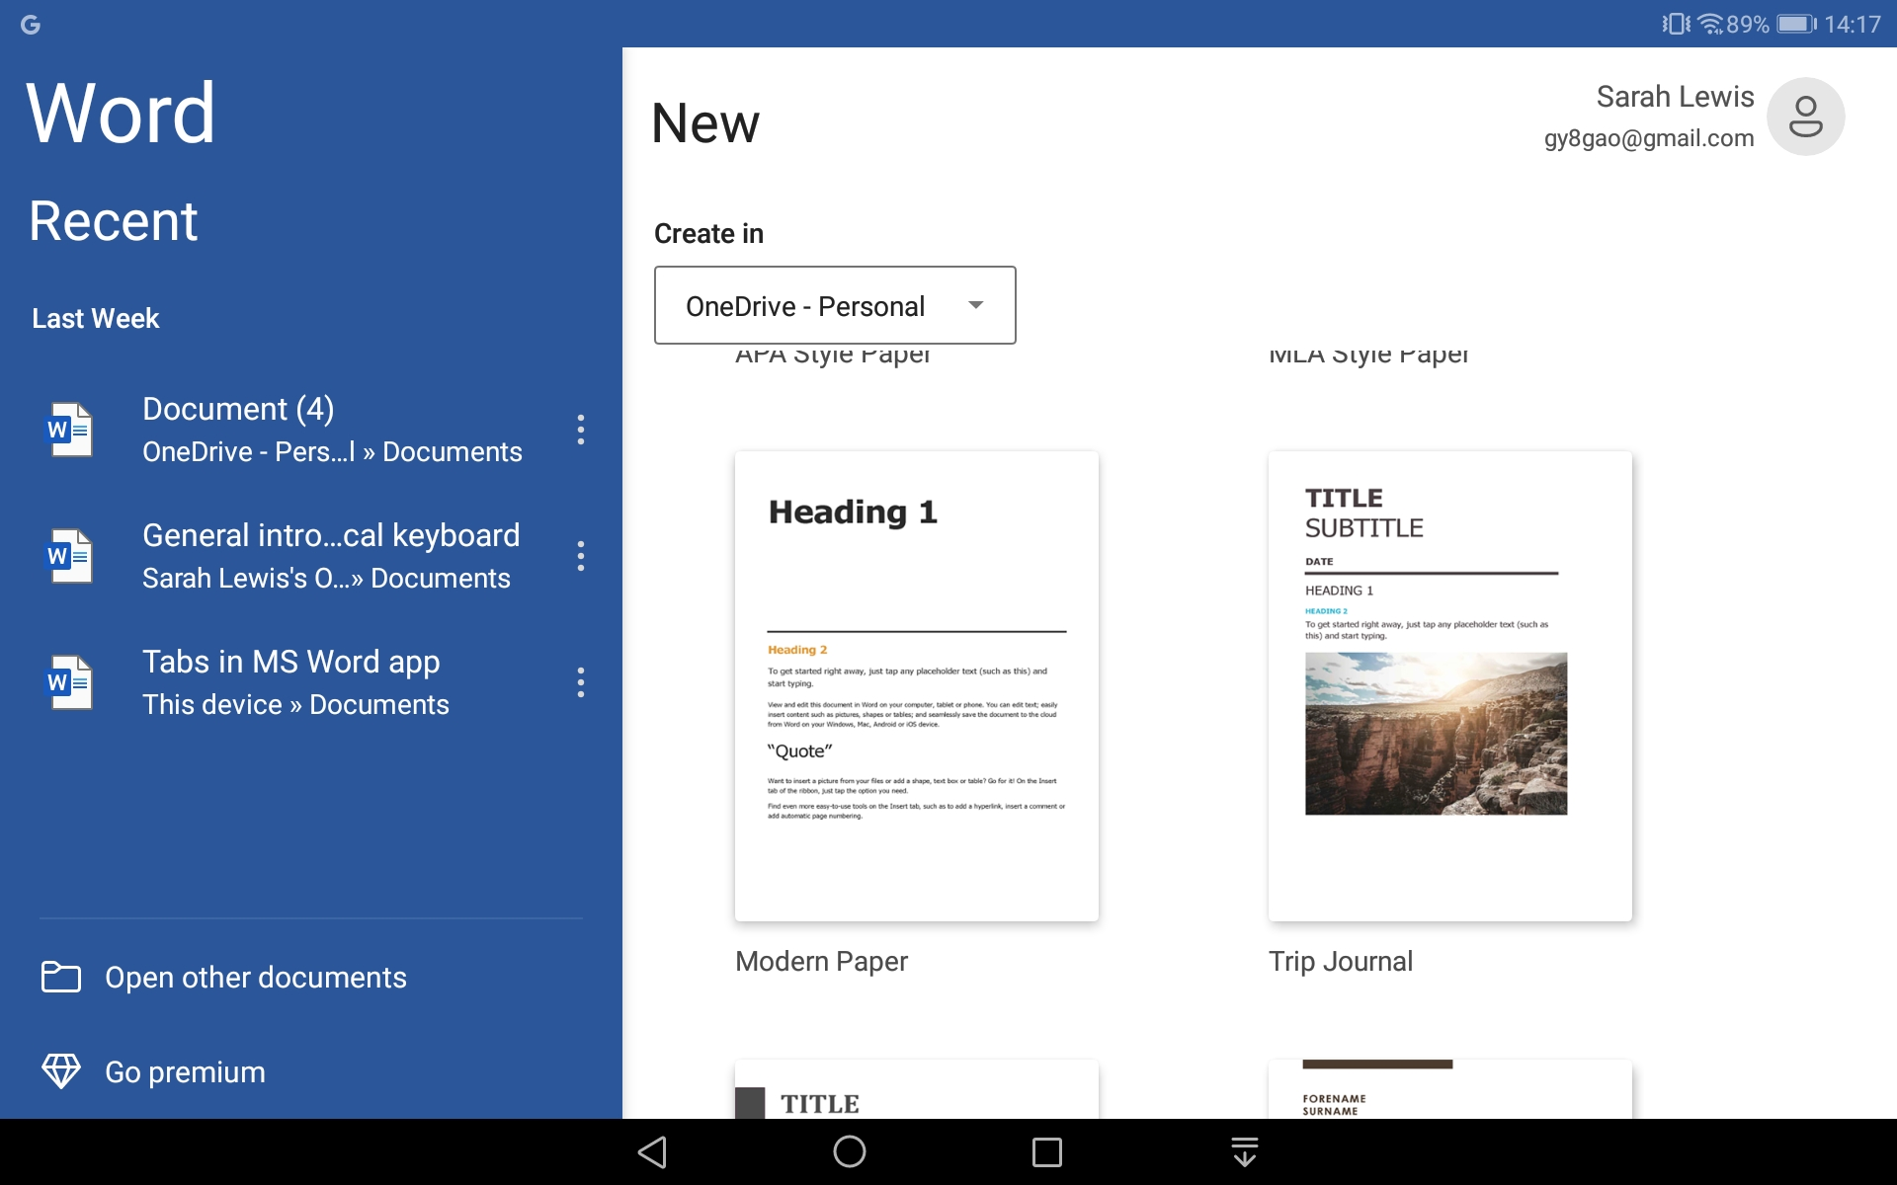
A trip journal template has text, headings wrapped and images… ?Christmas newsletter

Slide 14
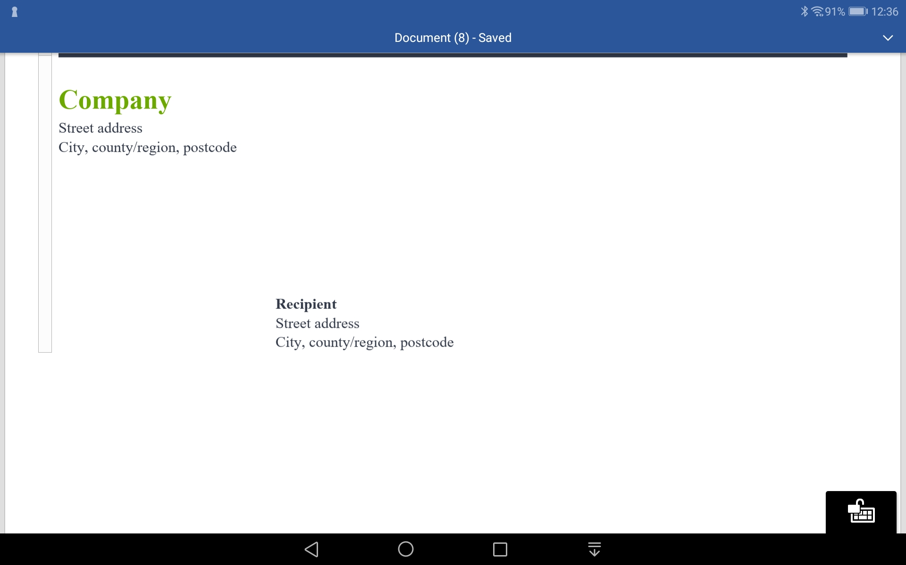
NB. Layouts reflect US preferences - address appears centrally - not useful for our window envelopes

Slide 15
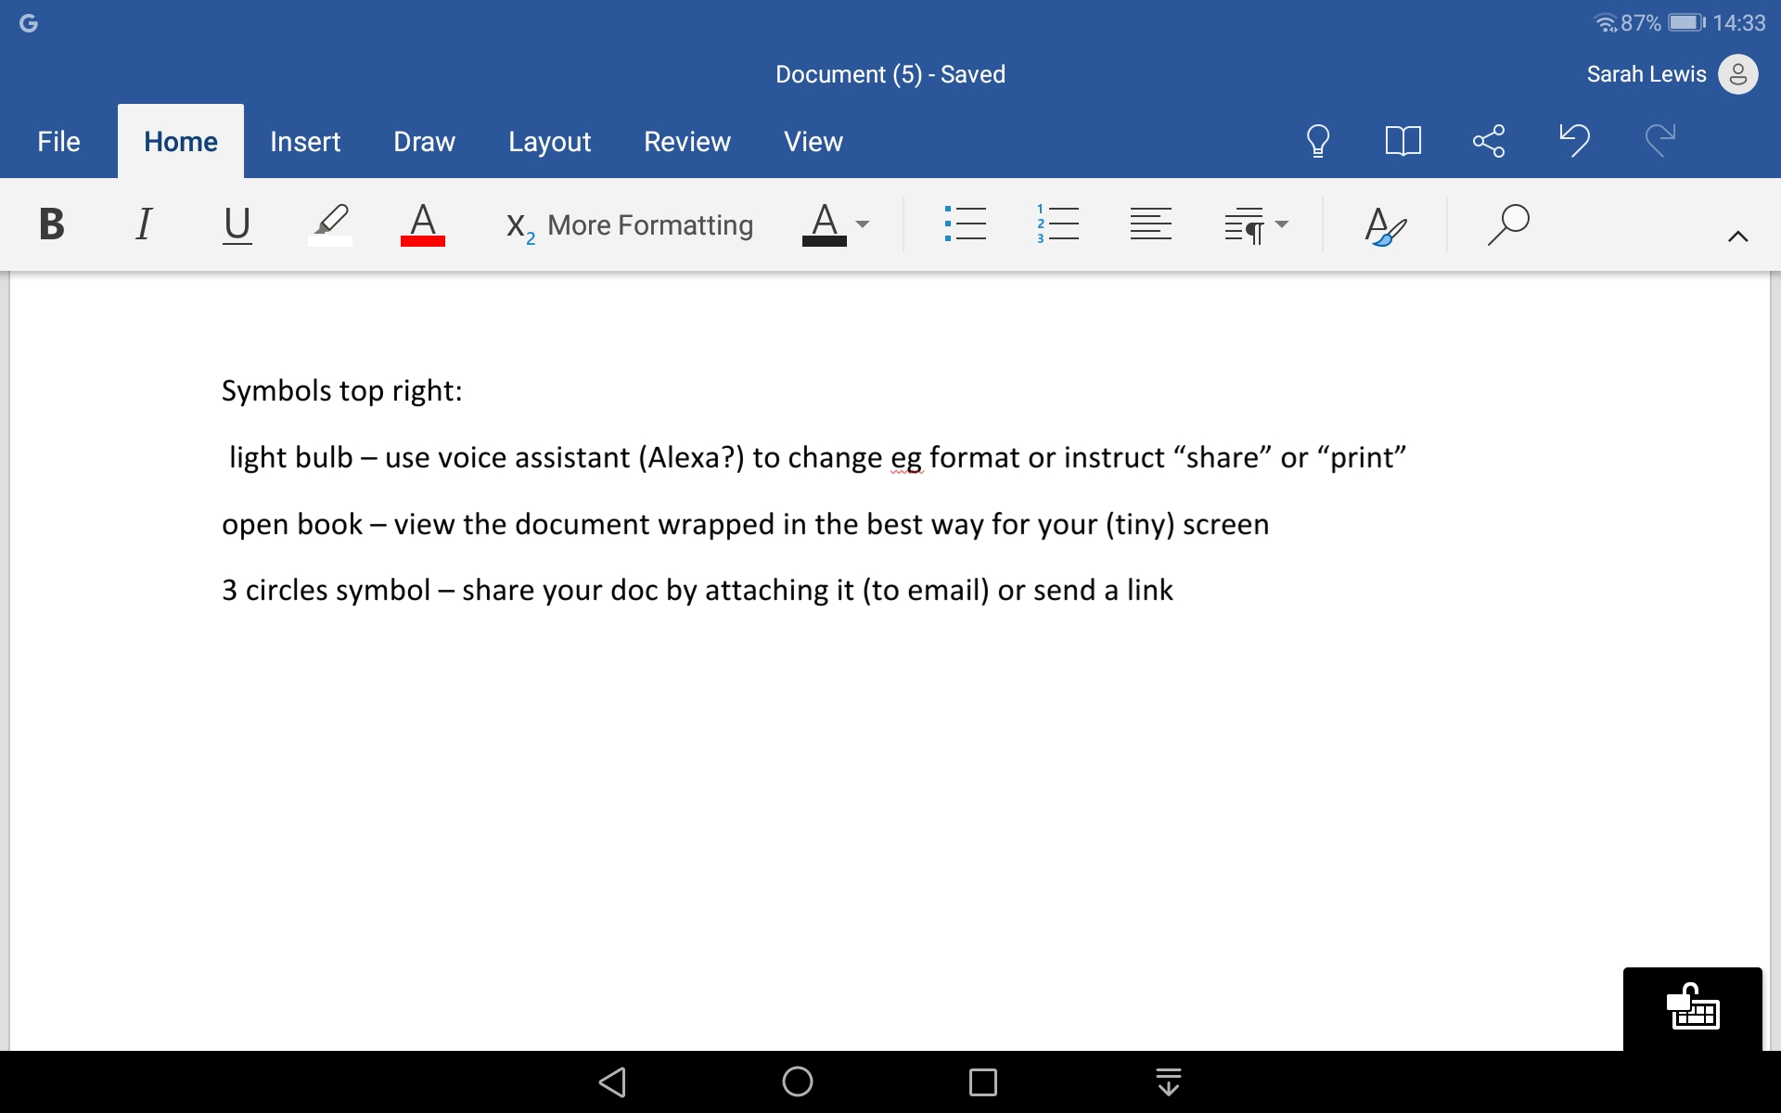
You save your document - when it can be downloaded, or rely on Autosave (default) when it syncs to OneDrive

Slide 16
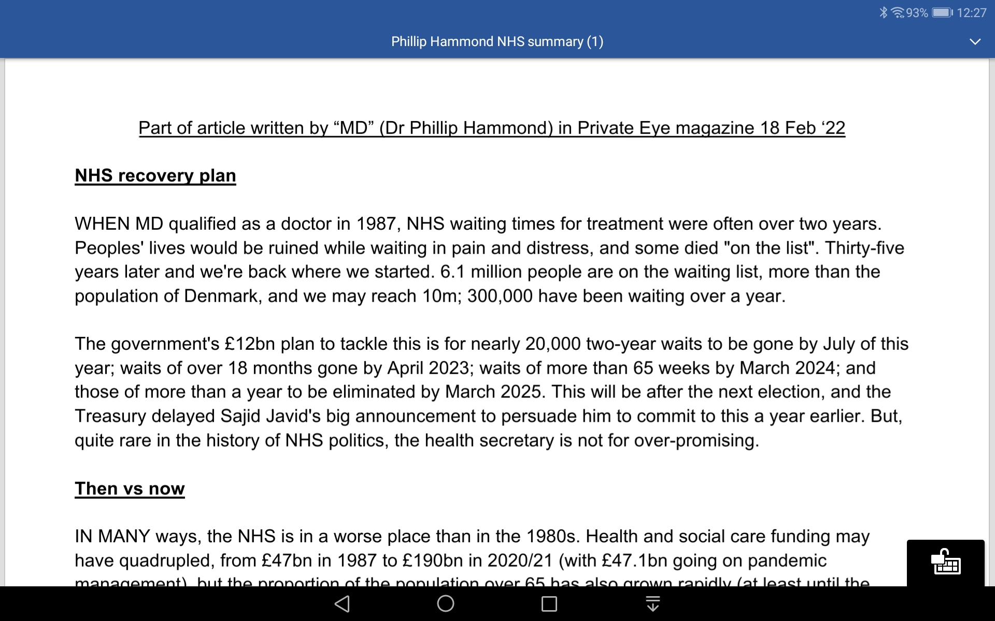
If someone sends you a long article and you find it a strain to read, use the “open book” symbol on the ribbon to change the layout for reading

Slide 17
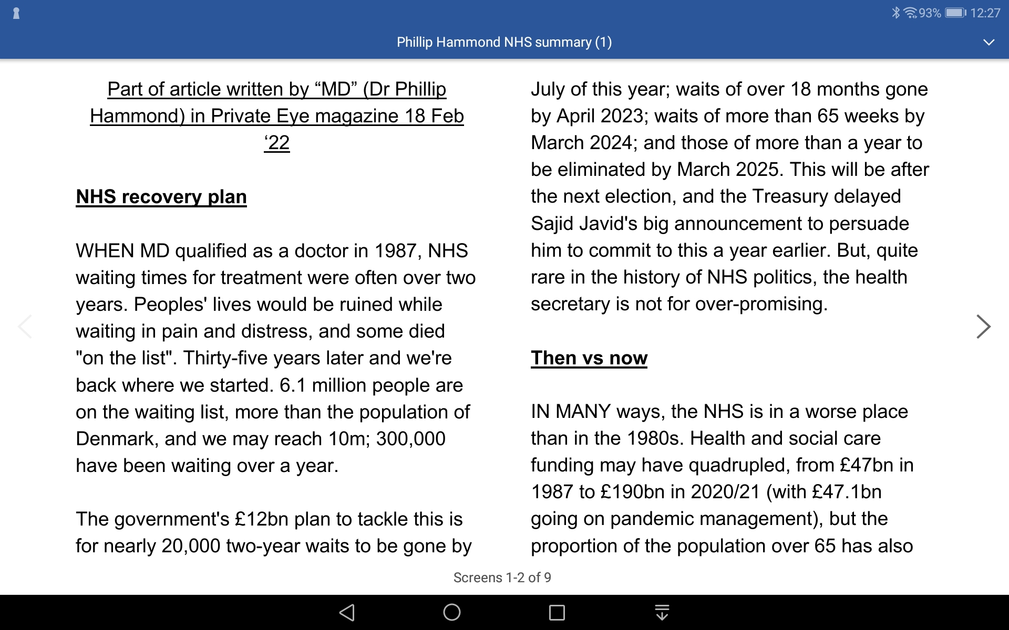
…to this column layout, for example. Text colour/contrast can also be changed eg white on black.

Slide 18
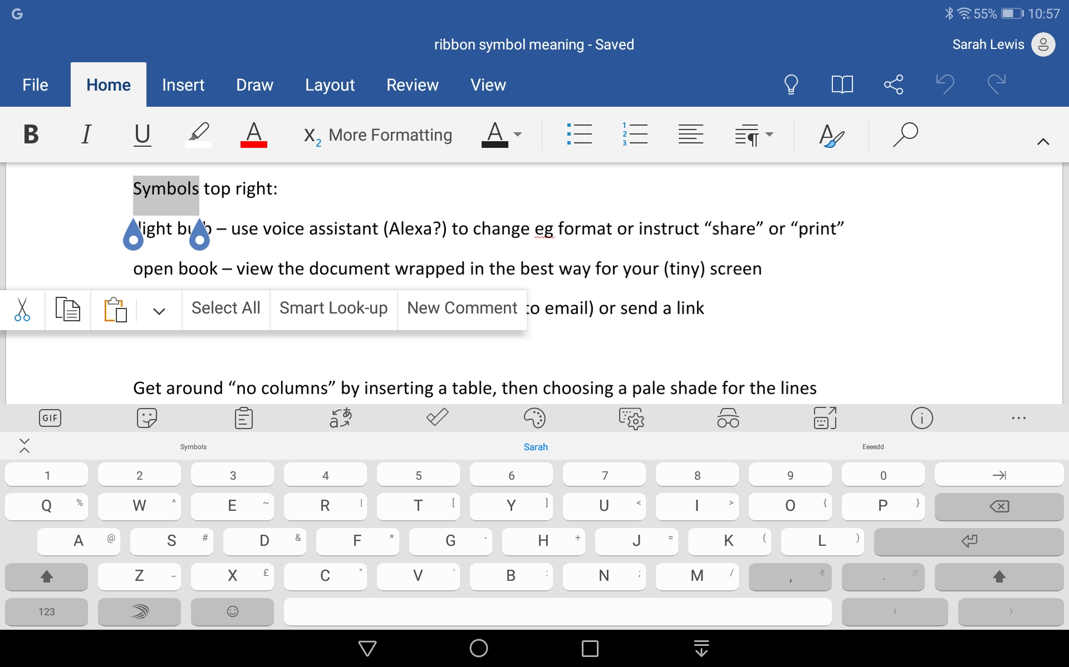
Copy and Paste

Slide 19
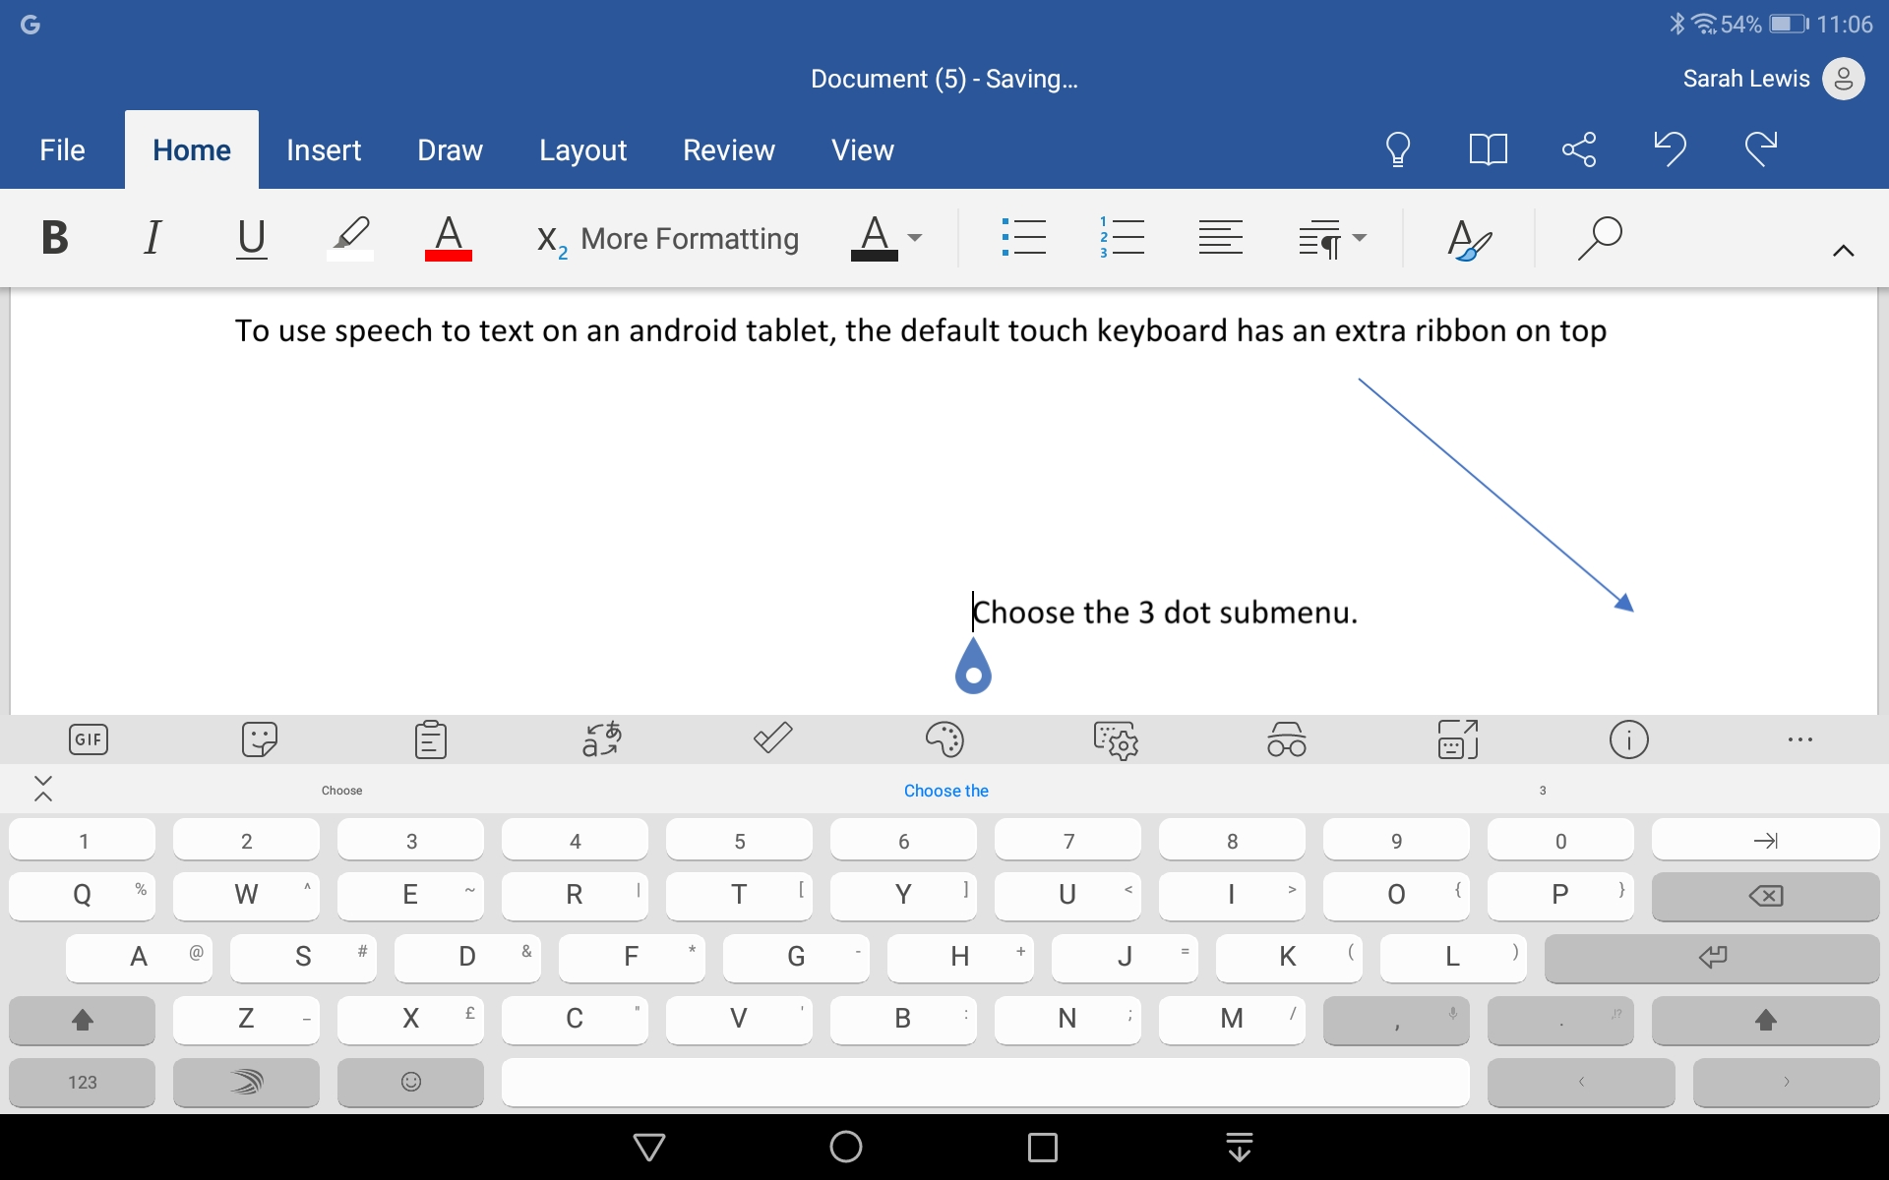
Voice to Text… (not in the app, accessed from android version of MS swift keyboard)

Slide 20
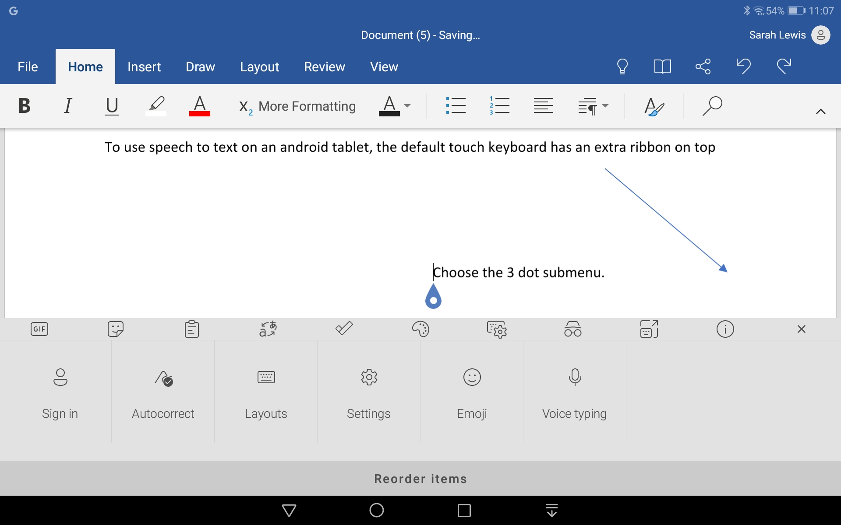

Slide 21
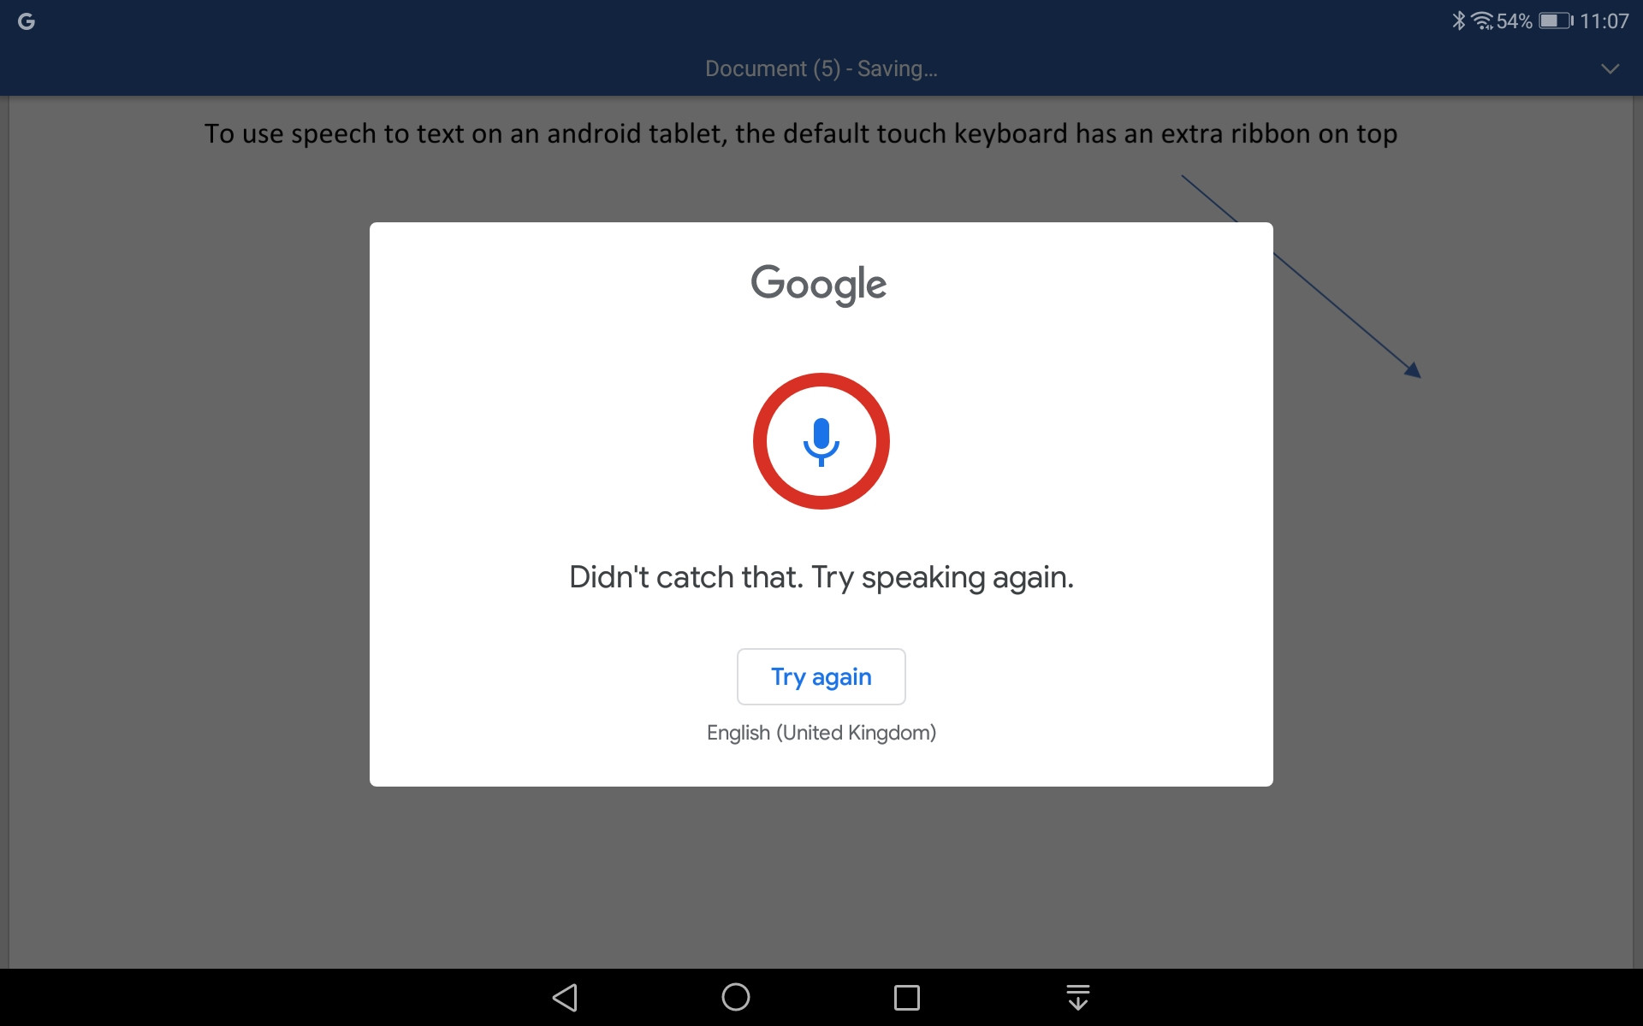

Slide 22
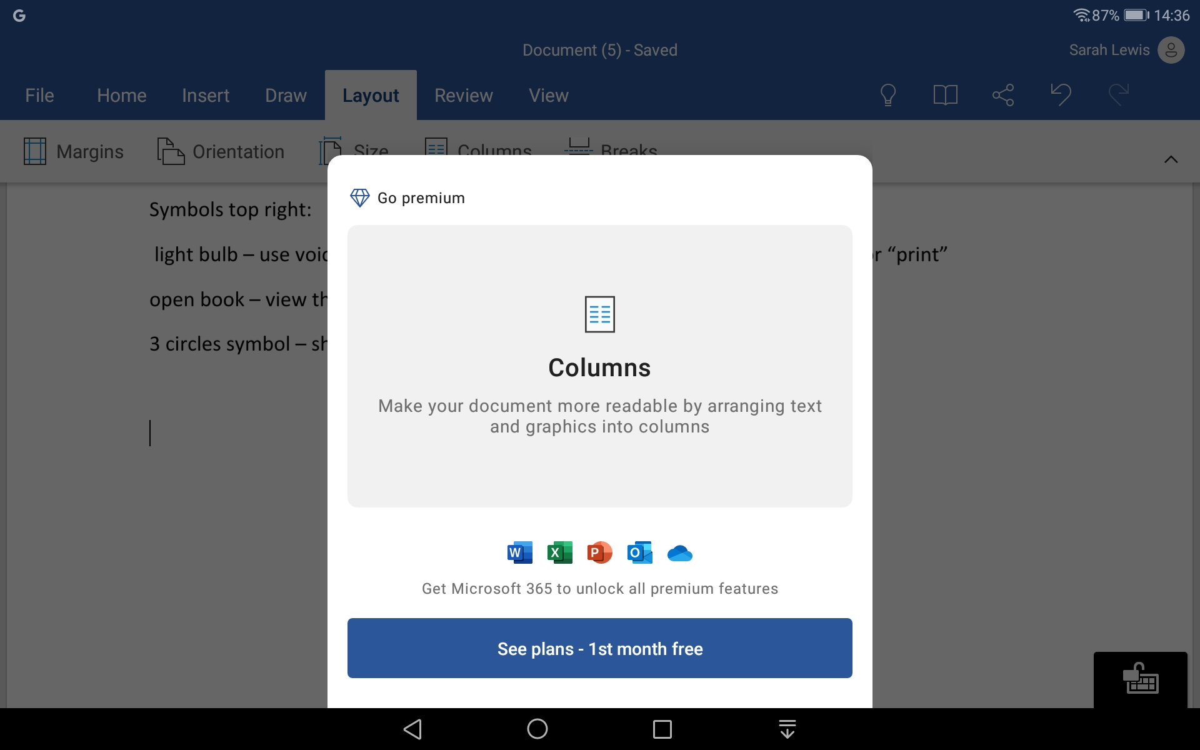
Columns and Tabs
No columns without paying!
(But Google doesn’t offer columns either)

Slide 23
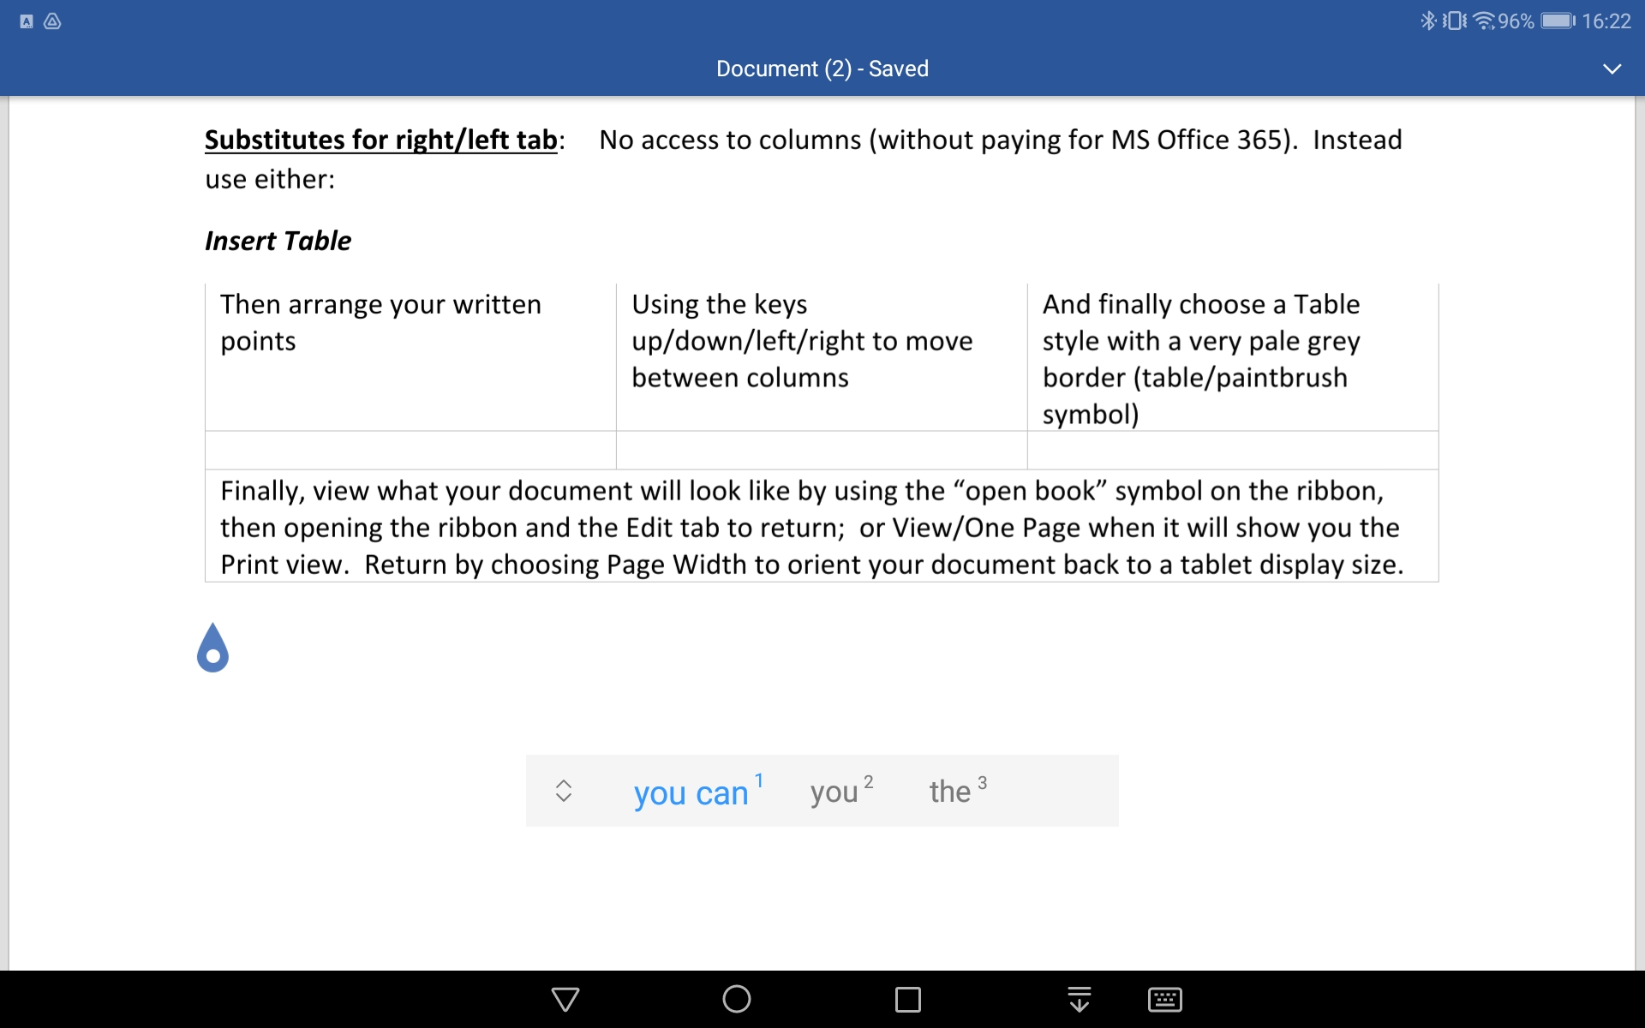

Slide 24
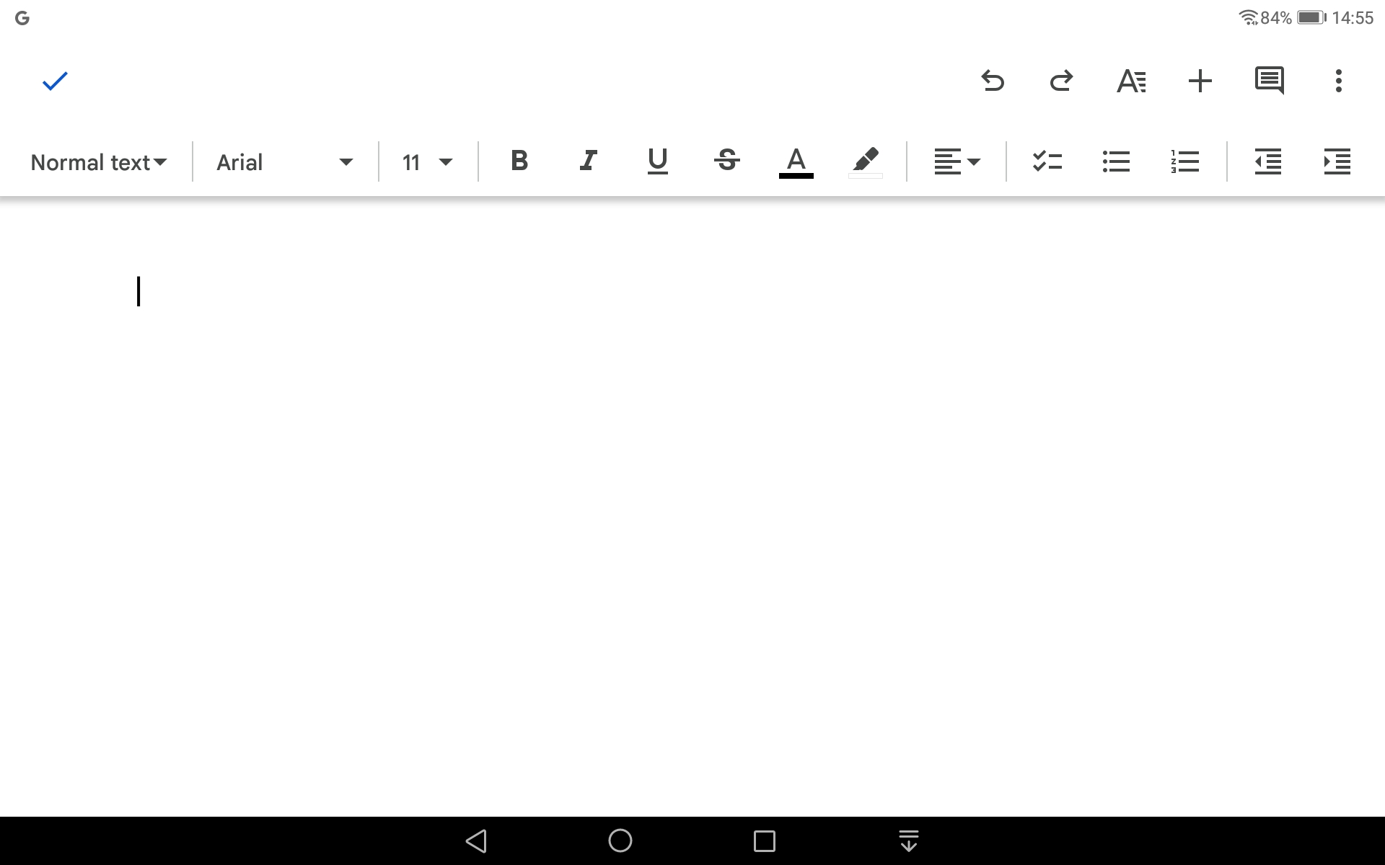
Google Docs Ribbon
MS Word Ribbon

Slide 25
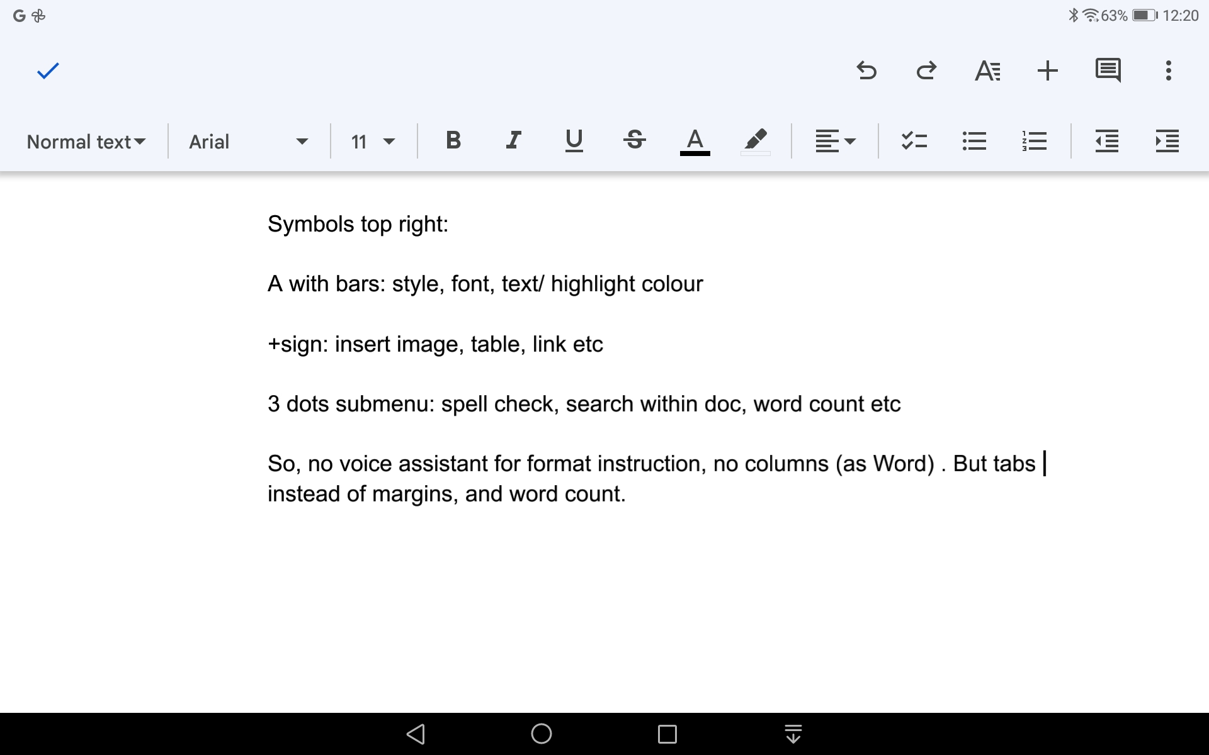
G Doc – MS Word app comparison: Most other functions are similar - just found in different parts of the ribbon

Slide 26
In Conclusion
If you are, say, travelling without a computer, you can still produce documents to attach to an email, share via cloud, retrieve later on your computer via cloud.
Or be independent of a computer (or wifi within limits) - by downloading.
Using a blue tooth keyboard makes typing quite easy, or Swyping with the touchscreen keyboard is useful for a sentence or two.
Cloud storage enables folder/sub folder structure to find previous documents.

