Slide 1
Quickshare between disparate devices - in this case Android phone to MS laptop

Slide 2
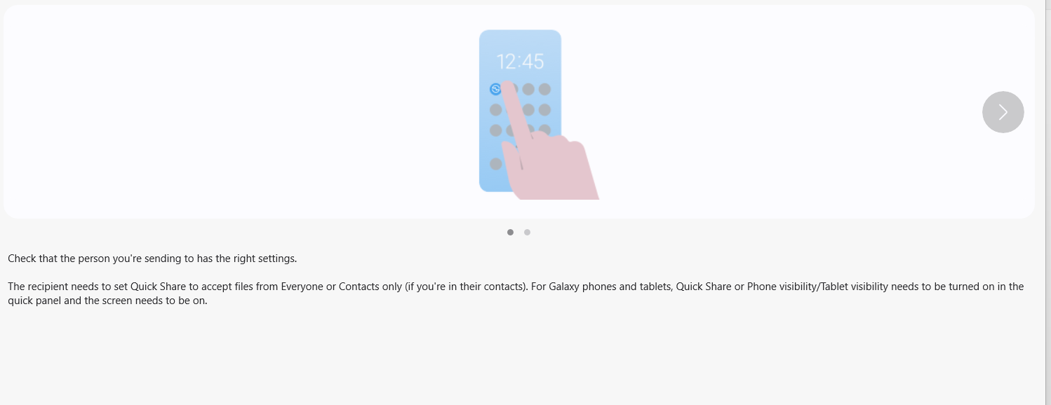
Quick Share: a Samsung app pre-loaded on MS laptop and (my) Android phone. Blue Tooth connection & Samsung cloud account interaction make the connection between disparate devices.

Slide 3
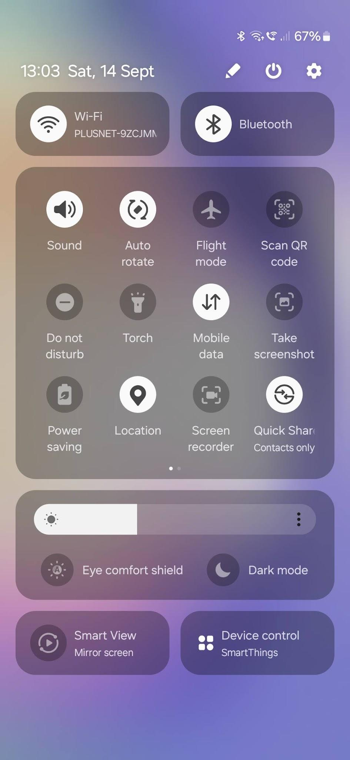

Slide 4
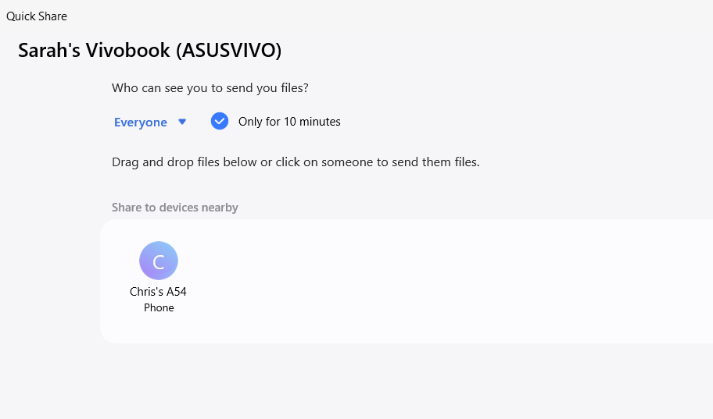

Slide 5
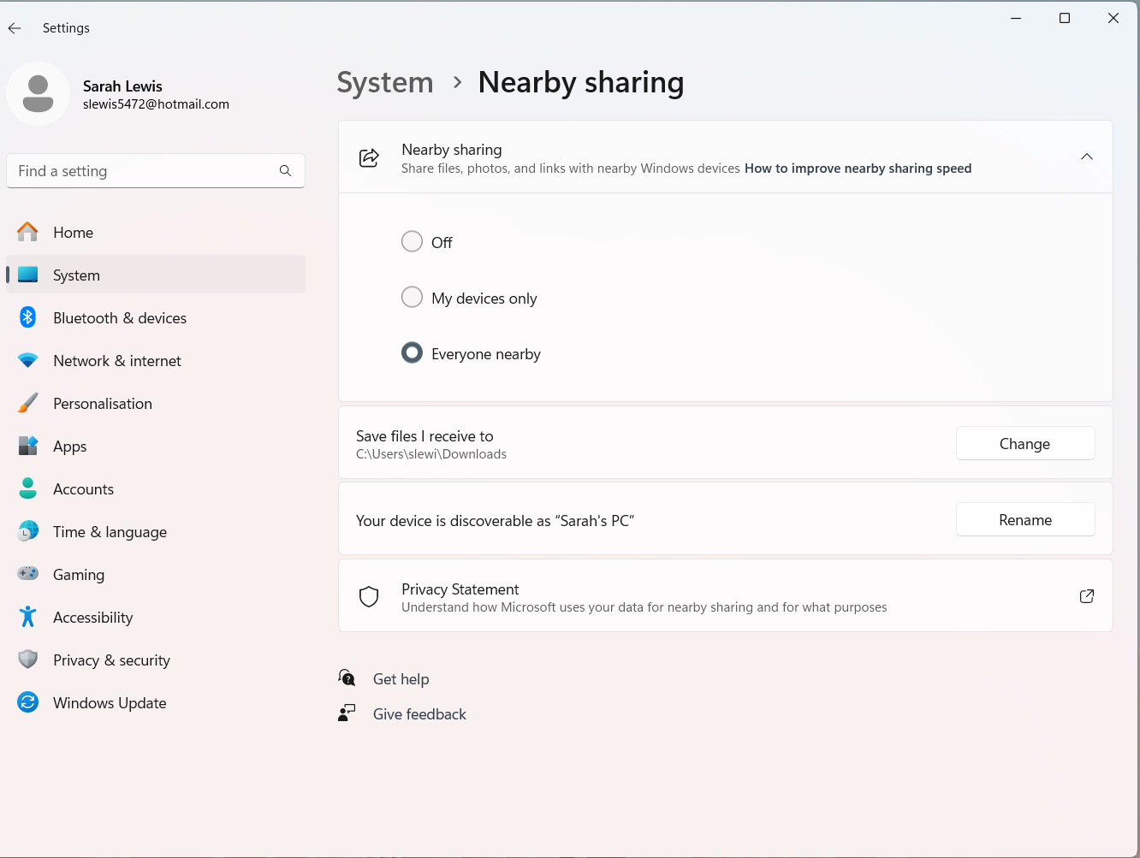

Slide 6

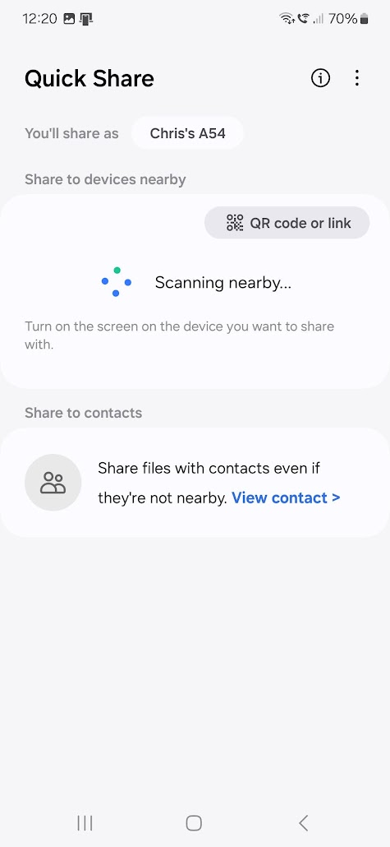
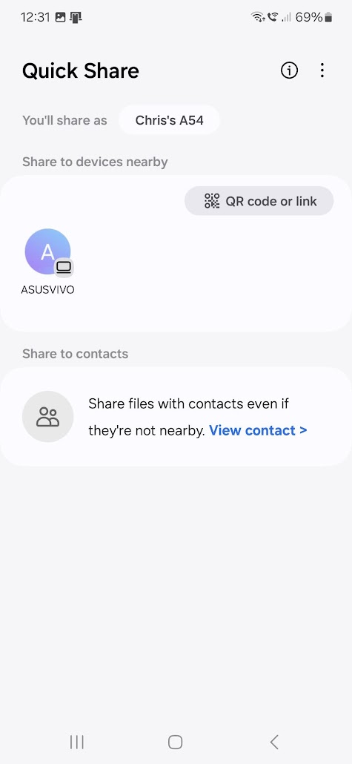
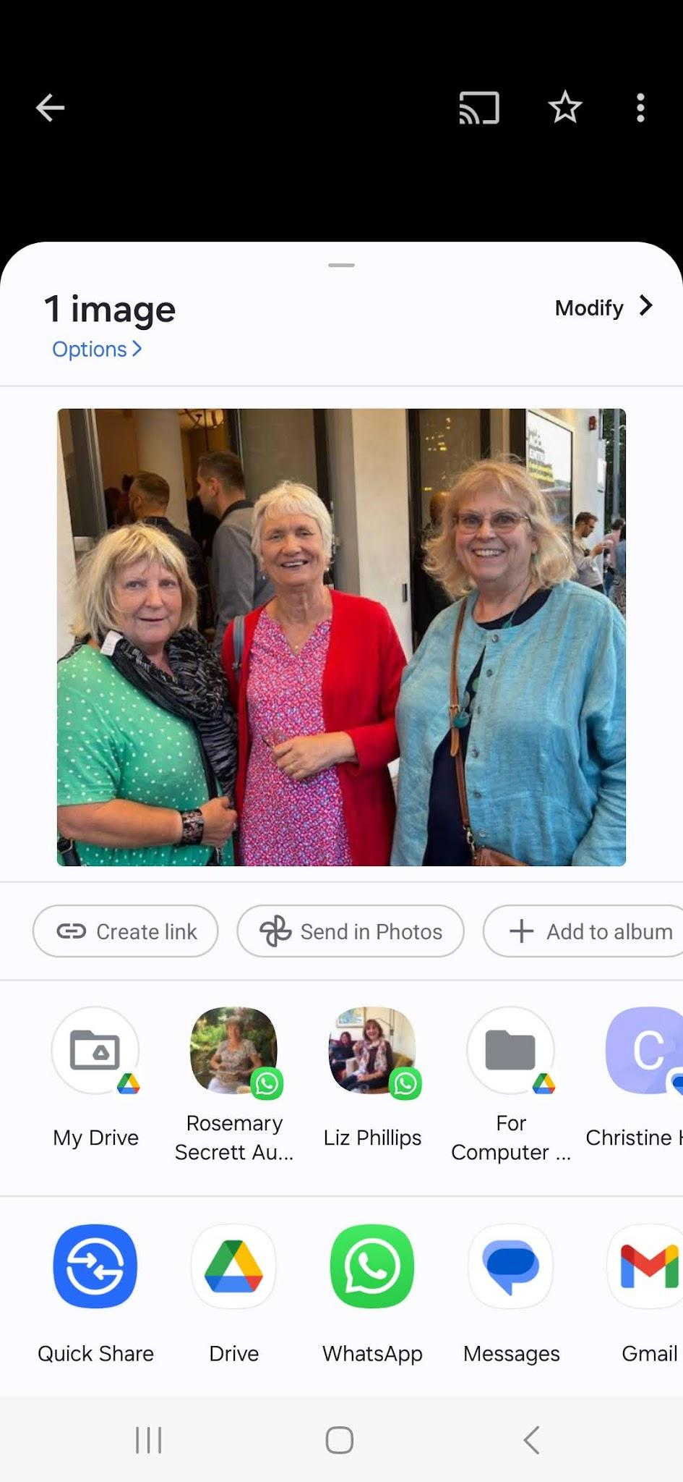

Slide 7
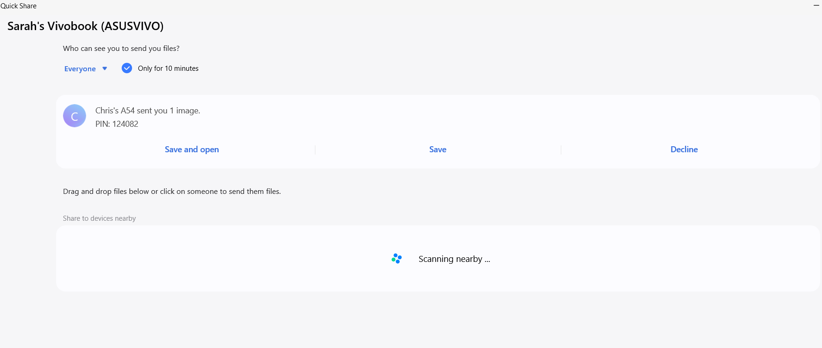

Slide 8
Free VPN offered with MS Edge Update. Useful?
(And how Gemini AI provided information to help me decide)

Slide 9
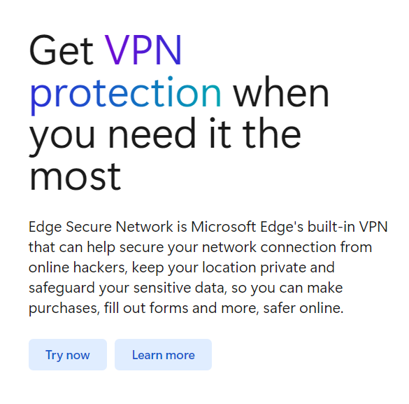
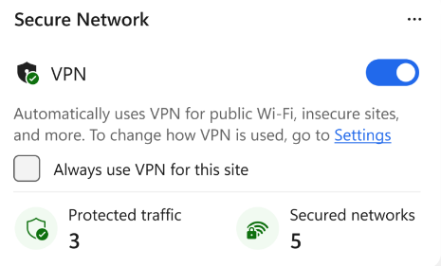
MS offers free “intelligent” VPN. But why would I need it if my email providers offer good encryption, and WhatsApp is end-to-end encrypted too?

Slide 10
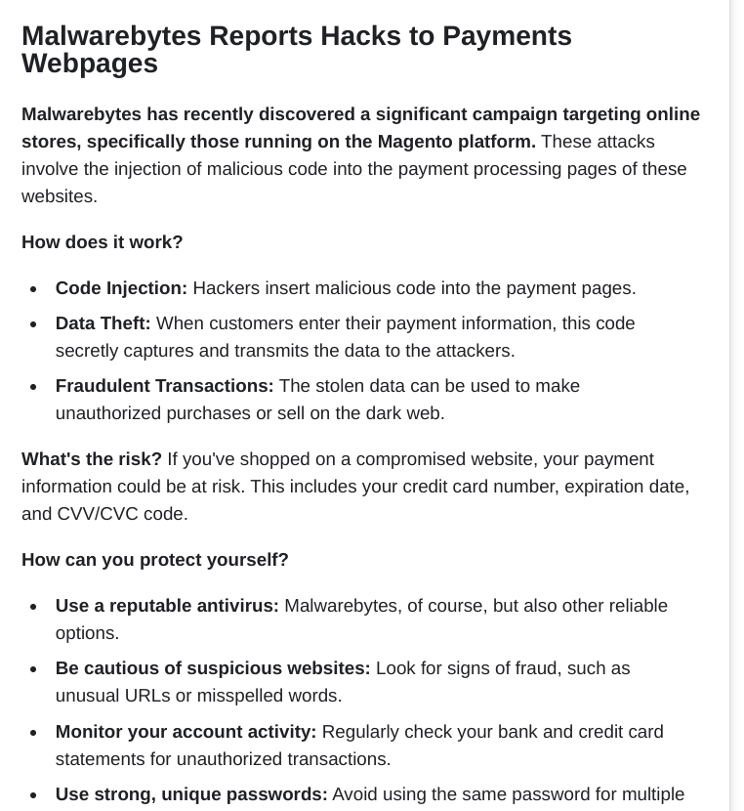
Why the MS offer of a website-sensitive VPN (Virtual Private Network) seemed attractive to me.
Would it solve this security issue?

Slide 11
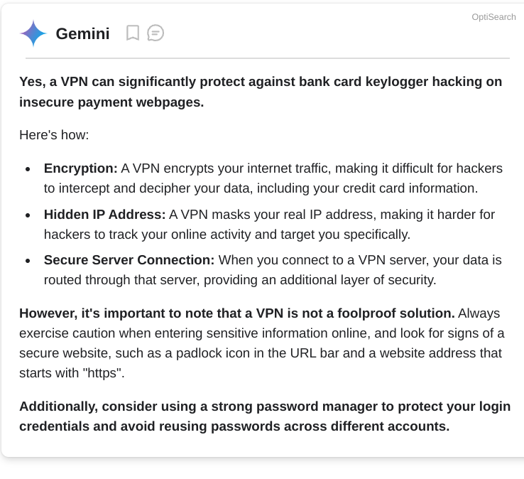
I asked Gemini (Android version of AI).
BUT Gemini lists NordVPN as a principal source ie citation, for its answer.
(The malware is on the webpage.. details are not intercepted in transit)

Slide 12
So I asked Gemini a more specific question:
Is it safer to use Paypal or Googlepay than a VPN to enter payment details?
This time, the first citation was a government cybersecurity website so I trusted its answer more..

Slide 13
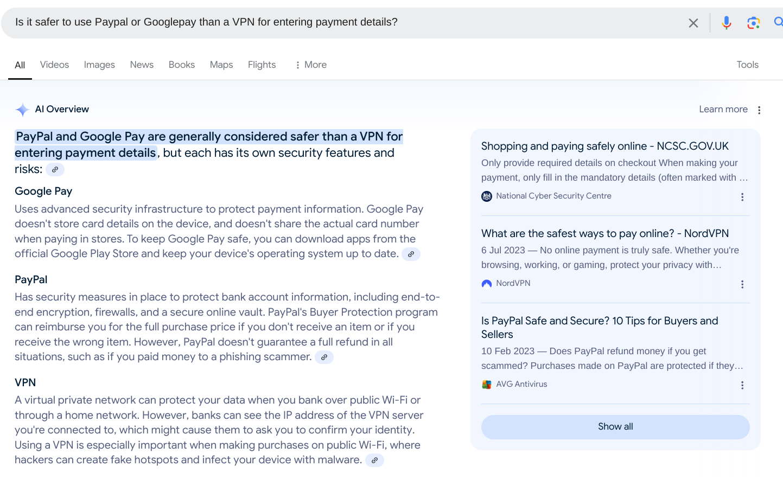

Slide 14
Chromebook update gives direct access to MS’s OneDrive cloud to allow MS OneDrive files to be accessed and opened in their MS365 apps

Slide 15
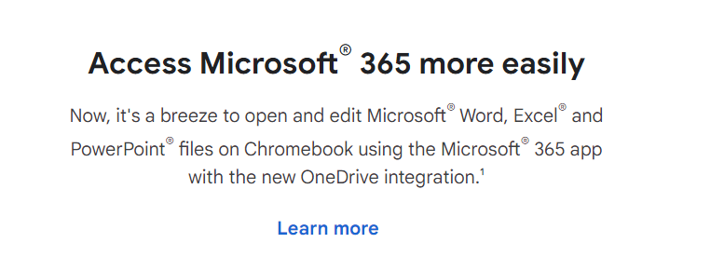
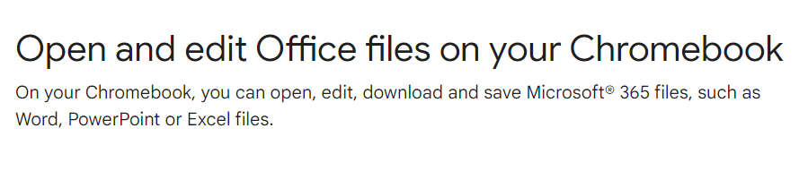
This is a one-way street! There is no equivalent way of opening Google files within One Drive

Slide 16
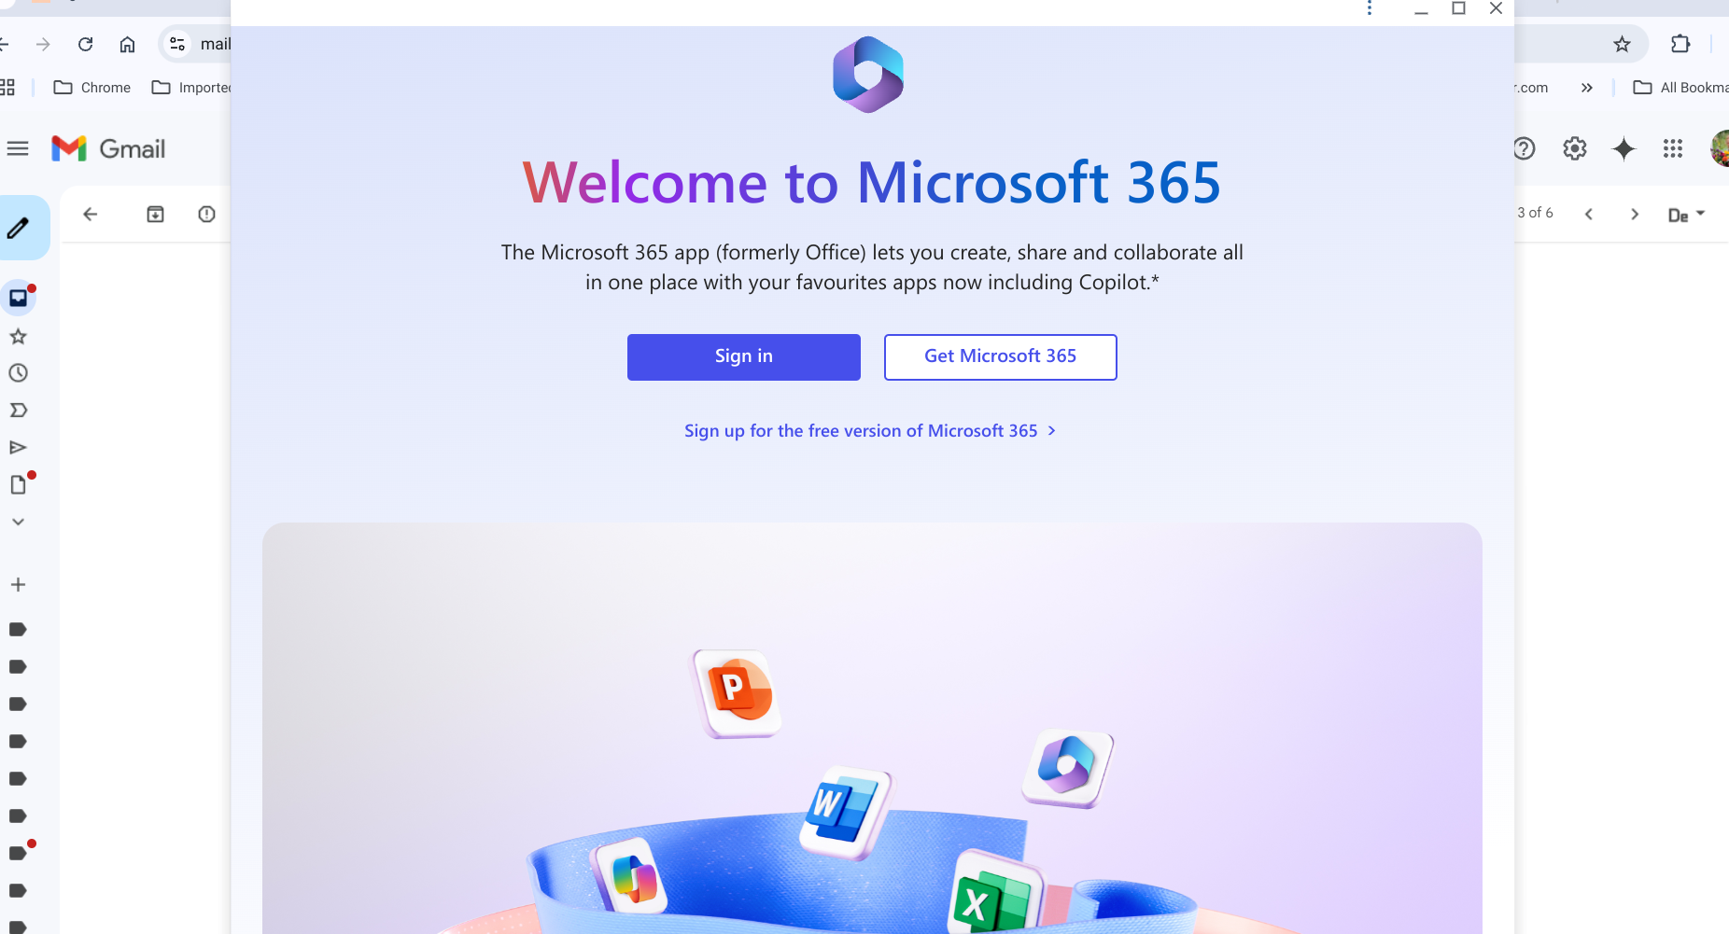
Install the free MS365 app from Google Playstore. Enter your MS account login and password to Sign In

Slide 17
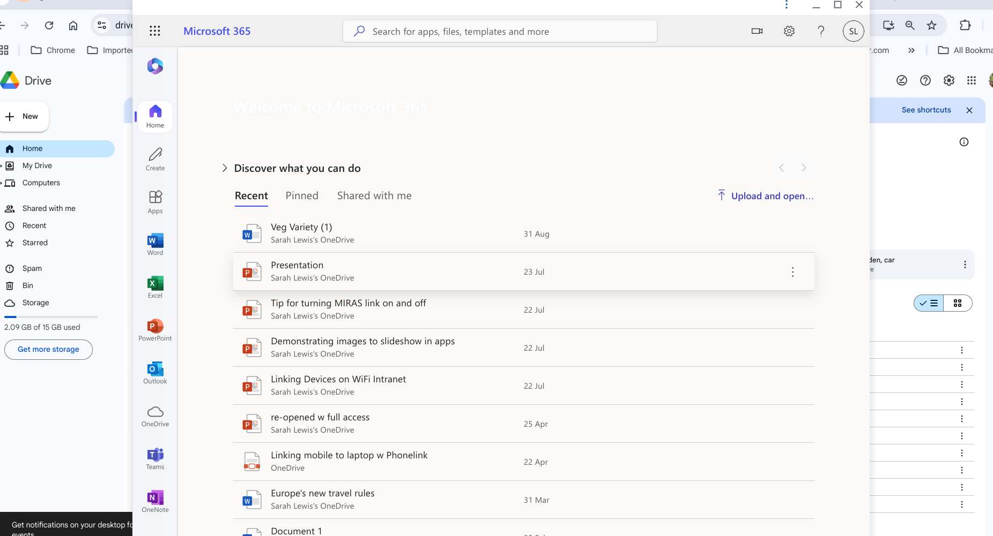

Slide 18
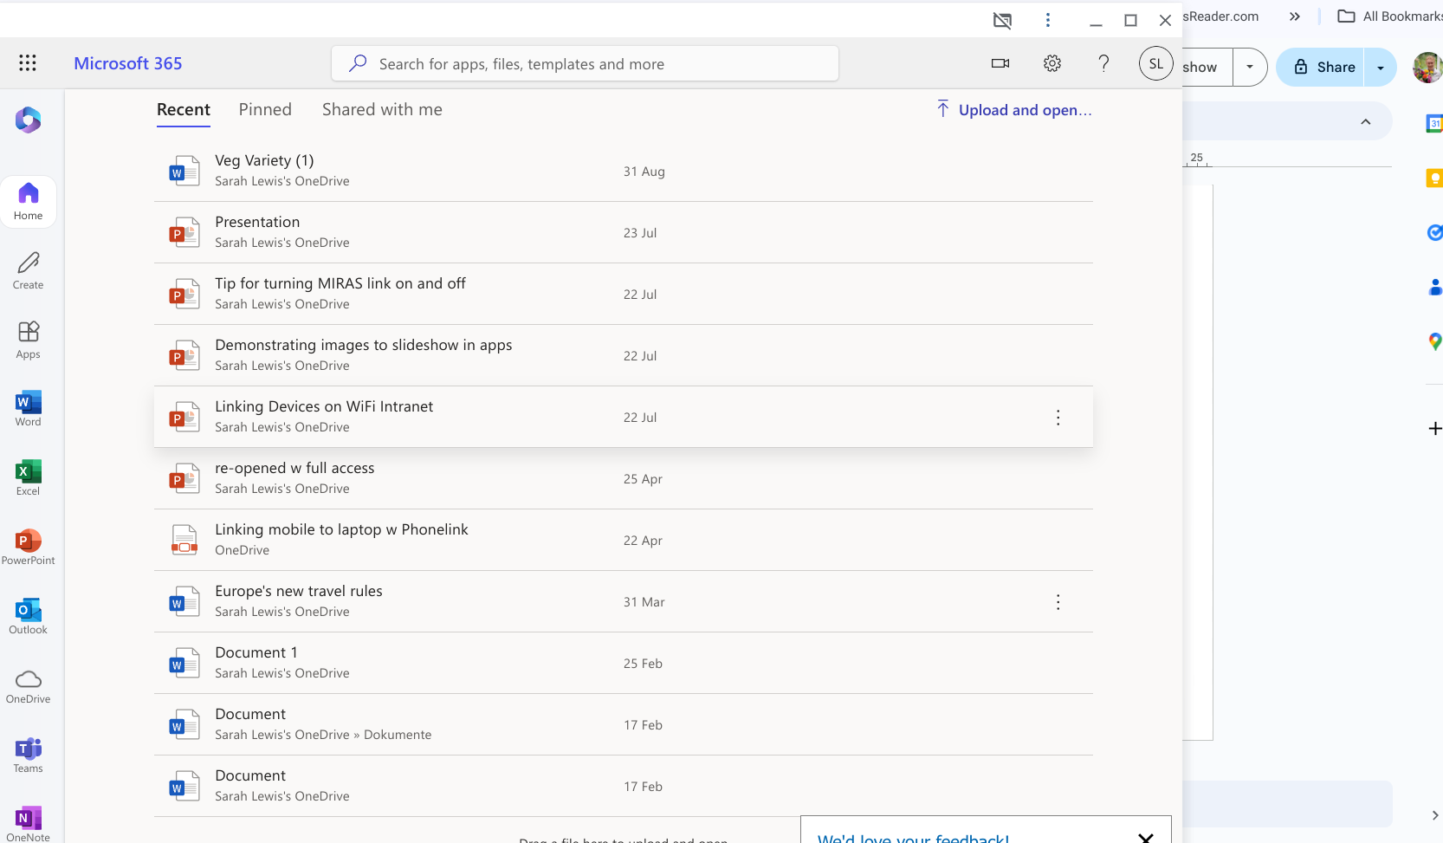
This command puts a chosen file into Downloads on the Chromebook ie via Google MyDrive cloud
Double-click on chosen file to open it directly

Slide 19
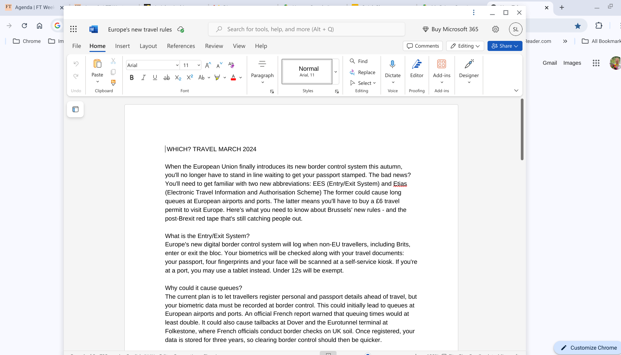
Standard (simplified) Toolbar for the web-based version of Word app

Slide 20
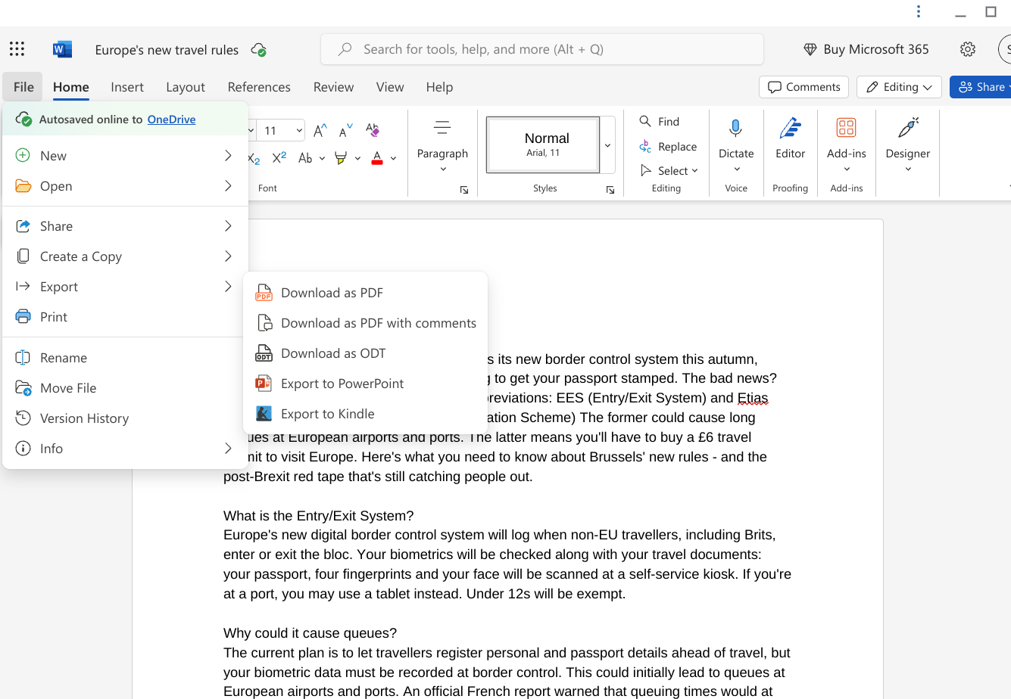
Opening the file directly in Word only allows download formats shown ie not Google format

Slide 21
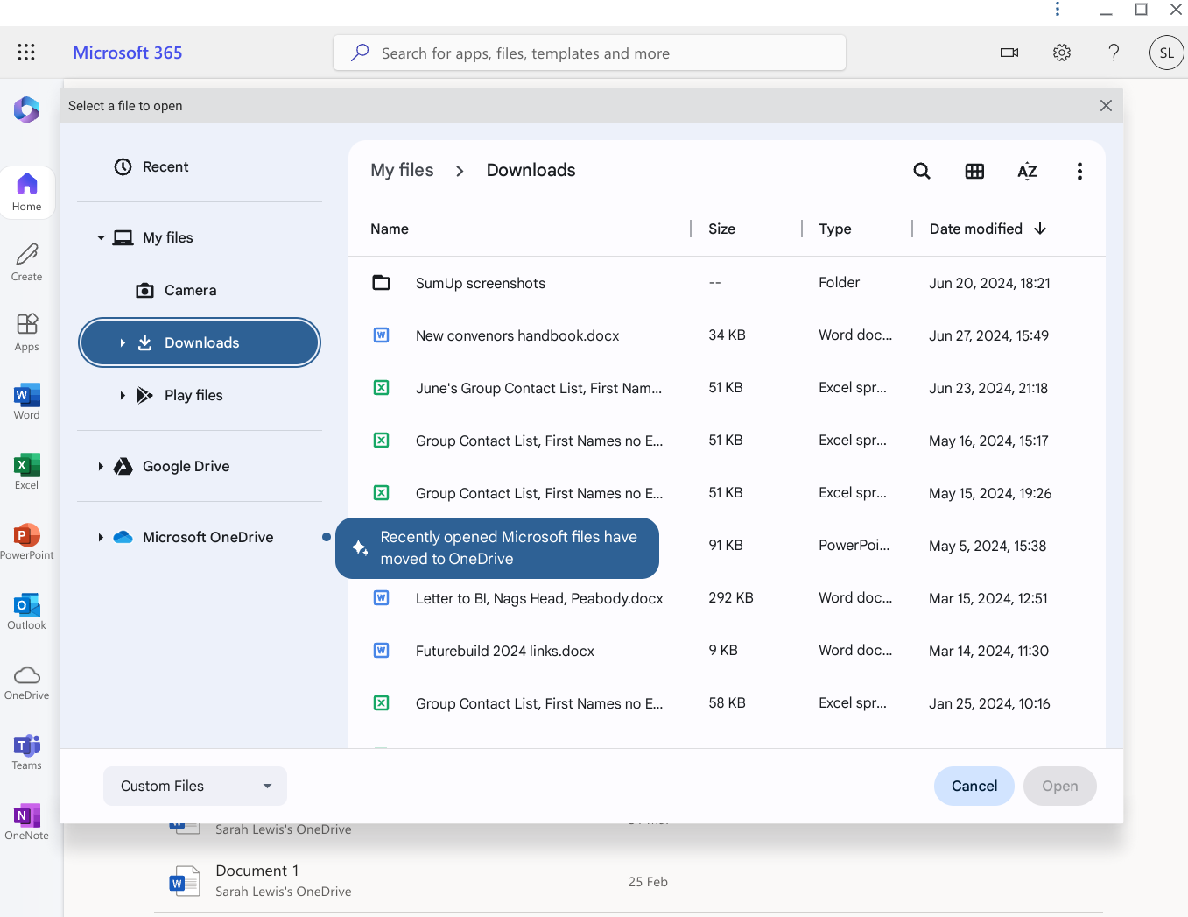
Clicking the Upload command will transfer the chosen file(s) via Google Drive cloud to Chromebook Downloads where it can be converted to Google format

Slide 22
Guest staying overnight may want to share your Wifi network and save their mobile data allowance - easy shortcut way to do it.

Slide 23
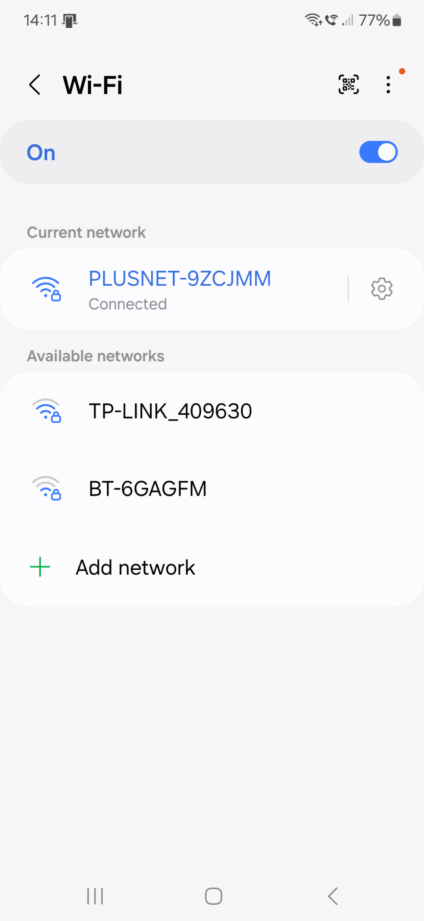
Phone: open Settings/Connections/Wifi
Cogwheel submenu for sharing Wifi 12 digit pass code with another phone: tap it
QR code symbol for adding a Wifi network to your phone via the 12 digit passcode

Slide 24
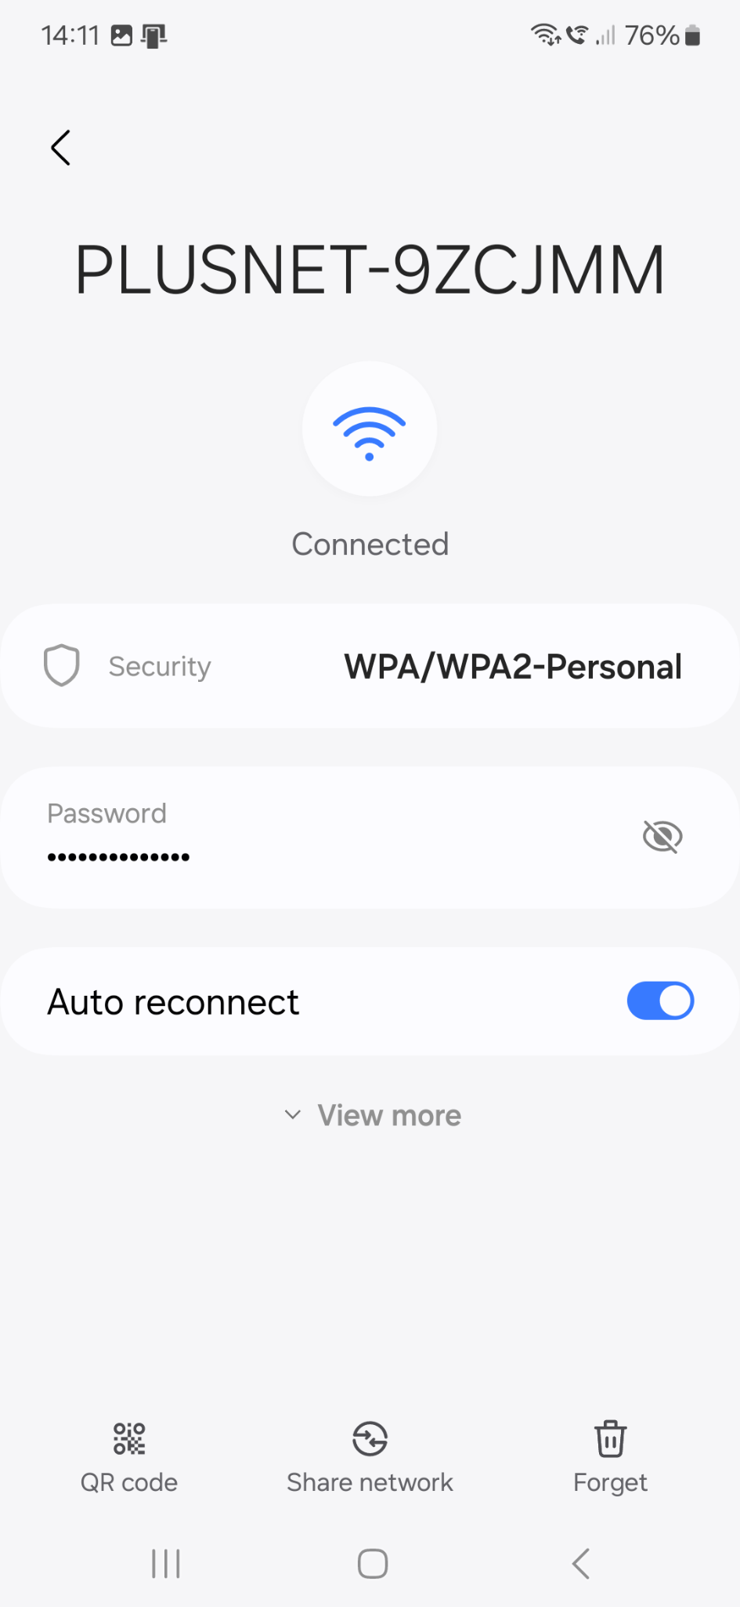
Tap the QR code symbol. (Or this phone allows you to use a Quickshare link too)

Slide 25
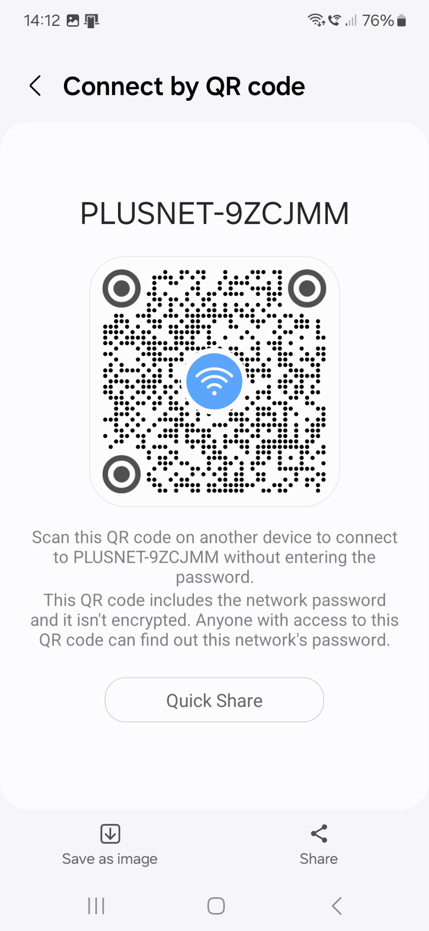
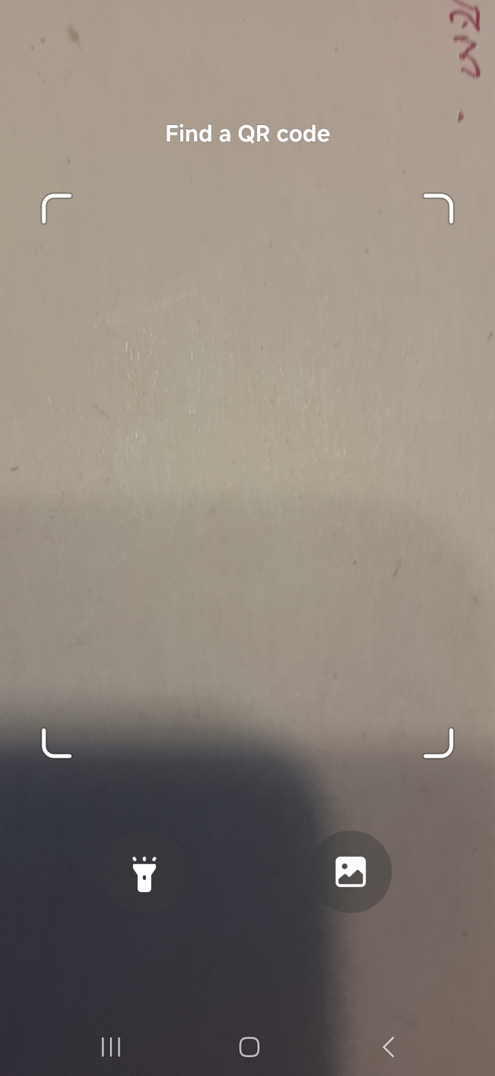
On the phone sharing the network
On the receiving phone - go into Settings/connections/Wifi and select the QR code symbol at the top of the webpage to open camera

Slide 26
Organise your open MS Edge tabs into logical groups and stack them.

Slide 27
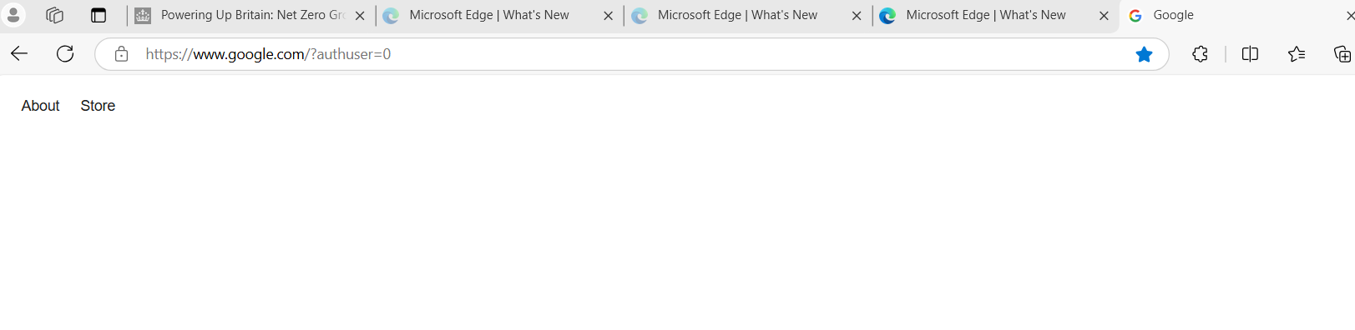
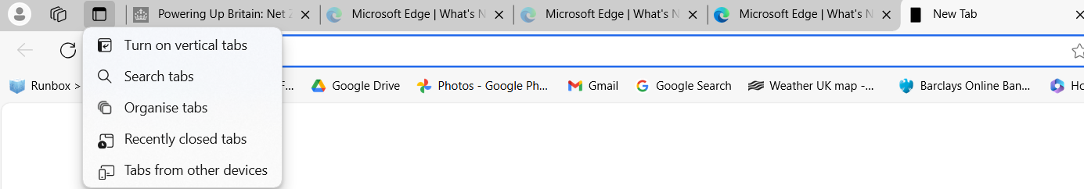
Multiple open tabs on MS Edge can be organised by AI: Useful if you need them to remain open

Slide 28
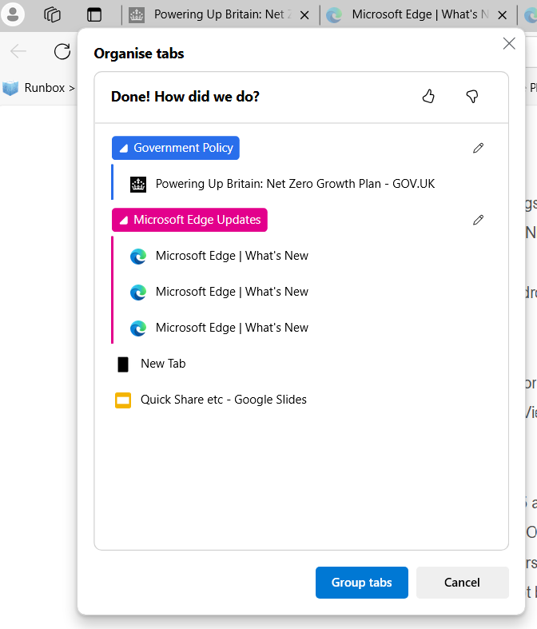
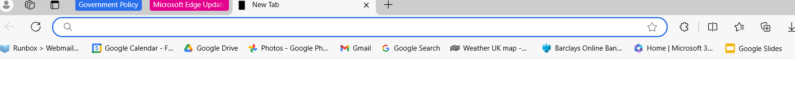
Click group headings to expand or close the stack of tabs within each group

