Slide 1
Quick keys, Shortcuts
& Function Keys

Slide 2
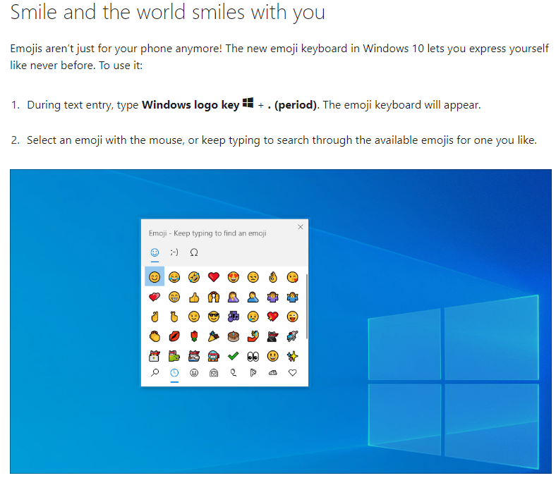
Emojis

Slide 3
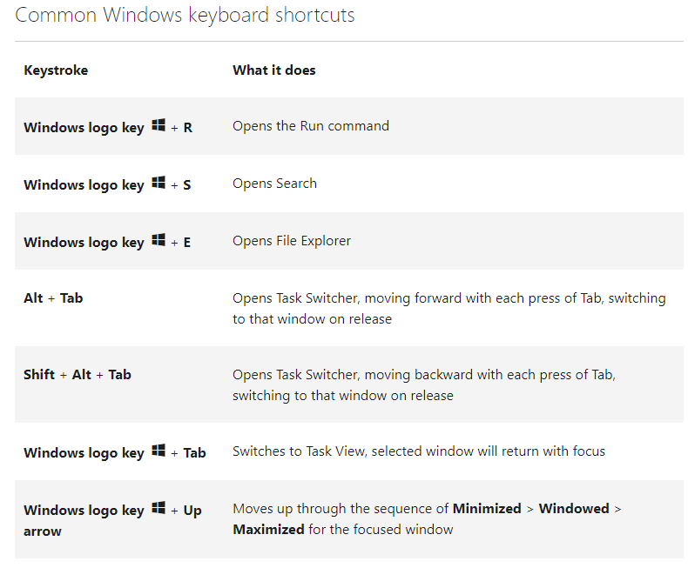
Common Windows Keyboard shortcuts

Slide 4
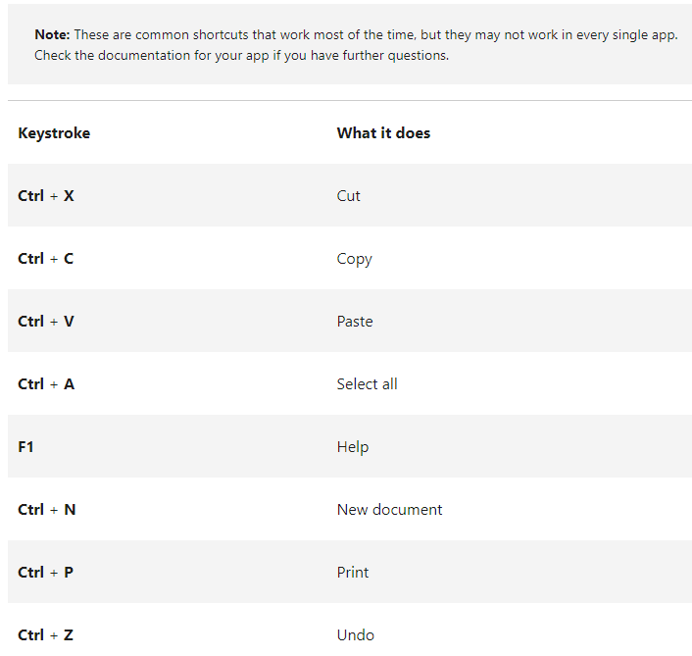
Common App Shortcuts

Slide 5


Apple Shortcuts

Slide 6

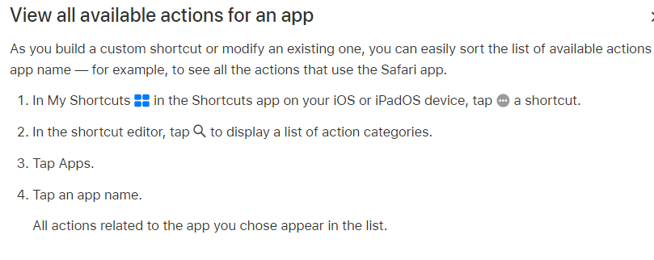
Apple Shortcuts

Slide 7
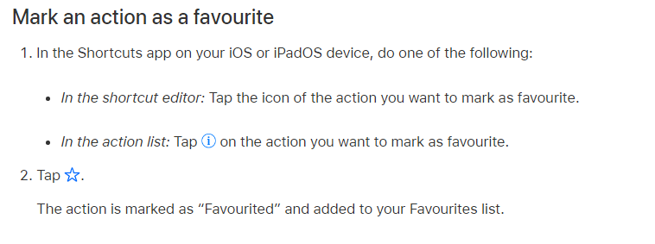
Apple Shortcuts

Slide 8
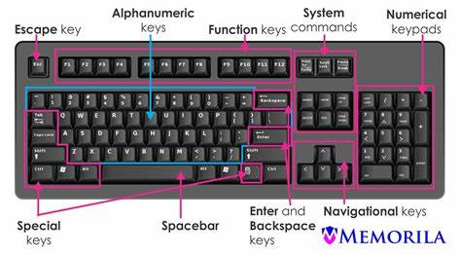
Function Keys

Slide 9
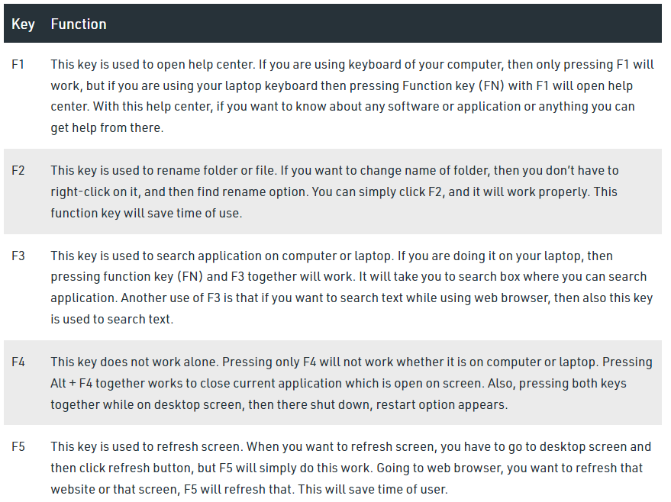
Function Keys

Slide 10
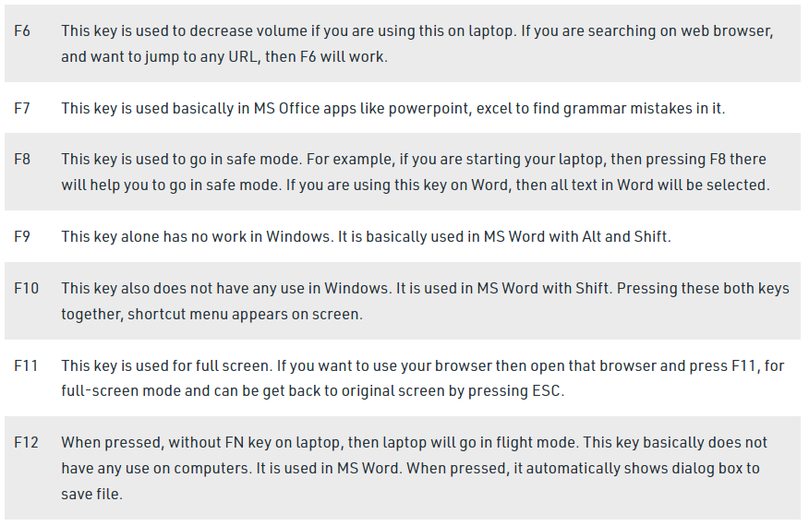
Function Keys

