Slide 1
Rich Communication Services (RCS) messaging/texting
vs Short Message Service (SMS)
SMS - the original cellular (mobile) text messaging introduced over 2G networks.
MMS - (Multi-Media Services) a beefed up version of cellular messaging transmission, enabling images etc to be sent.
RCS - requires a data link (through cable of various types), although the final transfer to/from the phones may be cellular, when it requires a 5G (sometimes 4G) network. WhatsApp, Facebook messenger, NHS app messaging are examples.

Slide 2
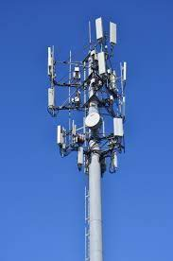
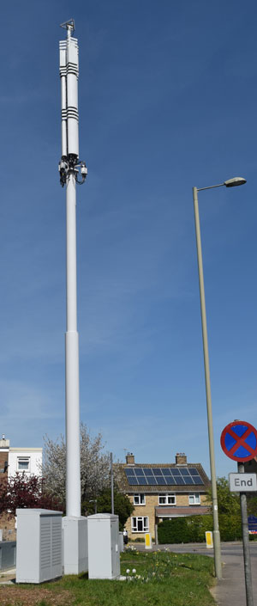
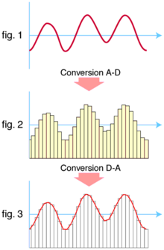
Towers:
Huge Modems!
SMS sent over 2G involves 3 or 4 bandwidths originally set aside for broadcasting. (Cellular transmission: radio waves.)
Modem conversion from analog (eg images, text, audio) to digital, and its conversion back again at the receiving end, can use an almost unlimited amount of digital “numbers” (bits) for the packets of data. 4G/5G capacity for data is much higher. Frequencies over the phone cable are much wider and faster. RCS utilises the full capacity & speed.
Your phone’s IP (Internet Protocol) address labels the message. Any digital communication via an IP address counts against your SIM mobile data usage unless all links are via Wi-Fi.

Slide 3
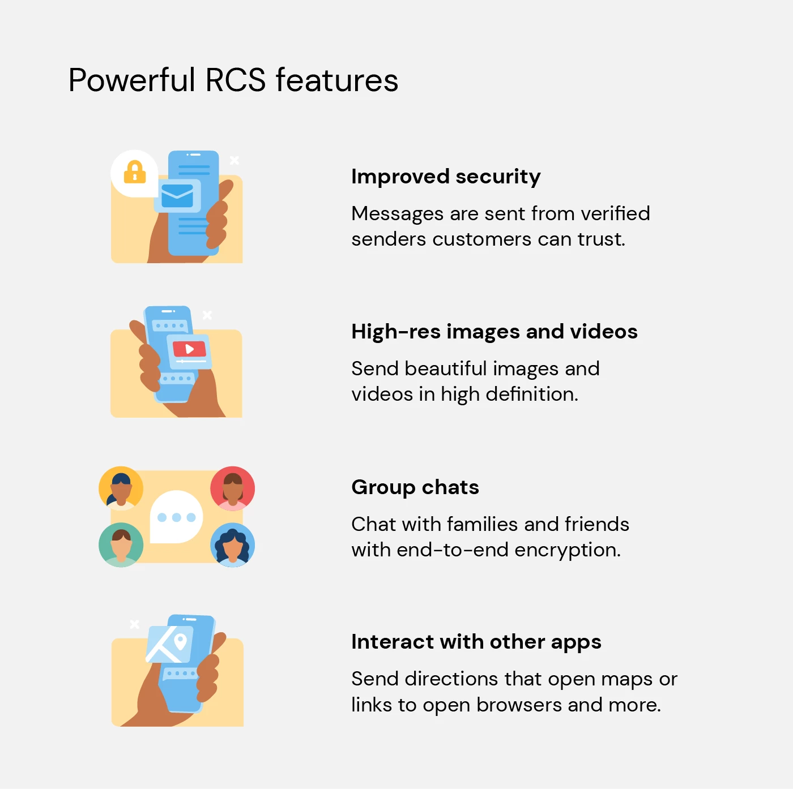
2-way encryption
Commercial texts can use logos, which are hard to scam.
Attach a link and it shows a preview (ie HTML)- like WhatsApp does.
Google photos & Drive
are already integrated - copy & paste

Slide 4
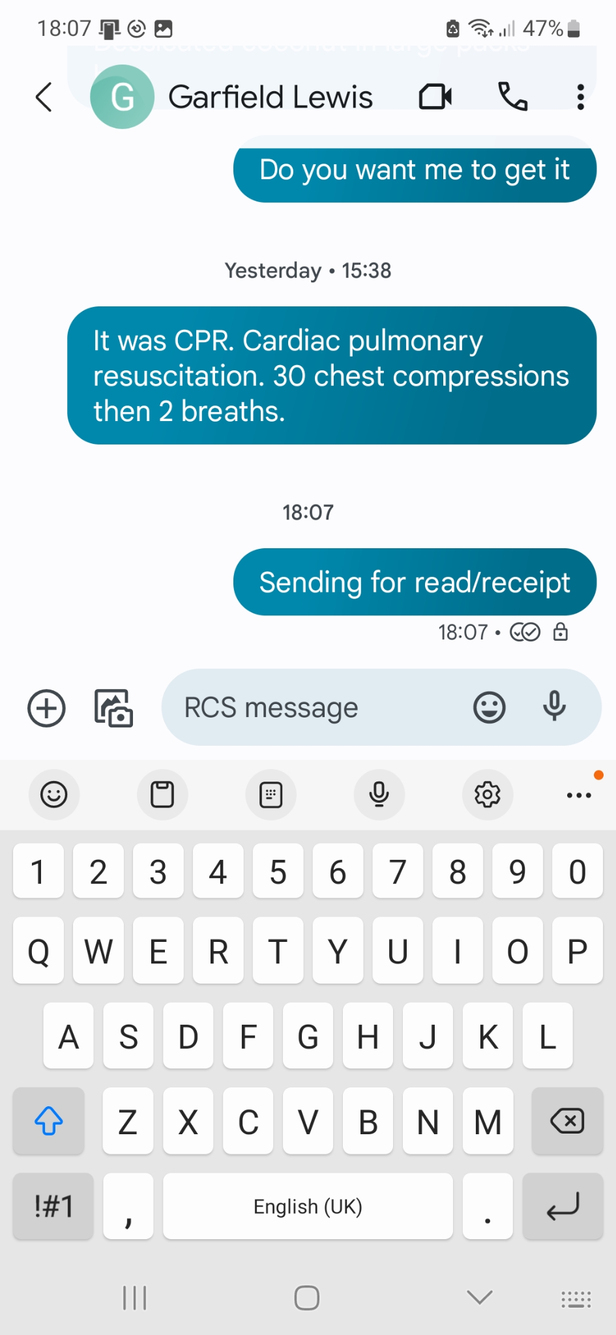
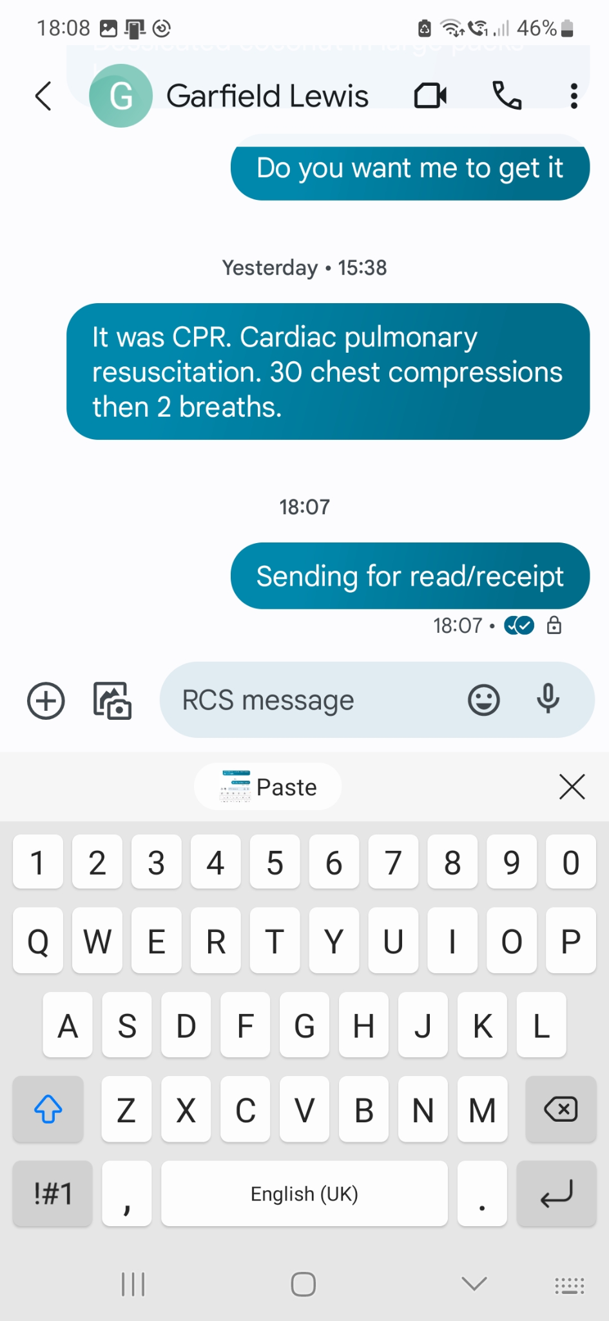

Slide 5
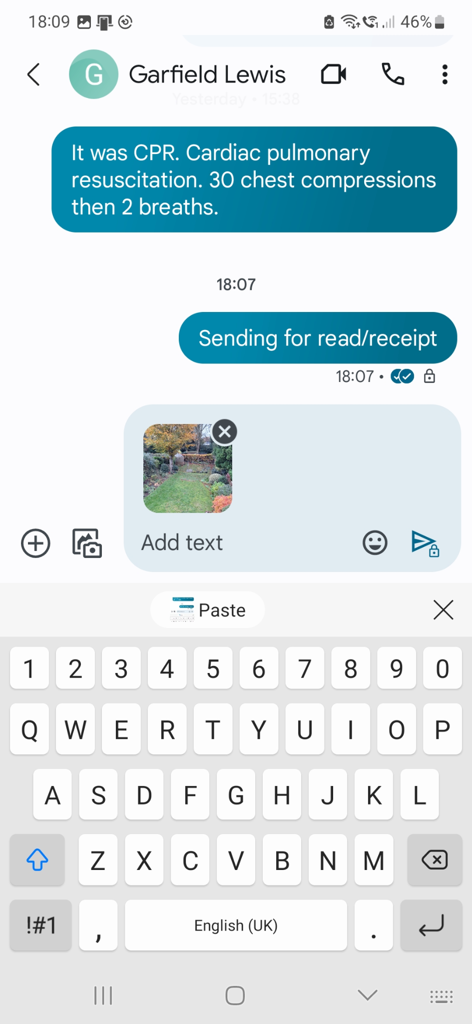
Attached pic straight from Google Photos (or Samsung gallery)

Slide 6
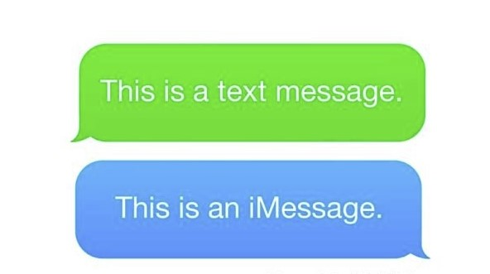
For i-Phone users: i-messages have the same features as RCS but are not compatible with that infrastructure (yet- coming 2024).
So messages from Android phones to i-Phones (& v/v) appear green on the i-Phone, denoting that they are SMS/MMS and not encrypted.

Slide 7
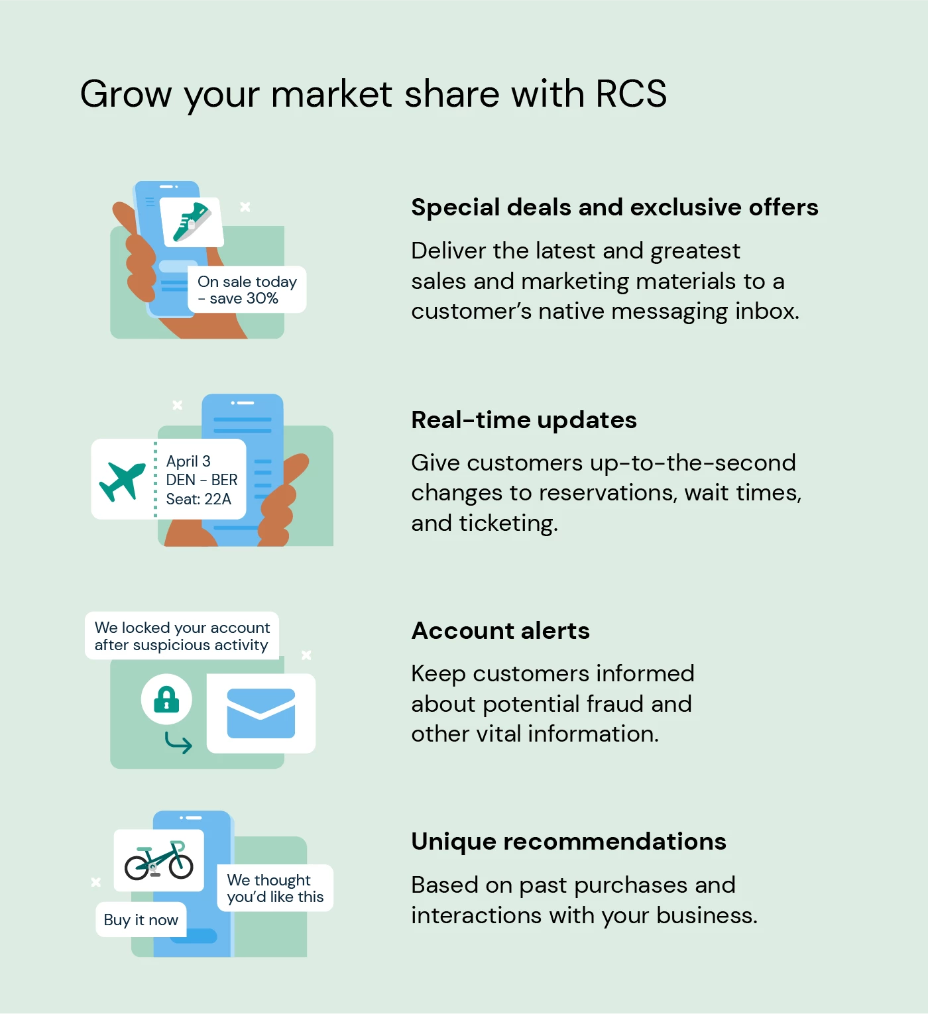
Commercial services RCS software gives more features than inter-personal RCS
Commercial companies are being targeted by software companies, to use RCS software.
However, changes in travel
timetables, appointment cancellation facility, would be welcome?

Slide 8
Charges
SMS are often charged per text. The phone network identifies your SIM card and IP address..
RCS charges are data-load driven and deducted from your data allowance provided on your cellular network deal. But most text-only usage is virtually free as data use is so small. Exception: roaming.
Handsets connected to Wifi have free data transfers, including RCS (within your ISP allowance which is often unlimited). If you want to send attachments, check that the Receiver handset is RCS enabled or it may go via MMS (which is cellular).

Slide 9


Current RCS Drawbacks
Apple equivalent messaging is not compatible with Android RCS yet. (Coming in 2024)
Some handsets, with old Android O/S, are not compatible. Only the Android messaging app and Samsung messaging app offer RCS at present.
Cellular networks not operating at 4G/5G will not be compatible.
The “registration” for RCS is carried on the SIM card - so tablets without a SIM will not be able to use it.
The default messaging route is SMS unless you have already successfully messaged via RCS and your recipient has opted in. It is not yet the industry standard that it was intended to be…. Apple changeover will cement it.

Slide 10
Smart - Techy things for the Christmas Break?

Slide 11
“Generative” (creative) Artificial Intelligence apps
Image Creators
Midjourney
Bing Image Creator
Adobe Firefly
Text Creators
ChatGPT
Bing Chat
Google Bard

Slide 12
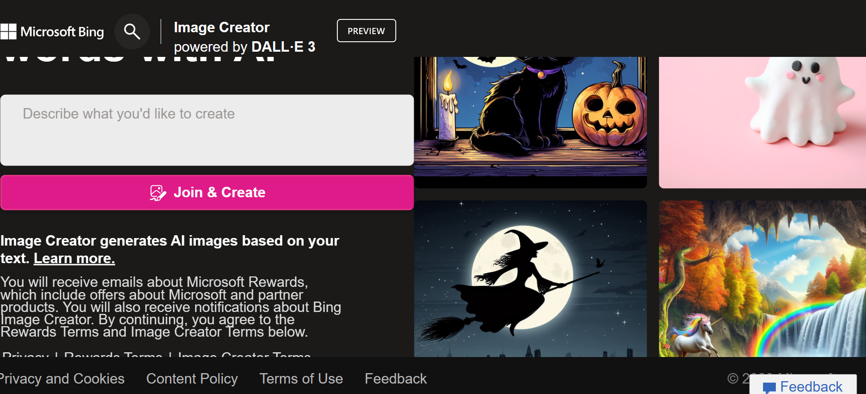
Also: the MS Bing AI chat app is closely linked with ChatGPT (OpenAI)

Slide 13
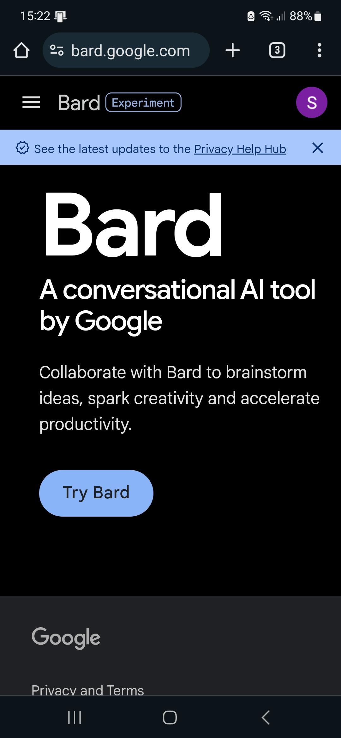
Bard didn’t rate so high as Bing Chat in Which? Tests.
Bing is based on the ChatGPT Large Language Model (LLM), unlike Bard.
Bing Chat isn’t hedged round with marketing “points” that have to be earned, unlike Bing Image Creator

