Slide 1
Some Considerations for buying or replacing a computer
Notes:
Habits have changed since we bought desktops: smartphones and web based activity claims as much of our computing time as traditional programs.

Slide 2
Factors
Purpose | Screen size | Processing speed
Compatibility with existing file formats | Built-in obsolescence & lifetime | Software updating issues
Size & portability | Graphics | Cost
 | OPERATING SYSTEM
Notes:
Purpose may range from the odd text/email to creative activities (photo editing & graphics, music notation, audio recording, report writing, browsing for learning), video-heavy activities ie streaming media etc
Screen size and Graphics even if projected to a TV, HDR images are only as good as the graphics card will allow.
Compatibility with existing formats eg .png projects - you may prefer your favourite Photoshop app, which does not run on all platforms.

Slide 3
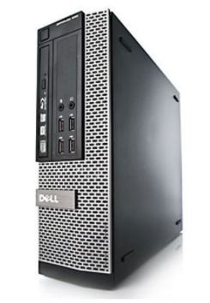
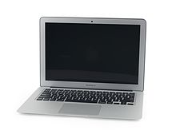
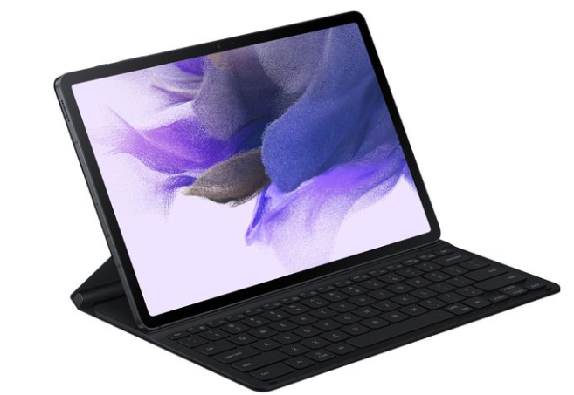
Tablet with blue tooth keyboard | Desktop with screen, speakers, peripherals of your choice | Most popular: laptop
Notes:
Most of us graduated from desktops. Even a basic Android tablet (with a keyboard if you like writing documents) can achieve everything the early desktops could do, and more. (Smartphones, I’m rating as tiny tablets.)

Slide 4
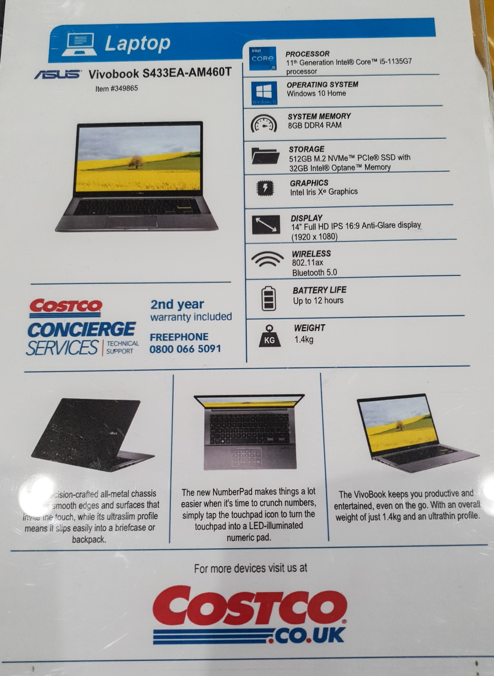
Processor - Intel or AMD. The higher the number generally the better.
Operating System - Windows 10 or 11. Alternatives are Google Chrome and Linux based open source systems.
System Memory (RAM) - A computers short-term memory. Having more Ram tends to improve the speed of your machine when opening large files and programs.
Storage - HDD (hard disk drive) or SSD (solid state drive) or a combination of both. SSD’s are fast and less prone to damage, they are more expensive and have less storage capacity.
Graphics - Intel, AMD and Nvidia. More expensive cards are supplied with own Ram.
Display - Generally HD but can go up to 4K those above HD will reduce the battery life.
Wireless, Battery Life and Weight - These aspects are dependent on how and where you will use your machine.
Notes:
BBC KS3 revision notes for computer processors: https://www.bbc.co.uk/bitesize/guides/zws8d2p/revision/2

Slide 5
Processor type | i(ntel core)5 i7 AMD celeron pentium, (core, cache, GHz= clock speed)
RAM random access memory | Together with processor, gives “active crunching power”
ROM | Mb for file storage and retrieval SSD eMMC embedded multimedia card
Screen | Size Resolution IPSin plane switching LEDlight emitting diode
Connectivity | Wi-fi: (chip name, 2x2) (1x1) 802.11 = Wifi5
Input/Output socket types | - USB Type-C x 2 - USB Type-C x 1 -USB 3.0 x 2 HDMI 2.0 x 1(or chromecast for video projection) - USB 3.1 x 2
Add-ons | Memory cards (SIM card) camera spec.
Notes:
Processor - look up the most recent model for the processor name. In general, the higher number is most recent. More cores, more cache the better. Clock speeds can be misleading. RAM the higher the better. BUT high processing speeds are not always necessary.
Large ROM is less important if using cloud storage. Screen performance is usually highlighted in the reviews online. Wifi latest protocol, more cores are better.

Slide 6
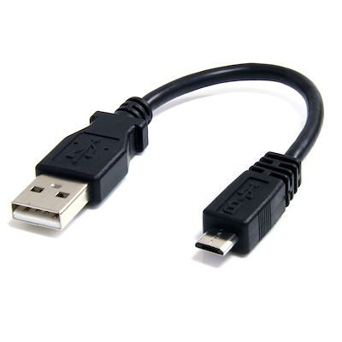
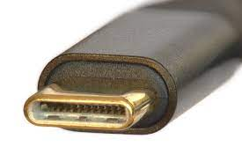
Connectivity also depends on plug types, broadband type and router position plus Wifi amplification, if you don’t use cable connections.
USB type C | USB type A (number) USB micro (obsolete)
Wifi firmware in the computer needs checking if it’s an old model. Look for the 802.11 (firmware standard) release number, and number of cores.
Notes:
Weakest link determines speeds and connectivity

Slide 7
“App” (Web Based Application) vs Program
A conventional program, written in one of the older, standard computer languages for a “platform” (ie Microsoft) needs an installer - an .exe file - and “client side” processing ie you have to click “install” and follow update prompts.
When a program is updated, upgrades are required at the server and client side.
Programs can be run locally on the hard drive of the client’s computer.
Apps are wider in scope - they address a whole need (eg spreadsheet, business point-of-sale, writing music) and are web-based, ie dependent on the internet.
On a webpage loaded while running an App, the client can execute commands by clicking on an area (via the web browser) which is thenprocessed mainly by the host application ie on their server..

Slide 8



(Wikipedia article quote)
“ In 2014, HTML5 (browser language) was finalized, which provides graphic and multimedia capabilities without the need of client-side plug-ins”
Steve Jobs favoured HTML5 over Adobe Flash - both of which do similar things. HTML5 was superceded by Blink - developed by Chromium, but HTML5Edge was then developed by Microsoft.
Small Android devices use a simplified version of the Chrome browser.
Which Platform you choose
determines the look, feel and performance of your browser.
Notes:
For chromebooks, the browser is the “home page” or desktop, but with a pop-up task bar that offers the installed apps.

Slide 9
My Chromebook - quite basic, designed for student use, bought 2020
Operating System Chrome
Processor “The AMD A4-5300 is a desktop processor with 2 cores, launched in 2012”. 1.6 to 2.4GHz clock speed.“It is probably good enough for not very recent games”
RAM 4Gb
ROM 18 - 32 Gb
Display 1920 x 1080 14in
WiFi 802.11AC (2x2)
Connectivity two USB-C 3.1 and USB-A 3.1 ports (so good for older and newer accessories)
Automatic Update Expiry 2026 NB The reviews don’t give this date: Look it up on Google Help!
Notes:
Better than average Wifi firmware.
No HDMI - instead the screenshare is passed through a Chromecast module which plugs into the HDMI socket on the projector or TV.
Security is high - and automatic (sandboxing, malware detection etc)
I can’t run Photoshop e (the advanced program/app) but I can run… (next slide)

Slide 10
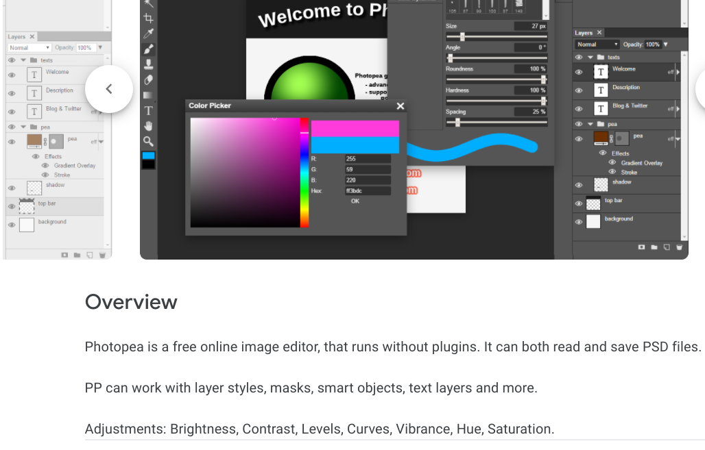
With Chrome: there’s always an app to get round file and program incompatibility
Notes:
A program that is entirely internet based - saving to Drive cloud. Gets round the Microsoft nature of Adobe PSD files: Cloud convert will convert .jpg etc to PSD.

Slide 11
Working Lifetime
Hardware problems
Battery non-replaceable (Solid State) drive packs up. Keyboard malfunction
Software problems
Processing power drops below requirements of operating system
Purpose of use changes eg gaming with grandchildren, screen sharing on Zoom, hosting on Zoom
Operating system no longer protected from Malware or no longer supported. Outcome: Hacked! (or unsafe)
Notes:
These are the hardware problems we’ve had… many others!
Operating system no longer supported - OK if you never go online!

Slide 12
Ball-park cost comparisons of computers bought in 2020/2021
Microsoft laptop Mid range quality 15inch | Chromebook laptop Student range quality 14inch | Tablet and keyboard (no SIM card)
Say: Cost (equivalent) £500 Maintenance: anti-virus £26 per year, Office 365 £60 per year | Say: Cost £250 No anti-virus needed No office software costs. Supplementary apps to date: £20 | Say: Cost £200 Bluetooth keyboard Cost £15
Lifetime, when used constantly Say: 4-5 years (Desktop, intermittent use, however will be 8-9 years) | Lifetime when used constantly Say: 3-4 years
Cost per year: say £200 | Cost per year: say £ 75 | Costs per year: similar to Chromebook
Notes:
Cost isn’t everything, but if a Chromebook for student use is so cheap, why not give it a go? Tablets can do more than we imagine, but the touchscreen nature of the interface isn’t for me.

Slide 13
What the Future may Hold has Implications for our Devices
Gaming the “Metaverse” can/could be accessed via headsets, game consoles, and ?giant computer screens. (Microsoft has paid $75bn for the company behind Call of Duty, World of Warcraft and Candy Crush).
Office/Home working
Android has restyled its major apps towards work projects ie sharing & oversight.
Microsoft has launched “Windows 365” (a subscription service) enabling Android and Apple to access Windows files (on the web ie One Drive) via their browsers.
Legal challenges to: Monopoly (“anti-trust”), privacy and espionage, data ownership, platform exclusivity imposed on app developers (Apple).
Outcomes may push web-based apps towards a subscription basis and away from advertising?
Notes:
All conjecture… Server capacity for 24 hour gaming ie living in the Metaverse?

