Slide 1
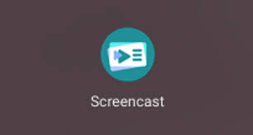
SCREENCAST - the app available to Chromebook users (- some results open to other OS’s)

Slide 2
It stitches together what you can see on your Chromebook monitor as a video of real-time Screen shots
You could just browse, but better to have a sequence of tabs to open, where you have arranged other visual material (photos, other videos, slides).
Can annotate the visuals using a visual trace (a “sketch pen”)
It records your commentary as a sound track and also as Voice to Text, and displays this alongside the appropriate screen shots in a side panel.
When you command the app to Stop, Chrome then integrates the data : allow up to 6 hours
Finally it downloads to your Drive cloud as a 3-part folder, one of which is readable and shareable to other OS users (as a .webm video)

Slide 3
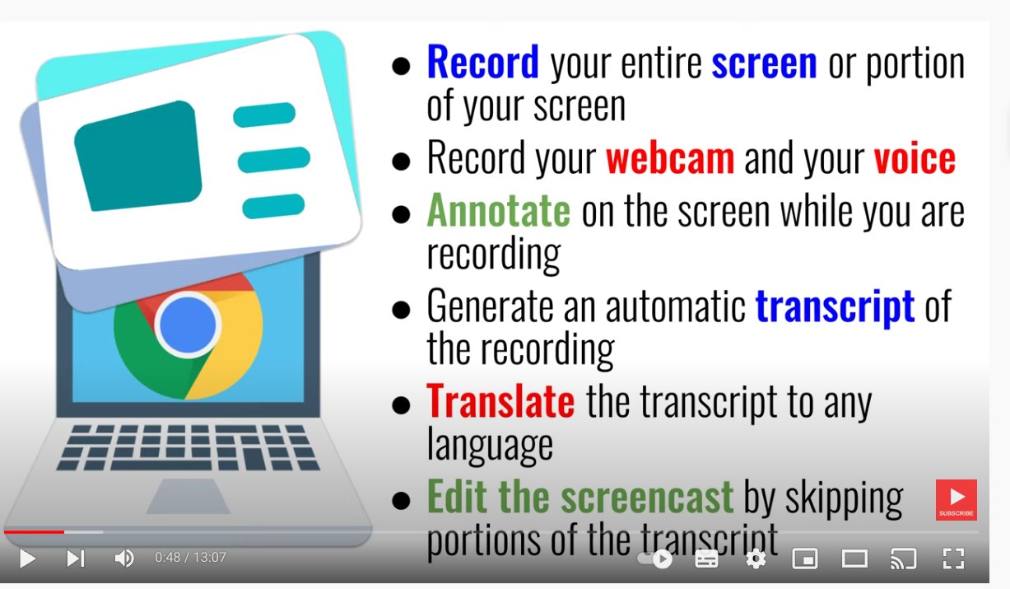

Slide 4
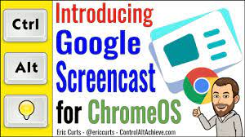
Eric Curts tutorial video on YouTube

Slide 5
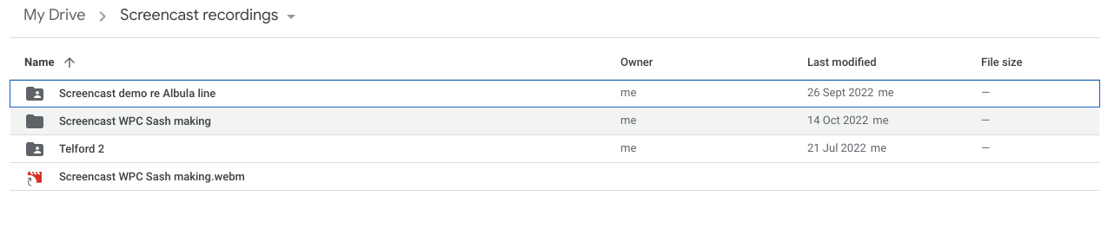
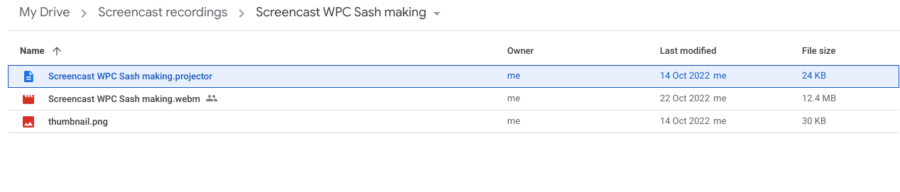
Which parts of your screencast video/text/commentary you can share with other OS’s
Opening the second (complete) folder shows:

Slide 6
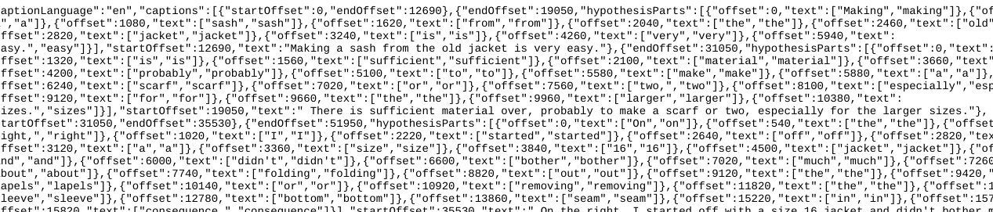

Of the three components to that folder, one is the voice to text programming (and cannot be sent to a non-Chrome user):
The .webm video - lacking the voice to text and excluding all editing - can be shared to non Chrome OS’s.
Send your non-Chrome recipients a link to it, to share from your Drive Cloud

Slide 7
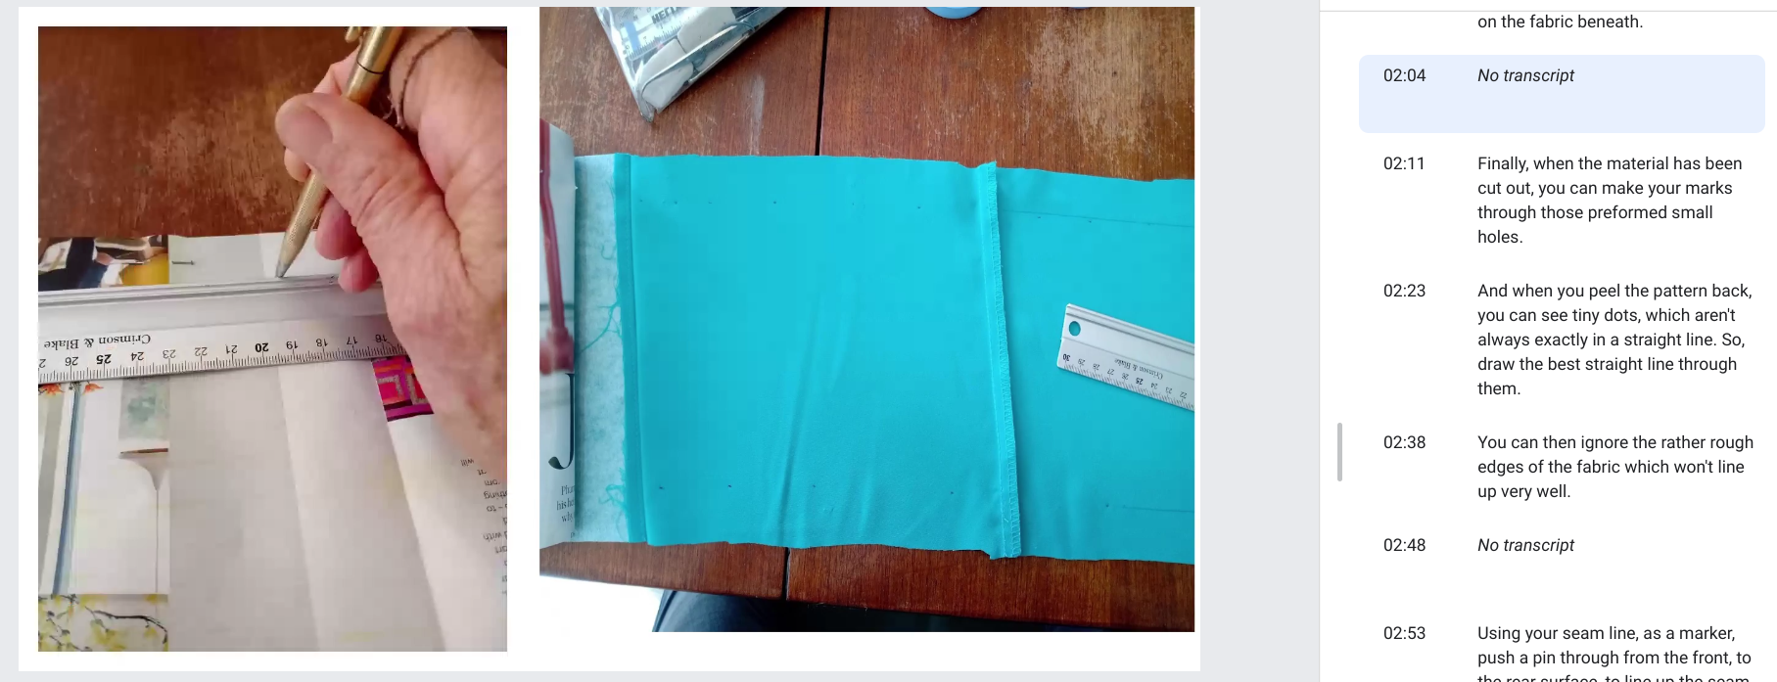
Alternatively: another way around the non-Chrome User sharing problem:
Screen shot your screencast video to show the text alongside your images, then make a Slides presentation of those shots, and download and send as a .pdf or Powerpoint.

Slide 8
Conclusions
The app offers:
A further audience or archive for all those presentations that have been laboriously put together and shown only once or twice.
Visuals can be much more engaging - include videos easily rather than hacking YouTube
The commentary - so much more informative than just “speaker notes” (which don’t download to .pdf anyway)
However:
It is designed to be shared between individuals using their own devices. The sound quality and text size of the voice-to-text is not suitable for projection via a projector/screen - but future smart screens/TV’s may get around that.

