Slide 1
Using Screenshots from your mobile phone and utilising them to inform and entertain

Slide 2
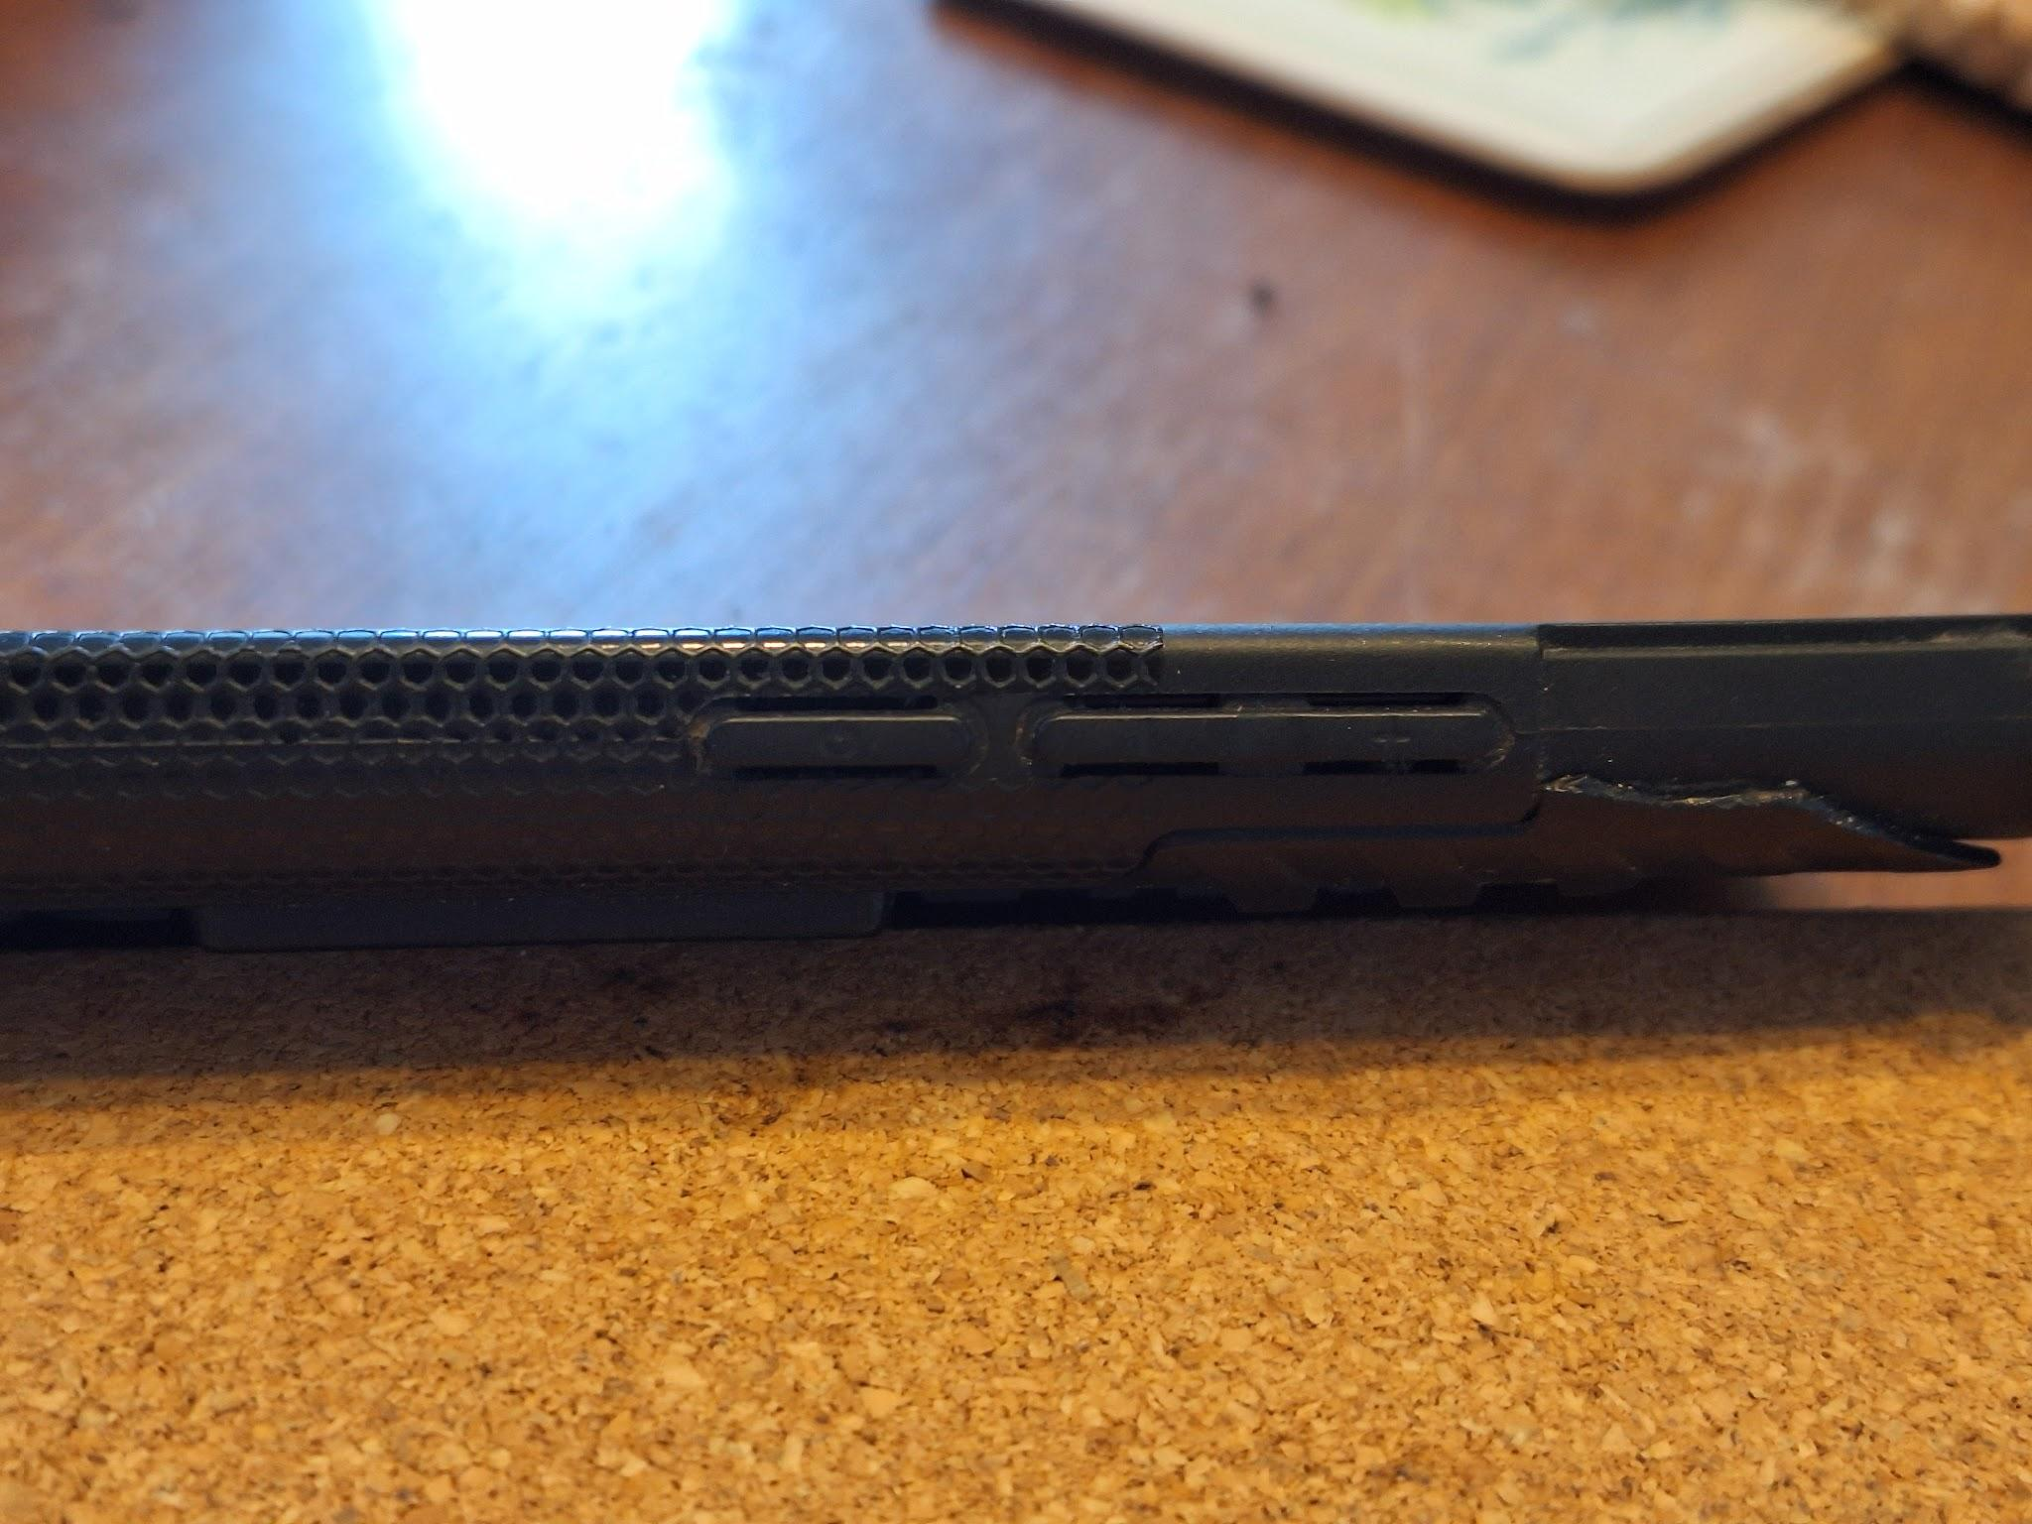
Default way of making a screenshot on a mobile phone: Press the on/off switch and the lower end of the volume switch together.
Success? “Shutter” sound and brief image on home screen

Slide 3
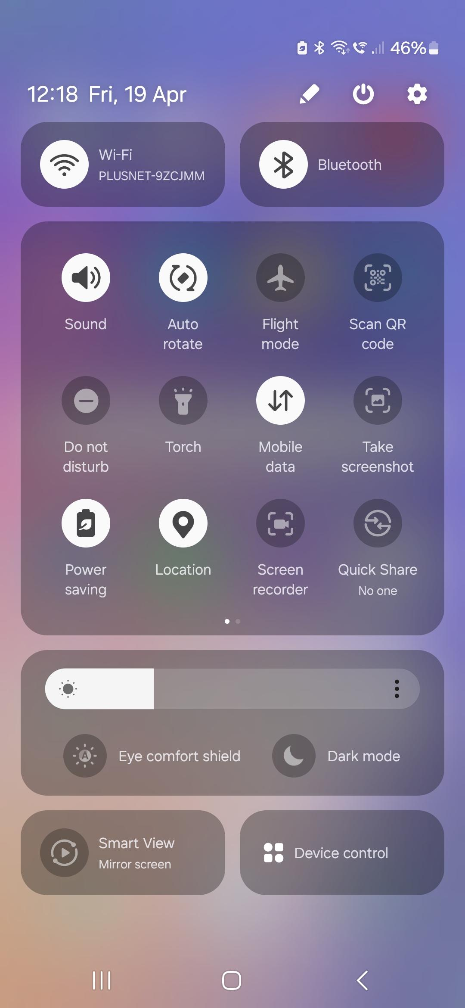
On a newish phone, alternative way of making a screenshot:
The pull-down menu from the top of the screen has a Screenshot option.
It will photograph whatever app page you have open under the pull-down screen.

Slide 4
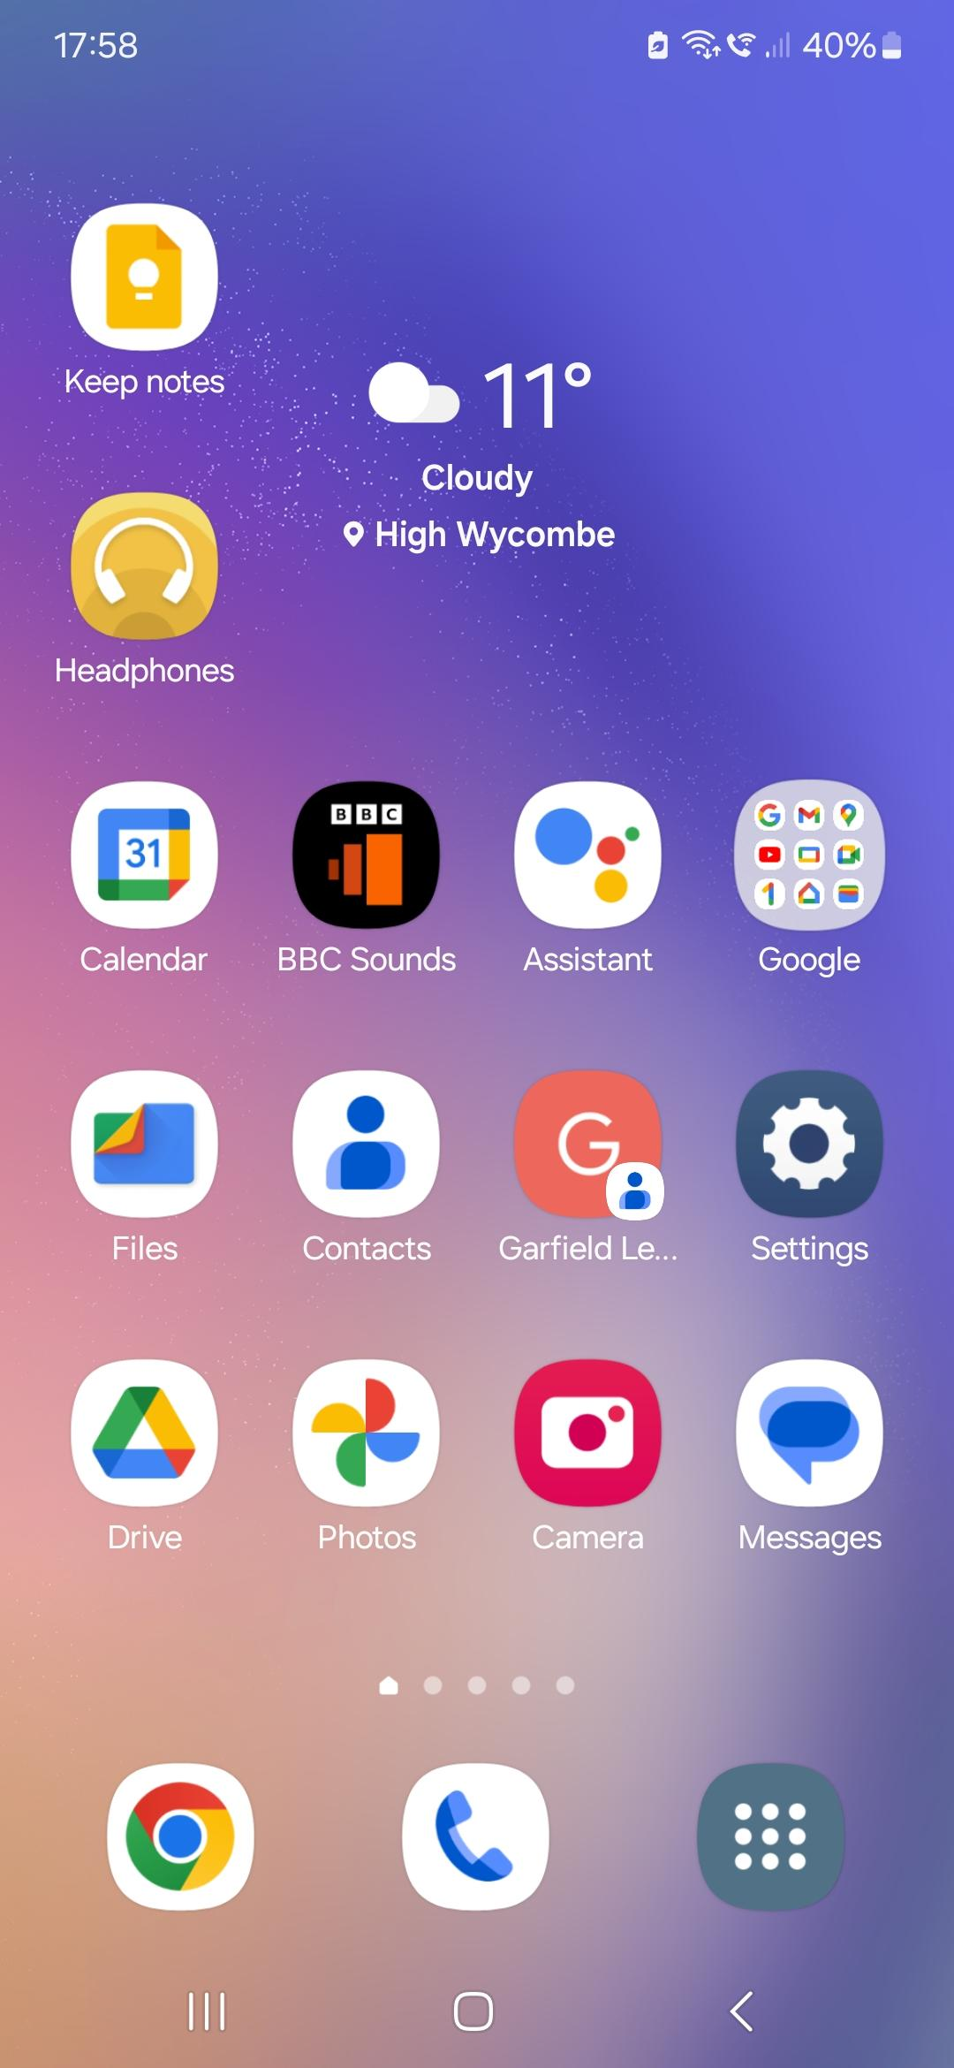
Where to find your screenshots and associated apps for modifying them.
If Google orientated: Use Files or Photos apps to find them.
(My) Drive apps to convert them into something useful
Or use your phones default apps
Or Settings (on a Samsung Galaxy, this offers some MS apps)

Slide 5



An Aside: If you principally use a mobile and tablet- choose your Cloud for compatibility with your devices and email addresses!
Google/Chrome For Drive (My Drive) & gmail
(Apple.. Now better communication with MS, but exclusive…)
Samsung.. Has own cloud and browser. Links well with Microsoft
On modern phones … “MS Edge for Android/Apple” browser is available now on any phone for linking with Microsoft’s OneDrive

Slide 6
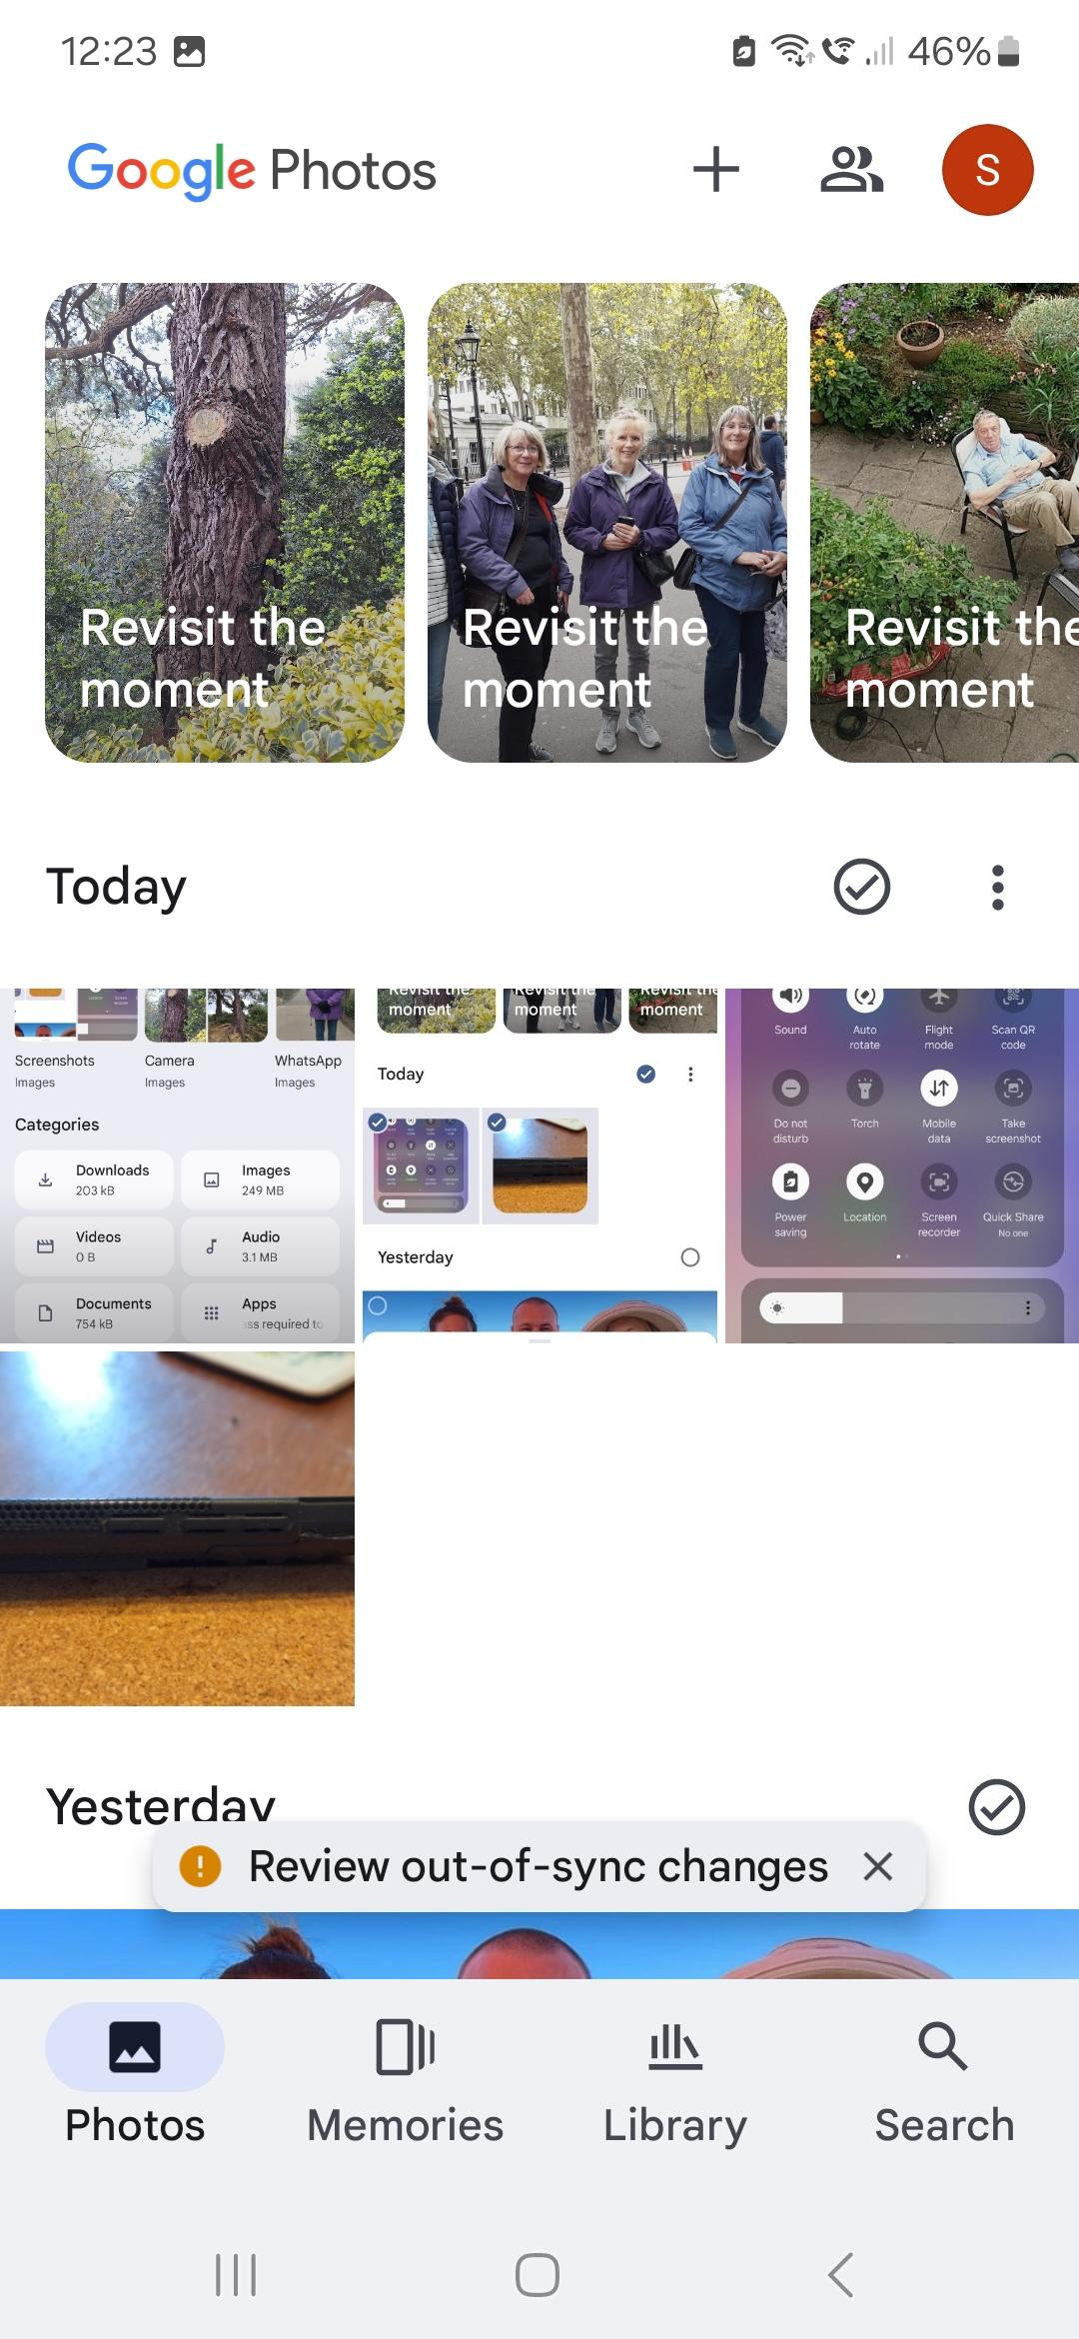
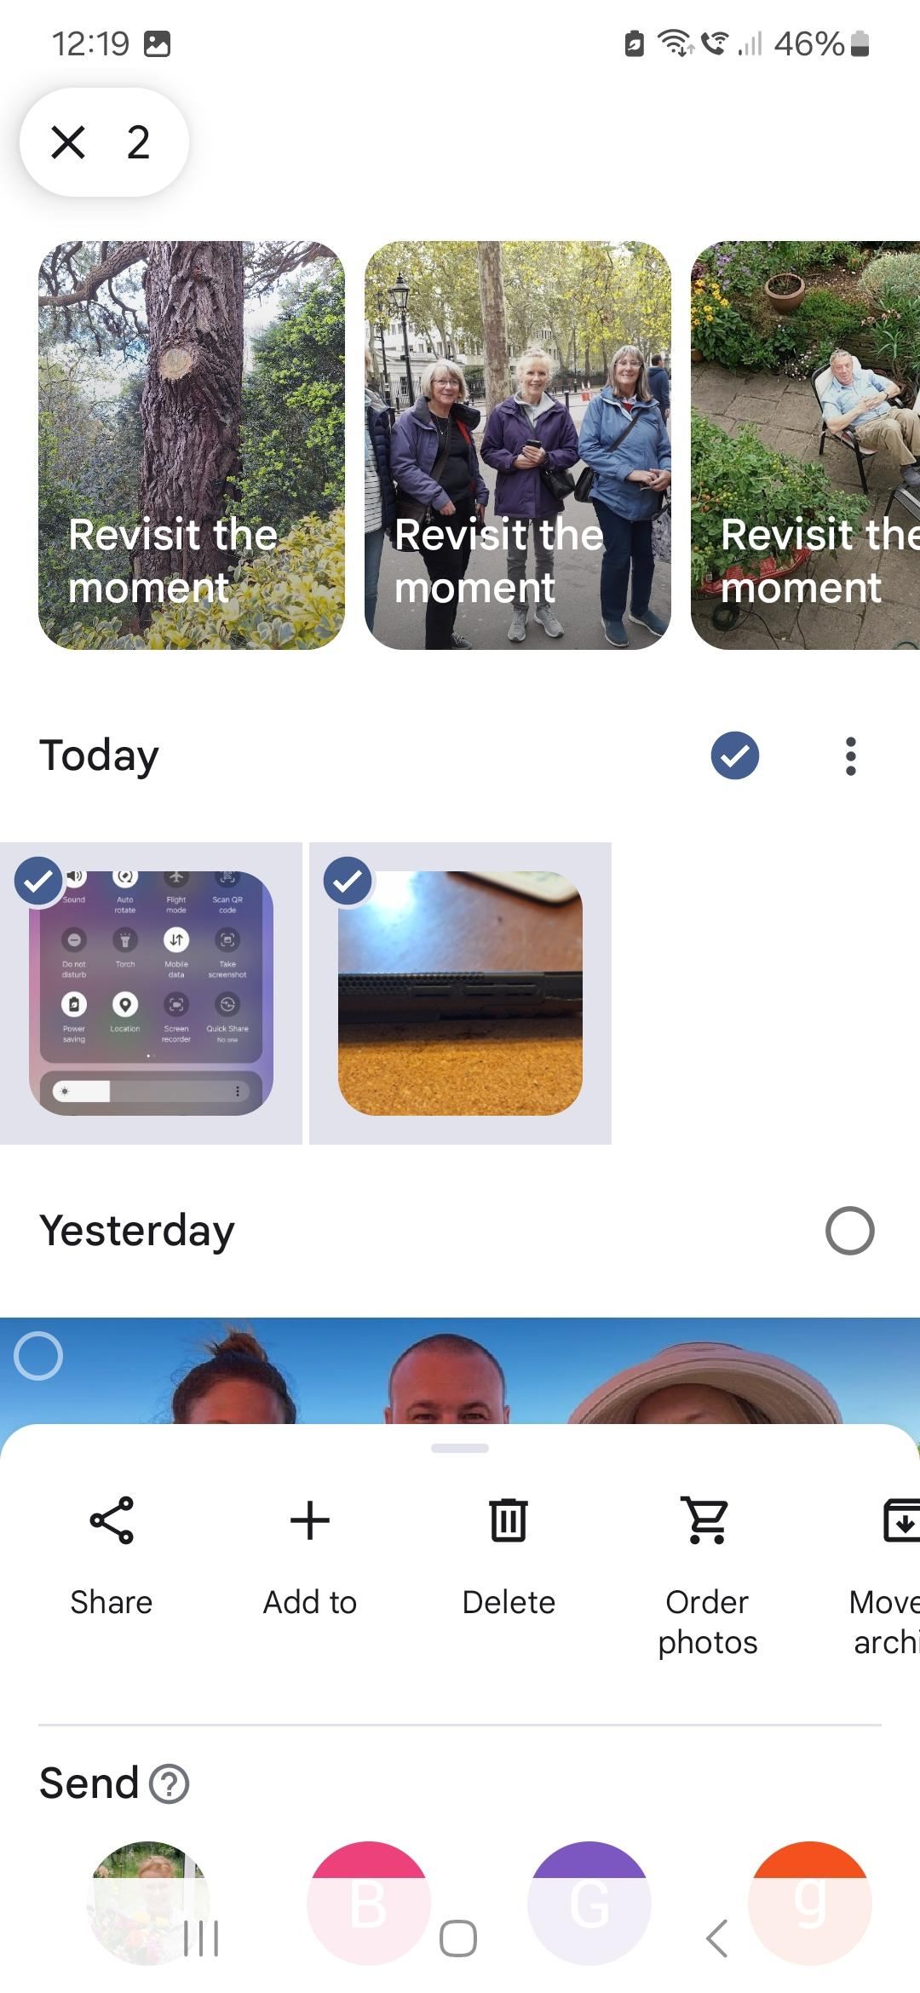
In Google Photos, images are in date order.
Clicking the Tick option will select Today’s images
And then offer you options of what to do with them. Select Share.
And then Drive to upload to the cloud (Drive)

Slide 7
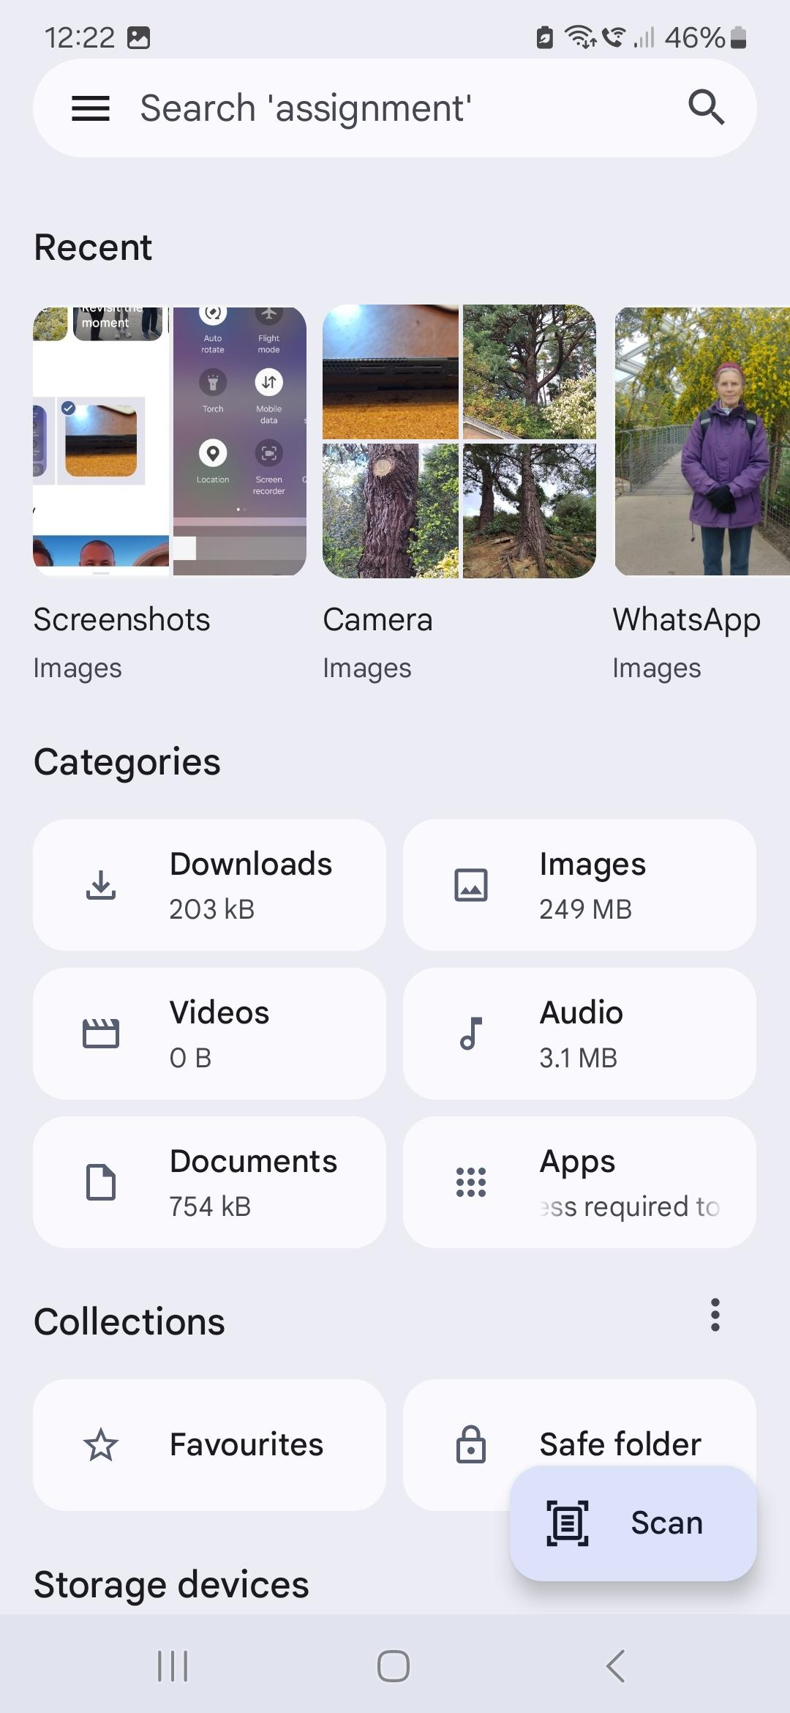
Alternatively, if you are using Google Files ( or your phone’s default file app), you can search the recent images , which are categorised into type of image - choose Screen shots and select them in a similar way,
then Share to Drive
(then load into Slides app which can download as .pdf)

Slide 8
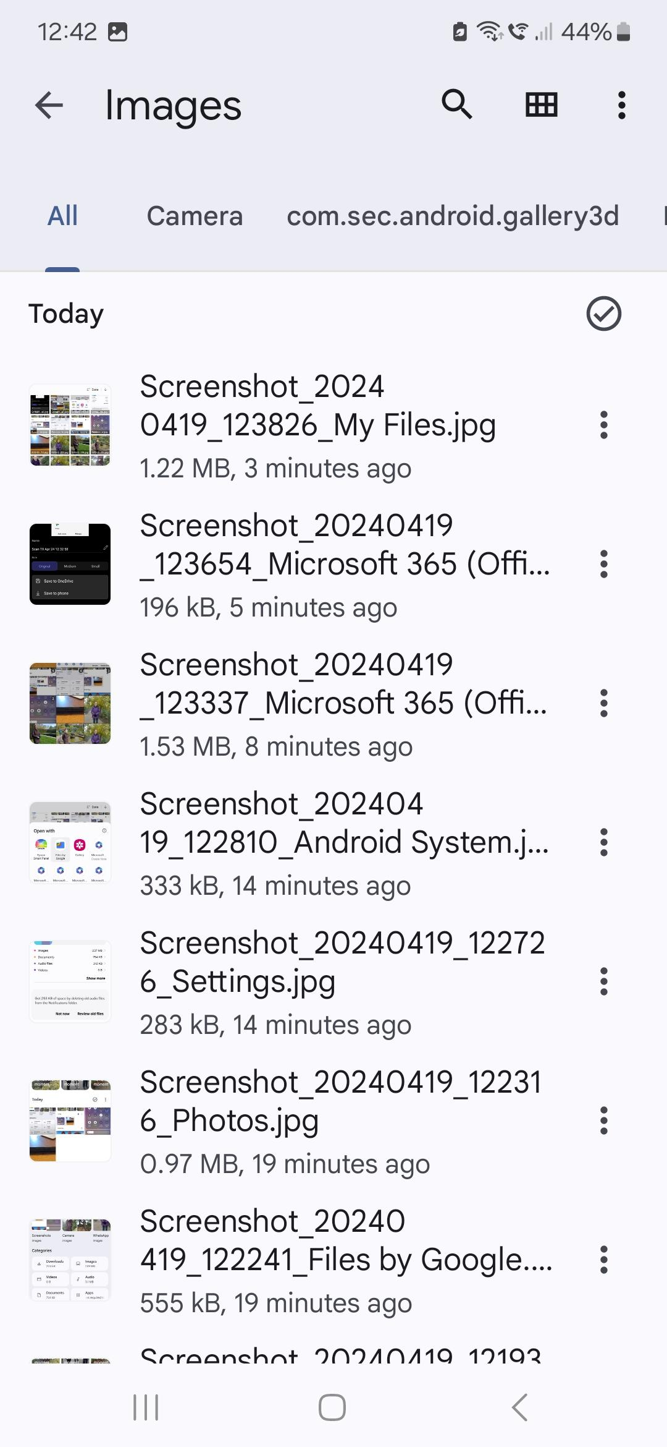
No need to rename your screenshots (if using Google apps to utilise them ) because you will be able to view these thumbprint images in most Google apps (such as Google Slides)

Slide 9
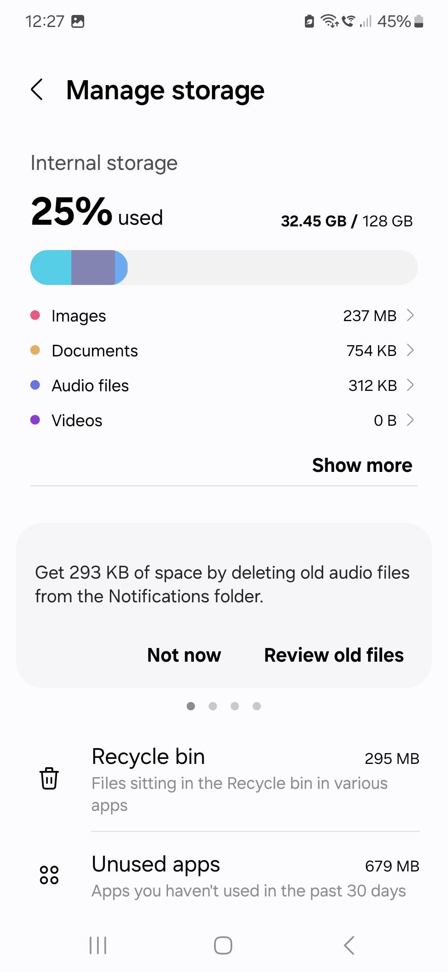
Another way of finding your screenshots:
Go into your phone’s Settings
Then “Device Care” (or similar submenu for reducing your memory and storage use)
Then Storage
Click on Images

Slide 10
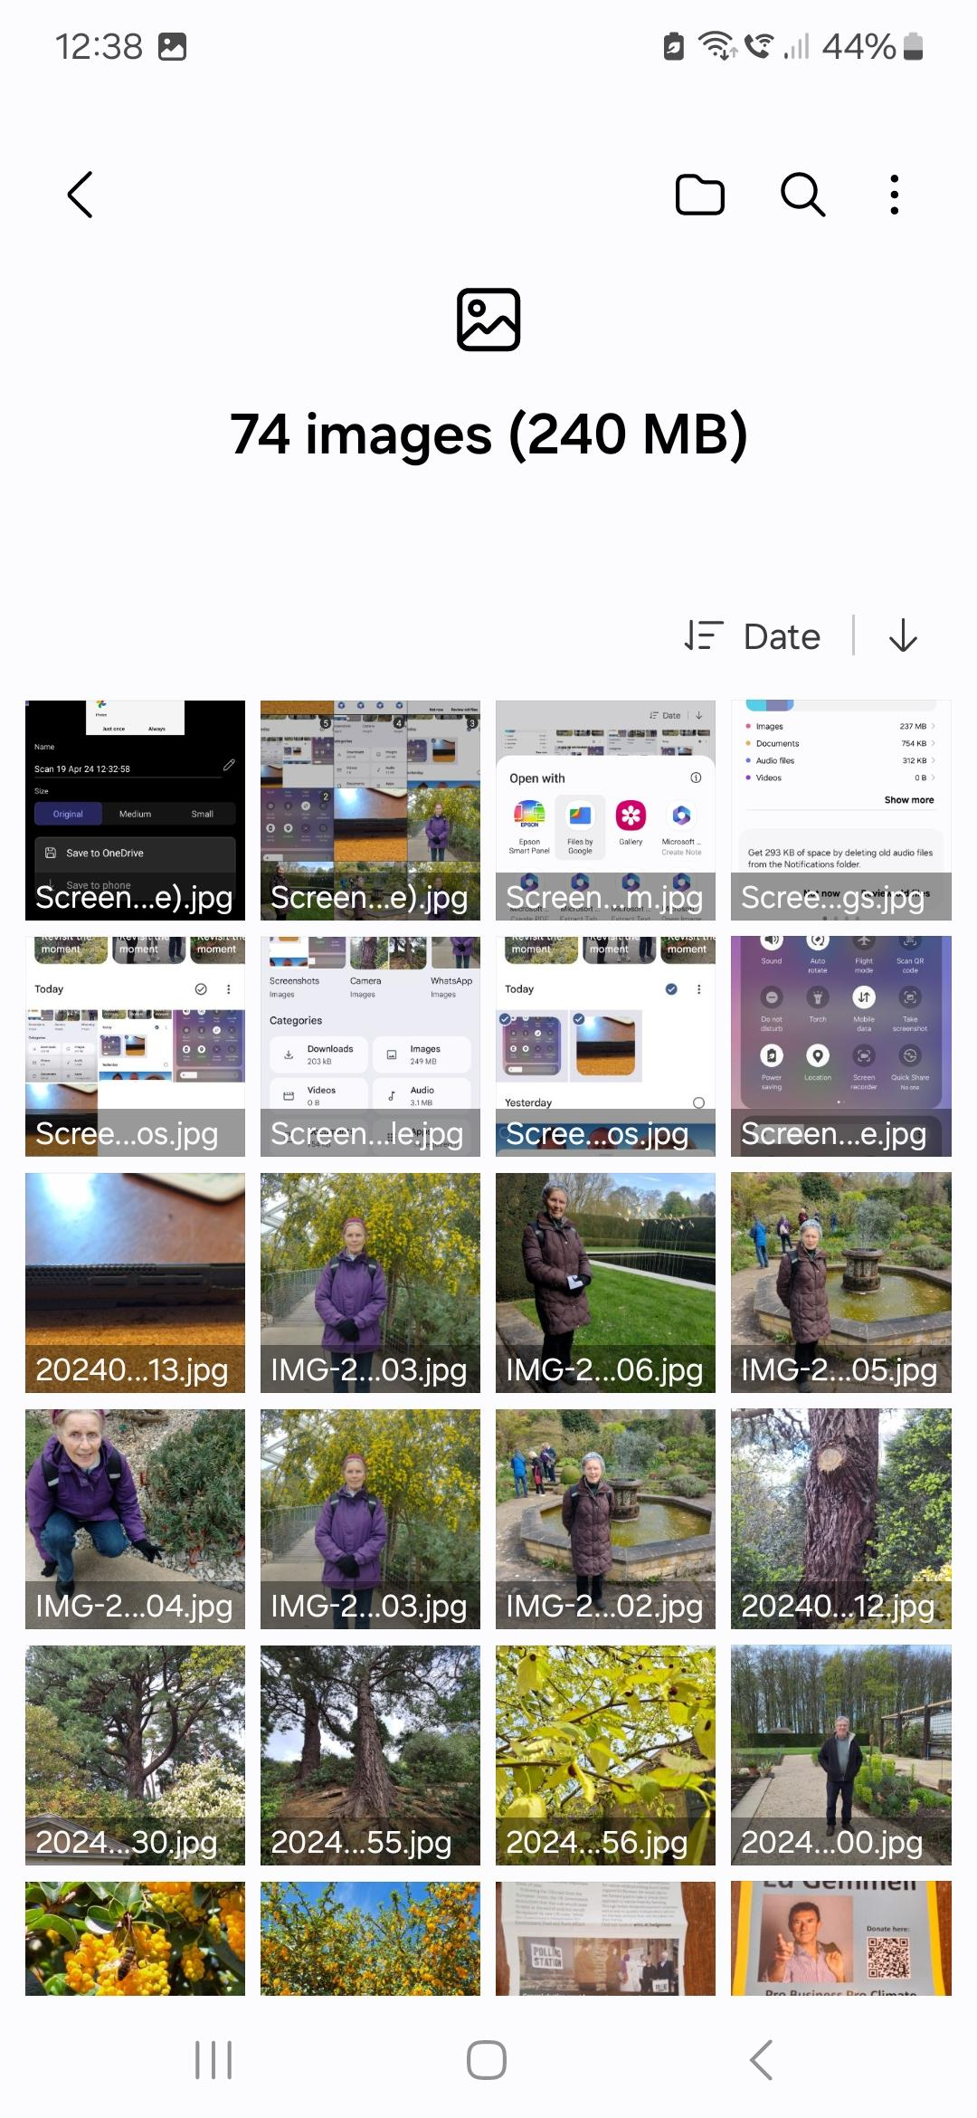
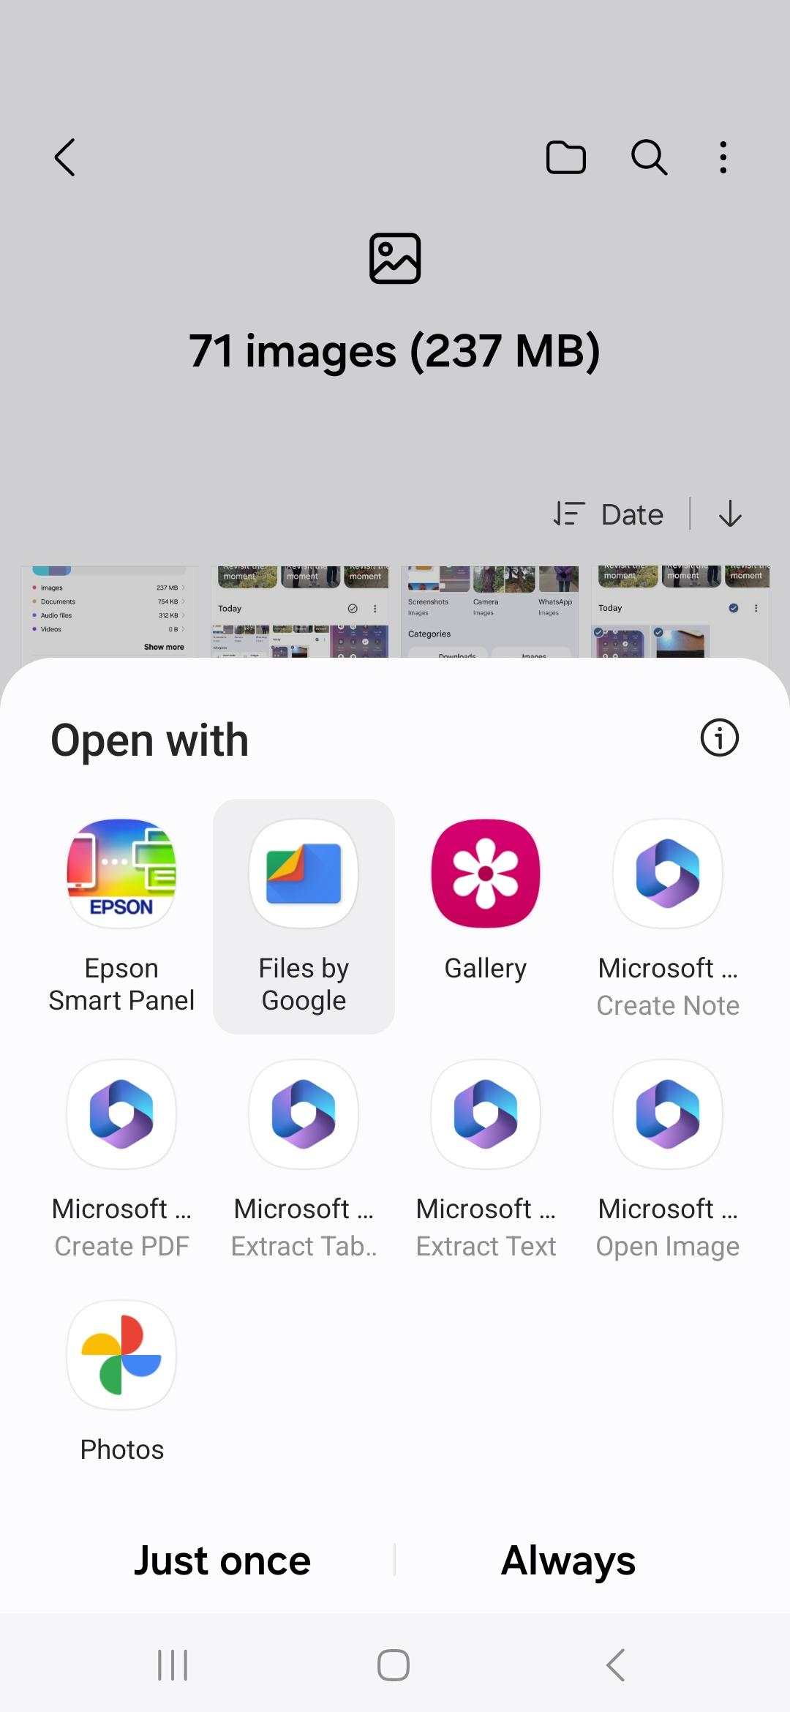
Downloaded images shown. Only organised by time!
Click Edit and select tickboxes to highlight the screenshots that are relevant.
Then click which app you want to handle them.
Some Microsoft apps are available because of pre-loaded MS apps and links.
One is MS Create PDF

Slide 11
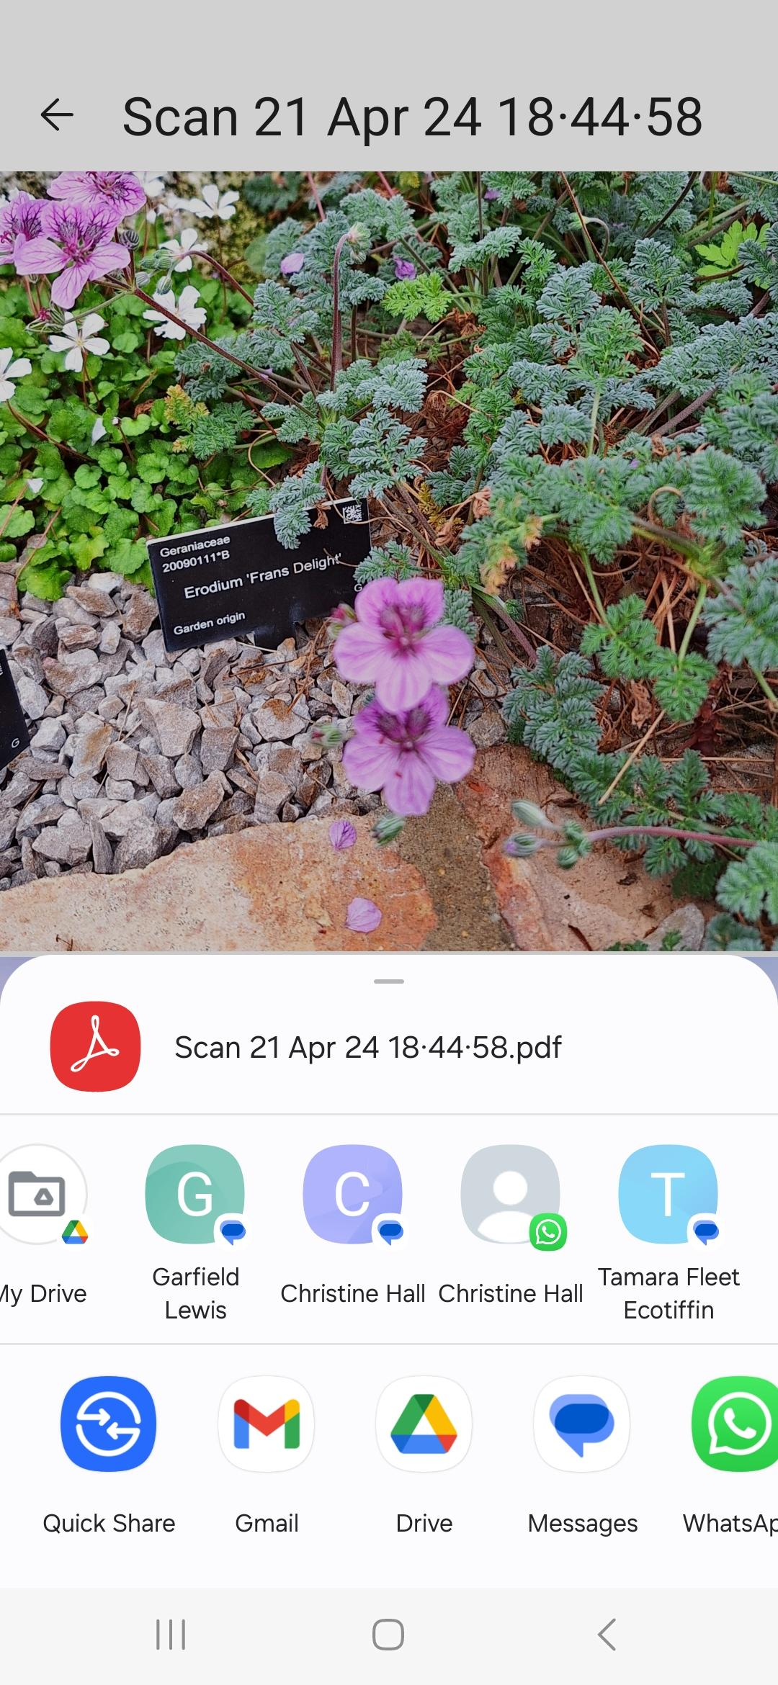
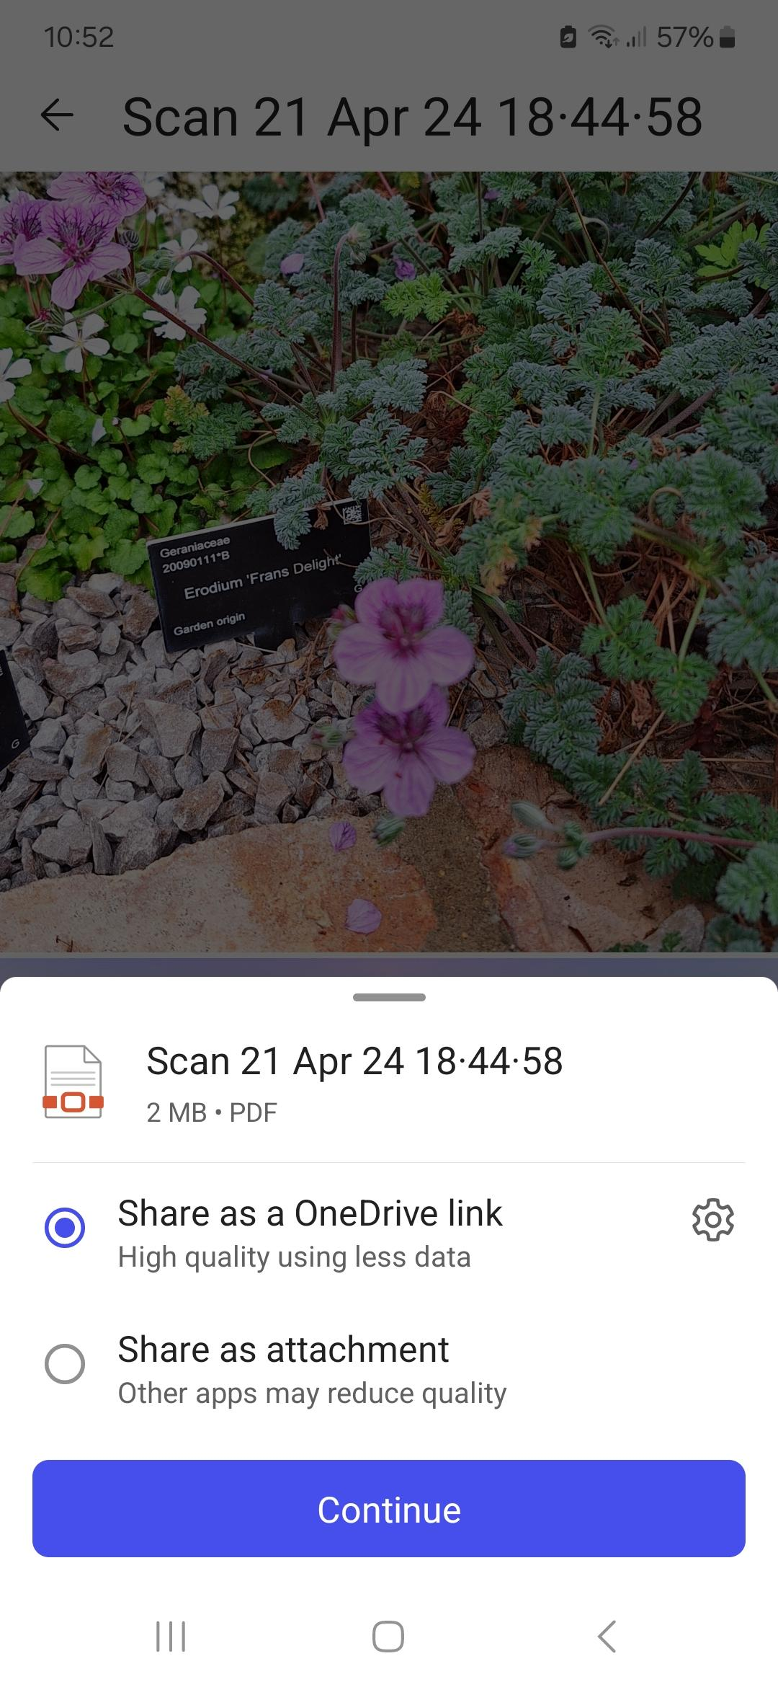
MS Create PDF app - select one image only, click the app and it will allow you to select further images to build the .pdf, tinker with the size of each, then save the .pdf to OneDrive or Download to your phone (into MS 365 “My Captures”)
Open MS 365 “My Captures” & share
(attach) to Gmail , Google Drive or
WhatsApp if that helps.

Slide 12
Advantages of saving screenshots/photos as .pdf
Size .jpg photos can be 2-5Mb (or larger: turn off automatic High Density Resolution)
Screenshots are typically 0.5Mb
Combining 6 screenshots and photos in a .pdf reduces the combined size to 2.5Mb
So, can easily attach .pdf’s to emails etc for sharing, download to memory stick etc.
Then you can present your interest at U3A Technology group in an engaging fashion

Slide 13
Advantages of saving screenshots/photos as .pdf (cont.)
Information sources:
Browse and search the web… No need to worry about copyright*- just screenshot photos, news items, social media
And use these to build up a file of interesting insights and facts.
(*So long as you are not profiting by using it, misrepresenting or trolling!)

Slide 14
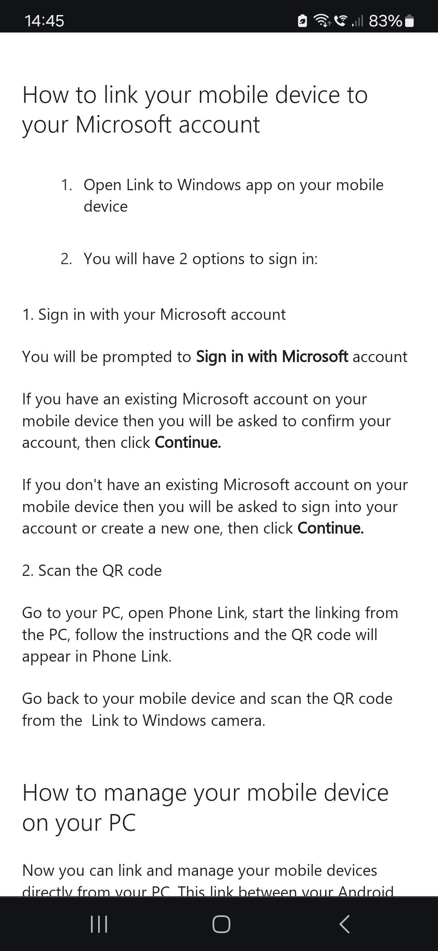
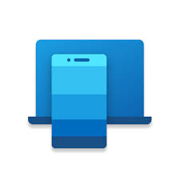
For those of us who like laptops..
Link to Windows app, on certain smartphones (Samsung + 2 others), will enable you to view your mobile and use all its apps, directly on your MS laptop. (It is “Cloud to Cloud” communication)
(With a cable link to the projector, you can explore your apps and show them to an audience…)

