Slide 1
Smart Digital Bathroom Scales

Slide 2
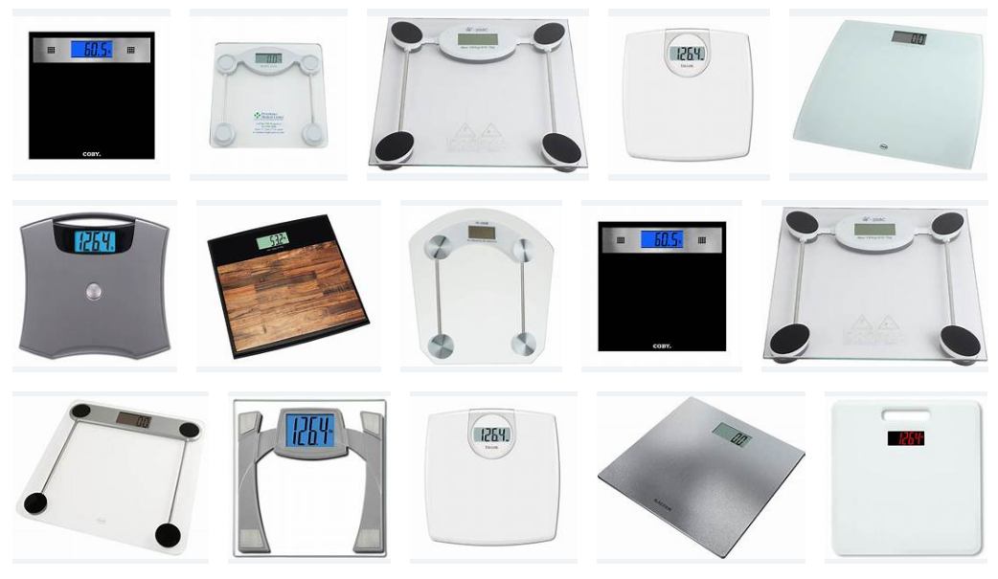
Digital Bathroom Scales

Slide 3
What are Smart Digital Scales?
These days, the best bathroom scales can help you track much more than just your weight. Many smart models also measure health stats including body fat, BMI, muscle mass and water percentage.
But whether you want an all-singing, all-dancing set of scales, or you go for a model to help you lose, maintain or gain weight, accuracy is key.
There are three main types of scales: mechanical (or analogue) scales that use springs to measure and display weight on a dial; digital scales that measure electronically and display weight digitally; and smart scales (or analyser scales) that measure by sending a safe electrical wave through the body, connecting to smartphones over Bluetooth or the internet.
Analyser scales tend to be the most accurate, offering a comprehensive breakdown of your body’s composition – some can track up to 17 different metrics. When it comes to size, a 30 x 30 cm scale should be large enough for most feet without taking up too much space.

Slide 4
What can smart scales analyse?
Smart scales use a process called bio-electrical impedance analysis to gather as much information about your body as possible. By passing a painless electrical current through your body, analyser scales measure the resistance your body gives against the current.
Different tissues such as bone, fat and muscle impede the current at different rates, which is how the scales can provide such an array of measurements, including weight, BMI, body fat, muscle mass, water percentage, bone density and more.
It is important to remember that these values are estimates but these estimates can be a good guide to your general health.
For the most accurate measurements, you should consult a doctor, and if you’re pregnant, have a pacemaker or other internal medical devices, you shouldn't use these features.

Slide 5
What is BMI?
Smart scales can calculate BMI, or your Body Mass Index. This value is your weight divided by your height in metres squared. A BMI score is designed to help you work out roughly if you’re in a healthy weight range or not. But this is an approximation, and it's important to note that a BMI score doesn’t distinguish between muscle, fat and bone.
There is an NHS BMI healthy weight calculator online:
https://www.nhs.uk/live-well/healthy-weight/bmi-calculator/
Which scale measurements should I use?
Make sure your scales use the unit of measurement you’re most comfortable with. It’s always best to check the specs before you buy, but almost all scales will give you the choice between kilograms, pounds and stone.

Slide 6
Summary
Digital SCALES START FROM ABOUT £15
THERE ARE A WIDE VARIETY OF MODELS AVAILABLE
Smart bathroom scales can connect to your smartphone or tablet, enabling you to view, store and track your vital statistics through an app.
As with all smart devices, not all smart scales are compatible with all operating systems. For example, some work with Apple's iOS but not with Android & VICA VERSA – so you'll need to check operating system requirements before buying.
Different scales offer varying degrees of smart functionality, but almost all of them transfer your weight and other body measurements to an app when connected to your device using Bluetooth and/or wi-fi.
Deciding which is the best one for you, largely comes down to how much you want to know about your weight and body.
OTHER KEY AREAS:
Body fat - percentage The proportion of your body fat to your overall weight.
Body water percentage - The total amount of water in the body expressed as a percentage of your total body weight.
Muscle mass - The percentage of your body's composition that's made up of muscle.
Visceral fat - This is also known as 'abdominal fat'. A higher amount of visceral fat is linked with an increased risk of several health conditions, such as type 2 diabetes, Alzheimer's disease and heart disease.

Slide 7
Smart Digital Bathroom Scales

Slide 8
https://www.nhs.uk/live-well/healthy-weight/bmi-calculator/

Slide 9
