Slide 1
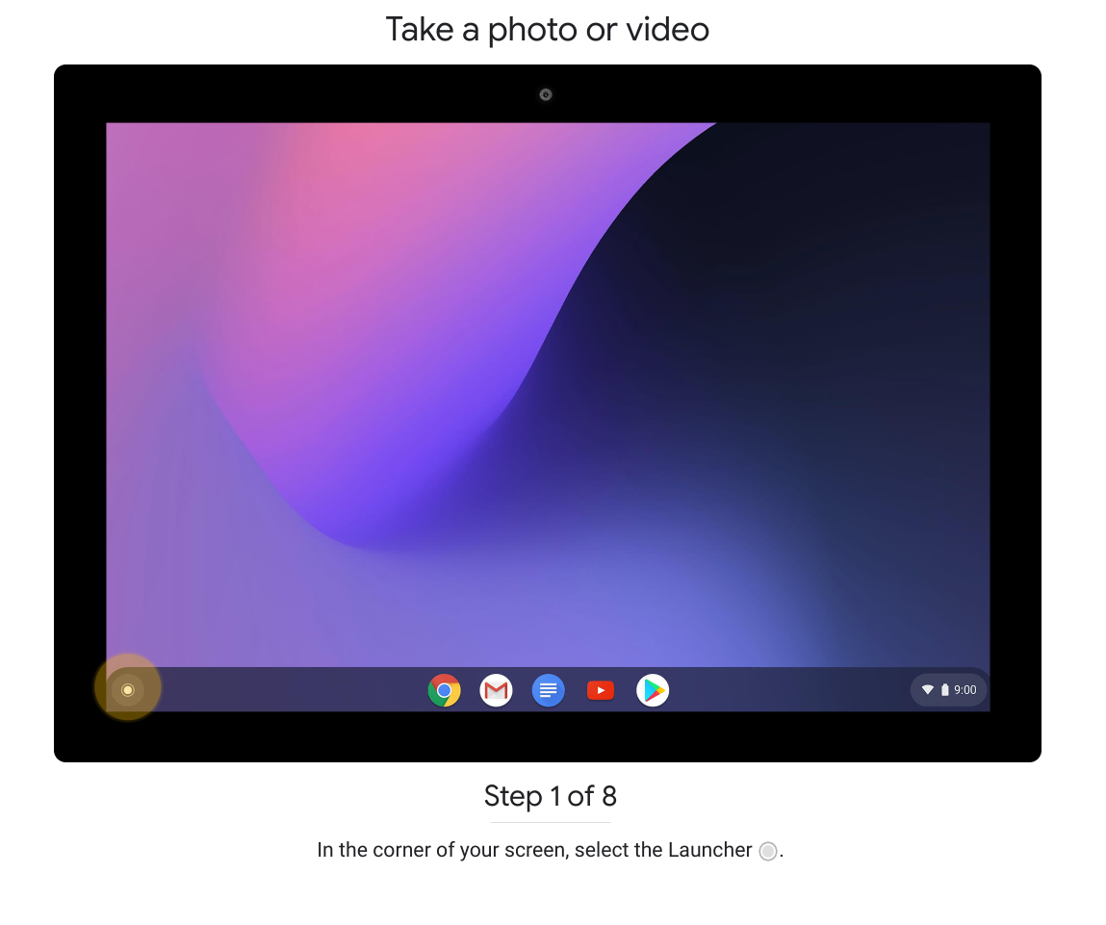
Chromebook - using the camera

Slide 2
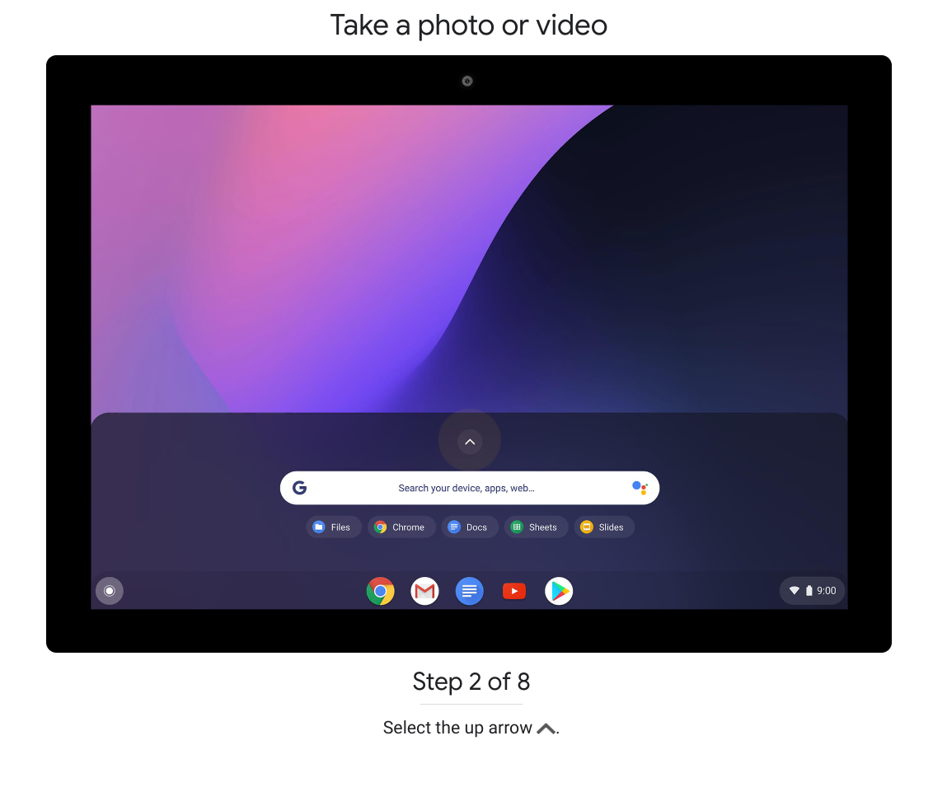

Slide 3
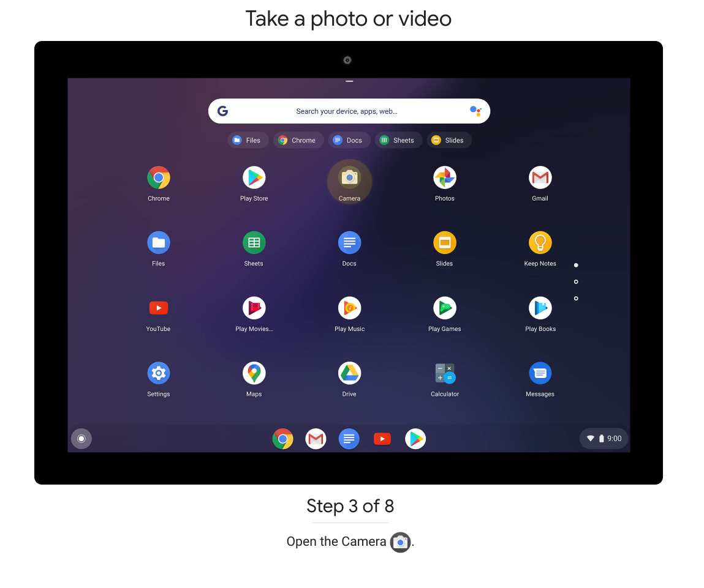

Slide 4
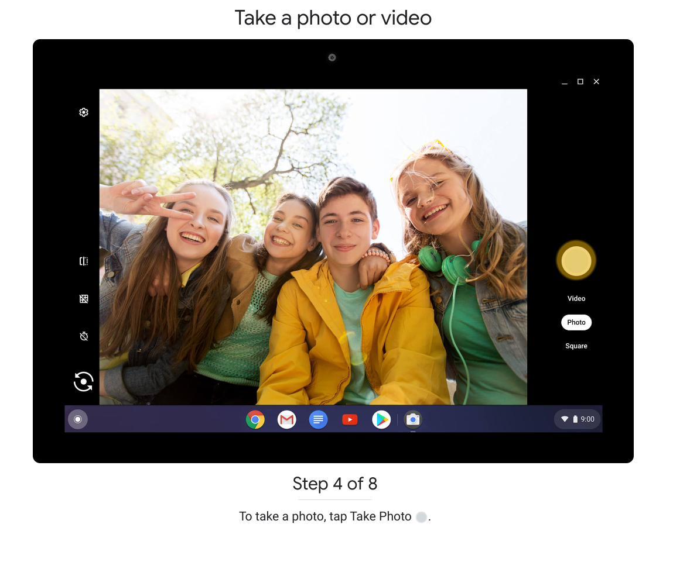
Once you have your image photo’d, Right click it to bring up “Search image with Google “ when Google Lens is activated as it is integrated with the camera app. Do the same with any image in Google Photos app.

Slide 5
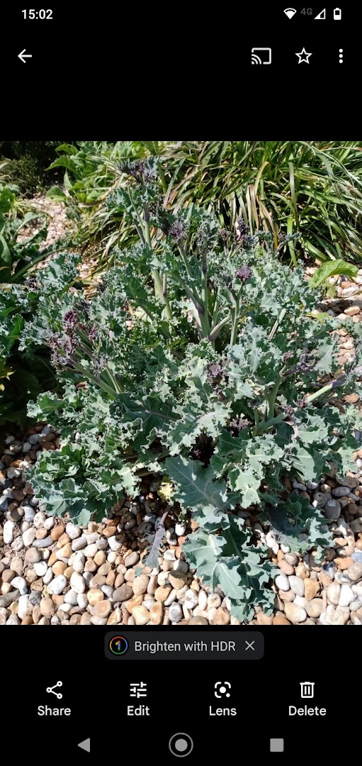
By contrast, on Android phone, Google lens icon appears below the photo when Google Photos is the default app for photos.

Slide 6
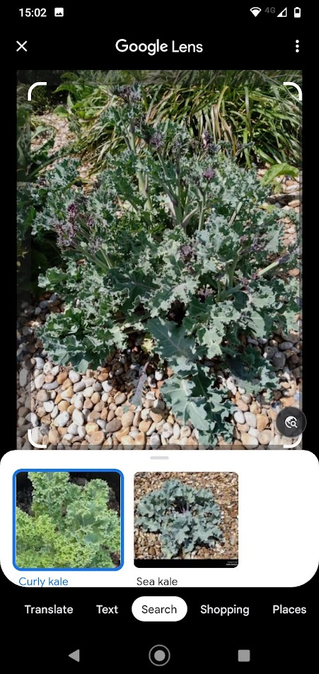
Garden visitors: name any unlabelled plant!

Slide 7
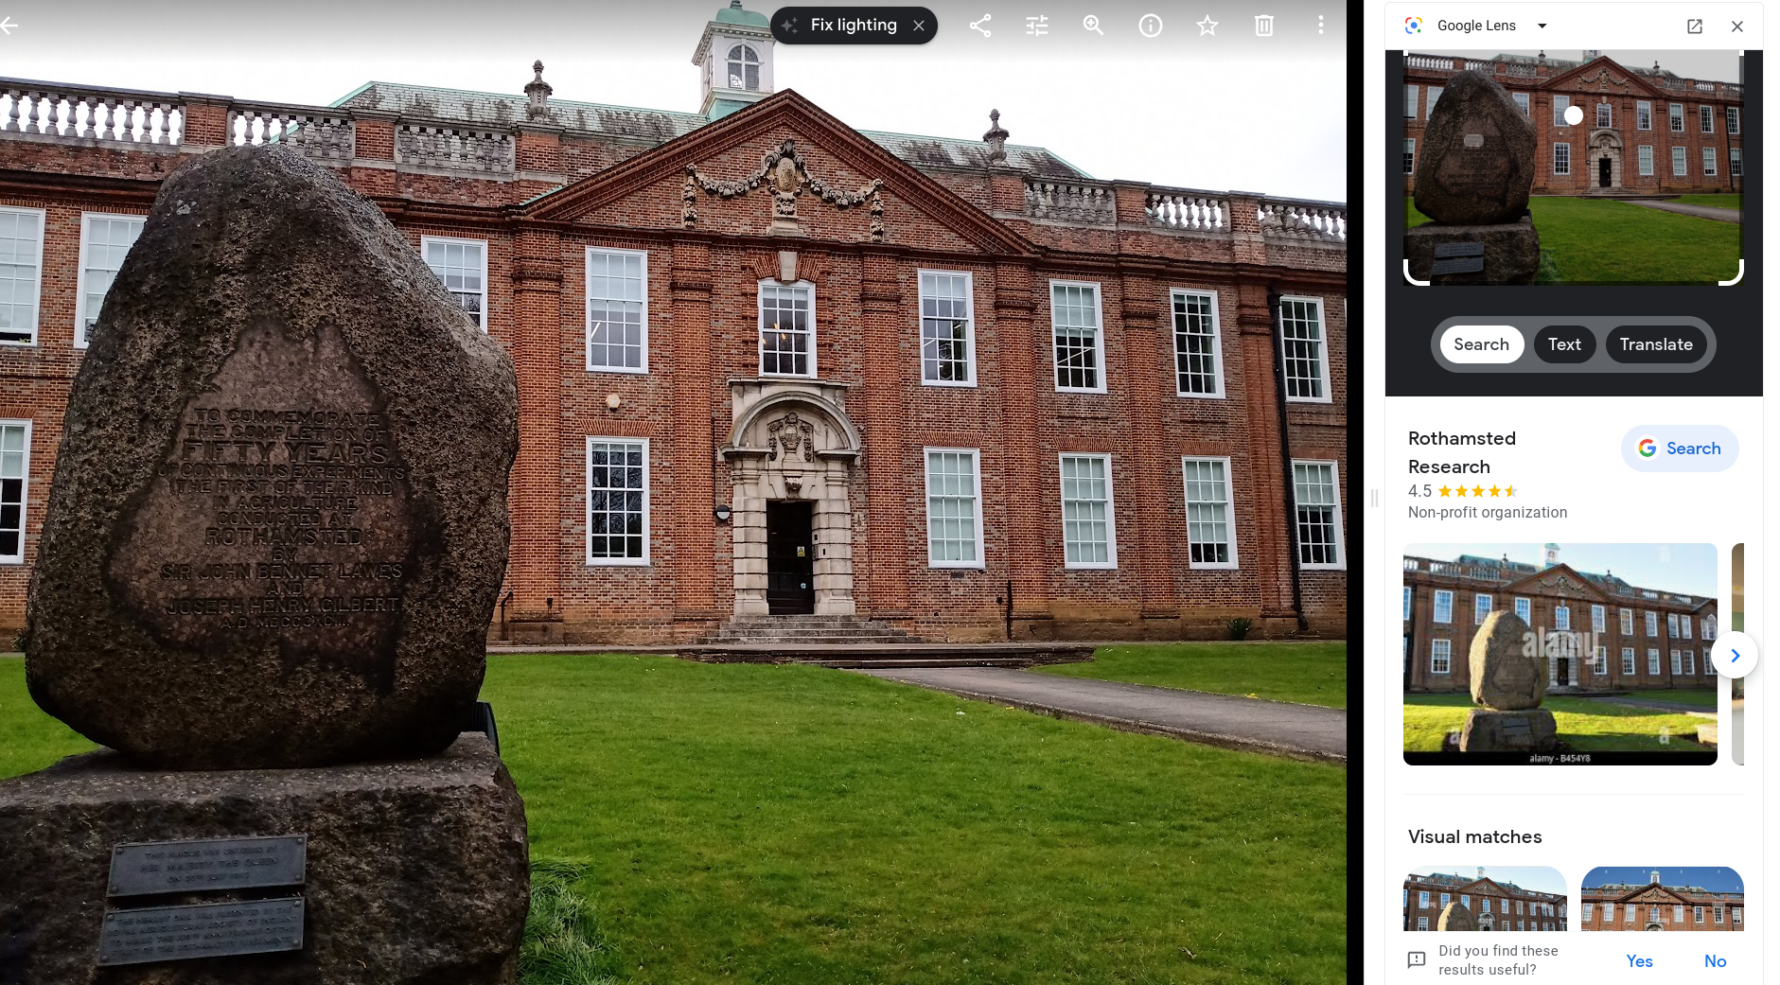
Identify any strange building…. (that would be regularly photo’d by tourists etc)

Slide 8
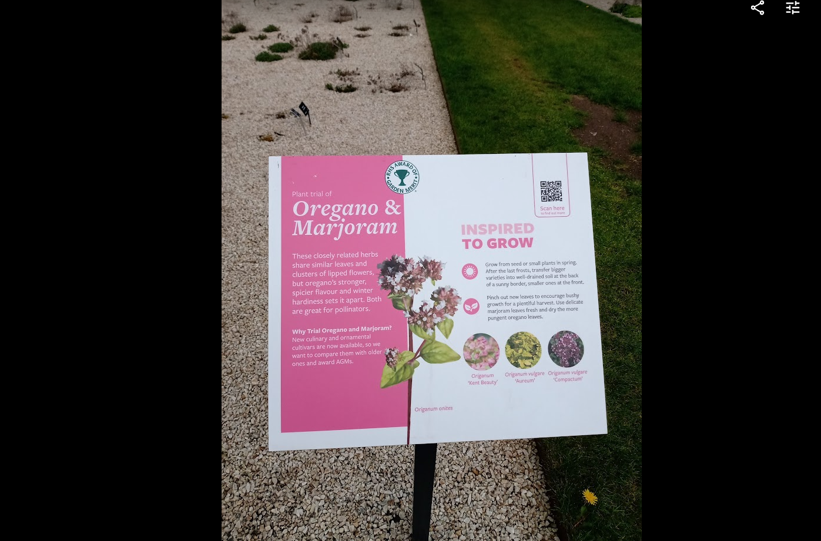

Slide 9
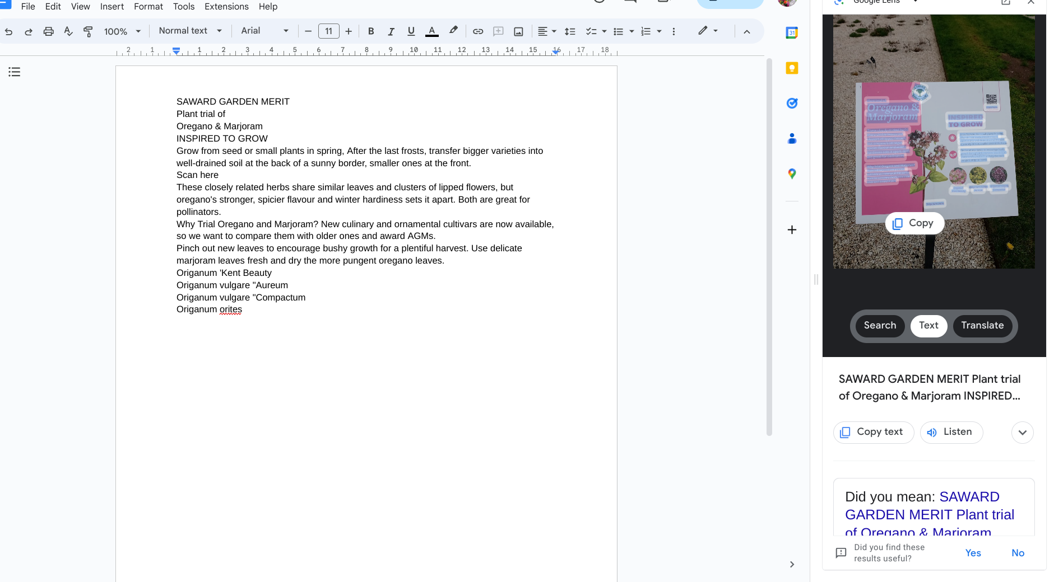
Paste the text from clipboard into a document. (Google Docs)
Will need to disentangle column text from the block of text that results.

