Slide 1
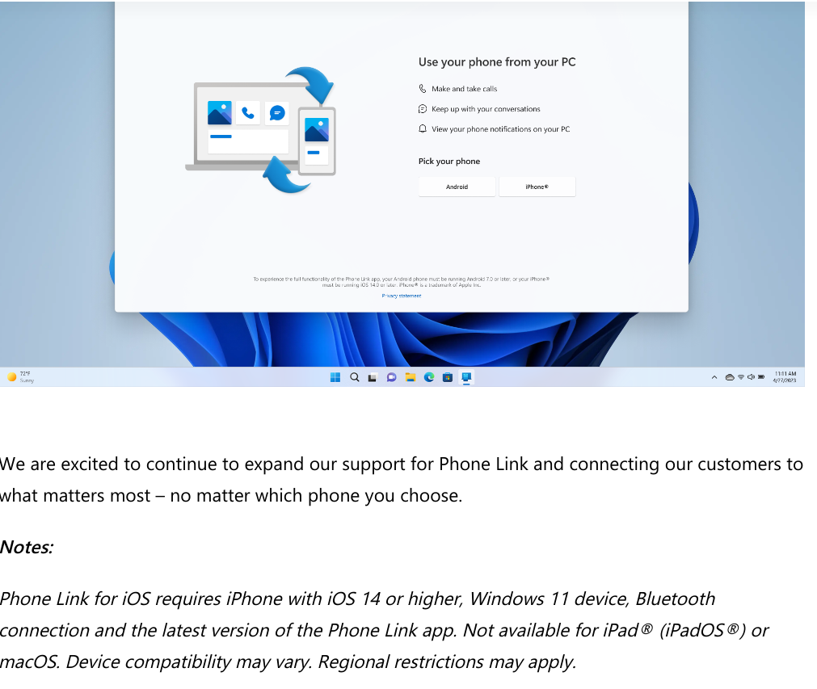
MS Phone Link app now compatible with iPhone.
(Clouds do the linking, so MS Cloud and i-Cloud)
Install “Phone Link” app on your computer, “Link to Windows” app on your phone if it isn’t pre-installed.

Slide 2


Slide 3
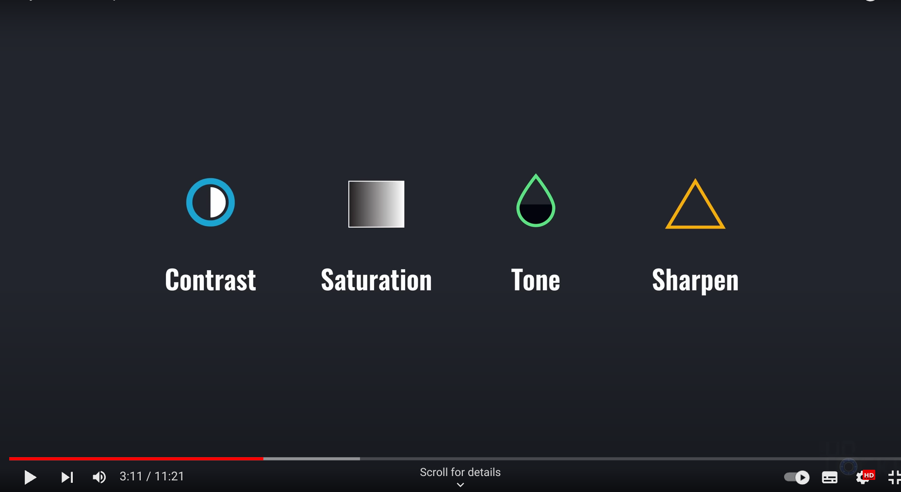

Slide 4


Slide 5


Slide 6


Slide 7


Slide 8


Slide 9


Slide 10


Slide 11



Slide 12



