Slide 1
Taking advantage of one of our previous Tech presentations to
Update it
Add extra slides of your own
IF you don’t have a Microsoft software subscription
(and this would be true of any .pptx that you were sent as a link and had full permission to modify..)

Slide 2
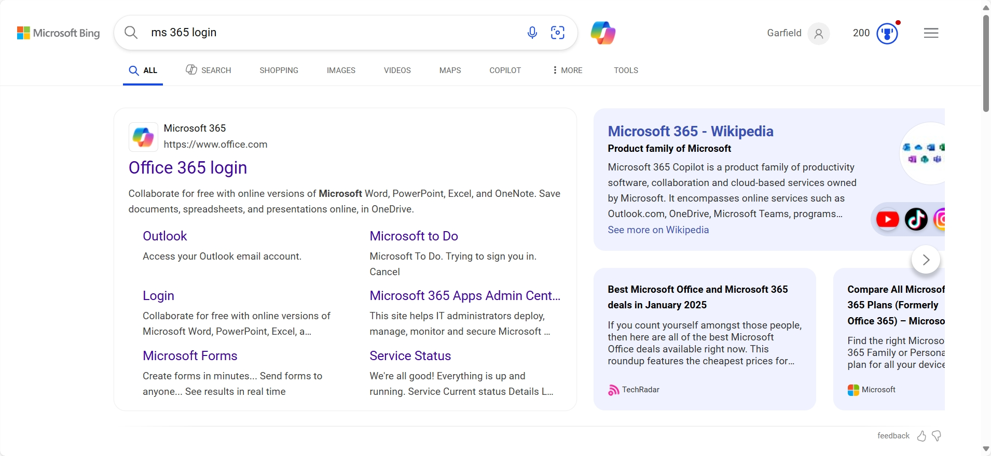

Slide 3
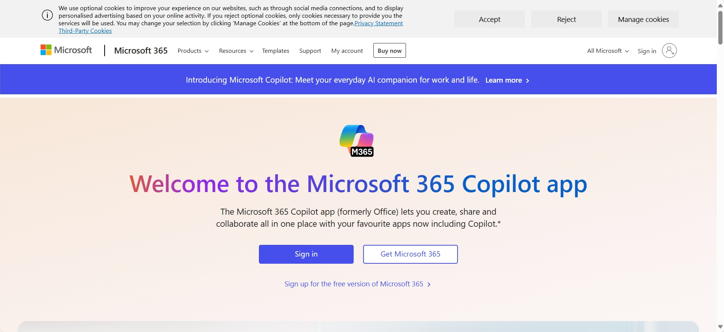

Slide 4
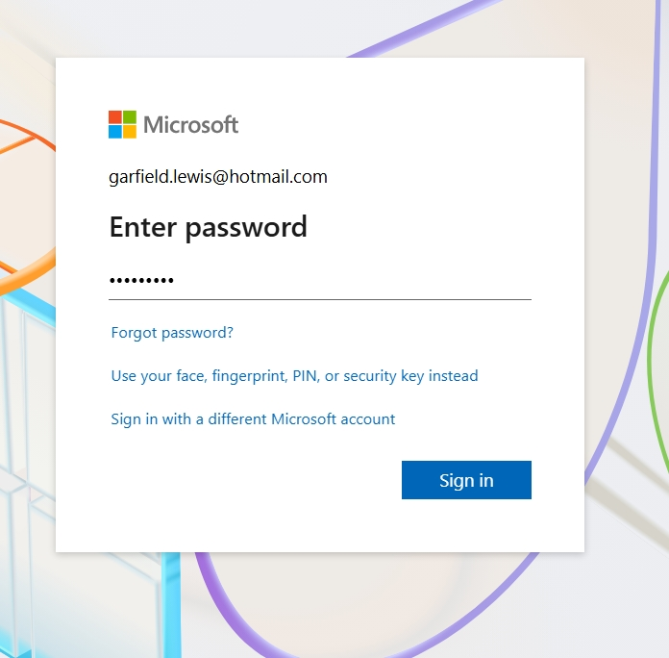
It will default to the MS account you set up when you installed Windows. If you’ve forgotten it or using someone else’s laptop, can set up/use a different MS account.

Slide 5
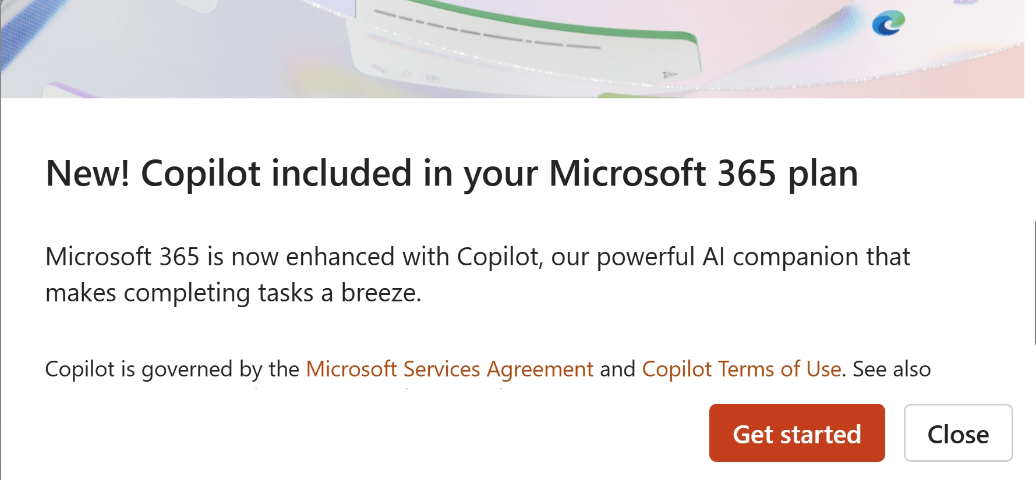
At least one popup! Just close it.

Slide 6
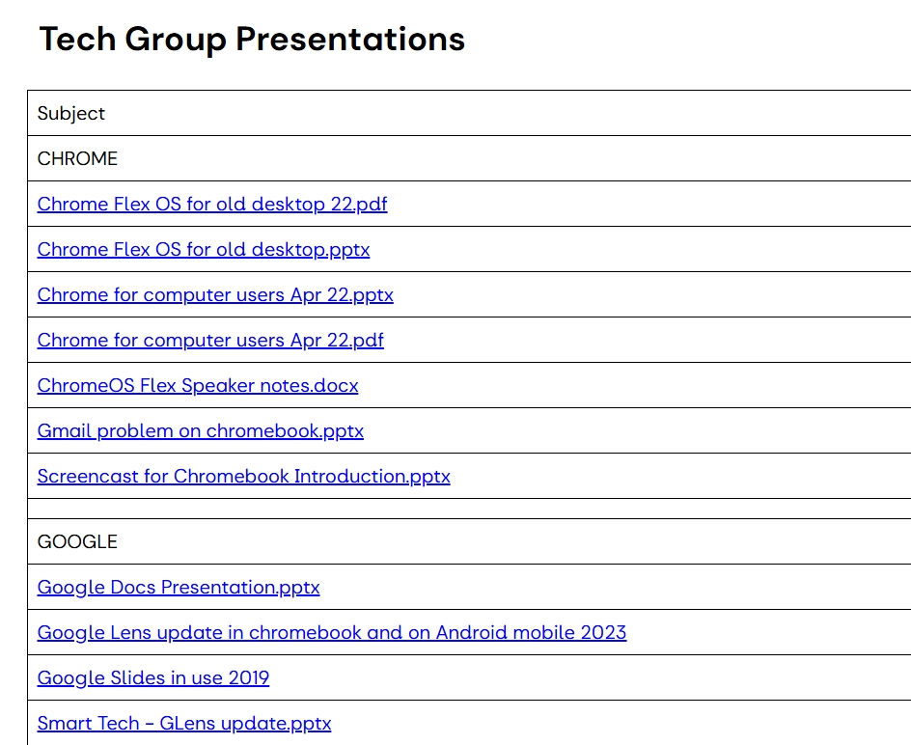
Our new listing of previous Tech presentations on the SBU3A website.
Pptx - powerpoint files give better resolution and can be modified.

Slide 7
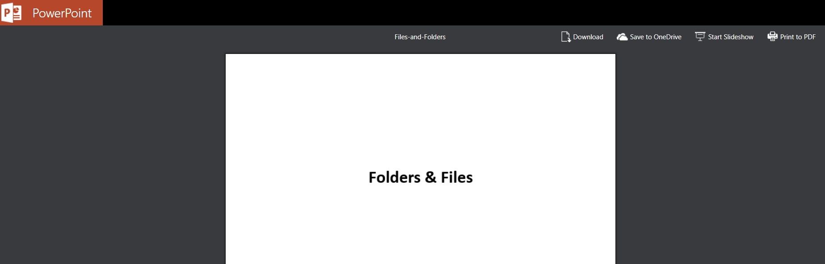
Clicking on the link will open it - whether you have an MS subscription or not. To adapt it for your use: Save it to OneDrive (which you have just opened and signed into.)

Slide 8
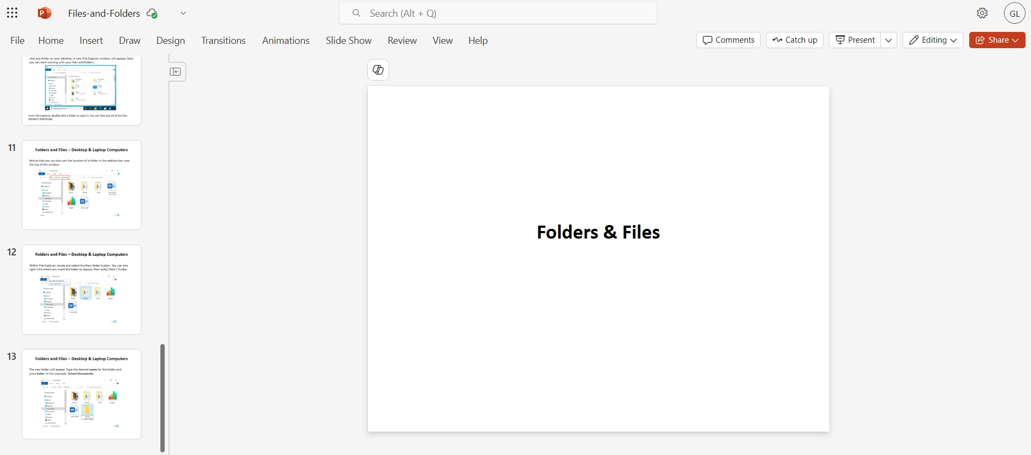
It will open in MS365 Powerpoint app and you can modify the .pptx in the same way as if you were working locally on your laptop.

Slide 9
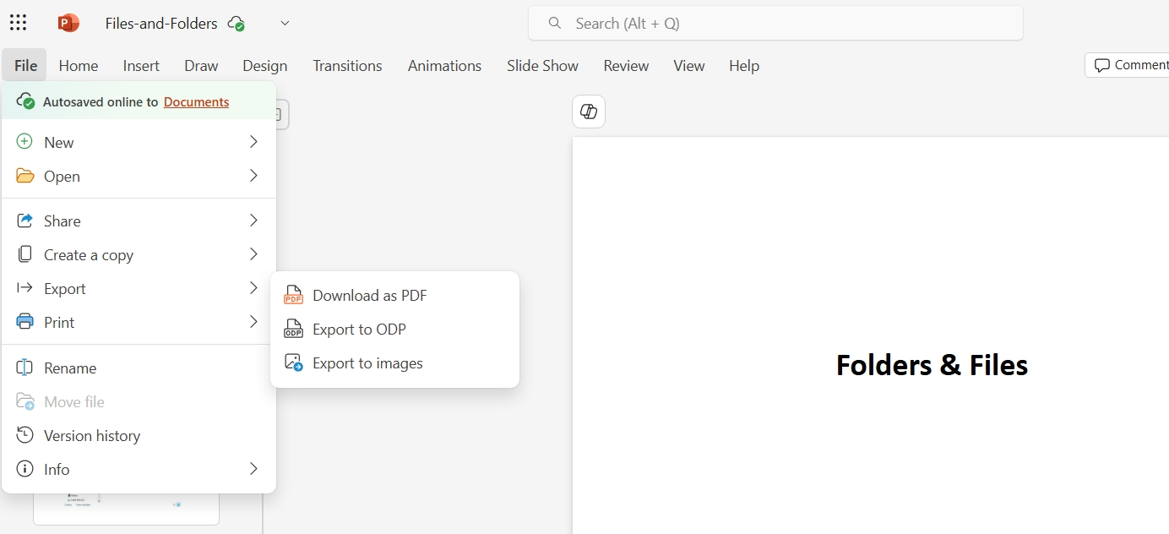
Finally - and here’s the rub - when completed you can display the .pptx from MS365 only. (So you’ll need wifi where you plan to present it.) Download is only available as a .pdf. - which will do in most cases!

