Slide 1
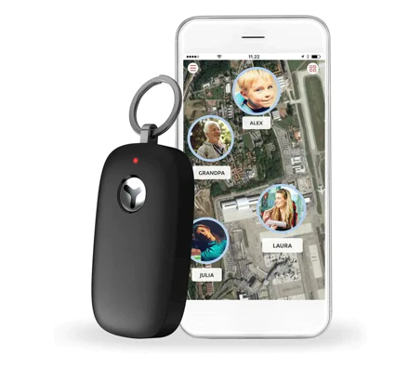
Age UK: Personal Alarms for the Elderly
Accelerometers in some models detect falls and automatically activate the call to the response centre
The digital personal alarm may be worn in a variety of ways and operates up to 75 metres from the base station. It is water-resistant up to 1 metre, so you may shower and bathe while wearing it.
To activate the alarm, push the button on the pendant to be linked to the UK-based resolution centres, which are open 24 hours a day and have a five-second response time. The responder will next determine whether to notify your family or the emergency services.
The caring team will talk to you over the alarm base unit's speaker.

Slide 2
Not sure if you need this in your house environment yet?
Blue Tooth connection (via a wrist device) to your phone:
The range of a Bluetooth® connection is approximately 30 feet (10 meters). However, maximum communication range will vary depending on obstacles (person, metal, wall, etc.) or electromagnetic environment
However…
 | BLUETOOTH V2.1 | BLUETOOTH 4.0 (LE) | BLUETOOTH 5 (LE)
Range | Up to 100 m | Up to 100 m | Up to 400 m
Max range (free field) | Around 100 m (class 2 outdoors) | Around 100 m (outdoors) | Around 1,000m (outdoors)

Slide 3
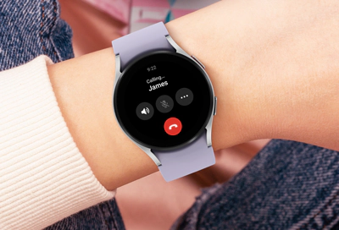
2) Blue tooth can be unreliable… how about Wifi?
Wi-Fi signals will usually reach about 150 feet or over 45 meters for a 2.4Ghz frequency. Using a 5Ghz frequency, you will get about 50 feet or about 15 meters of reach.
Devices that can use Wifi and have a microphone???
With some Samsung Galaxy Watch models you can make calls remotely over Wi-Fi in the event the Bluetooth connection between your phone and the watch disconnects. (Around £300)

Slide 4
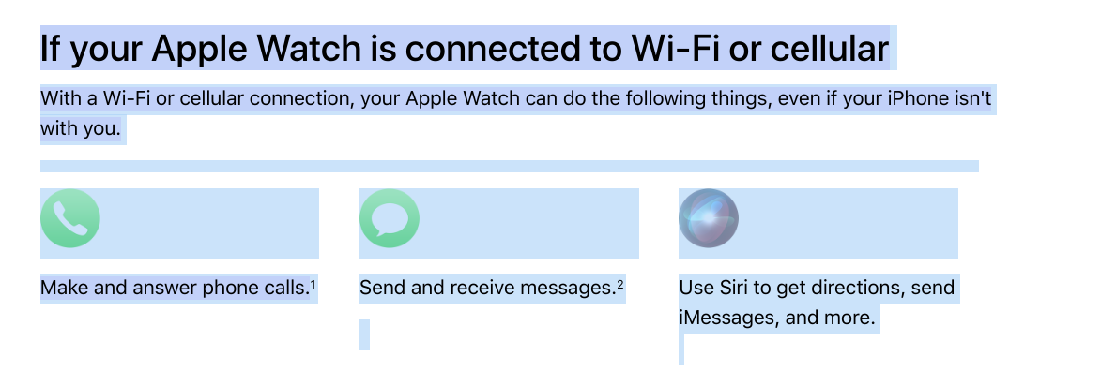
Cost about £1000

