Slide 1
Passkeys

Slide 2
What are they and how do they work?
They are a method of proving you are who you say you are
They use public key cryptography – creating a unique pair of keys, one public, one private
The private one stays secure on you device and your device only
The public one is shared with whatever needs to prove who you are
The public key is used to encrypt an authentication request ‘this is Microsoft asking who are you?’ which can only be decrypted using your private key.
The response ‘This is Keith’ is encrypted using the private key, and can only be decrypted by the public key.
You can only gain access to your private key by using your device, and some additional authentication (face, fingerprint or PIN)
The face, fingerprint or PIN depends on the device you are using (PIN will work for all).

Slide 3
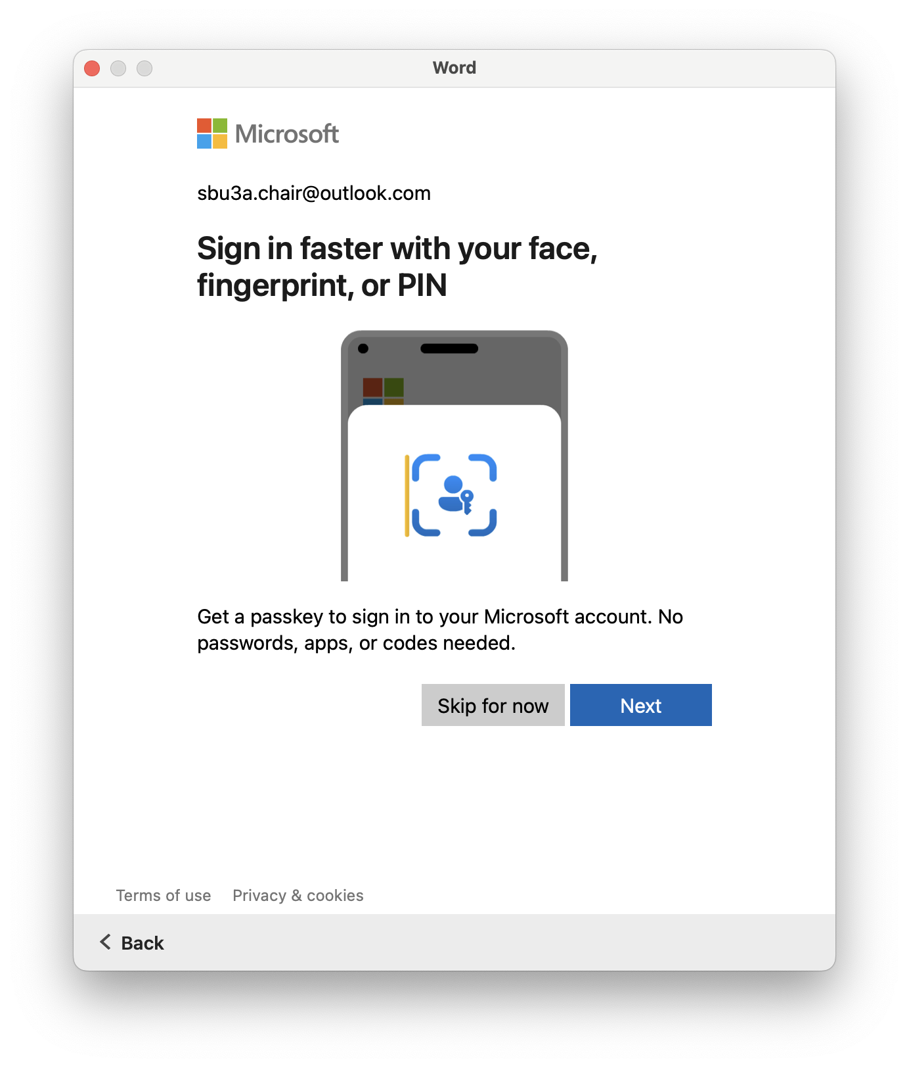

Slide 4
