Slide 1
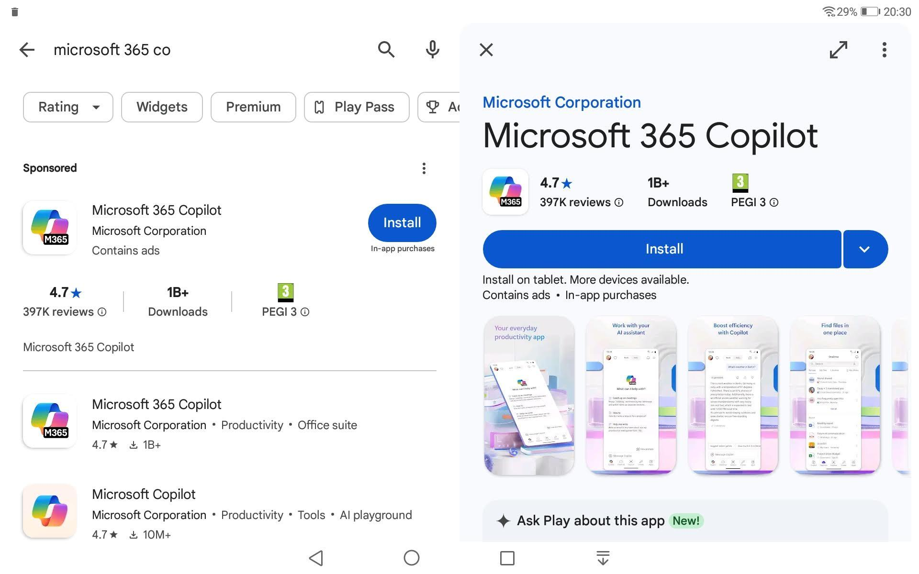
Search Microsoft 365 in Google Play store and download the app. “In app purchases” means you’ll get pop-ups to subscribe… ignore and close them.

Slide 2
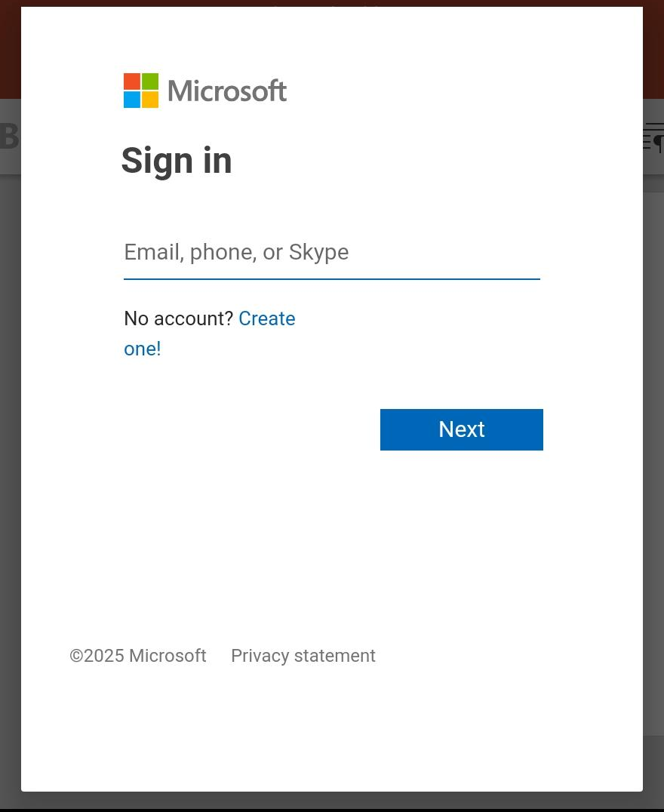
If you have a Windows laptop, it’s a good idea to use the same login, but otherwise just create one (it will be “your ID” .hotmail.com or outlook.com probably)

Slide 3
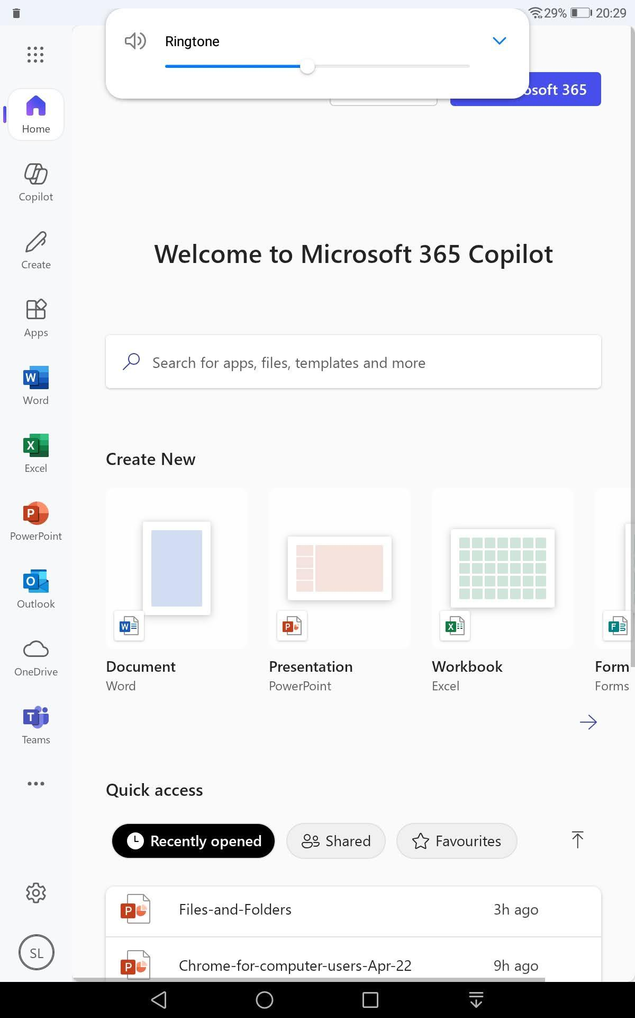
On opening the app, the full range of MS web-based software is in the vertical menu.
NB It shows your MS Cloud (OneDrive) account - about 5GB capacity. This is where you should upload anything you want to use with MS web-based software.

Slide 4
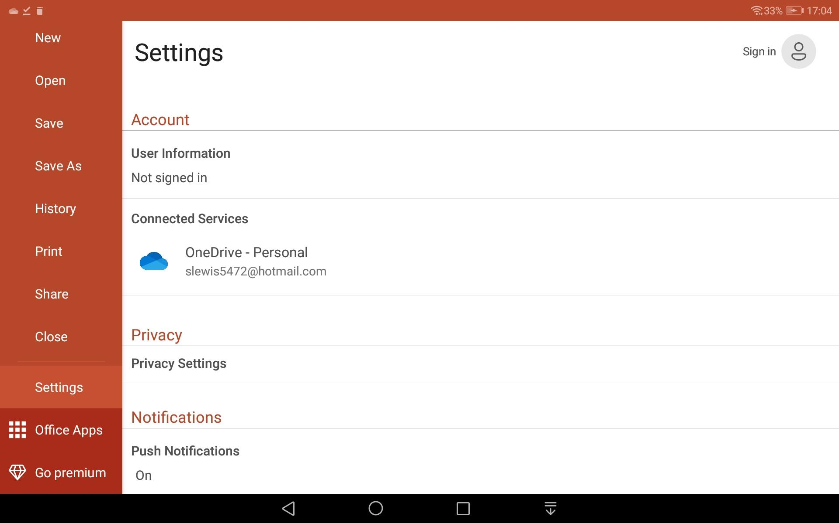
You have signed in to MS 365 and OneDrive! This if for subscribers.
In MS 365 settings, your OneDrive account is shown again with the associated login. Record it somewhere!

Slide 5
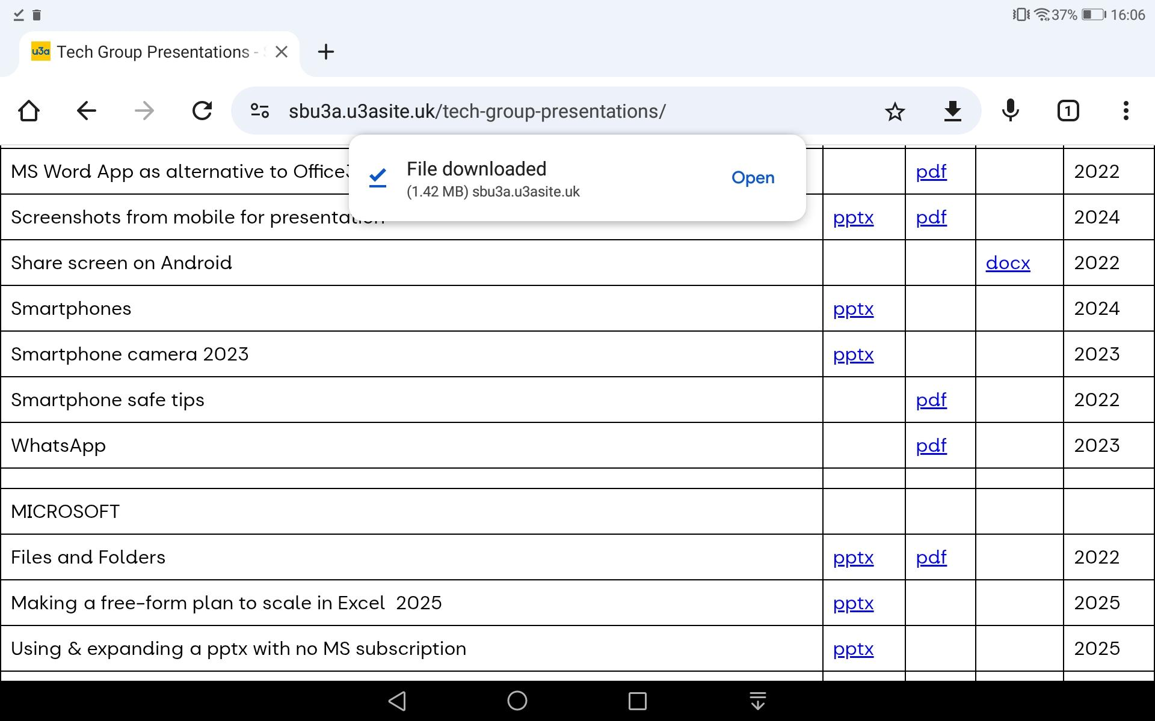
If using one of our previous powerpoints, go to our SBU3A website and select, then click to Download

Slide 6
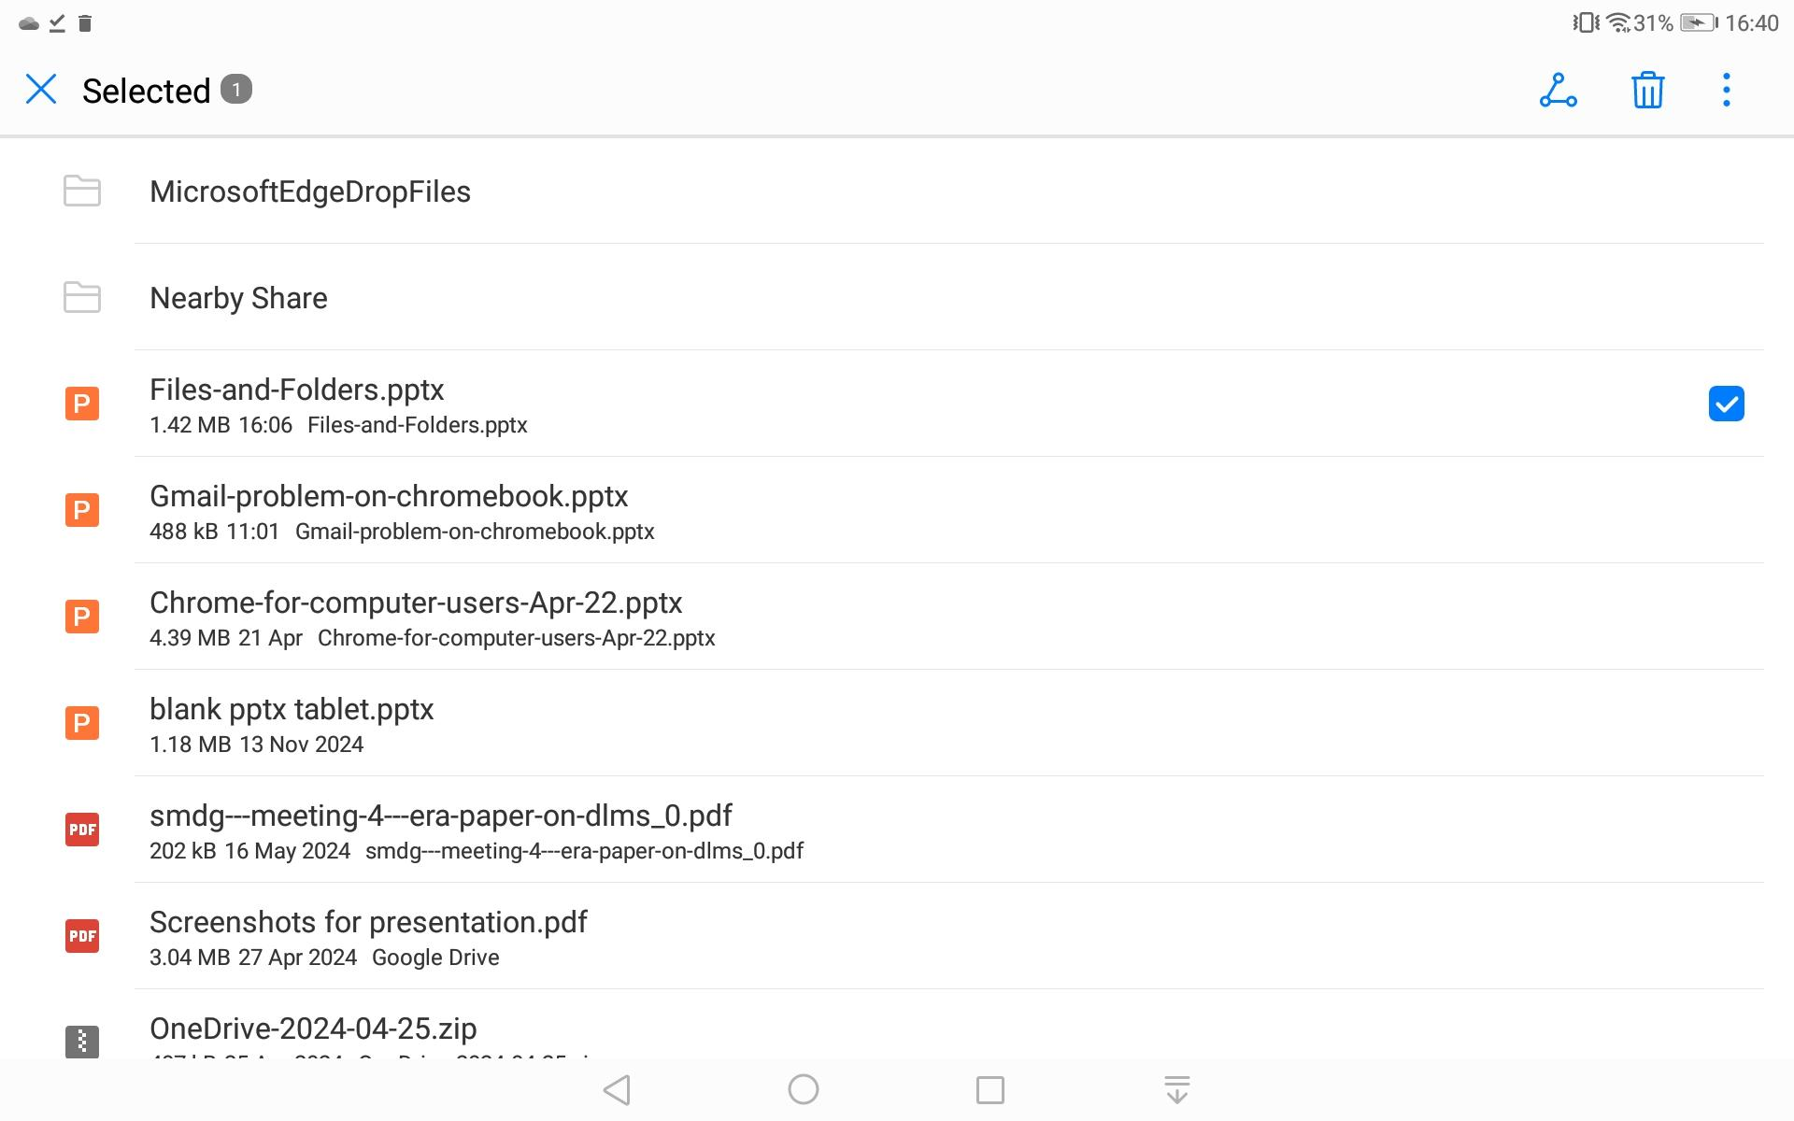
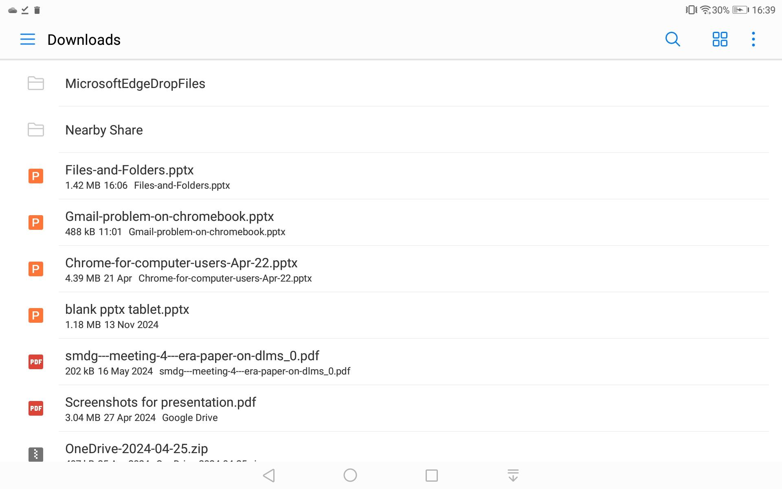
Find it in your tablet Downloads (probably in your Files app). Select it by gentle pressure on the title - not clicking it. Tickbox appears
Then click Share symbol

Slide 7
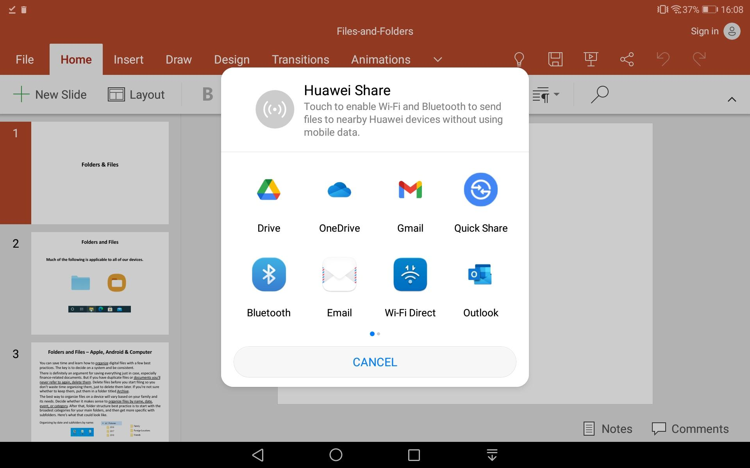
A drop-down menu appears. Click OneDrive

Slide 8
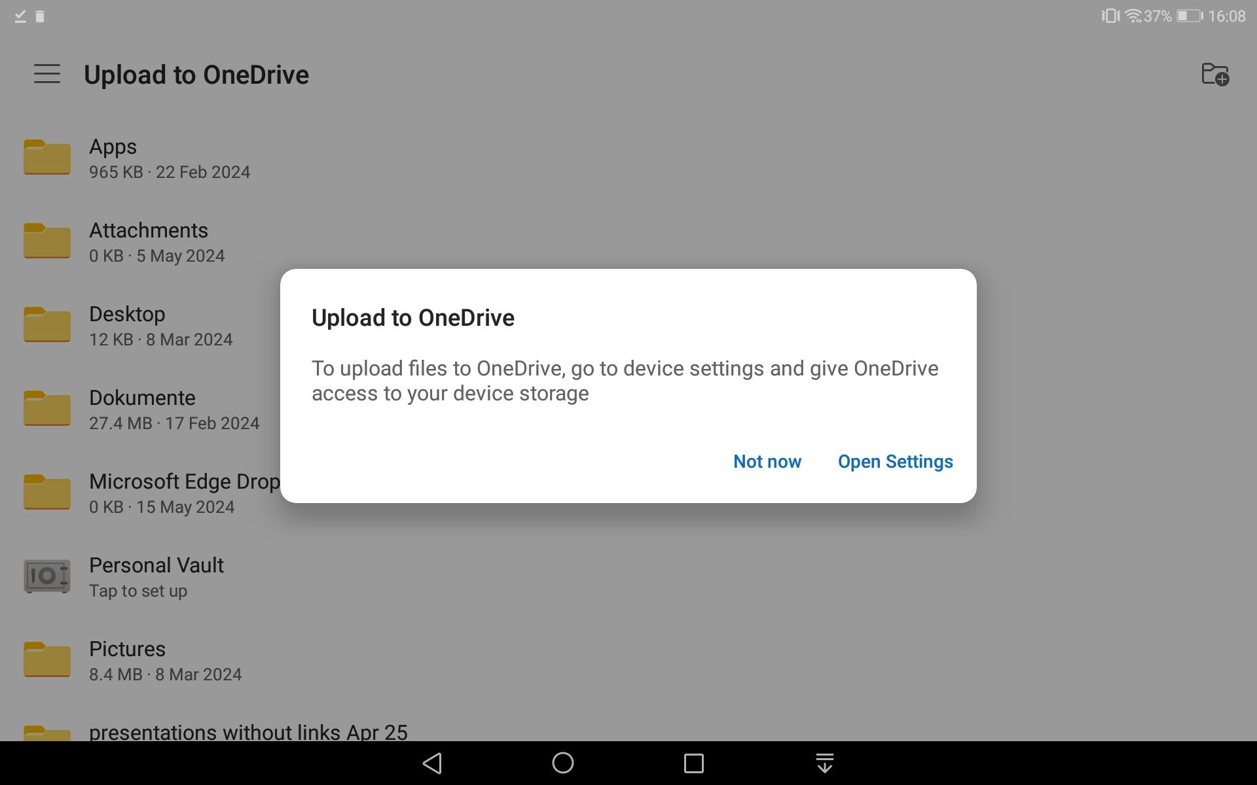
If you haven’t used OneDrive on your tablet before, you will have to open settings and give the required permissions

Slide 9
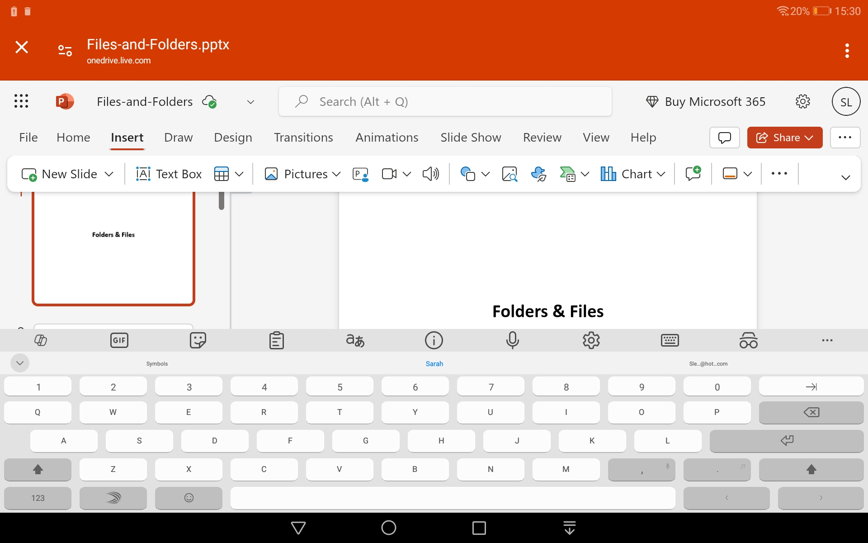
Open MS 365 and the submenu for OneDrive, click on your uploaded .pptx file when it will open in Powerpoint. The Powerpoint Insert submenu is the same range as you’d get if you had paid for an MS subscription..

Slide 10
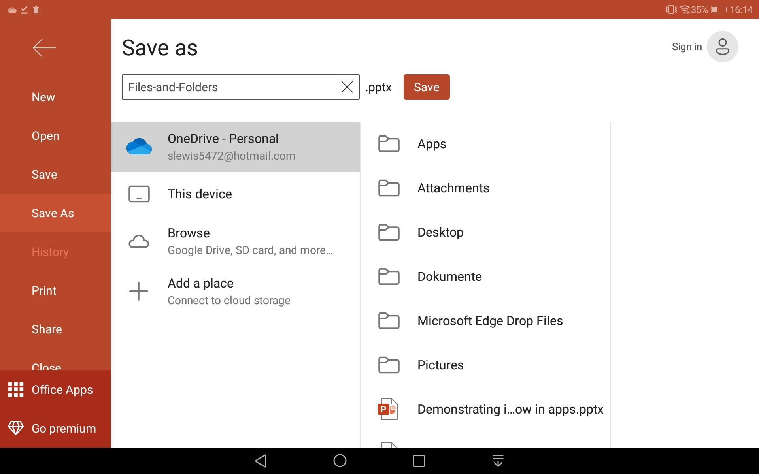
When you have modified the powerpoint, the Powerpoint File submenu brings up this webpage. Choose Save As to make sure it goes to your OneDrive cloud account.

Slide 11
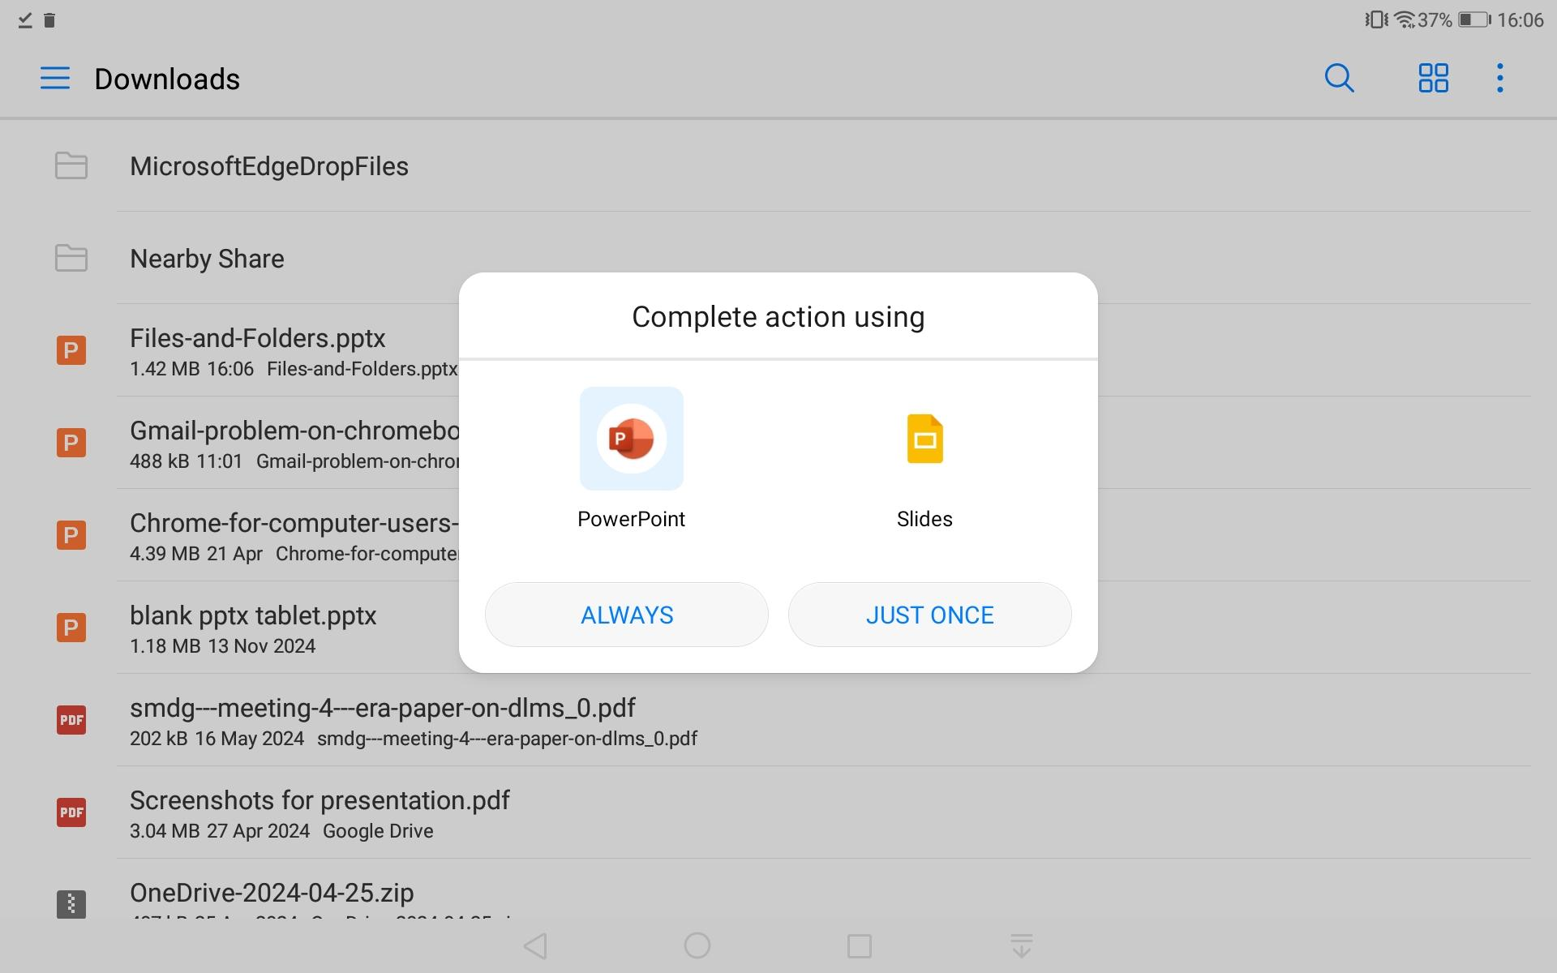
By Contrast If you had clicked your .pptx in your tablet Downloads area (rather than selecting and uploading it), it would have opened in a local version of PowerPoint - or you could have used Google Slides, which is not considered here…

Slide 12
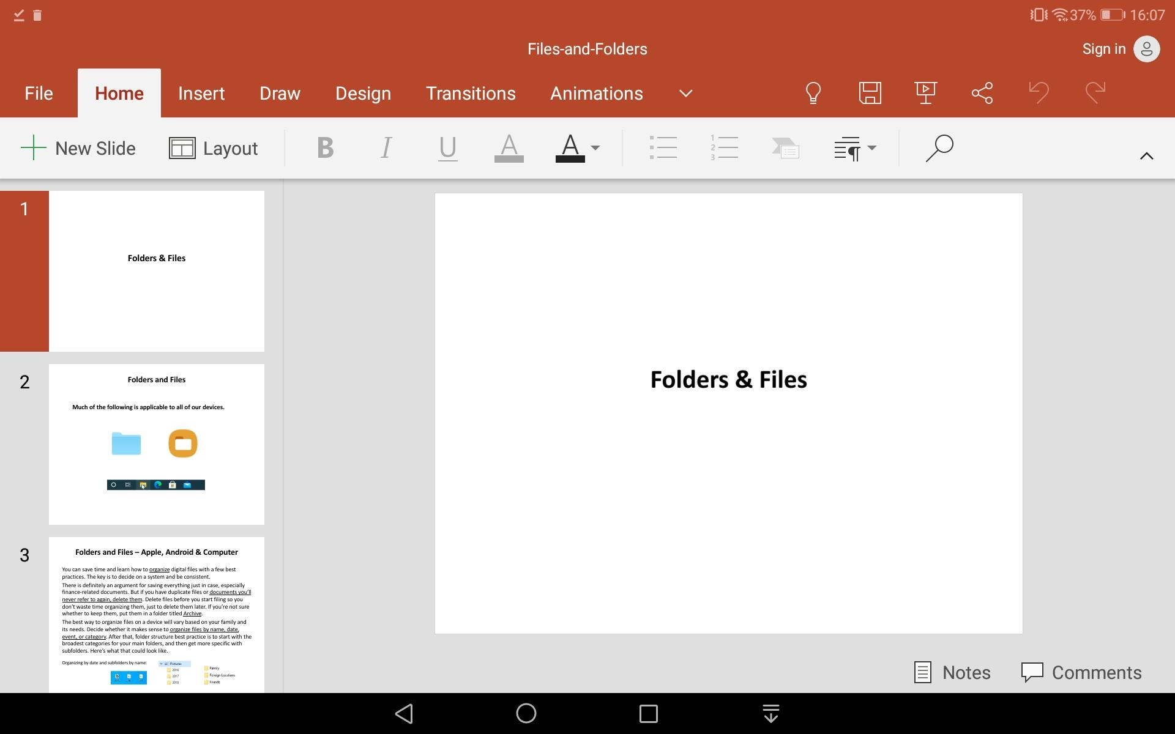
The tablet local app for Powerpoint is very basic

Slide 13
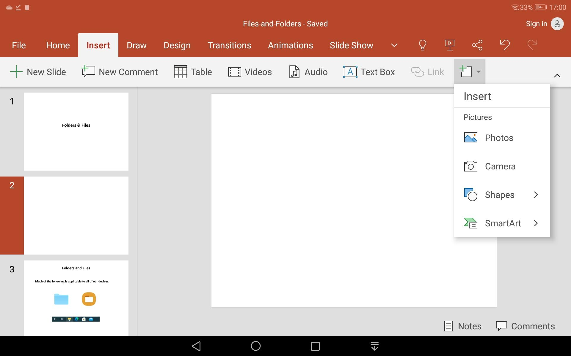
Contrast the Insert submenu here in the local app with the MS 365 web-based app (slide 9). It would be OK if you just wanted to add a few image slides, but the file wouldn’t be available to other devices - .pptx is often too large for emailing as an attachment. You would copy it to a USB drive (stick drive) instead.

Slide 14

SUMMARY
Go to Google Playstore and download MS 365 Copilot App
Open it and sign in to the Microsoft account you might use on any other Windows/MS Edge device - to enable sharing across devices. (Or create an MS account on the Sign-In prompt)
Find the .pptx you want to modify - from our SB3A website perhaps or shared with you by someone else. - and Download it by clicking on the link.
Open Downloads and select the file - then find the Share symbol
Click it and choose OneDrive. Open the MS 365 app and the
OneDrive submenu. Click your .pptx when it will open in MS 365 version of Powerpoint - the full one.
When modified, save it back to OneDrive so that you can find it on any other MS device by, either by logging into OneDrive from there or using a link, then show the slides from that device (ie for the projector display that would be intricate to arrange directly from your Android tablet.)
It’s suggested you don’t modify the .pptx locally on your tablet using a simple Powerpoint app there - as the tablet version is very basic - unless you just want to add an image or two.

Slide 15
THEORY SUMMARY
Select a powerpoint (shared) and download.
Upload to the OneDrive Microsoft Cloud and use Cloud-based apps to modify it.
Save to OneDrive and access the Cloud from another device (via a link or logging in directly) that can project it.
ALTERNATIVELY
Download a powerpoint. Upload it to the Google/Android Cloud (“Drive”/”MyDrive”)
Use Google Cloud-based apps to modify it.
Either access the Cloud on another device, use a link, or download as a Powerpoint to a USB Drive. (See Google Slides presentation and Google Drive presentation)

