Slide 1
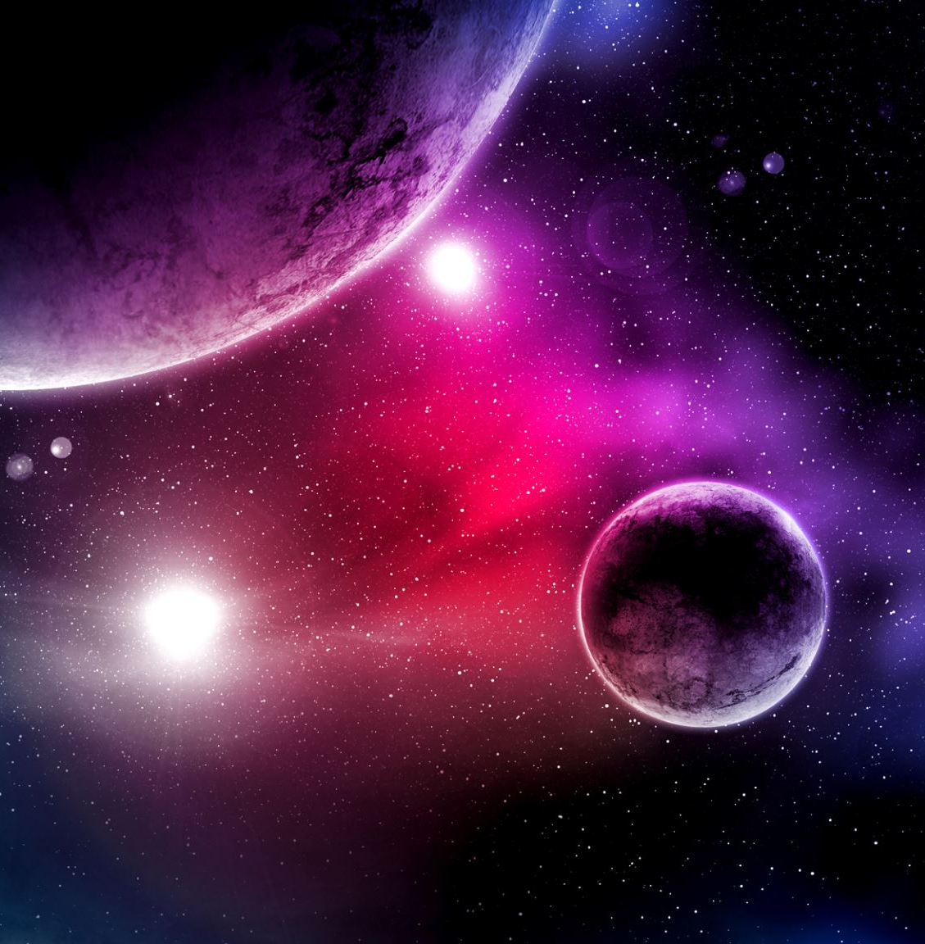
Exoplanets
and the
search for life
Mary Garbett

Slide 2
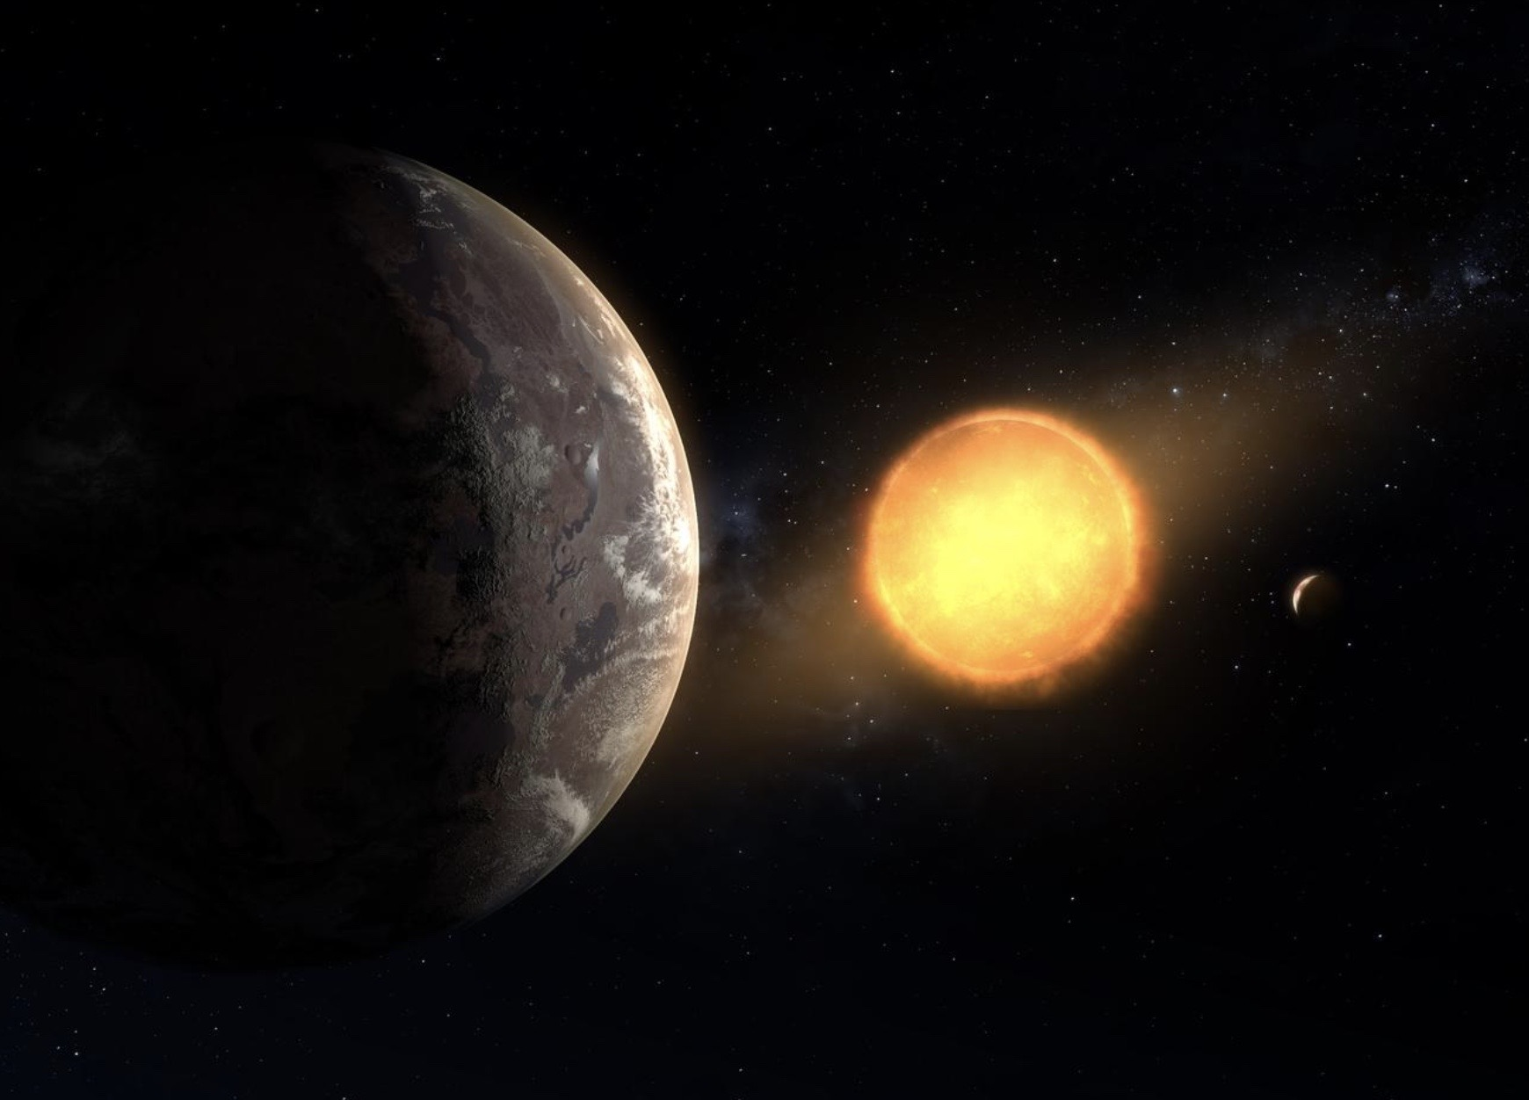
Exoplanets
What are planets and exoplanets?
How do you find and characterise them?
Current and future missions?
Habitable zones and finding signs of life
Citizen science
N.B: This will be a maths free presentation.
Artist’s concept of Kepler-1649c
NASA/Ames Research Center/Daniel Rutter
Notes:
The presentation will be shared after the meeting.
It contains all the detail so I’ll focus more on what it all means.
There are links on each slide to the source images and videos.
Hope I’m not disappointing anyone by being maths free.

Slide 3
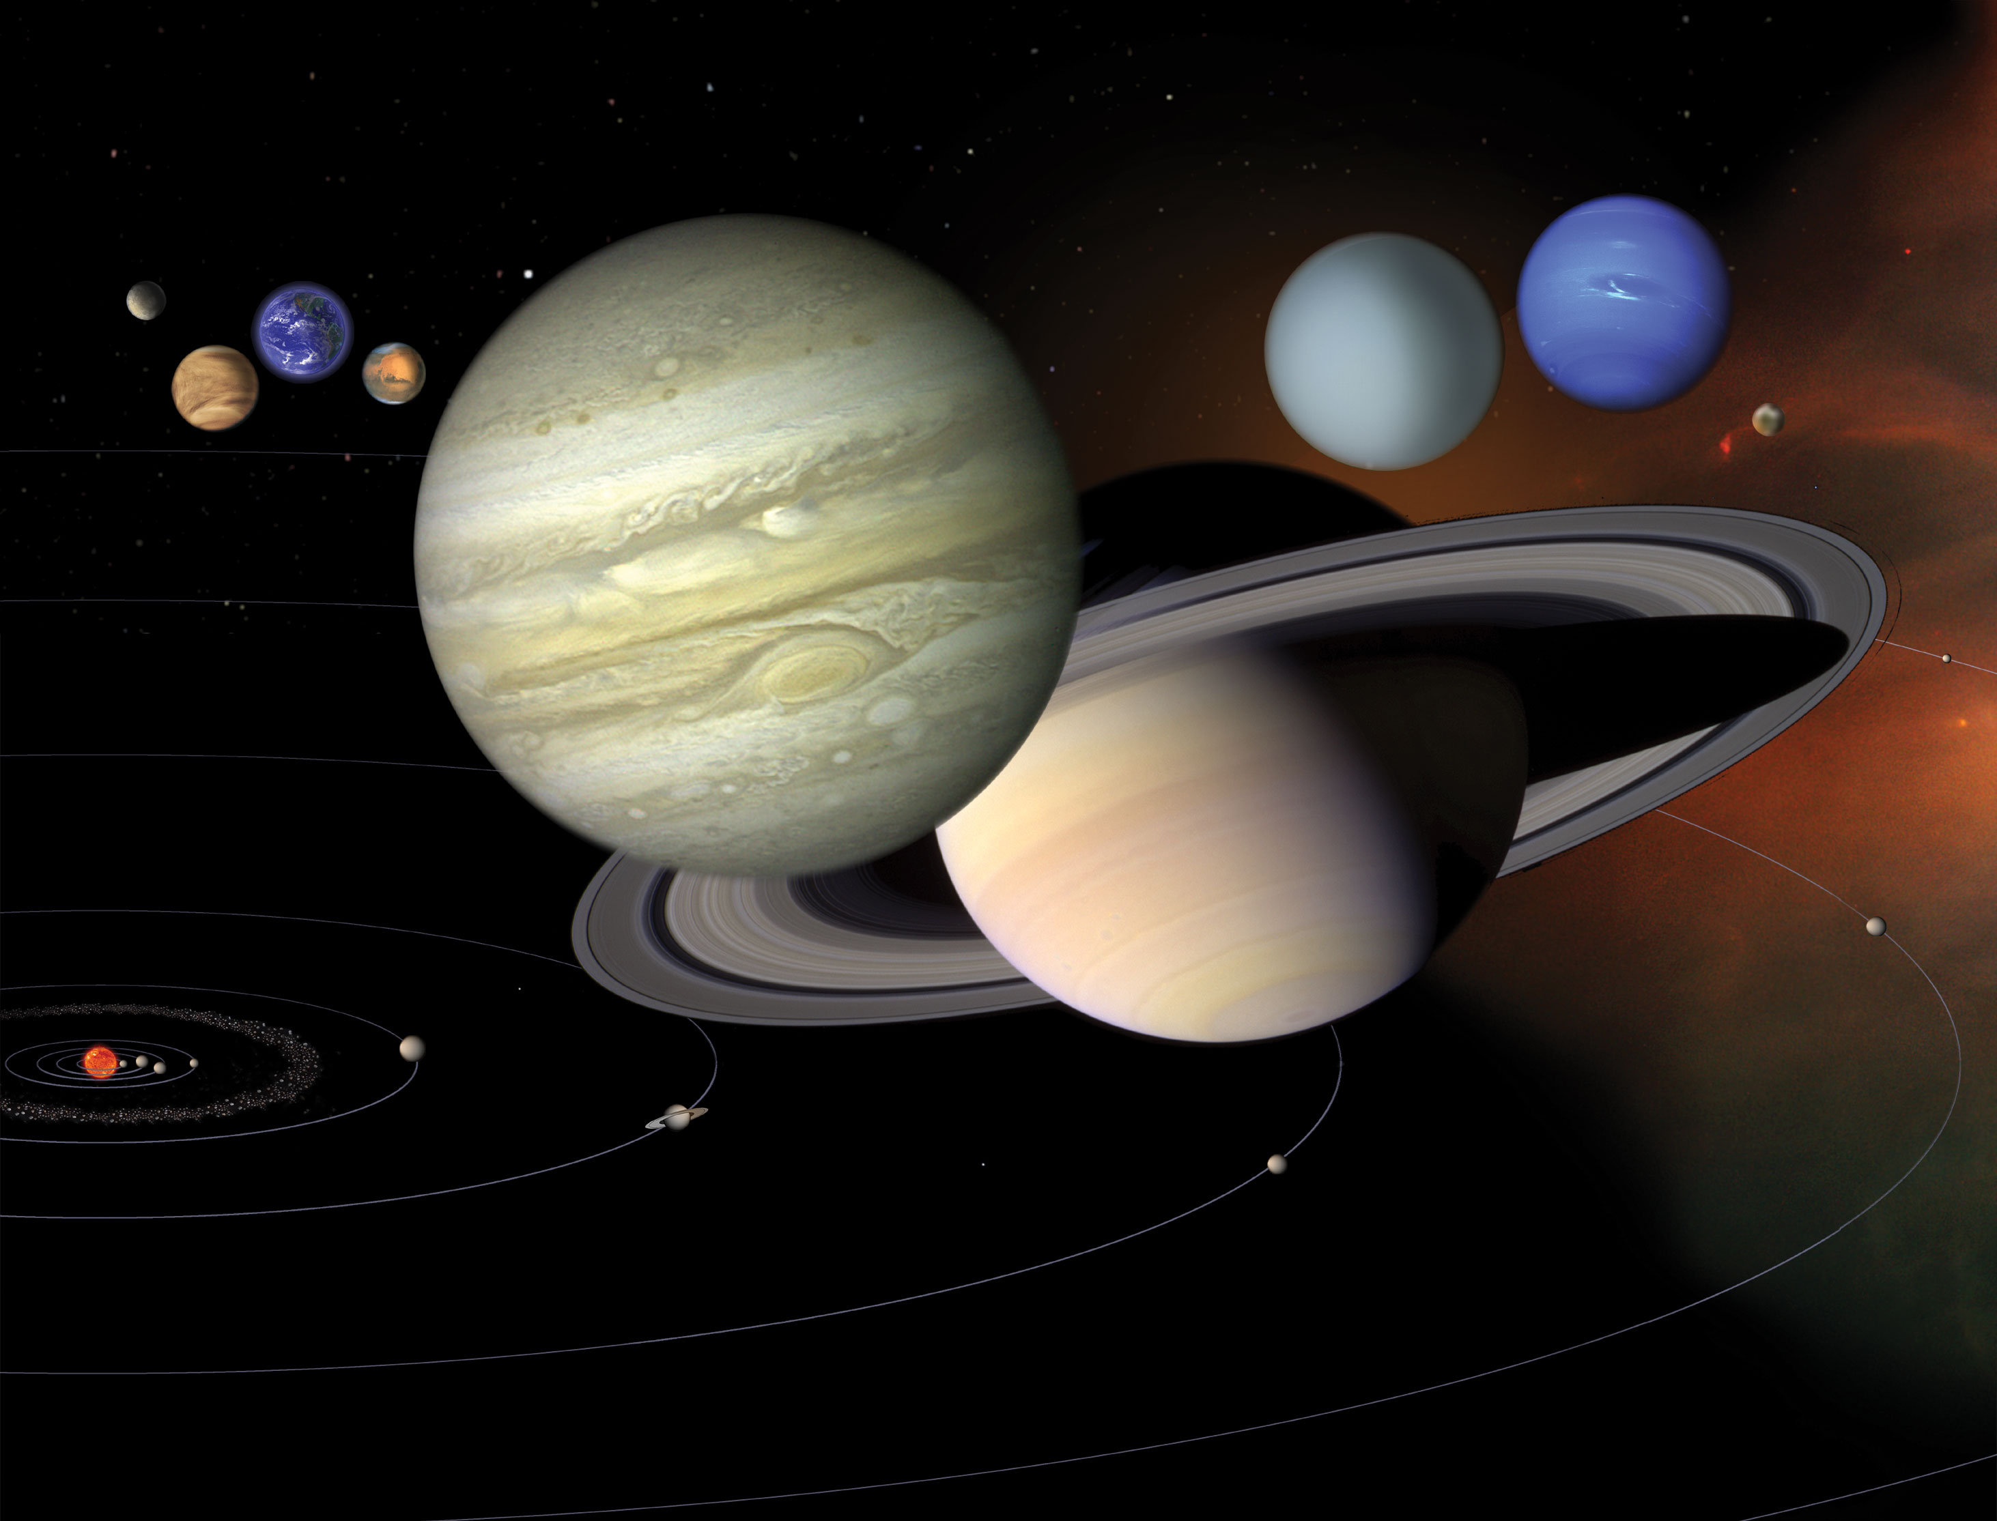
What are planets and exoplanets?
A planet must:
Orbit the sun
Have enough mass for its own gravity to make it round
Exoplanets are planets around stars other than our sun.
Have cleared the neighbourhood around its orbit of debris.
https://science.nasa.gov/wp-content/uploads/2023/09/OSS2-1.jpg
Notes:
What makes a planet a planet and not a large asteroid?
The demotion of Pluto being a case in point.
Having enough mass to make it round makes the difference between being a planet or just a large rock.

Slide 4
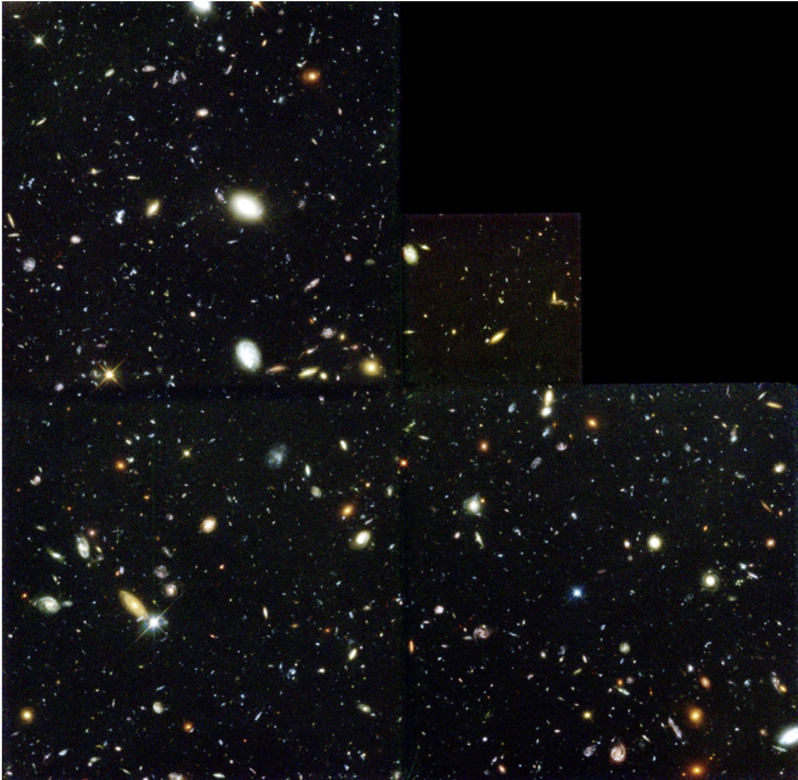
How many exoplanets are we talking about?
Galaxies in the universe = 2 trillion
Stars in the Milky way = around 100 billion
Stars in the Universe = 200 sextillion that’s a 2 followed by 23 zeros
And it’s thought that every star might have at least one planet orbiting around it …
Hubble Deep Field
https://hubblesite.org/contents/media/images/1996/01/388-Image.html?news=true
Notes:
These are my rough calculations based on information from the web.
This doesn’t include how many moons there might be out there too.
How many of these might harbour life is another matter we’ll come to later.

Slide 5
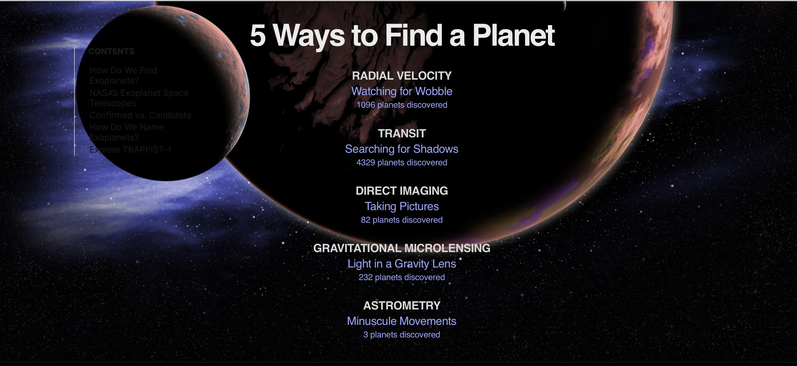
Graphic https://science.nasa.gov/exoplanets/facts/
More info on detection methods - https://sci.esa.int/web/exoplanets/-/60655-detection-methods#:~:text=Astrometry%20is%20the%20method%20that,mass%20of%20the%20planetary%20system.
Notes:
Finding exoplanets means measuring very small effects.
I’ll focus on the first three as they’re the main methods used.
Direct imaging – for young and (relatively) nearby planets
Radial Velocity – using the Doppler method and looking for wobbling stars
Transits – planets passing in front of the star and dimming its brightness.

Slide 6
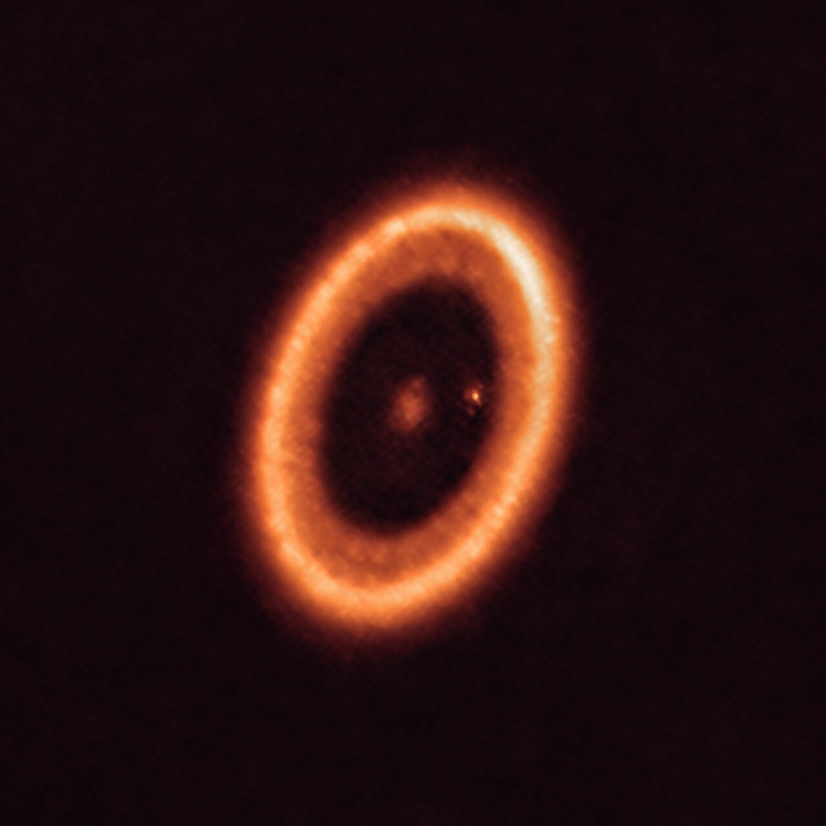
Direct imaging
Seeing exoplanets isn’t easy
they’re small
they’re a long way away
the light from these worlds is overwhelmed by the glare from their stars.
For more info read https://exoplanets.nasa.gov/news/1605/observing-exoplanets-what-can-we-really-see
PDS 70 system, located nearly 400 light-years away. It’s so young that the glowing ring is the planetary disc in the process of being formed. Credit: ALMA (ESO/NAOJ/NRAO)/Benisty et al.
https://www.eso.org/public/images/eso2111b/
Notes:
So let’s put this into context.
Apart from our Sun the closest star is Proxima Centauri
By close we’re talking about 4.2 light years away.
Any exoplanets orbiting those stars will be small by comparison making it harder to find them.

Slide 7
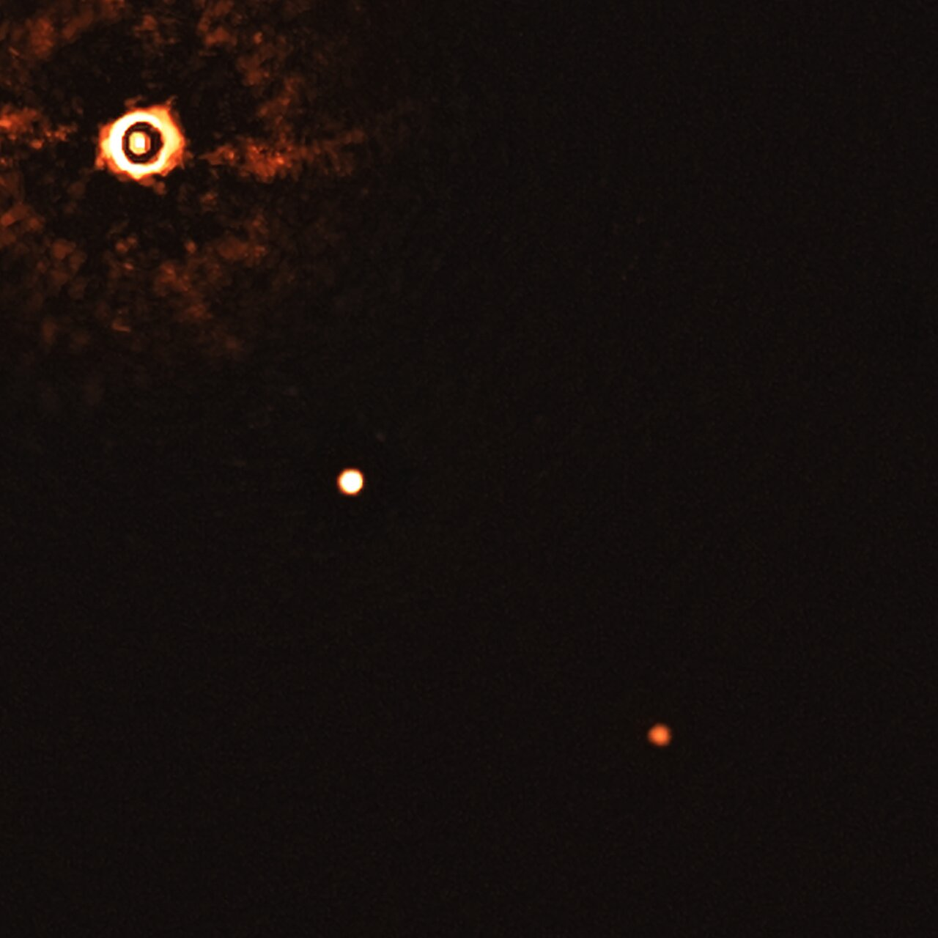
Direct imaging TYC 8998-760-1 b
TYC 8998-760-1 b and a companion planet orbit a Sun-like star some 300 light-years away.
The star is about the same size as our Sun but only 17 million years old
Planets formed recently
They’re so hot (1,400C) that their glow can be detected by ground-based telescopes.
Compared with Jupiter 1 b is about 14 times the mass and three times as big in circumference.
The image was captured by blocking the light from the young, Sun-like star (on the top left corner) using a coronagraph. The two planets are visible as two bright dots in the centre and bottom right of the frame.
Credit: ESO/Bohn et al. https://www.eso.org/public/images/eso2011a/
https://exoplanets.nasa.gov/exoplanet-catalog/7608/tyc-8998-760-1-b/
Notes:
This amazingly image was taken by a ground based telescope, using a coronagraph to block the starlight and make the planets more visible
shows a young sun and it’s developing planets.
Our Sun - 4.6 billion years old, according to radioactive dating.
1 b may be a brown dwarf - too massive to be a planet, but not quite big enough to be a star.
Size - could indicate that its young atmosphere is highly inflated or
it could be two objects orbiting each other.

Slide 8
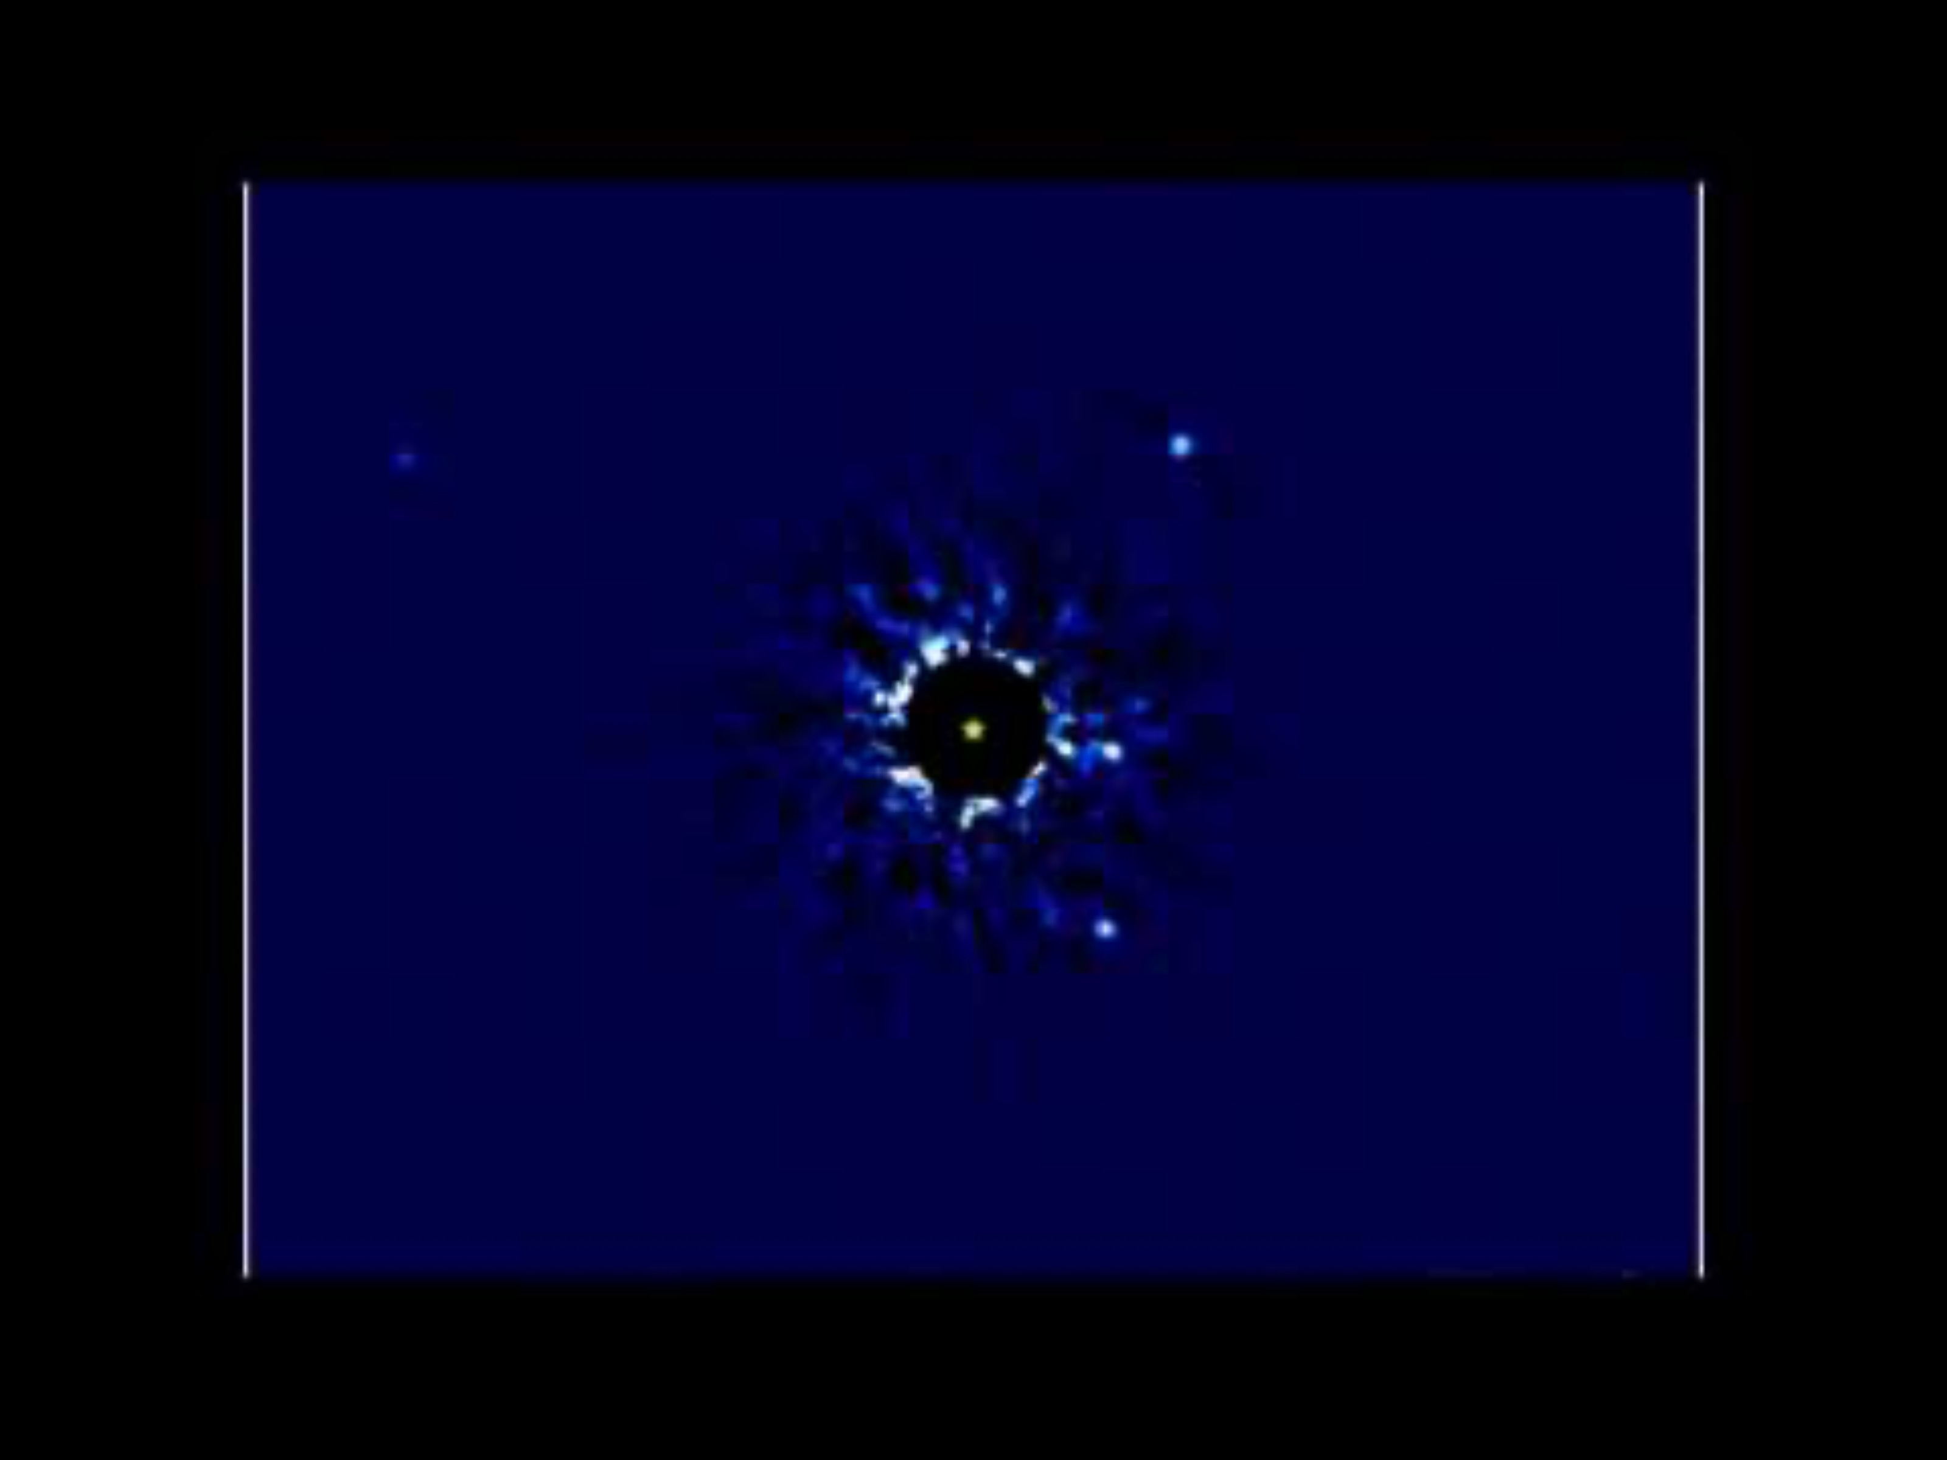
Direct imaging HR8799
129 light years away in the constellation of Pegasus
Less than 60 million years old
Almost five times brighter than our sun.
Observing orbits can be a lengthy business.
Video credit: Jason Wang, UCA Berkeley https://youtu.be/KVgKidAuf4o?si=21piRVq-WTkw7q7U
Article: https://devmanyworlds.wpcomstaging.com/2017/01/24/a-four-planet-system-in-orbit-directly-imaged-and-remarkable/
Notes:
Video - shows four planets larger than Jupiter orbiting this young star.
Produced by Keck Observatory in Hawaii
Black circle – chronograph, used to block the blinding light of the star and make the planets visible.
Lengthy business
Video uses seven years worth of images.
Will take around 40 years to see a full orbit of planets closest to the sun
And over 400 years for the furthest planets.

Slide 10
Radial Velocity Method (RMV)
Stars and planets rotate around their common centre of gravity
Depending on a star’s size and mass this may be on the edge of the star or within it.
Stars wobble due to the gravitational pull of orbiting bodies.
This can indicate exoplanets
Movement seen by using the doppler shift.
Changes in light from blue to red as the star moves towards and away from us due to the gravitational pull of orbiting planets.
Notes:
Basic principle - as planets orbit their star their gravitational pull makes the star move, or wobble, slightly.
Movement - observed by comparing images from telescopes over time.

Slide 11
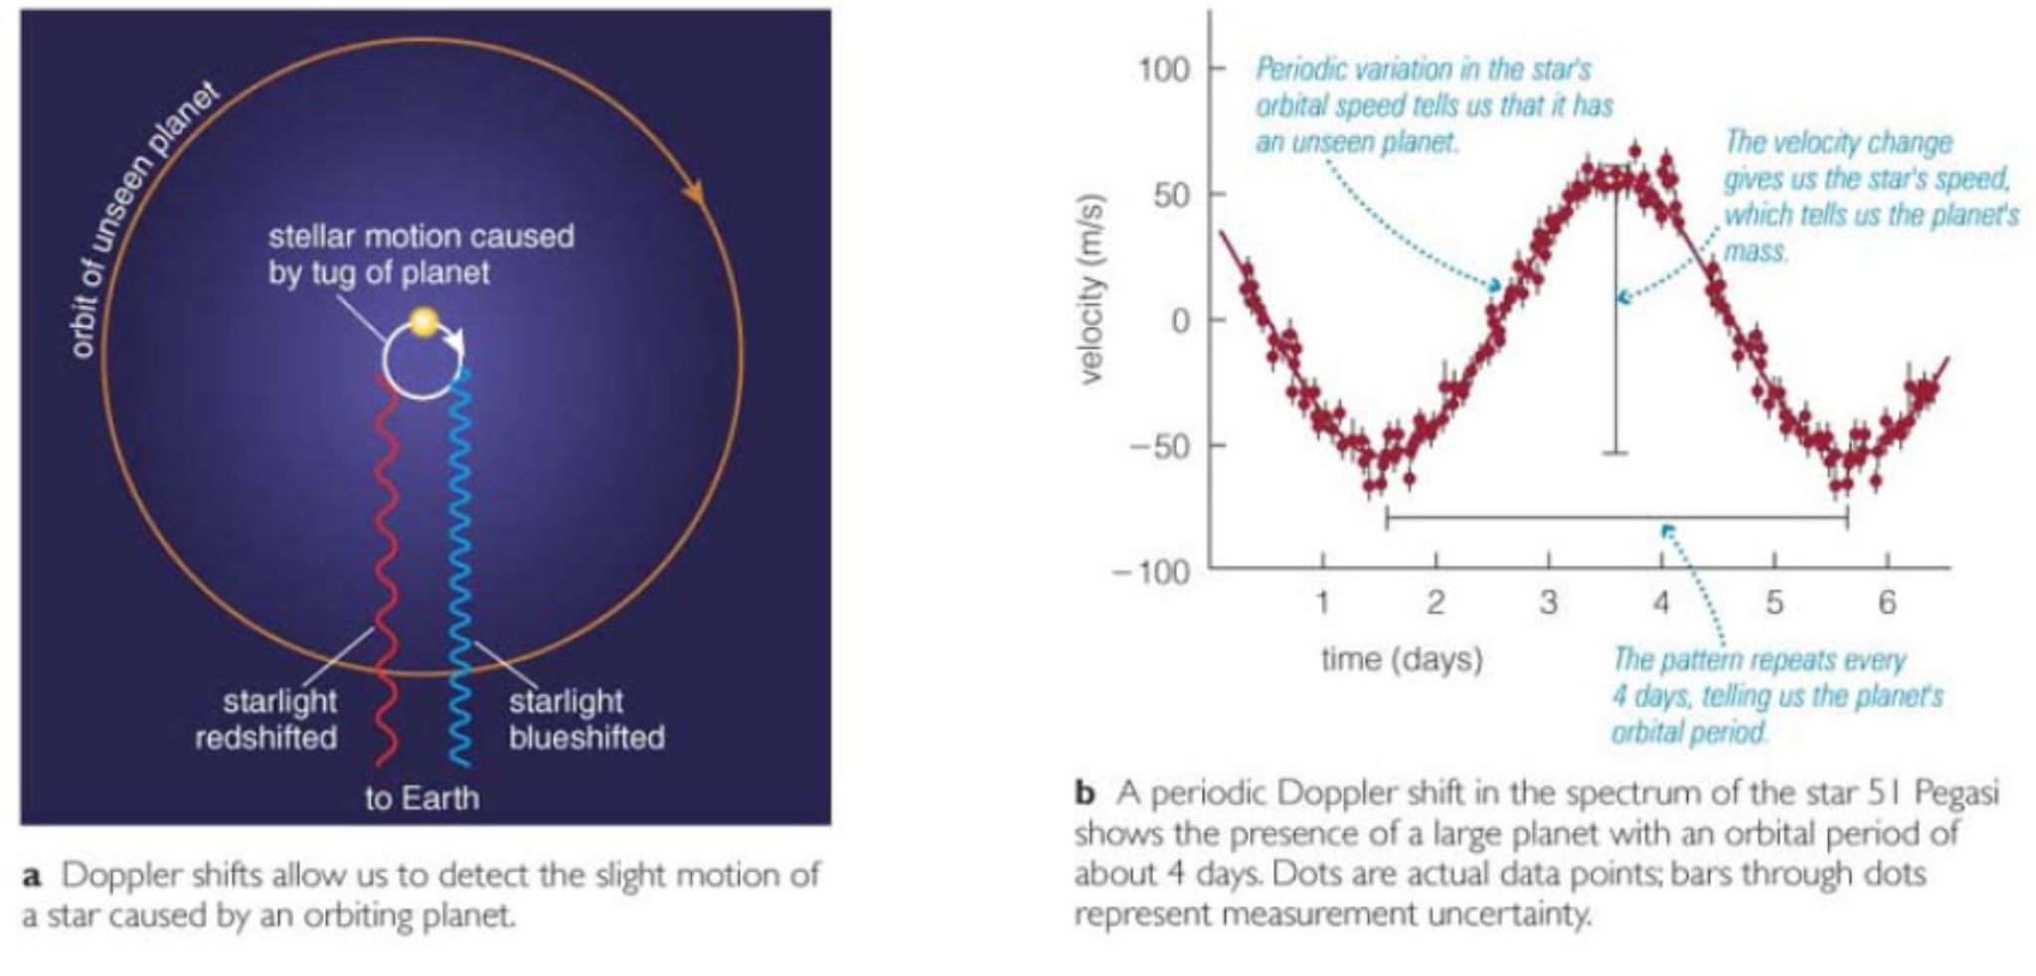
Radial Velocity Method (RMV)
Depends on the plane we view the star in from Earth
Image credit: Pearson Education
https://lasp.colorado.edu/outerplanets/exoplanets.php
Animation on next slide showing how a star wobbles in response to an orbiting planet . Credit European Southern Observatory (ESO)
https://youtu.be/QkMrPOkNNZU?si=T1KdtJxPDHvUD1nK
Notes:
Colour of the light detected by our telescopes and the doppler shift show us a star is wobbling.
If a star is being pulled away from us - light will be redder, red-shifted.
If a star is pulled towards us - light will be less red, or blue-shifted.
We can only see this for stars in the plane of their orbiting exoplanets, i.e. side on.
Where we see stars from above or below – might be able to see a side to side motion by comparing images. But resolution may be an issue as they’re so far away.
The animation on the next slide shows the movement of a star and its planet.

Slide 12
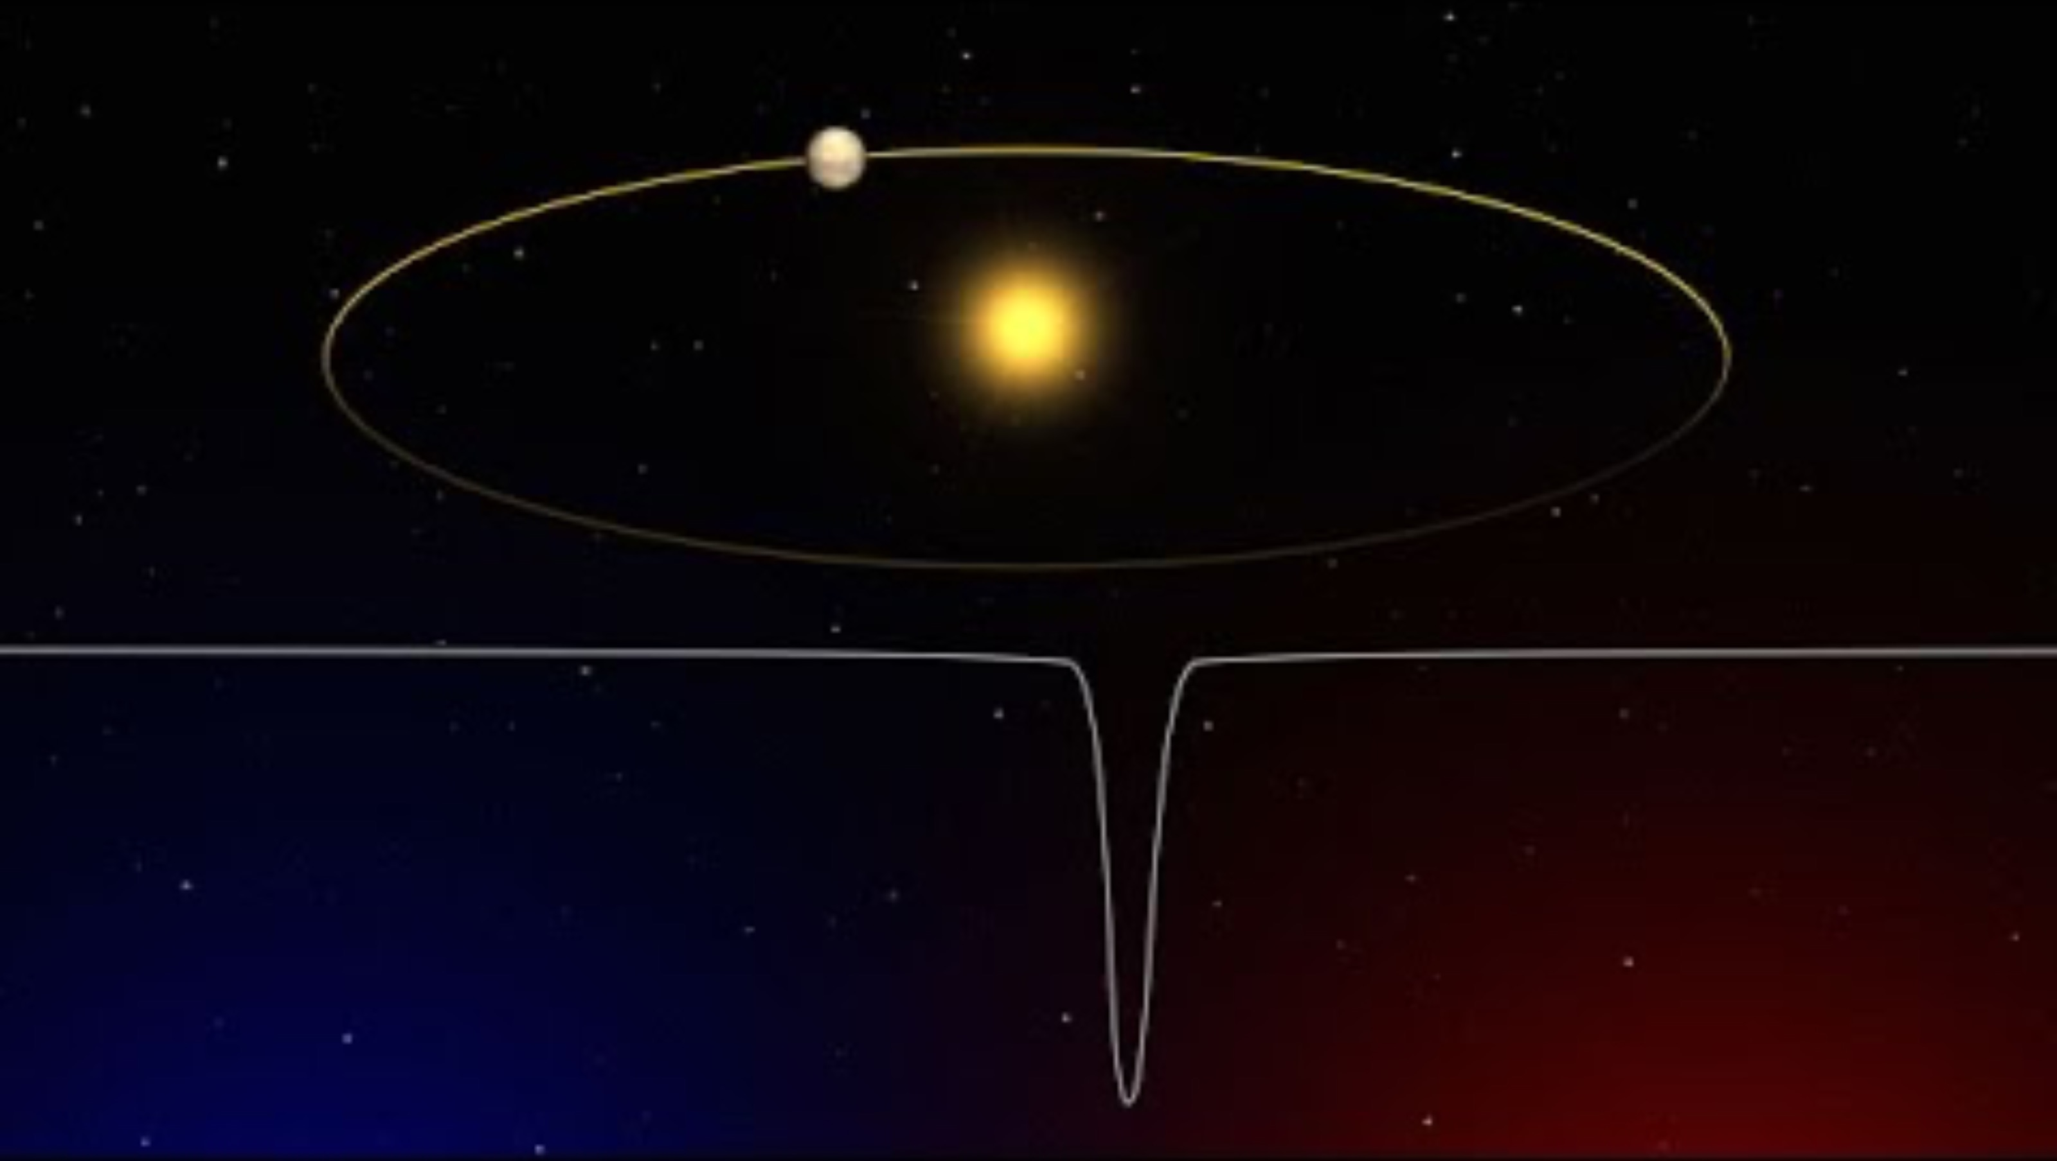
Notes:
The animation shows the movement of the star and its planet.
The graph shows how the colour of the light shifts between blue and red

Slide 13
Radial Velocity method
Also allows us to estimate:
A planet’s mass
Orbital period
Orbital eccentricity and
Tell us which way the star is revolving
Image credit: Pearson Education https://lasp.colorado.edu/outerplanets/exoplanets.php
Notes:
What else does this method tell us?
Regular changes in the star’s orbital speed – suggest there’s an unseen planet causing it to wobble.
Measuring changes in the speed the star rotates at - can be used to calculate the mass of a planet.
Measuring the blue and red shift - can tell us which way the star is rotating and
Identifying patterns in the star’s velocity - tell us how long it takes a planet to orbit the star.

Slide 14

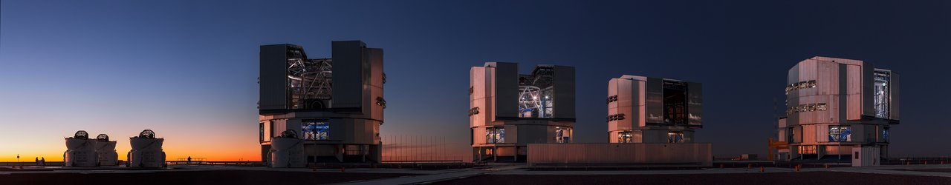
Current limitations of the Radial Velocity method (RVM)
Seems to be a barrier at 1 earth mass.
Technical limit as current spectrographs only get us to an accuracy of 1m/ps.
ESPRESSO (Extreme Precision Spectrograph) on the Very Large Telescope (VLT) - 10cm/ps accuracy – The same speed as Bertie!
VLT - https://www.eso.org/public/images/potw1239a/ , https://en.wikipedia.org/wiki/Very_Large_Telescope#:~:text=The%20VLT%20is%20capable%20of,resolution%20of%20approximately%200.002%20arcsecond.
Bertie - https://www.guinnessworldrecords.com/news/2015/9/record-holder-profile-video-bertie-the-fastest-tortoise-395633
Notes:
Technical limitations mean we can only see planets around the same mass as our Earth – for the time being.
Very Large Telescope, or VLT
gotta love the original names astronomers give to telescopes
will get us down to a resolution of 10cm/ps
That will allow us to see objects that are four billion times fainter than we can see with the naked eye.
10cm/ps is the same speed as Bertie, the fastest Tortoise in the world!

Slide 15
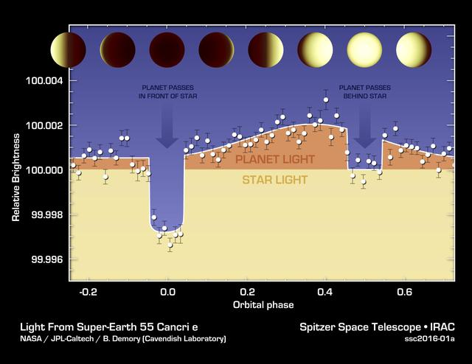
Transits
Primary eclipse – planet passing in front of the star – causes a dip in starlight
Secondary eclipse – planet passing behind the star – less reflected light from the planet
Sun and stars make noisy backgrounds – making transits hard to detect
Hot N Hotter Planet Measured by Spitzer
The varying brightness of an exoplanet called 55 Cancri e is shown in this plot of infrared data captured by NASA Spitzer Space Telescope.
Credits: images-assets.nasa.gov/image/PIA20069/PIA20069
Secondary credit NASA/JPL-Caltech/University of Cambridge.
Notes:
We’re familiar with transits of Mercury and Venus when they pass in front of our sun as small dark disc.
Same applies to distant stars and exoplanets – just further away and harder to see.
Primary eclipse – planet passing in front of the star causes the largest drop in the amount of light from the star.
Amount of light from the star can increase as planet orbits to the side due to reflected starlight.
Secondary eclipse – when the planet passes behind the star the amount of light drops due to the lack of reflected starlight.
These tiny differences tell us something is orbiting the star.

Slide 16
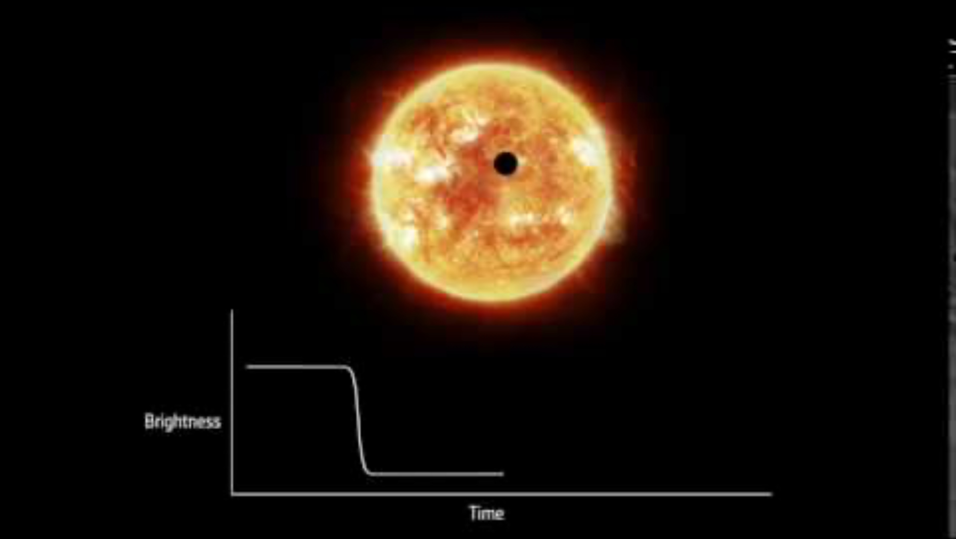
Transits can also tell us - the mass of a planet
By dividing the radius of the star by the radius of the object
Can cross-check with the Radial Velocity Method.
Animation showing a planet transiting in front of its star as seen from Earth. During these transits, the star appears less bright. By detecting these periodic decreases of brightness over time, it is possible to detect the presence of planets orbiting the star.
https://sci.esa.int/web/gaia/-/58789-detecting-exoplanets-with-the-transit-method
https://youtu.be/xNeRqbw18Jk
Notes:
The animation shows how a transiting planet affects the brightness of light received from a star
Transit method best at finding sub-Neptune like plants with orbits much smaller than Mercury’s.
For solar systems like ours transit studies could miss every planet!

Slide 18
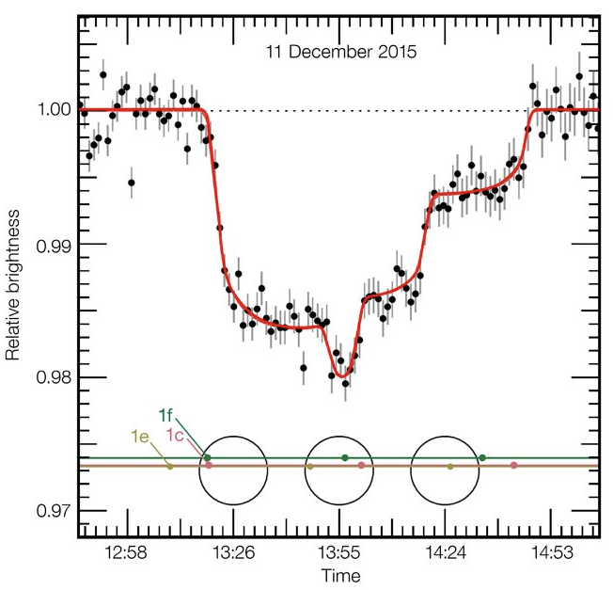
Extra planets?
Shown by differences in the amount of light blocked and
the number of dips in the light curve.
On 11 December 2015 the HAWK-1 instrument on ESO’s Very Large Telescope (VLT) observed an unusual triple transit event around the faint dwarf star TRAPPIST-1. As the planets passed in front of the star they blocked the star’s light in varying combinations. The light curve is historic as it shows for the first time three temperate Earth-sized planets, two of them in the habitable zone, passing in front of their star.
Image Credit: ESO/M. Gillon et al. https:c/www.eso.org/public/images/eso1706g/
Notes:
Shape of curve can tell us if there is more than one planet orbiting a star.
Graph shows how the light from the star Trappist-1 changes as the planets pass in front of it in various combinations.
Scale on the left is percentage brightness and the dots with lines are error bars.
Most light blocked when the three planets are passing across the face of the star as separate dots.
Most exoplanets don’t transit their star.
Direct imaging is essential for measuring atmospheres and possible biosignatures.

Slide 19
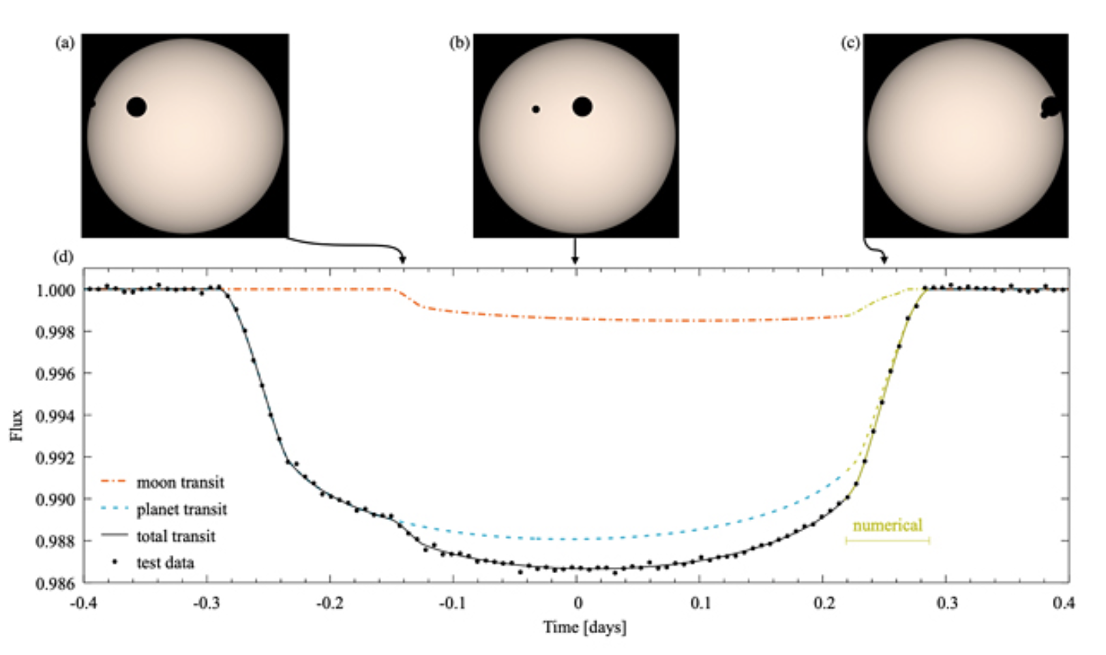
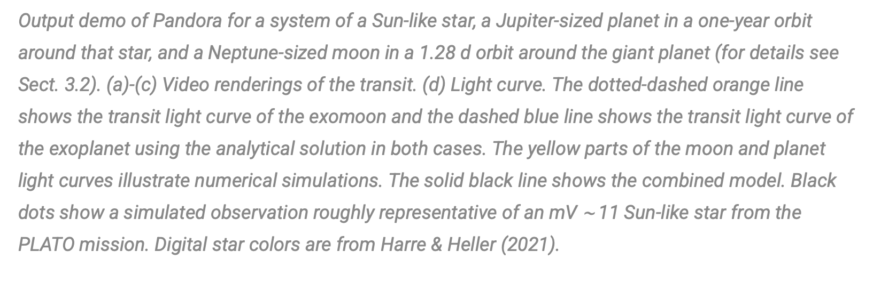
Exomoons?
Harder to see
Could be revealed by:
  a deeper transit curve for a planet followed by a less deep dip for the exomoon
  A transit timing variation (TTV)
  Looking for gases from volcanic moons
Two suspects so far
https://hubblesite.org/contents/news-releases/2018/news-2018-45.html
https://www.planetary.org/articles/where-are-moons-of-exoplanets#:~:text=At%20this%20point%2C%20we%20have,the%20moons%20in%20our%20neighborhood.
Image Credit: Michael \Hippke, Rene Heller Ouput demo from Pandora a fast open-source Exomoon transit detection algorithm
https://astrobiology.com/2022/05/pandora-a-fast-open-source-exomoon-transit-detection-algorithm.html
Notes:
Too small to see directly, may be inferred from effect on a planet’s transit
Shape of light curve - could reveal if the moon is leading or trailing the exoplanet at the time.
Only two strong contestants so far
Kepler-1625b-i – 8,000 light yrs away and Kepler-1708b-I – 5,600 Light Years away
Both Neptune sized – 1.6 – 4 times the size of Earth and orbit planets 5-10 times as big as Jupiter
Image and graph - demo output from the Pandora algorithm
Shows what might be expected for a Jupiter sized planet with a Neptune sized moon transiting their star.
Orange line - shows the light curve for the moon.
Blue line - light curve for the planet
Black line - combined curves for planet and its moon.

Slide 20
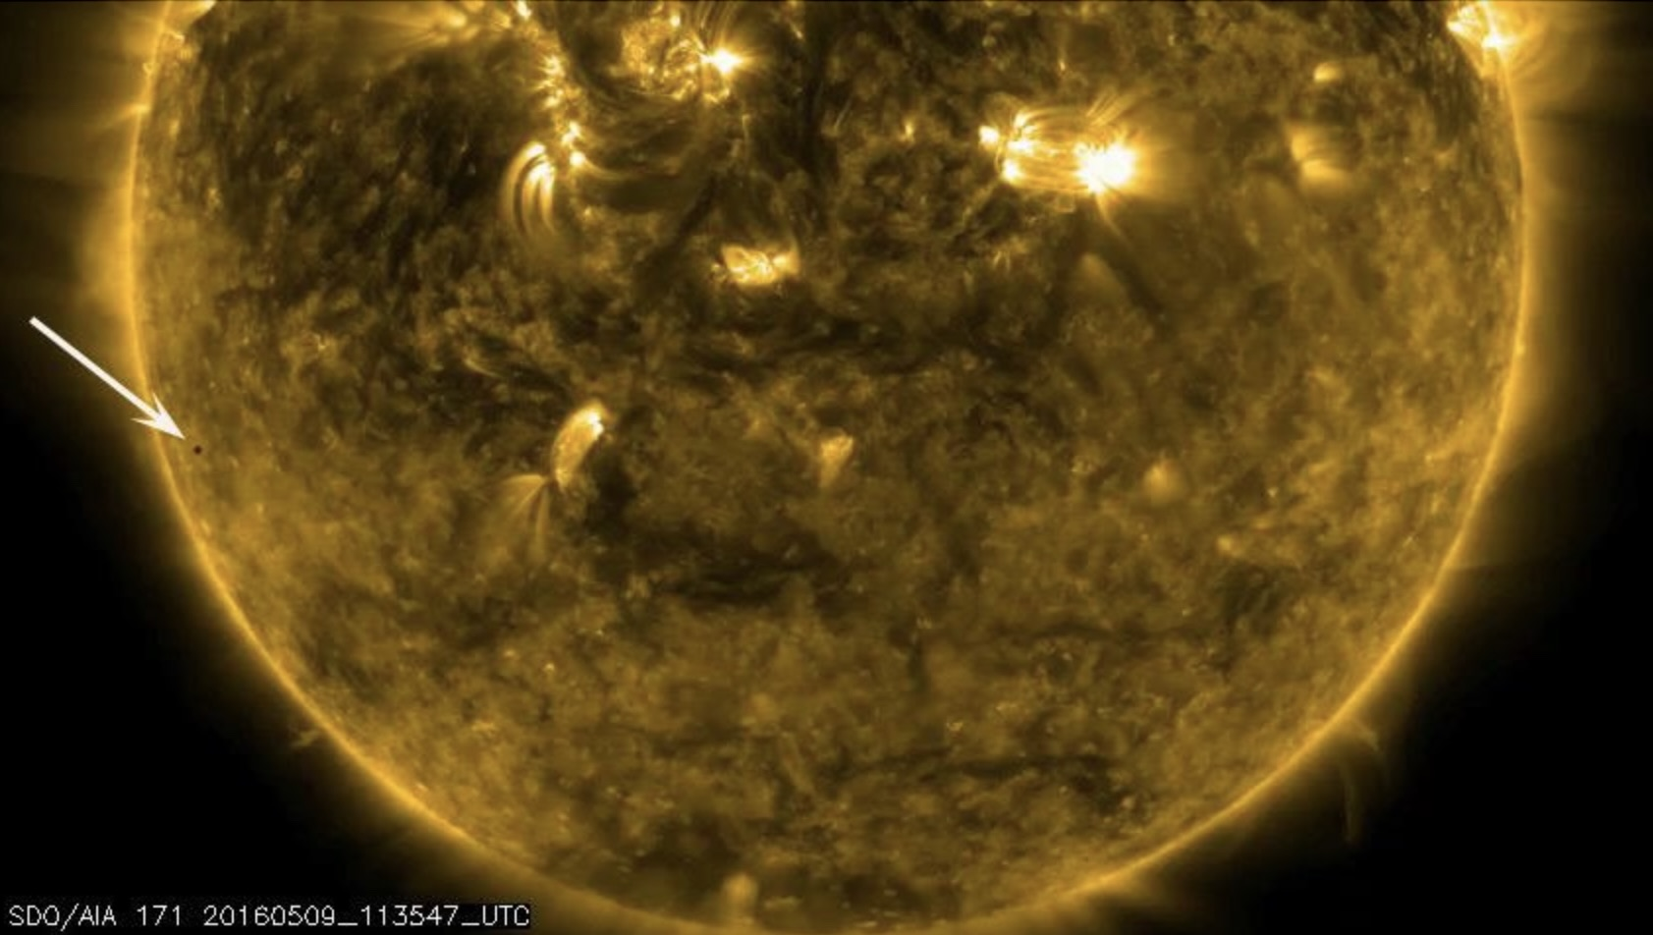
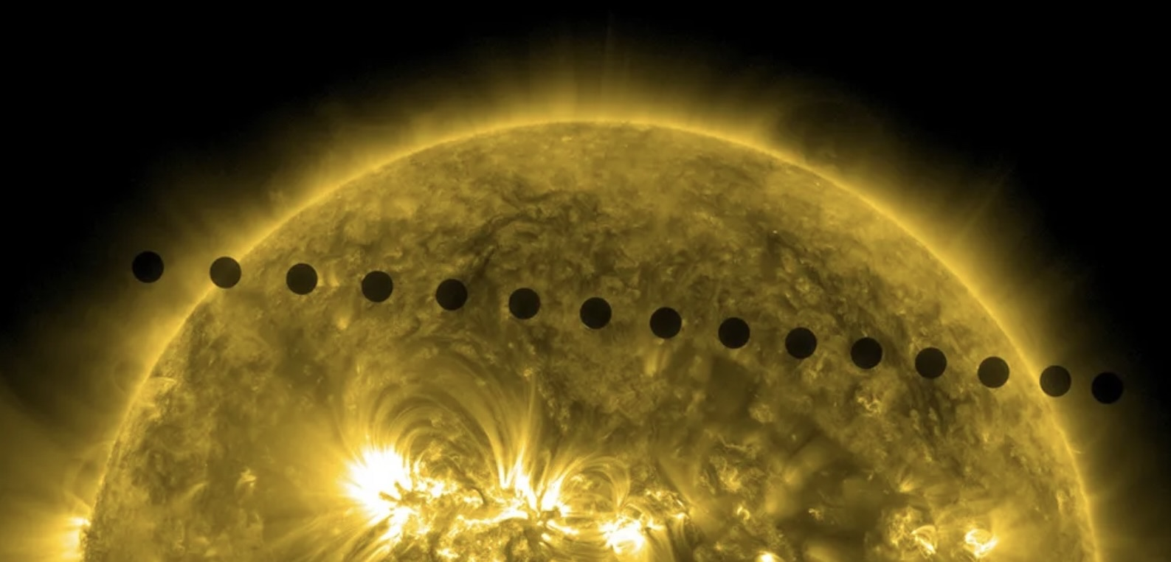
What can transits tell us
Orbital decay
when transits are later or earlier than calculated.
Could be due to precession and eccentric orbits – potentially other planets further out which don’t transit the star.
Orbital variations
can work out orbital variations from changes in the orbit/transit times.
The shape of the orbit can change too.
Information about the star
May not be totally spherical and this can impact a planet’s orbit.
Binary stars - exoplanets orbiting around one or both stars
Mercury transitting across the sun NASA GSFC Solar Dynamics Observatory
https://www.jpl.nasa.gov/images/pia14729-mercury-transit-across-the-sun
Venus transiting across the sun NASA https://science.nasa.gov/resource/venus-transit-across-the-sun-2014/
Notes:
These images give us an idea of how hard seeing exoplanets is.
Top - Mercury starting to transit our sun.
Mercury is the tiny black dot by the white arrow.
Mercury is smaller than earth so wouldn’t be visible to many telescopes.
Bottom - time lapse of transit of Venus.
Whole transit takes around 6 hours.
Reveals another issue with observing exoplanets.
Transits of Venus happen in pairs eight years apart. These are separated by 105 or 121 years.
The last transit was in 2004 and the next won’t be until 2117.
So, if we’re looking for something that’s only visible for 6 hours twice every 120 or so years you can see how easy it would be to miss an exoplanet if we weren’t observing at the right time.

Slide 21
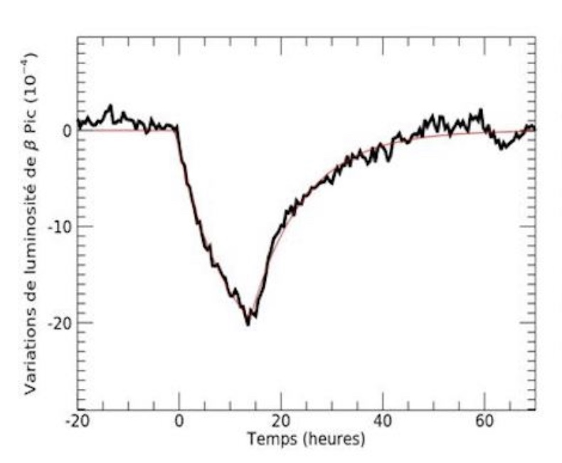
Things that mimic planets
Comets
Detected by spotting the comet’s tails as they cross the face of their star.
Comet nuclei range from 1.9 – 8.7 miles (3 – 14 km) in diameter – 64 light years away!
Exotrojans
Asteroids around other stars. These could be planetary debris or dust or matter forming a planet.
Light curve for Beta Pictoris, showing the transit of comet tails. the TESS (Transiting Exoplanet Survey Satellite) observation. Image via A. Lecavelier des Etangs et al./ Astronomy & Astrophysics 1999 CNRS.
https://earthsky.org/space/30-exocomets-beta-pictoris-tess/
Notes:
An object can only be confirmed as being a planet if we know its mass.
Other objects can mimic planets in transit curves
Comets - Tail reflects light and changes the shape of the curve from a U to a V shape.
Transiting Exoplanet Survey Satellite, TESS, has found over 30 exocomets in the Beta Pictoris system.
These comets are between 1.9 – 8.7 miles in diameter, 64 light years away.
Exotrojans - In the unlikely event you ever wondered what an asteroid around another star is called they’re known as exotrojans.
Likely to be small and the collective effect of them in a band, like our asteroid belt, would have to be observed and identified.

Slide 22
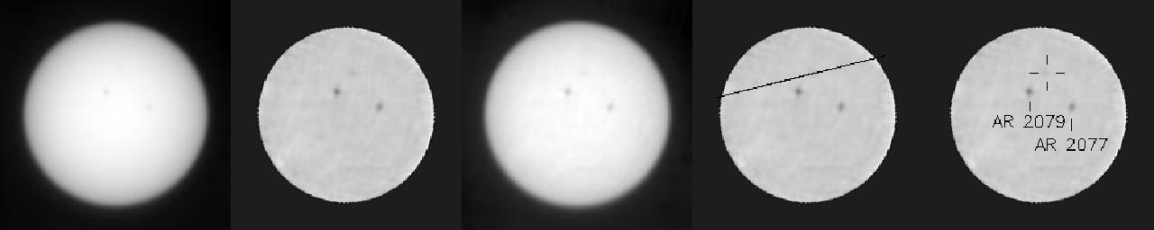
Things that mimic planets
Starspots
Can lead to incorrect measurements for planetary radii.
Can give false positives
The surface around starspots is magnetized and this can suppress red shift.
Distortions in transit graphs can provide info on the position and size of starspots.
More info
Astronomy and Astrophysics – Effect of stellar spots on high-precision transit light-curve
https://www.aanda.org/articles/aa/full_html/2013/08/aa21309-13/aa21309-13.html
Transit of Mercury across the sun as seen from Mars by the Curiosity Rover – Image NASA JPL https://www.jpl.nasa.gov/images/pia18389-mercury-transit-of-the-sun-seen-from-mars
Notes:
If a planet and a starspot cross the face of a star close together
can lead to them being measured together and a planet being perceived as being larger than it actually is.
Starspots can be misinterpreted as planets but planets tend to move faster.
Images show transit of Mercury across the sun as seen from Mars by Curiosity Rover.
Mercury occupies 0.6 of a pixel in the images.
If Mercury is this small from Mars it shows the challenges of seeing exoplanets around other stars.

Slide 23
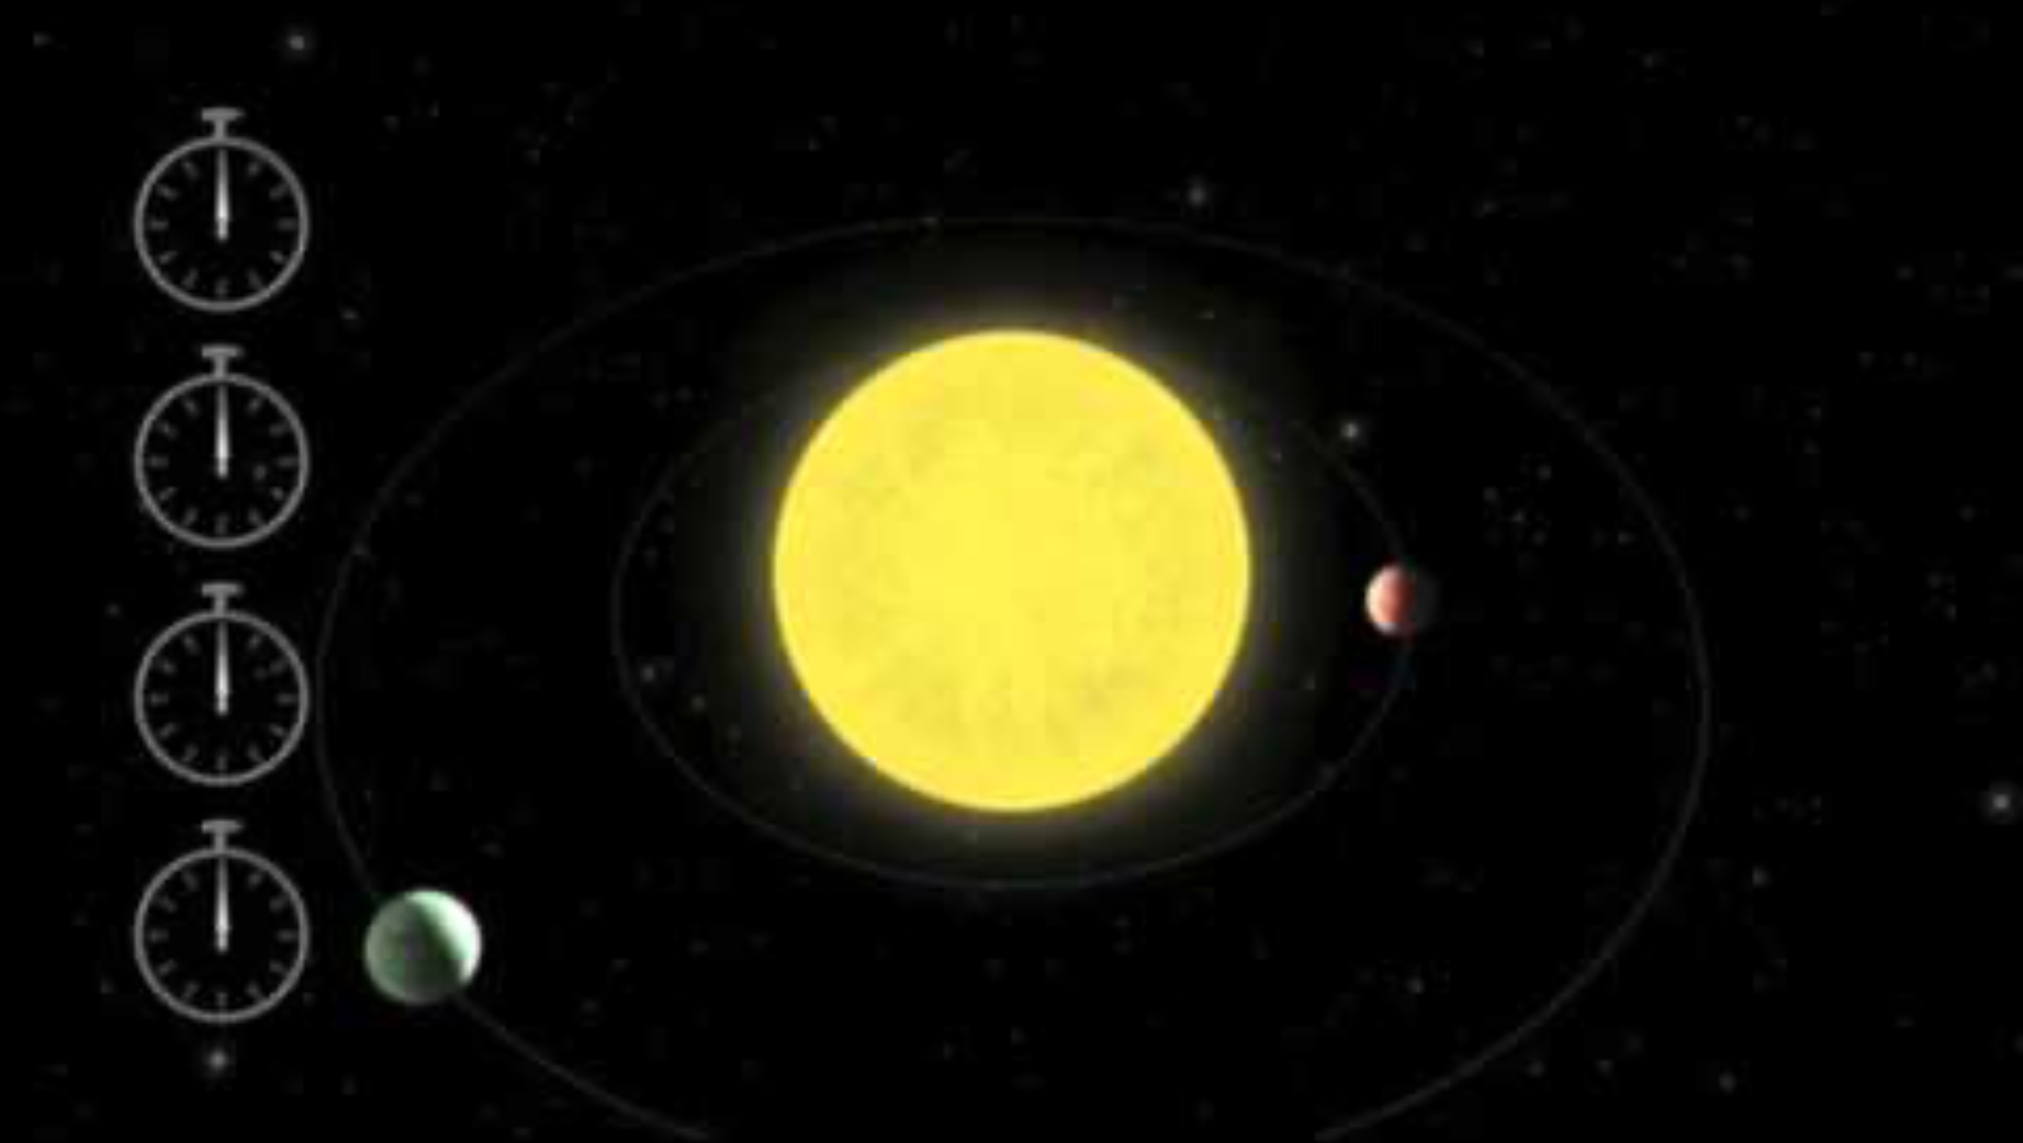
Transit timing variation
Can reveal exoplanets which don’t transit the star from our point of view.
Gravitational pull between planets
  can cause one planet to accelerate
  and another to decelerate in their orbits.
Video showing the impact of gravitation interaction on transit timing
https://en.wikipedia.org/wiki/File:201008-2a_PlanetOrbits_16x9-_Transit_timing_of_1-planet_vs_2-planet_systems.ogv
https://www.youtube.com/watch?v=oF1Zlzs69b4
Notes:
Changes in the time it takes for a planet to orbit its star can reveal the presence of other planets we can’t see transiting in front of the star
due to their inclination, angle or orbit
Basically a single planet will have a regular orbit time.
If orbit period varies - suggests the presence of another planet, or planets.
Their gravitational pull may slow down or speed up the orbit of the planet that can be seen transiting its star.

Slide 25
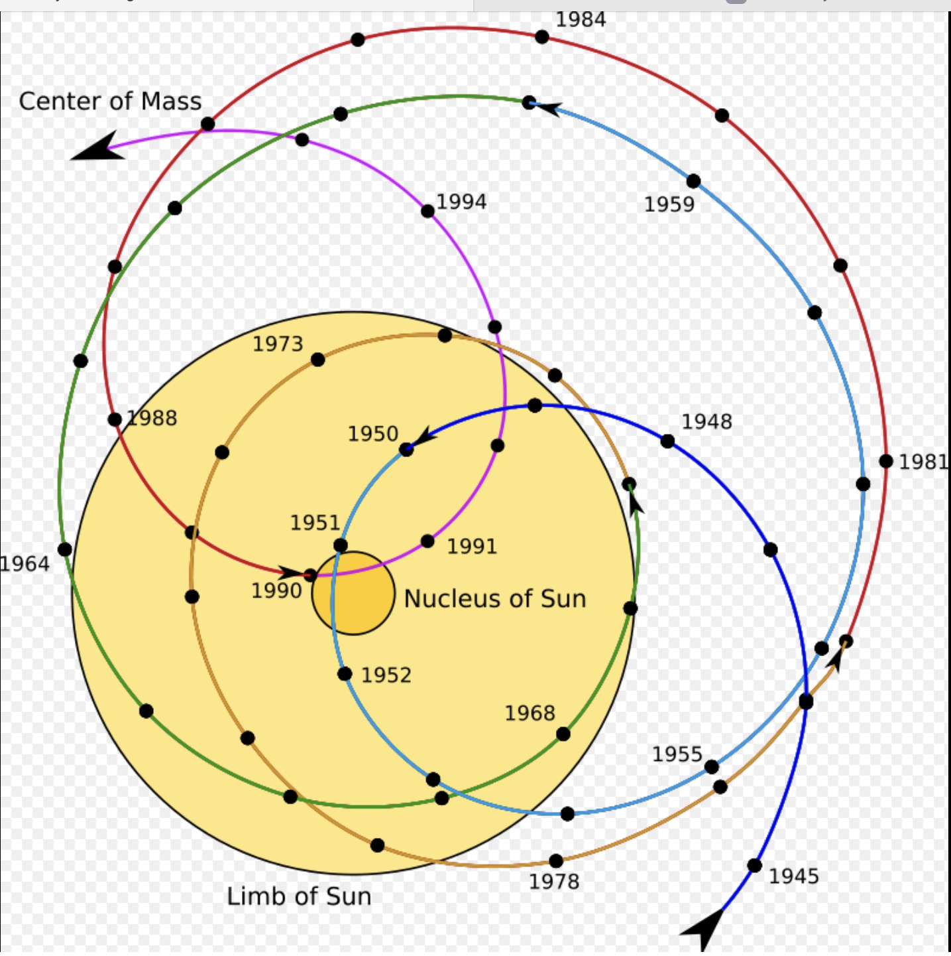
Astrometry
Looks for tiny wobbles in a star’s position
Diagram showing the motion of the barycenter of the solar system relative to the Sun 1945 – 1995 Credit Carl Smit derivative work
https://commons.wikimedia.org/wiki/File:Solar_system_barycenter.svg#/media/File:Solar_system_barycenter.svg/4
Video on next slide Astrometry – method to find Exoplanets – by NASA
https://youtu.be/1Cc2c6HOz_A?si=I44KYeuWgWRw6AUS
Notes:
Diagram shows how the sun has moved in response to the pull of it’s planets over a 50 year period.

Slide 26
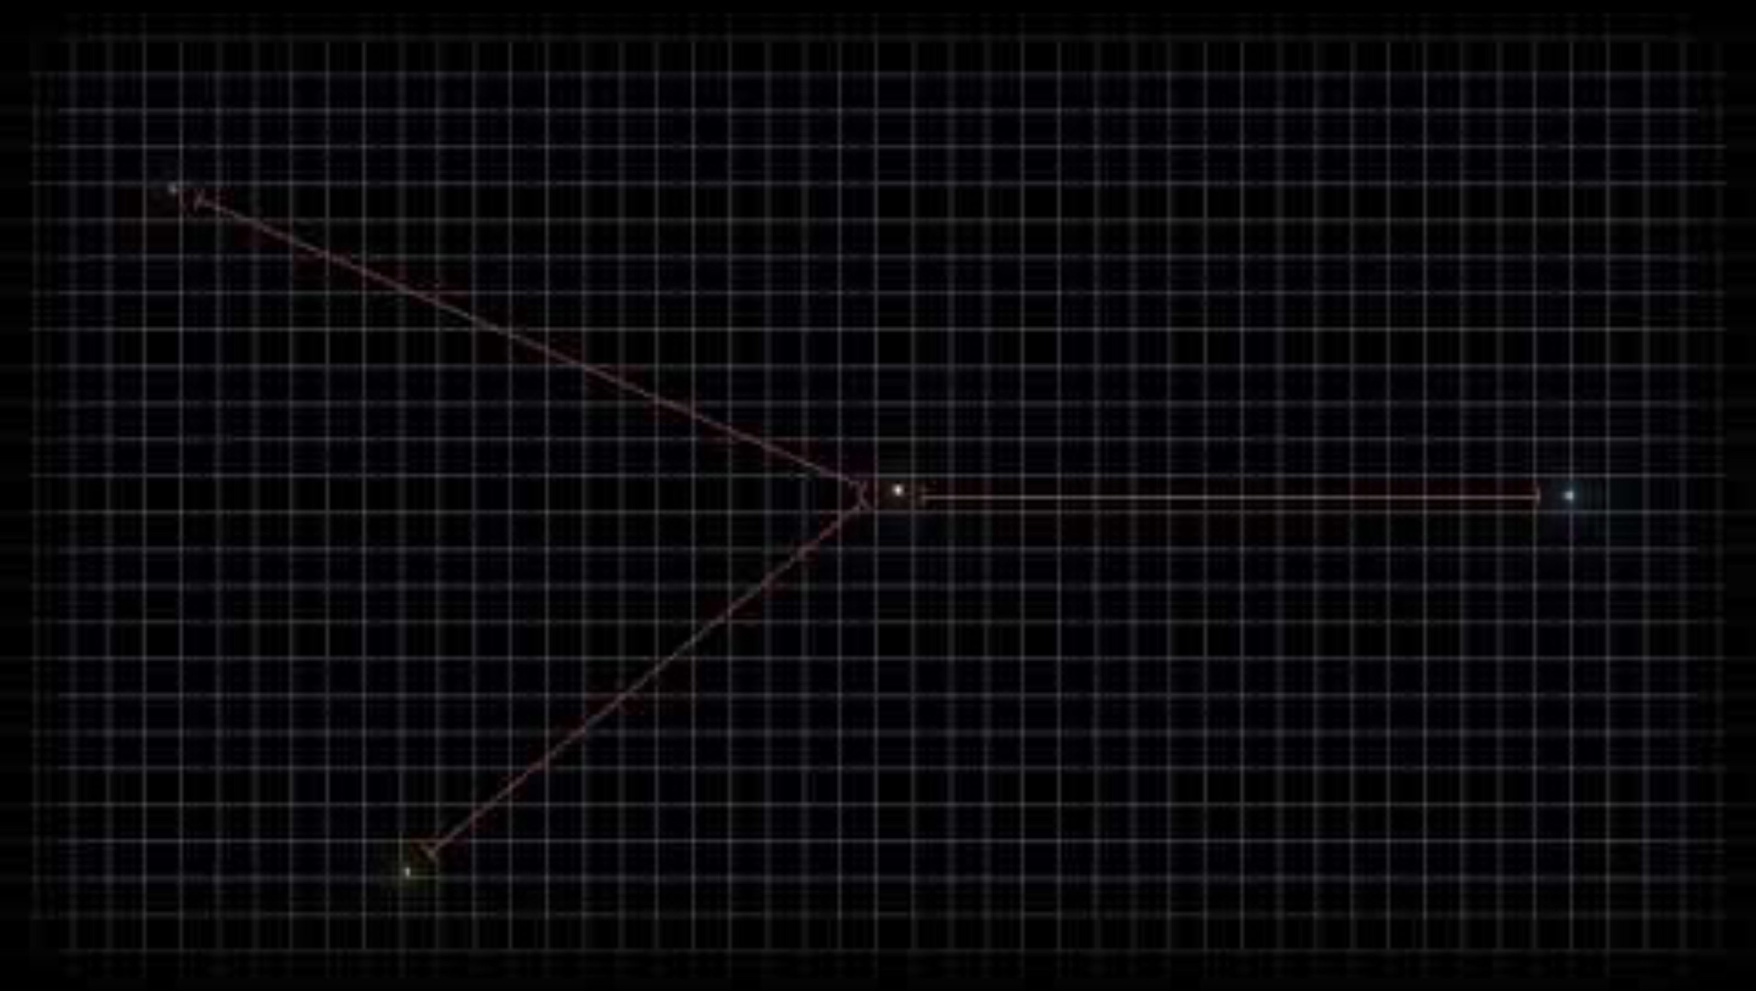
Notes:
Video on next slide Astrometry – method to find Exoplanets – by NASA
https://youtu.be/1Cc2c6HOz_A?si=I44KYeuWgWRw6AUS

Slide 27
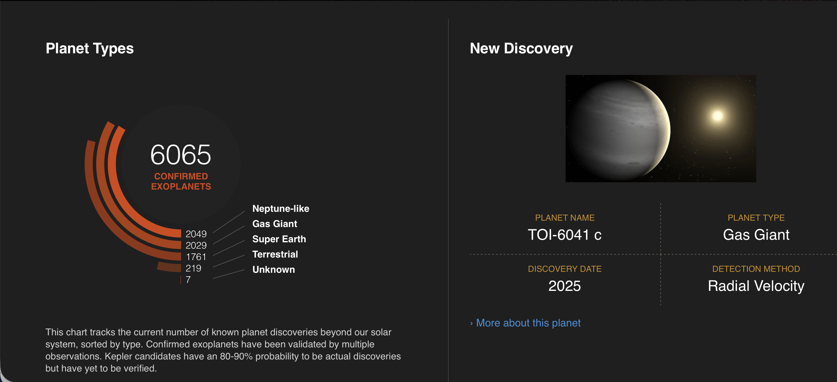
How many exoplanets have we found so far?
Screengrab taken Jan 6 2026 credit: https://science.nasa.gov/exoplanets/discoveries-dashboard/
Notes:
This is the current tally of exoplanets that have been confirmed
The number of each type of planet is shown on the left and the latest confirmed discovery on the right.

Slide 28
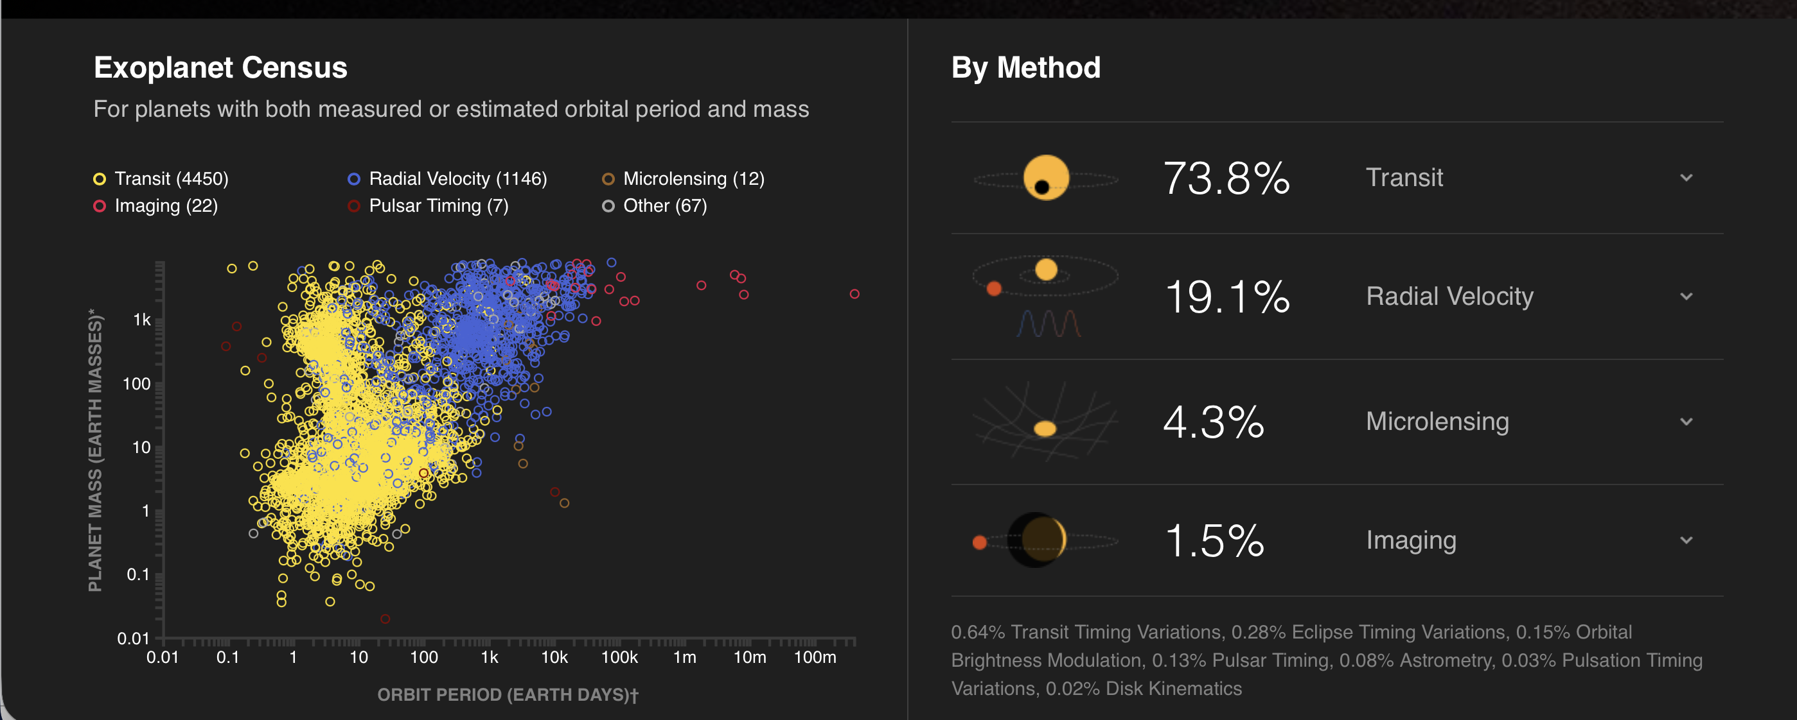
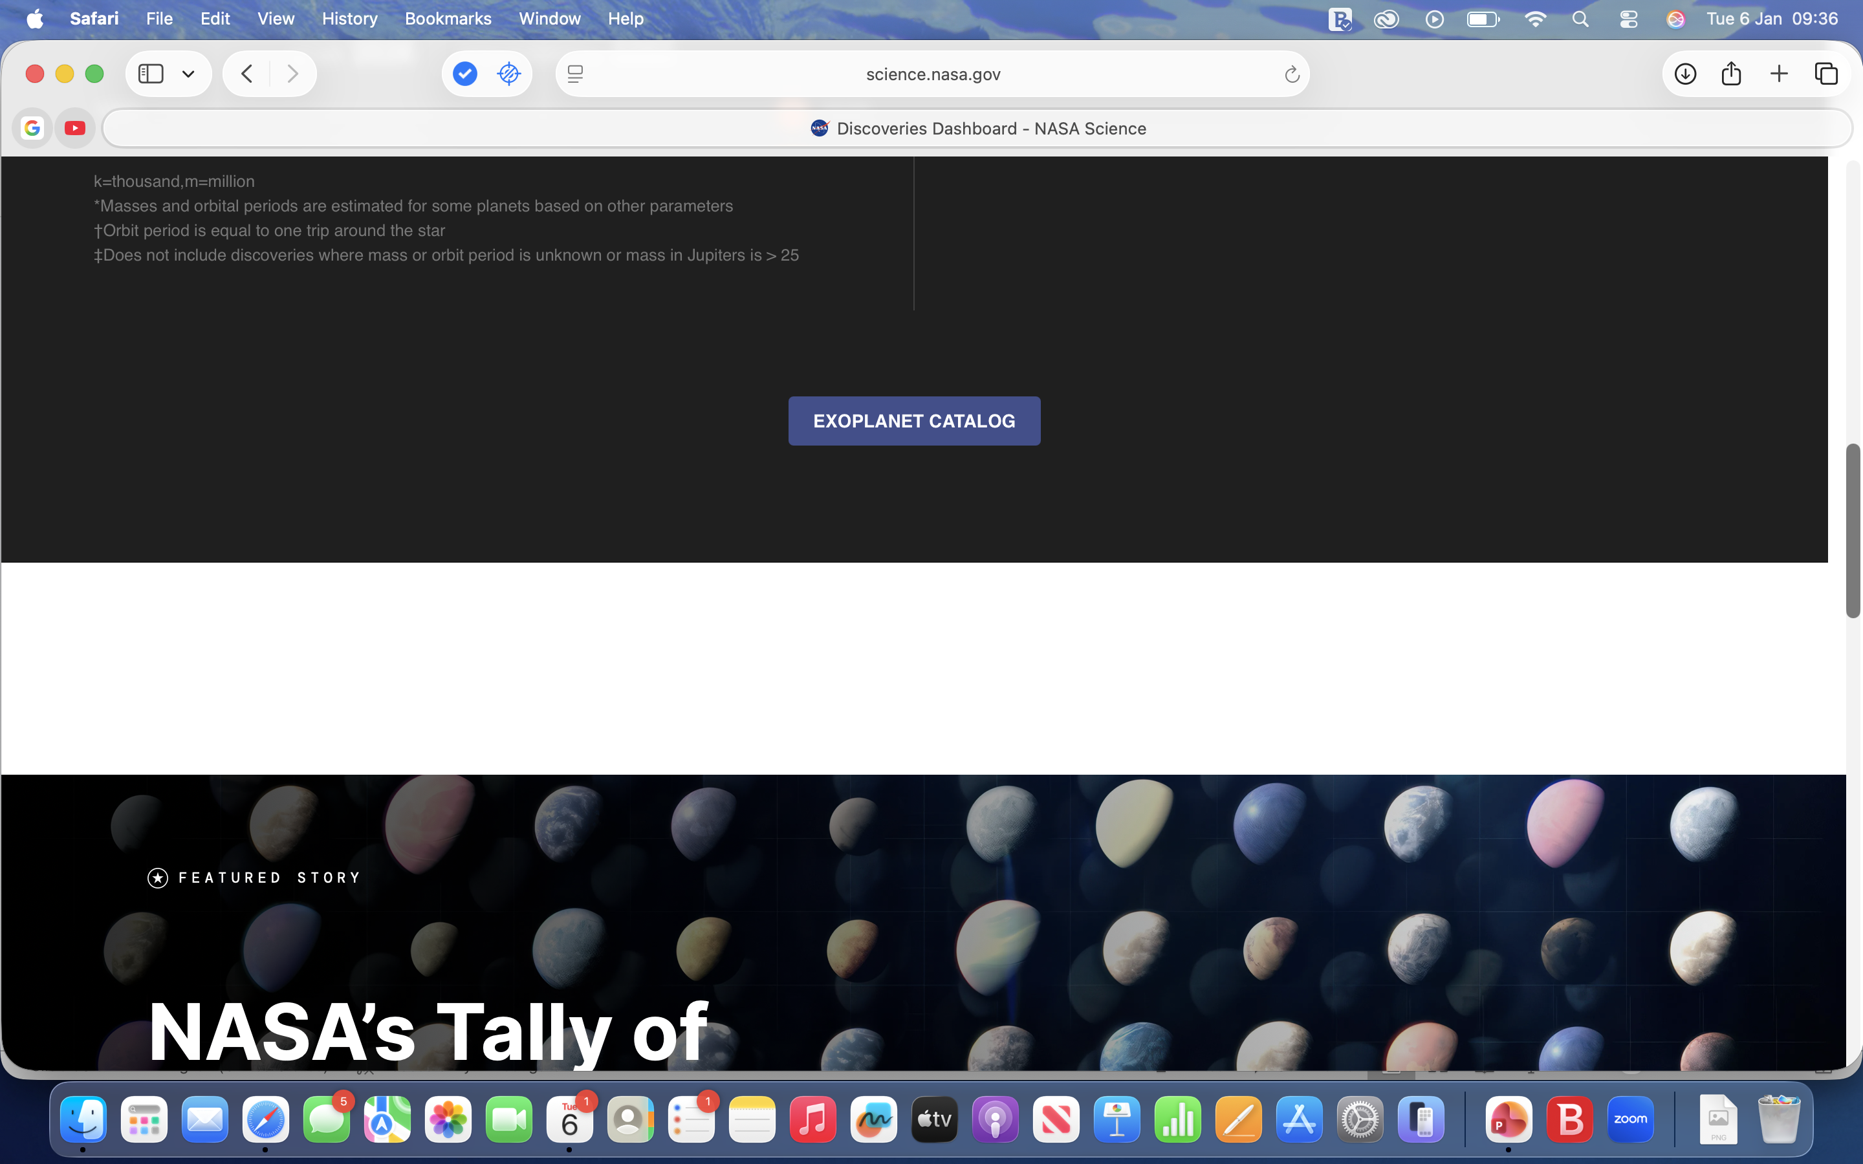
How many exoplanets have we found so far?
Screengrab taken Jan 6 2026 credit: https://science.nasa.gov/exoplanets/discoveries-dashboard/
Notes:
This shows how many were found by each method.
Graph shows the mass of the planet and the length of it’s orbit and the method used as well.
Most have been found using the transit method..

Slide 29
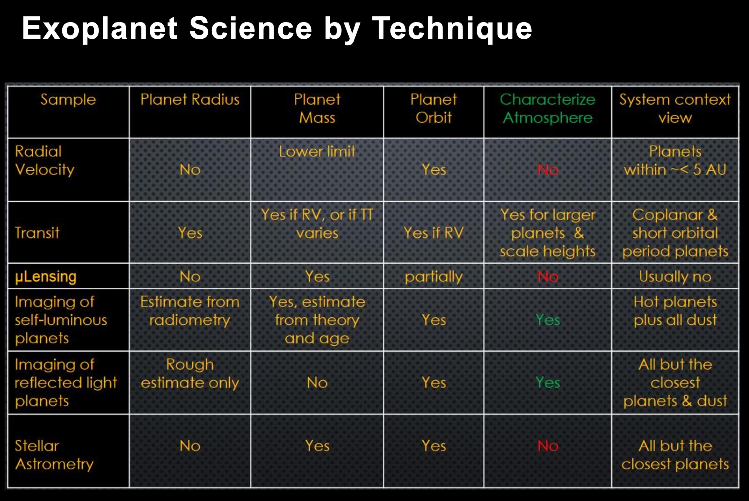
Table showing exoplanet science by technique from You had me at habitable slides by Dr Gary Blackwood, JP:L, NASA
https://exoplanets.nasa.gov/exep/resources/presentations/
Notes:
Table shows what we can learn about other stars and exoplanets from the various methods:
Stellar mass and size
Which way the star is rotating
Whether there are any objects orbiting it
Planetary size and mass
orbit, presence of large moons and which way they’re orbiting a planet
presence of an atmosphere around large planets
Direct imaging of young hot planets

Slide 30
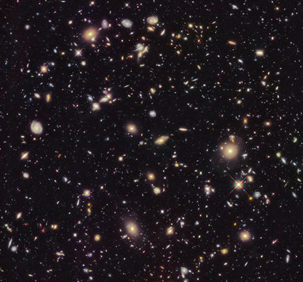
Exoplanets in habitable zones
10 Sextillion sun like stars in the universe
22% of these in the Milky Way galaxy have Earth-sized planets in their habitable zone.
That’s 2.2 sextillion stars with earth-sized planets in habitable zones
That’s an awful lot of potential planets around sun like stars alone.
We don’t know about other types of star yet…
Hubble deep space field
Credit: NASA
https://www.flickr.com/photos/nasahubble/51265789389/in/album-72157719327086276
Notes:
So how many planets are in the habitable zone?
Quick calculation based on info available on the web from NASA’s Kepler telescope and the Keck observatory
Assuming the rules of physics are the same across the universe
22% of 10 sextillion stars = 2.2 sextillion stars could have earth sized planets in their habitable zones across the universe..
And this is just sun like stars…
Drake equation calculated that there could be 12,500 intelligent civilisations in the milky way alone.
https://askanearthspacescientist.asu.edu/drake-equation#:~:text=The%20Drake%20Equation%20is%20part,easy%20to%20discover%20alien%20life.

Slide 31
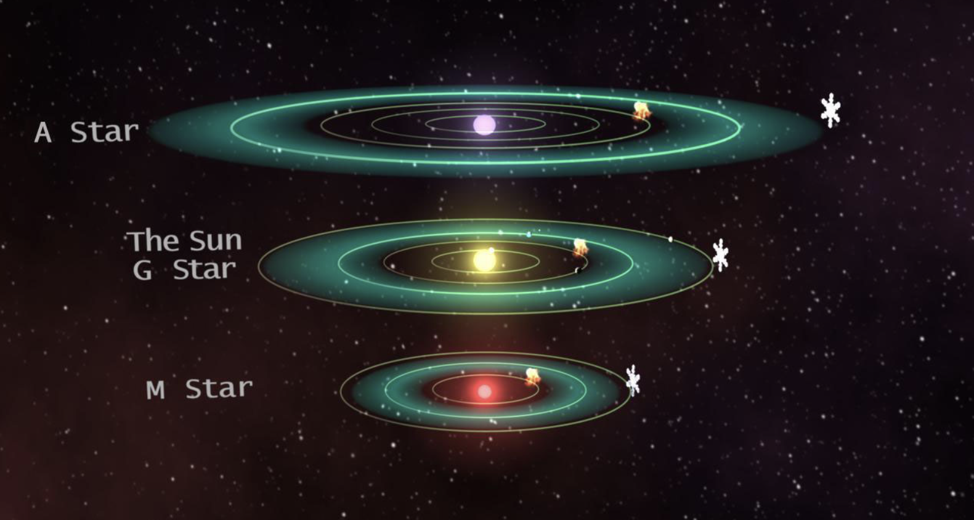
Habitable zones around stars
Space around a star where a rocky planet could continuously support liquid water on its surface.
Too close = too hot and water evaporates.
Too far = too cold and water freezes.
A-Dwarf stars
larger, hotter and more massive than our Sun
habitable zone much farther out from the star.
M-Dwarf stars
smaller, cooler and lower mass than our Sun (G-dwarf)
habitable zone much closer to the star.
.
Image credit – NASA Astrobiology Institute
Article on the habitable zone for M type stars https://astrobiology.nasa.gov/nai/articles/2016/6/30/where-is-the-habitable-zone-for-m-dwarf-stars/index.html
Notes:
Why all this effort to find exoplanets? To answer the biggest question of all. Are we alone in the universe or is there other life elsewhere?
Basic premise is that around each star there is a region where liquid water could exist on the surface of a planet.
Where it’s not too hot or too cold – the Goldilocks zone.
Determined by the type of star - Our sun is a G dwarf type star
A dwarf stars
Larger, hotter and more massive than our sun
Habitable zone is much further out
M dwarf stars
Smaller, cooler and lower mass than our sun
Habitable zone is much closer to the star.
Earth sized plants (0.5 – 2 Earth radii) are common in the habitable zone

Slide 32
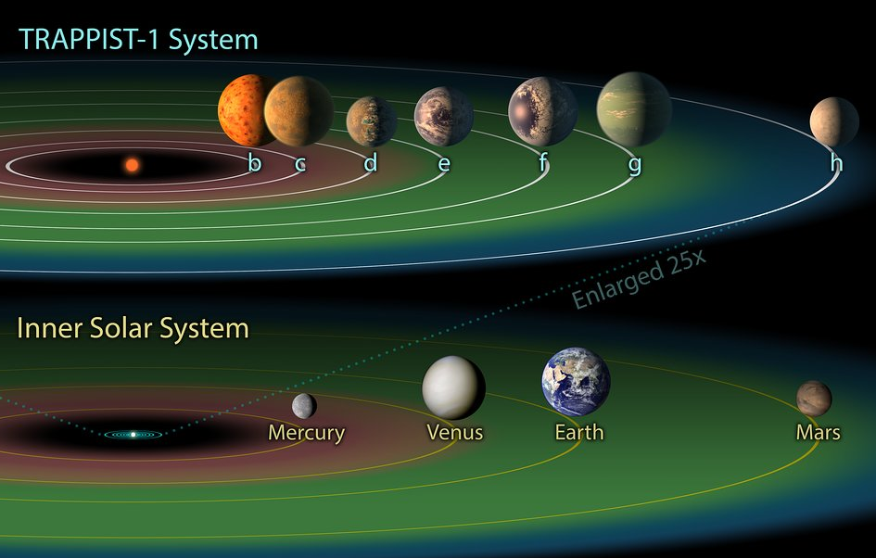
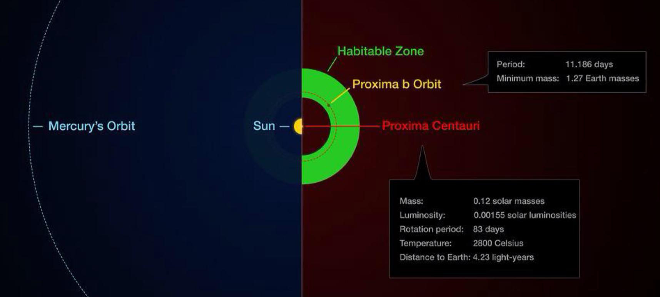
Insights from the Trappist discovery
Richest set of Earth-sized exoplanets around a single star found so far
Red Dwarf – most common
Targets for JWST
The potential habitable zone for the Trappist1 system compared with our inner solar system.
Credit: NASA/JPL-Caltech
https://esahubble.org/images/heic1802d/
Habitable zone of Proxima centari Credit ESO/M.Kornmesser/G.Coleman
from You had me at habitable slides by Dr Gary Blackwood, JP:L, NASA
https://exoplanets.nasa.gov/exep/resources/presentations/
Notes:
Trappist 1 is a red dwarf star
less than 30K km larger in diameter than Jupiter
three earth sized planets in its habitable zone
Shows that Red Dwarf stars can host rich planetary systems
Another example is Proxima Centauri - closest star to us at 4 light years away
Again a Red dwarf – only 12% the size of our sun
Compared with our sun it’s habitable zone is well within the orbit of Mercury.
These exoplanets will be top targets for JWST
Measure presence and composition of an atmosphere using infrared spectra taken during transits
Observations will be difficult.

Slide 33









Physical properties affecting habitability
Stellar luminosity and temperature
Radiation and stellar winds
Orbit eccentricity
Very elliptical orbits
Tidal locking
Notes:
How hot and bright the star is
How much radiation it emits – lots of X and gamma rays would be lethal to life.
M type stars, smaller than our sun, throw out a lot of x and gamma rays.
How regular the orbit is.
Highly irregular orbits may mean a planet can’t sustain liquid water on its surface long enough to allow life to survive.
Very elliptical orbits are only an issue where they take an exoplanet out of the habitable zone for too long.
Tidally locked planets have the same side constantly facing their star – like the Earth and our moon.
May only be able to sustain water in a limited ring around the planet between the heat of the sun on one side and the cold of space on the other.
Unlikely for very short orbit exoplanets.

Slide 34
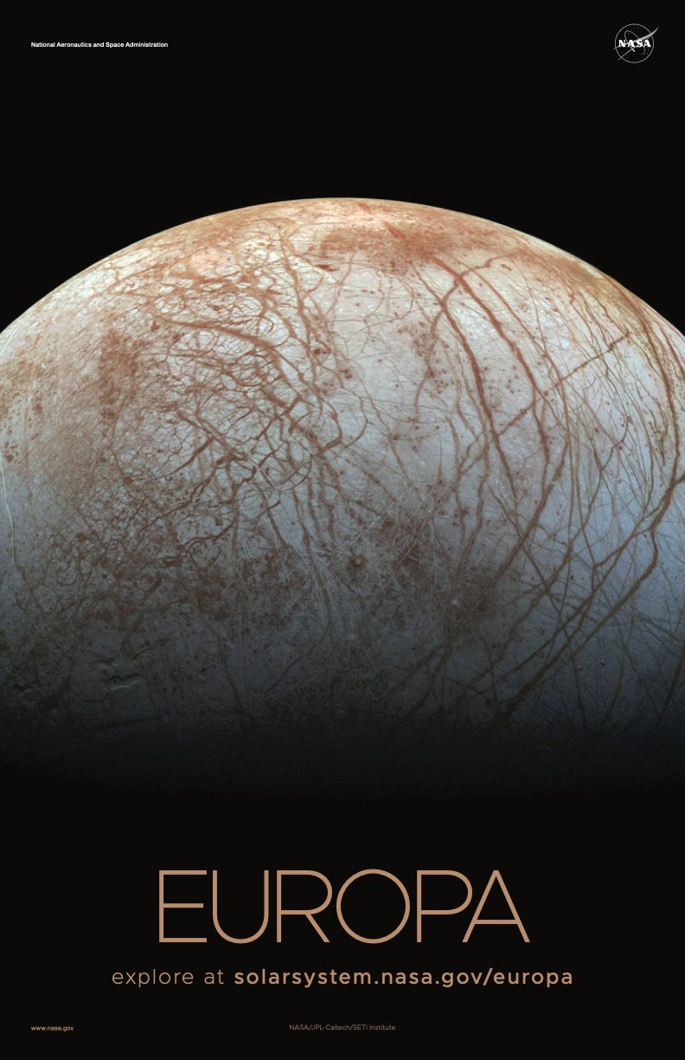
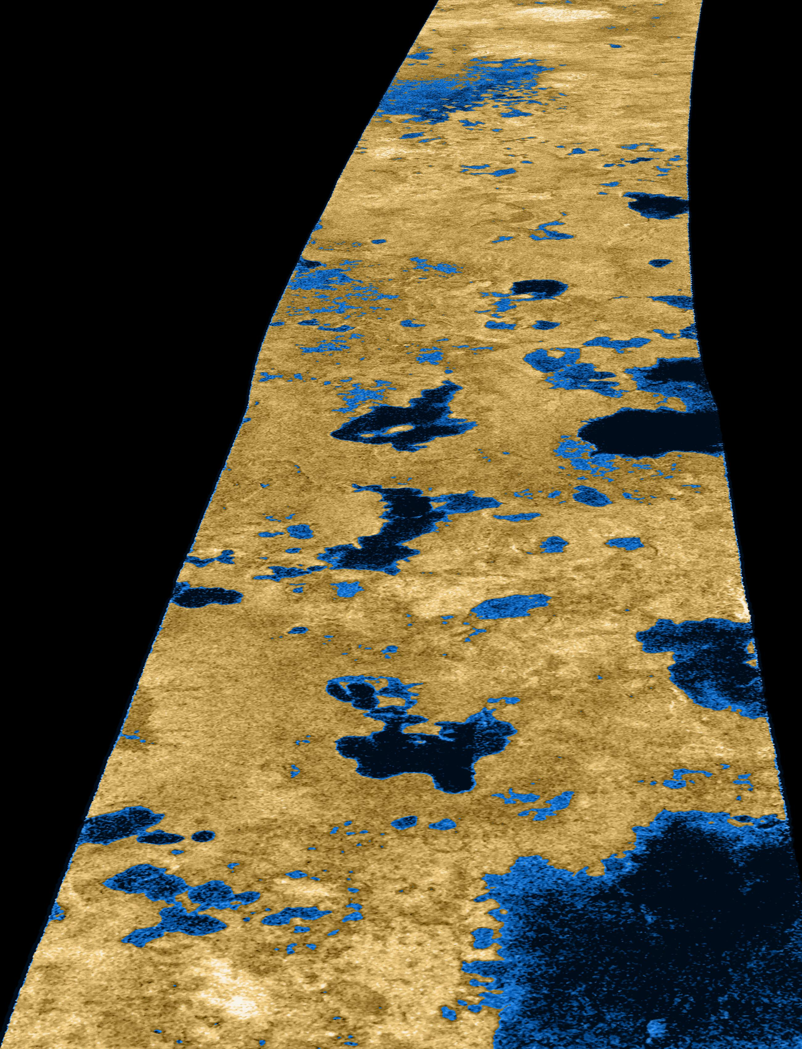
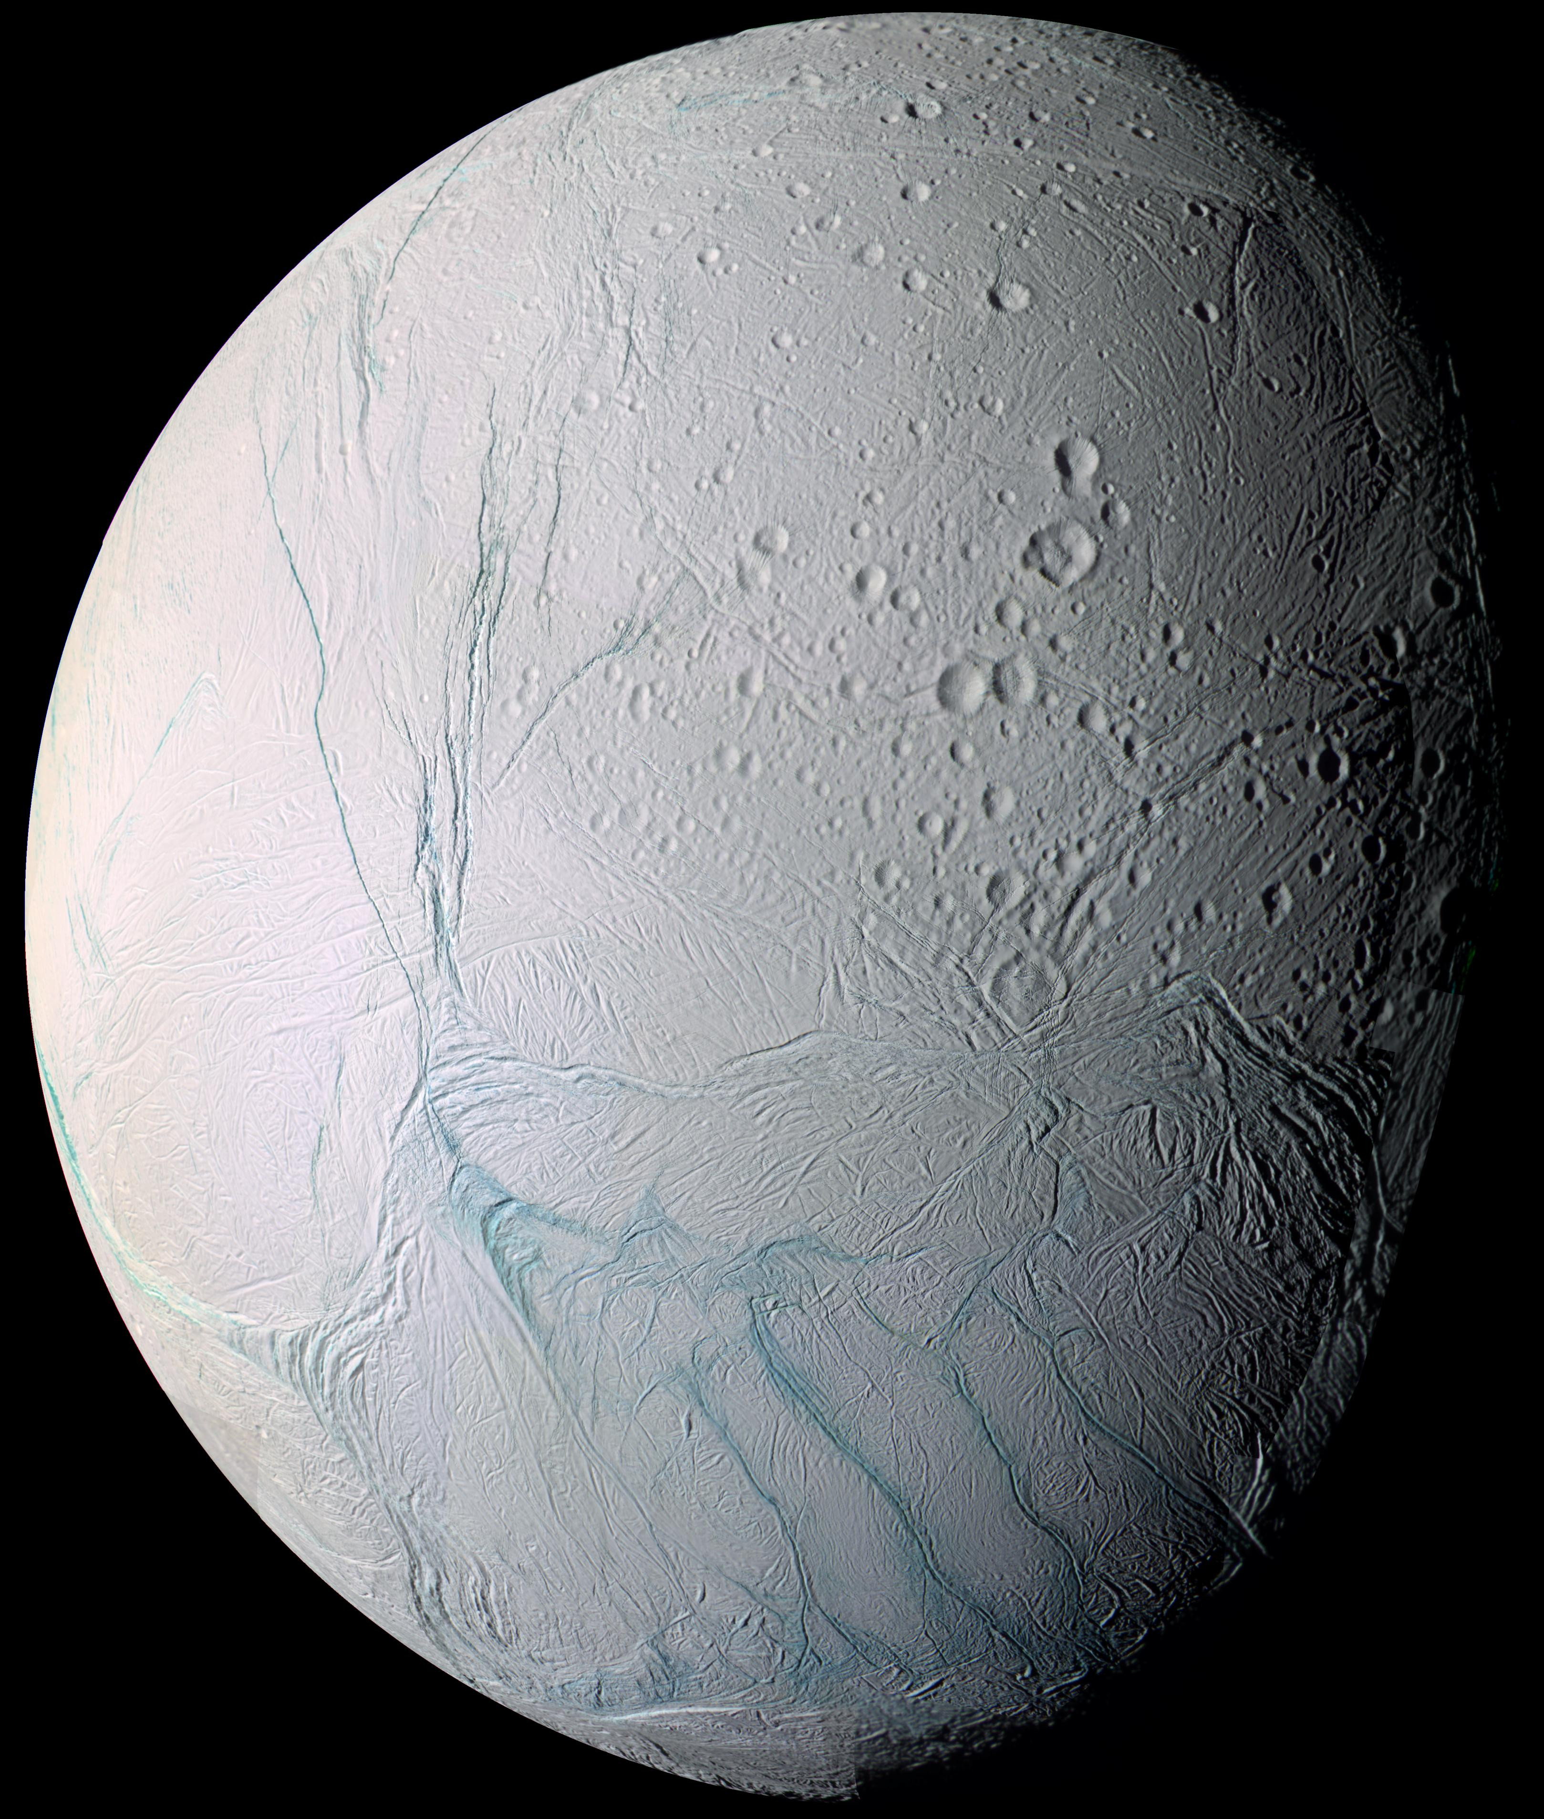
Life in other locations?
What about the potential for life outside the habitable zone?
Some moons around gas giants could support life – icy moons like Europa, Enceladus and Titan
If we find life there and the same applies across the universe life could be everywhere.
Does life have to be carbon based, are other chemistries possible?
Left top - NASA Europa leaflet https://science.nasa.gov/resource/jupiters-moon-europa-poster-version-a/
Left bottom - NASA Enceladus image https://science.nasa.gov/resource/zooming-in-on-enceladus-mosaic/
Right - NASA Liquid lakes on Titan https://science.nasa.gov/resource/liquid-lakes-on-titan/
Notes:
What about the potential for life outside the habitable Zone?
In our own solar system we don’t know whether the icy moons Europa, Enceladus and Titan harbour life of any kind.
That’s three extra potential candidates in our solar system alone.
This would vastly expand the number of locations that could harbour life.
What about other types of stars? And other chemistries?

Slide 35
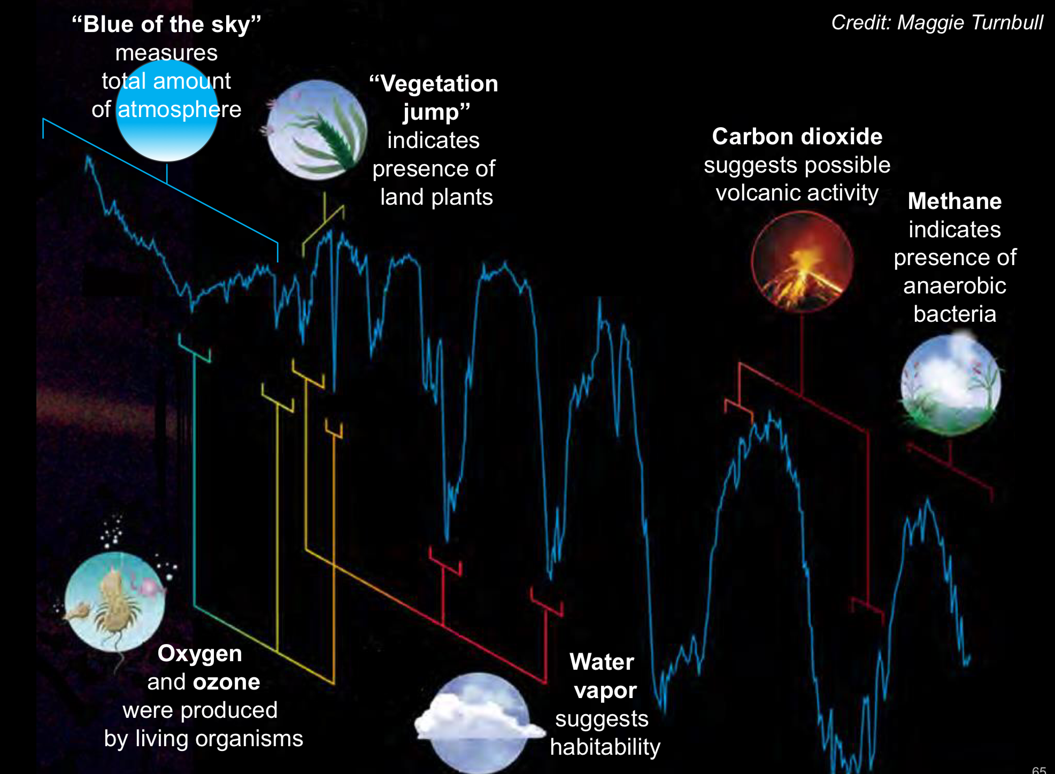
Detecting signs of life – as we know it at least - 1
Carl Sagan’s experiment l
Control experiment to see if life could be unambiguously detected by a spacecraft
The near infra-red mapping spectrometer (NIMS) detected:
  water vapour in the atmosphere, ice at the poles and oceans
  Temperatures from -30C to +18C
  High concentrations of oxygen and methane
  An ozone layer shielding the surface from UV radiation
  Global tectonic and volcanic processes
Image credit Maggie Turnbull from You had me at habitable slides by Dr Gary Blackwood, JP:L, NASA
https://exoplanets.nasa.gov/exep/resources/presentations/
Notes:
30 years ago Carl Sagan led a group of scientists and found evidence of potential life on Earth!
Control experiment to see if life could be unambiguously detected by a spacecraft.
Used NASA’s Galileo which isn’t optimized to search for life.
Detected high levels of oxygen and methane compared with other planets.
Being highly reactive that have to be constantly replenished.
This suggests but doesn’t prove life.

Slide 36
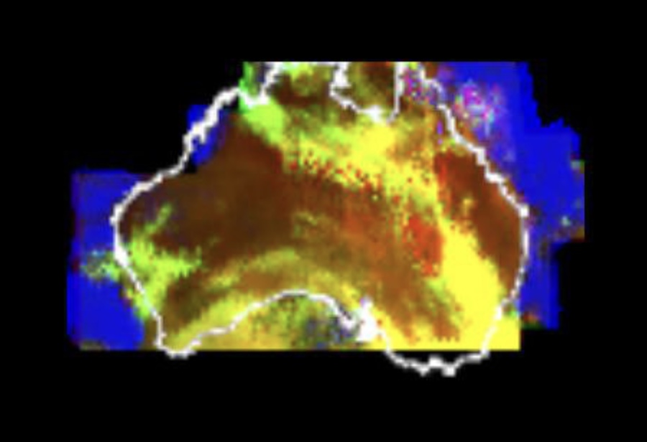
Detecting signs of life - 2
Camera showed:
Oceans, deserts, clouds, ice and darker regions (which we know to be rain forests)
Combined with more spectrometry
narrowband IR filters - can detect differences between plant species and leaf moisture content
Potential problems
Fly-by geometry
Timing of fly-bys.
Image – Galileo IMS multispectral map of Australia and surrounding seas taken shortly after closest approach from a range of about 80,500 km.
The image shows various ocean, land and atmospheric cloud features as they appear in three of the wavelengths sensed by the instrument.
Blue = enhanced liquid water absorption.
Red = enhanced ground reflection as on the Australian continent. This wavelength is also sensitive to the reflectivity of relatively thick clouds. Green = strong water vapor absorbing band and is used to accentuate clouds lying above the strongly absorbing lower atmosphere. (NASA/JPL) https://www.drewexmachina.com/2020/12/08/the-first-planetary-probe-encounter-of-the-earth-nasas-galileo-on-december-8-1990/
Notes:
Narrowband IR filters can detect differences between plant species due to regional variations in the ‘red edge’ of chlorophyll.
Darker regions particularly absorbed red light – strongly suggestive of light being absorbed by photosynthetic plant life.
Water absorbs light at 1-μm – depth of this band is diagnostic of leaf moisture content indicating vegetation.
No minerals are known to absorb light in the same way.
The experiment revealed:
The highest res images were of the deserts of W Australia and the ice sheets of Antarctica..
The fly-by was at night so no cities, city lights or clear examples of agriculture were seen.
So, if the fly-by geometry doesn’t cross the right parts of the planet
or take place at the right time of day , or in history, we might not detect signs of life.

Slide 37
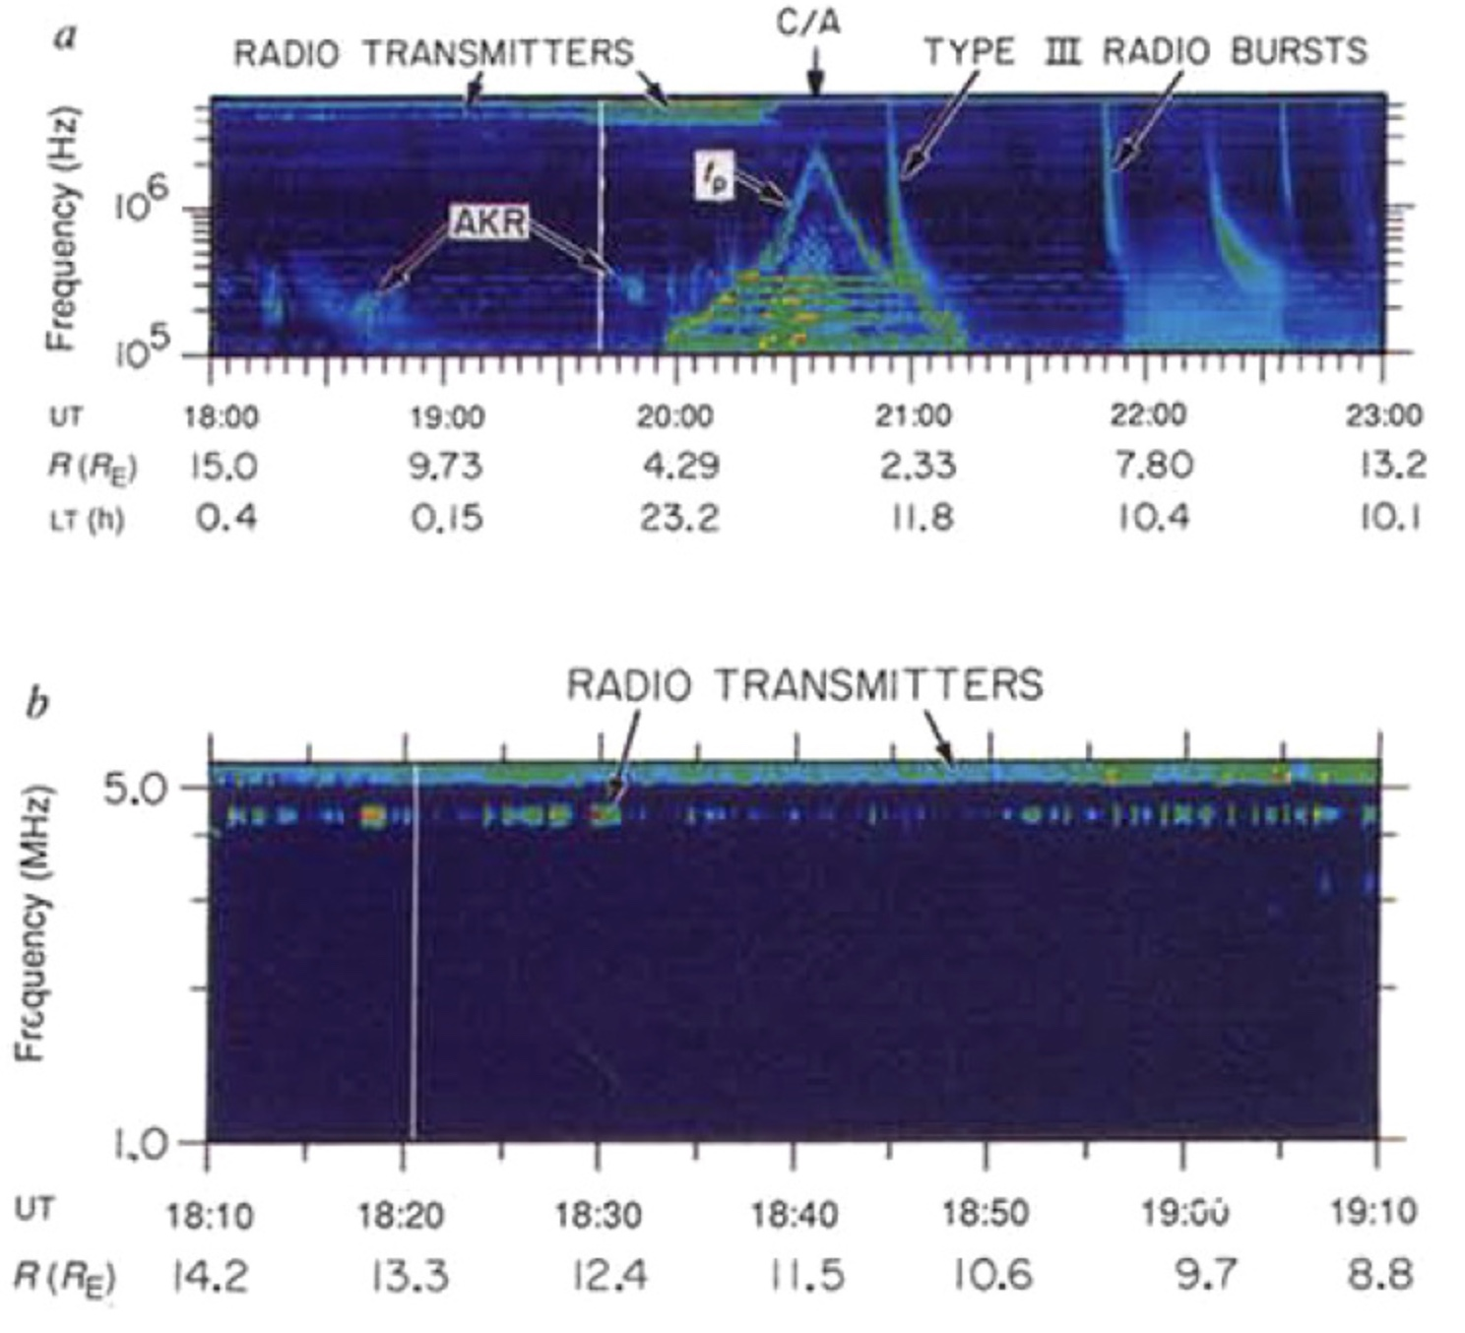
Detecting signs of life - 3
Plasma wave radio
Detected consistent narrowband radio emissions from Earth at fixed frequencies
This suggests an artificial source.
Image - Time series spectra of radio emissions from the Earth as observed by Galileo’s Plasma Wave experiment.
UT = units of time
R = distance (in Earth radii)
LT = local time (hours).
Upper panel shows emissions from various sources including auroral kilometric radiation (AKR), Type III solar radio bursts and electrostatic oscillations in the plasma surrounding the Earth (f_{P}). Time of closest approach is denoted by “C/A”.
Lower panel provides a closeup view showing modulated VLF transmissions of artificial origin. (Sagan et al.)
https://i0.wp.com/www.drewexmachina.com/wp-content/uploads/2020/12/Galileo_EGA1_radio_spectra.jpg?ssl=1
Notes:
The cosmos is full of natural radio emissions across many frequencies, i.e. broadband.
The top image shows emissions from various sources:
Aurora - Auroral kilometric Radiation (AKR)
The Sun - Solar Radio bursts - Type III
Plasma around the Earth – electrostatic oscillations – fp
The closet approach reading is shown by C/A.
Artificial radio sources are narrowband.
The lower image shows these signals.

Slide 38
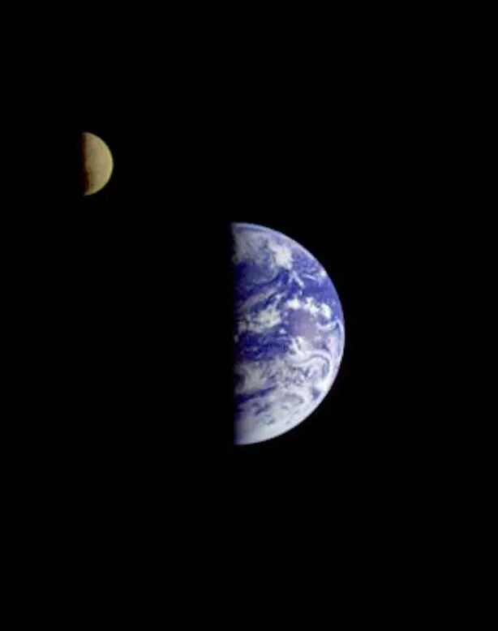
Detecting signs of life - Conclusions
Found:
Water, a weather system and modest temperatures
Chemical traces in the atmosphere which are hard to explain
Light absorption clues
Narrowband radio signals
Timing is critical – fly-by geometry, time of day and point in history.
Image – Earth and moon as seen by Galileo from a distance of 6million kilometres away – NASA
Info – The Conversation https://theconversation.com/carl-sagan-detected-life-on-earth-30-years-ago-heres-how-his-experiment-is-helping-us-search-for-alien-species-today-216037
https://www.drewexmachina.com/2020/12/08/the-first-planetary-probe-encounter-of-the-earth-nasas-galileo-on-december-8-1990/
https://agupubs.onlinelibrary.wiley.com/doi/abs/10.1029/95JE01407
Notes:
One image (at ∼2 km/pixel) showed geometrization plausibly attributable to our technical civilization!
Spacecraft flying within a few thousand kms of human civilisation on Earth aren’t guaranteed to detect it.
Control experiments like this are therefore critical in informing the search for life elsewhere.
Life is the last assumption based on a combination of evidence:
Water, weather and modest temperatures- necessary but not enough to prove life by themselves..
Light absorption - suggesting photosynthetic-like processes.
Narrowband radio emissions - only emitted by technological societies but these would only have been detectable for the last century from Earth.
And Timing is critical - may not:
capture the right areas
be taken at the right times or day or at the right point in a planet’s history.
An alien spacecraft making the same flyby prior to the 20th century would have seen no definitive evidence of civilization on earth.
No surprise then that no evidence for extra-terrestrial civilisation has been found - yet.

Slide 39
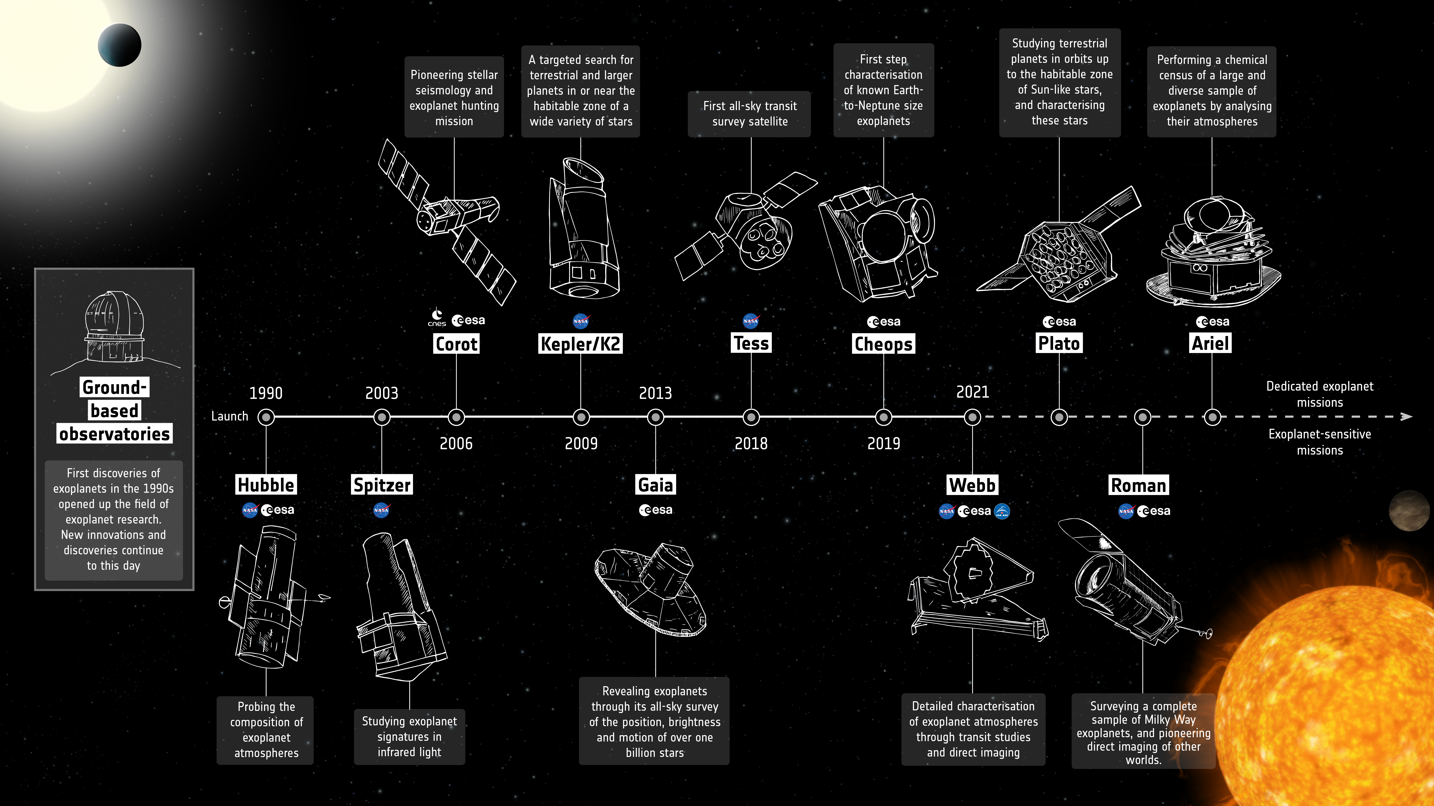
Image and article: ESA Exoplanet mission timeline https://www.esa.int/Science_Exploration/Space_Science/Exoplanets/ESA_s_exoplanet_missions
Notes:
SETI objectives
To explore, understand and explain the origin, nature and prevalence of life in the universe
Plus applying the knowledge gained to inspire and guide present and future generations
Keplar/K2 – for potential planet data – but only a few planets were large enough to use spectrometry
Typical spectrograph takes us to 2 pixels = 5Km/ps need narrower lines to give best results
Cheops - First characterization of known Earth to Neptune sized exoplanets
VLT and ESPRESSO - will get us to 10cm/ps accuracy but cost 50K Euros per night
Need to get to thousandths of a pixel for accurate planet detection
James Webb Space Telescope (JWST) - Exoplanet atmospheres
Plato - Studying terrestrial planets in orbits up to the habitable zone of sun like stars and characterizing these stars
Ariel
Chemical census of large and diverse sample of explanets
Analysing their atmospheres
Using transit studies and direct imaging

Slide 40
Do you want to help to find another Earth?
NASA – Citizen Science page lists seven projects you can get involved with
  https://exoplanets.nasa.gov/citizen-science/
Exoplanet Database – NASA’s continuously updated exoplanetary encyclopaedia
  https://exoplanets.nasa.gov/discovery/exoplanet-catalog/
If you like to dive into raw telescopic data, TESS data is publicly available to use for free.
DIY planet search - Using the MicroObservatory Telescope Network - https://waps.cfa.harvard.edu/microobservatory/diy/index.php
Even if you’re not a researcher, you can still help by participating in TESS’ Citizen Science project, which has already helped discover several exoplanets including a world orbiting two stars, similar to Tatooine in Star Wars.
  Source: https://www.planetary.org/space-missions/tess
  https://www.unistellar.com/en-uk/citizen-science/exoplanets/
If you want to have a go at producing your own transit data this article from the BAA tells you everything you need to know,
  https://britastro.org/2020/exoplanet-transit-imaging-and-analysis
Notes:
If you want to help to find another Earth these are some of the Citizen Science projects that you can engage with.

Slide 41
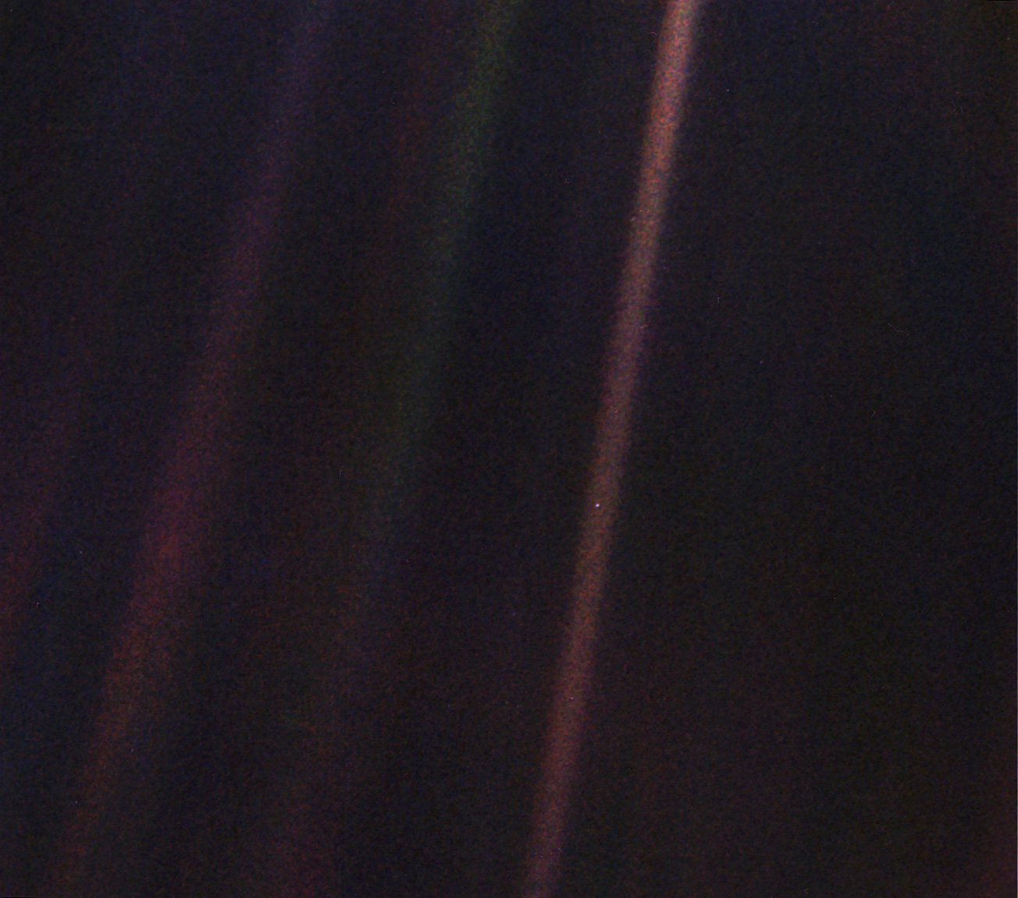
Freebies and programmes
Talks
British Astronomical Association – Exoplanet seminar recordings https://britastro.org/sections/exoplanets
Free Hubble ebook
Hubble book on exoplanets - free to download https://www.nasa.gov/ebooks/nasas-new-hubble-e-book-takes-readers-on-a-journey-to-curious-worlds/
Free Open Learn course - An introduction to exoplanets https://www.open.edu/openlearn/science-maths-technology/an-introduction-exoplanets/content-section-overview?active-tab=content-tab
Chandra exoplanet leaflet https://chandra.harvard.edu/exoplanet/images/Exoplanet_Final.pdf
NASA ABC of Exoplanets
https://explorers.gsfc.nasa.gov/abcs/index.html
https://explorers.gsfc.nasa.gov/abcs/downloads/TheABCsofExoplanetsSinglePagesDownload.pdf
Amazon Prime
Planet Hunters – The search for Earth’s twin
Image: NASA Voyager 1 of The Pale Blue Dot https://science.nasa.gov/resource/voyager-1s-pale-blue-dot/
Notes:
As a final nod to Carl Sagan I’ve included the Pale Blue Dot.
The image was taken by Voyager 1 on 14 February 1990 at a distance of 3.7 billion miles from the sun.
Taken just 34 minutes before Voyager 1 powered down it’s cameras for the last time.
If you want to find out more about exoplanets there are some free talks, books and courses you can access online.
The TV programme is also good, I watched it on Amazon Prime but you might find it elsewhere too.
It’s worth typing ‘plantary geology pdf’ into google – there are a number of books on planetary geology you can download in pdf format for free if you’re interested.

Slide 42
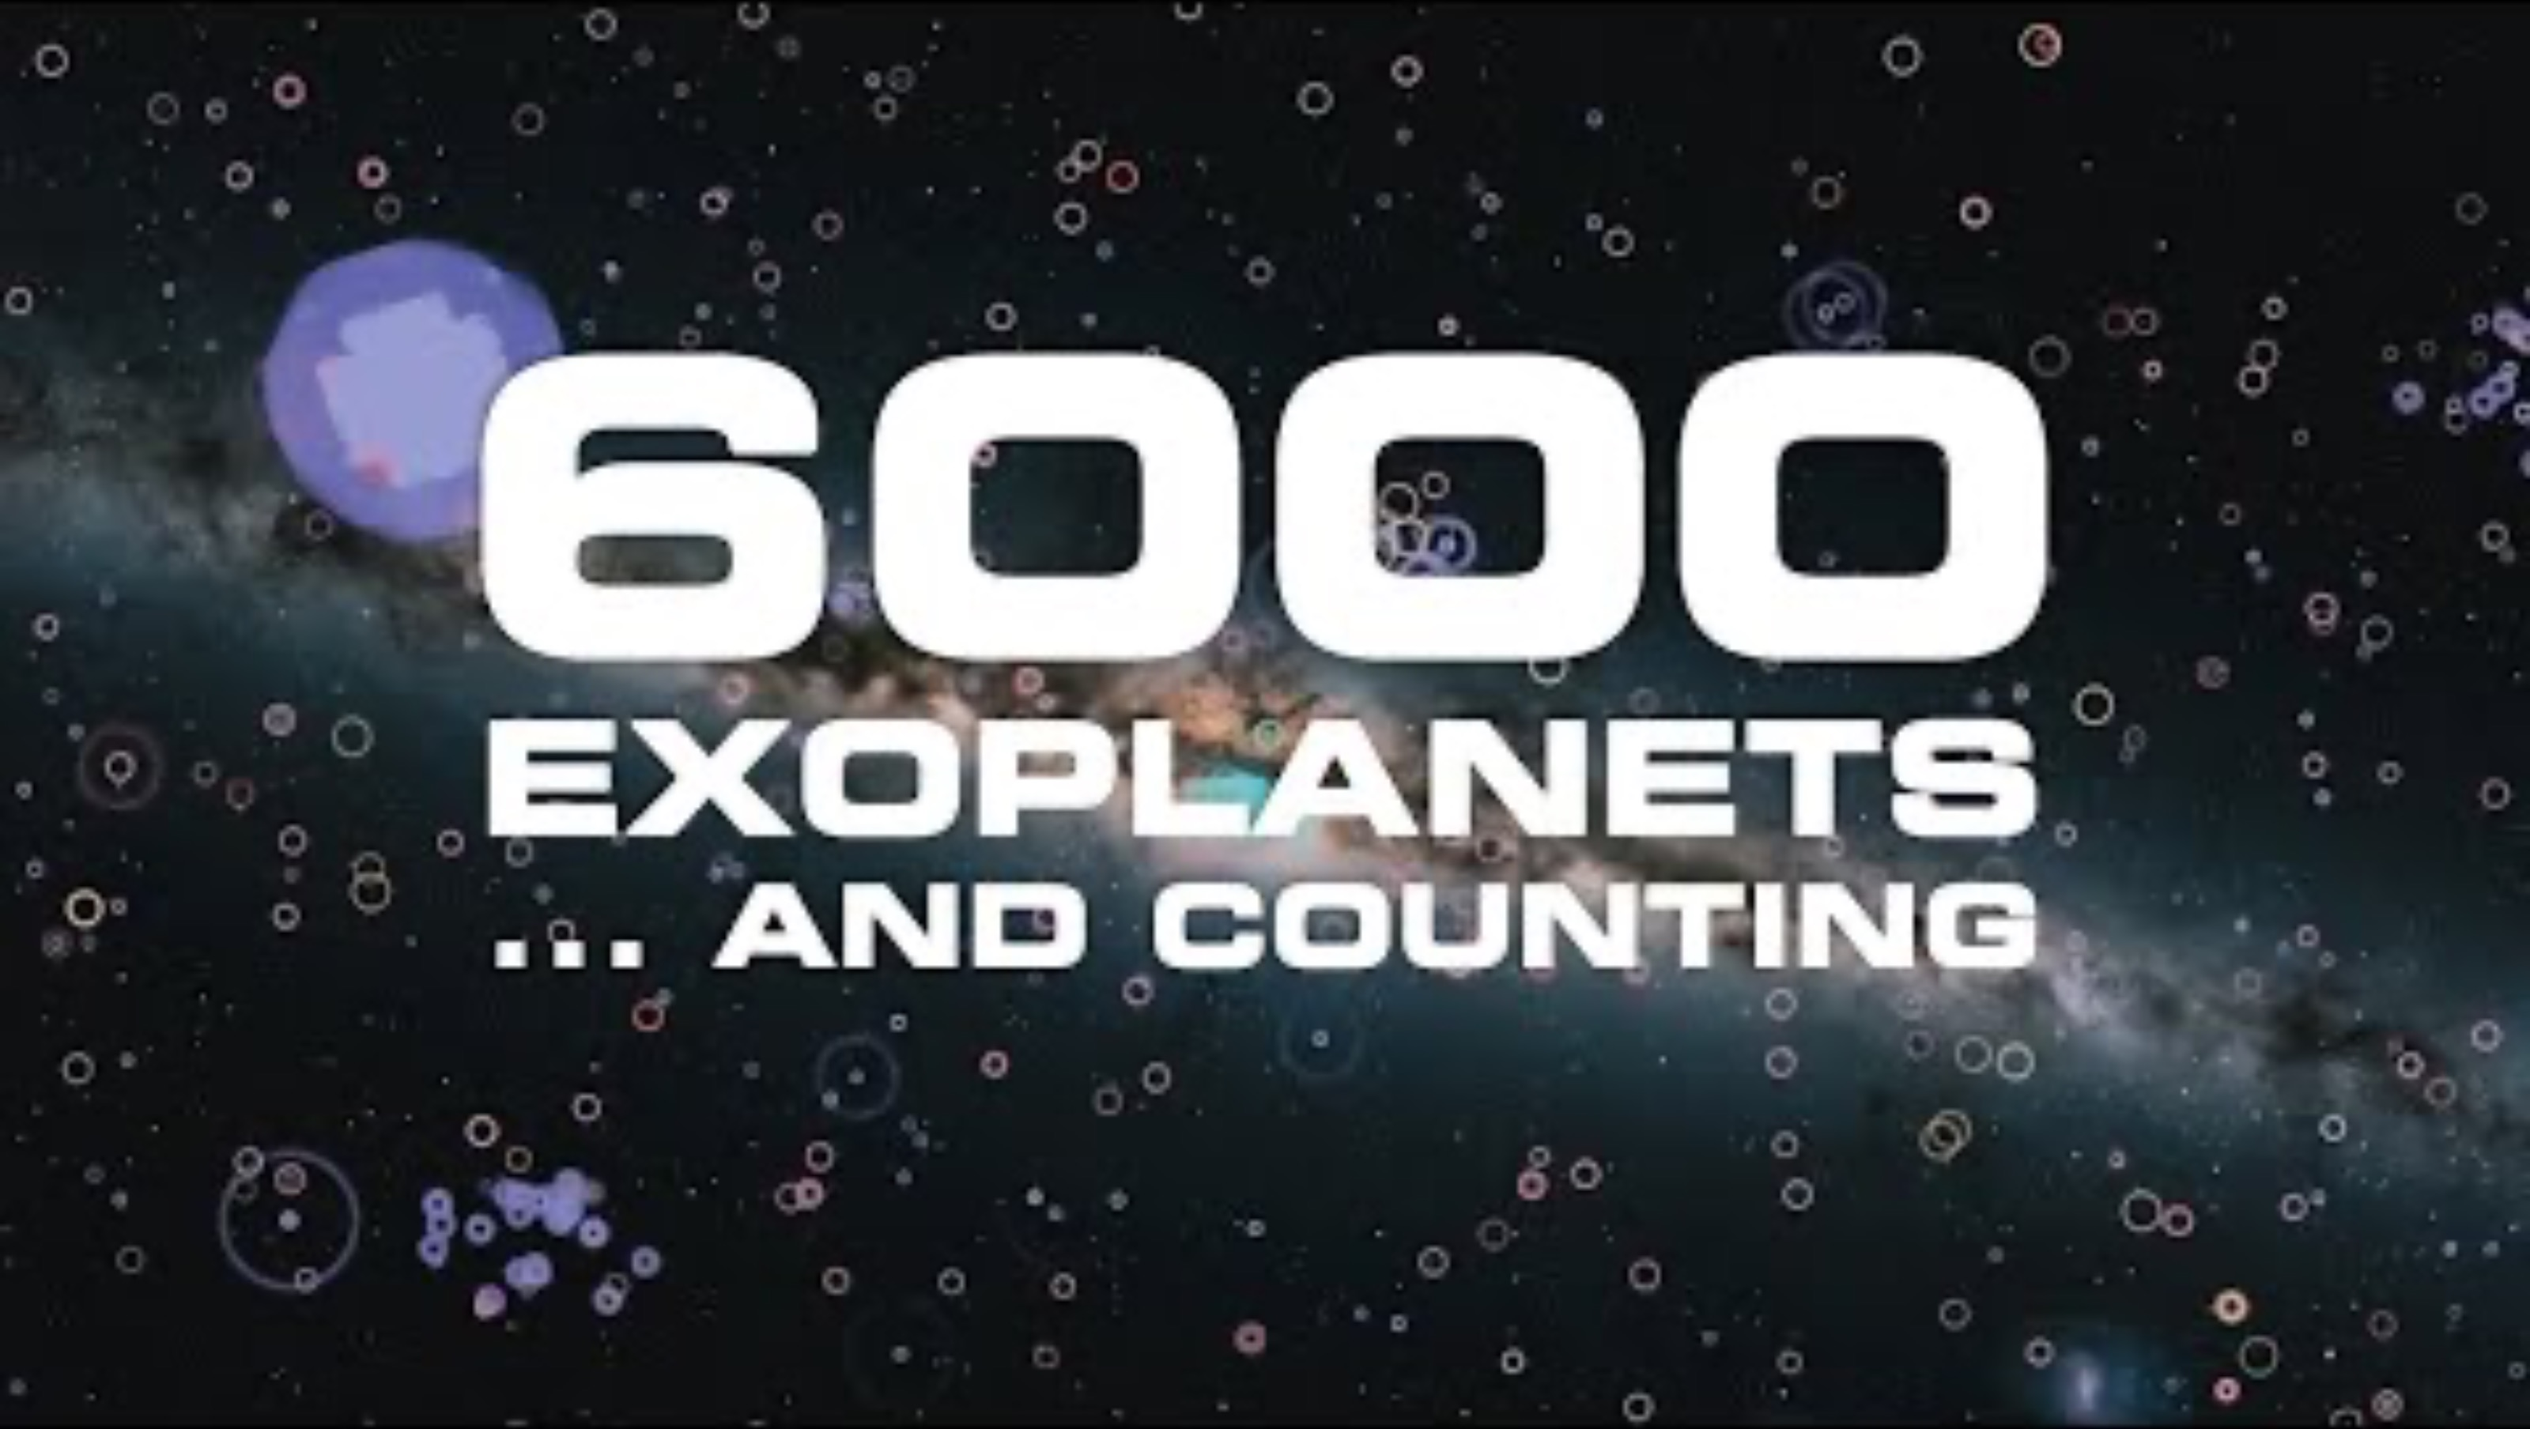
Video: NASA https://youtu.be/vAna9jBZRd8?si=QigFLCYj4gTwRmdA
Notes:
https://youtu.be/vAna9jBZRd8?si=QigFLCYj4gTwRmdA

