Slide 1
The Earth’s Resources
TITANIUM

Slide 2
What we’ll cover
Titanium properties and major commercial usage
Titanium containing ores and mining
TiO2 pigment production
Titanium metal production

Slide 4
Titanium
Tita-
nium
Only found in nature as an oxide, 9th most abundant element
Highest strength to weight ratio of all metals
Resistant to corrosion due to oxide layer
Can be alloyed with Fe, Al, Va & Mo to increase strength further
Affinity for chlorine, producing TiCl3 & 4
TiO2 is the major source of white pigment
22
Ti
47.867

Slide 5

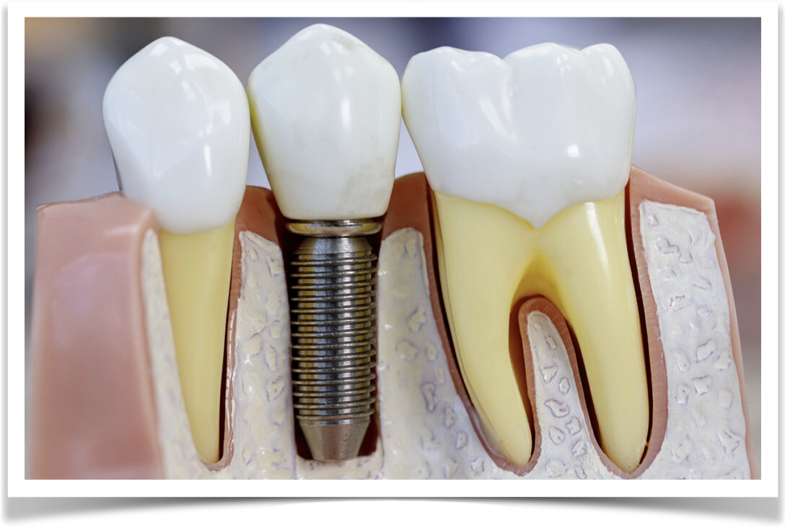
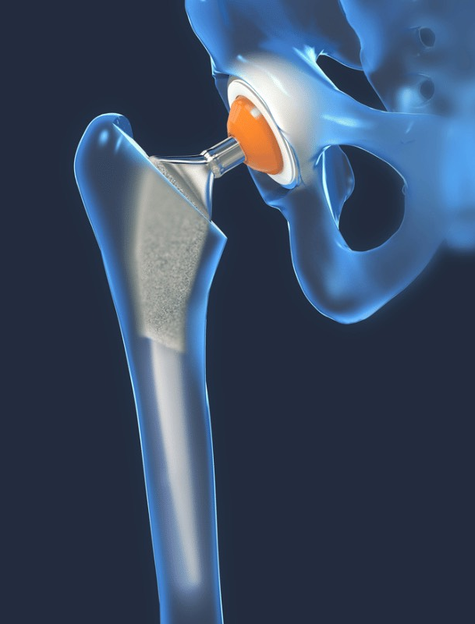
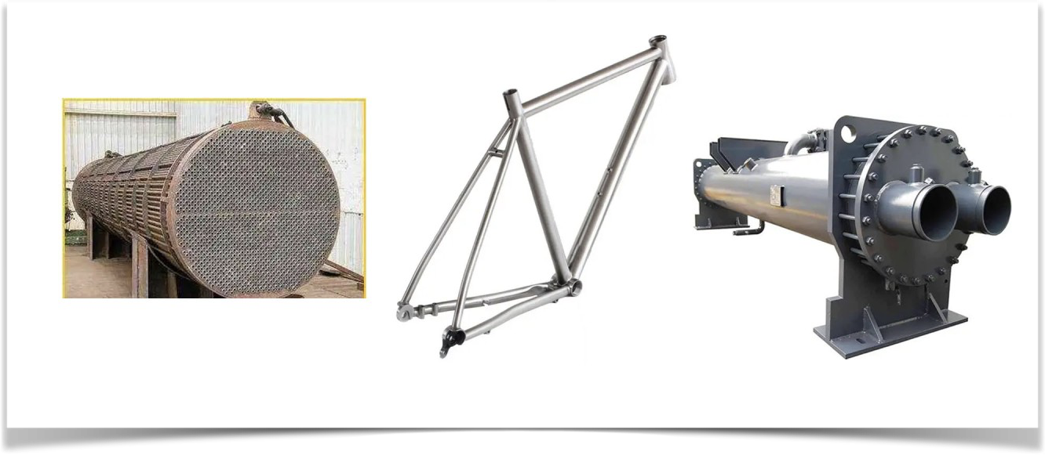
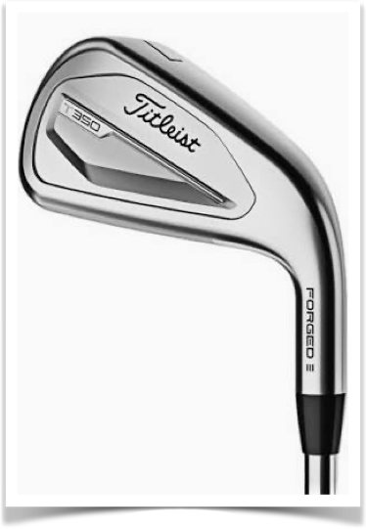

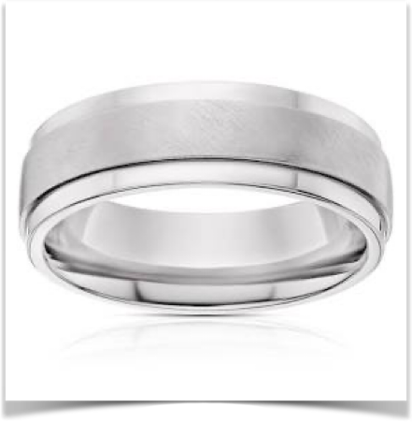
Titanium metal uses

Slide 6
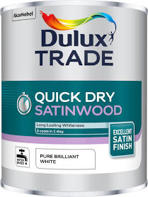
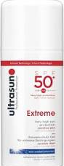
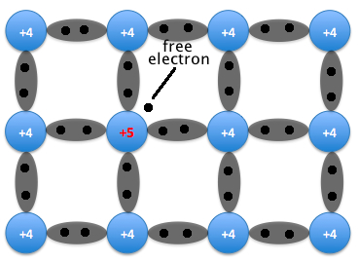
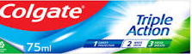

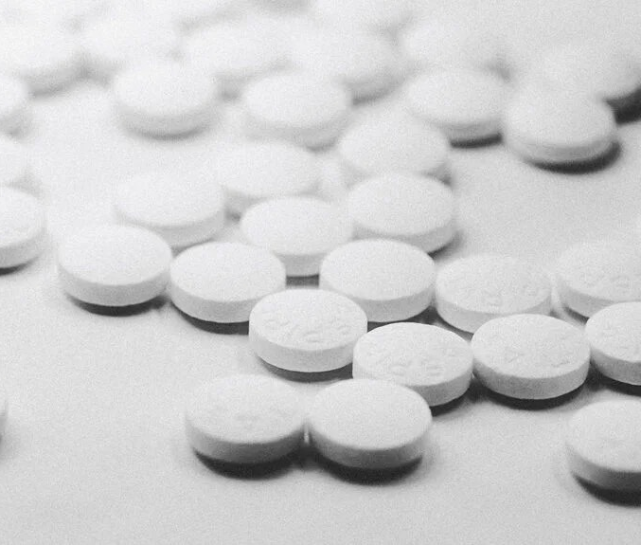

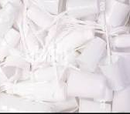
Titanium Dioxide end uses

Slide 7
Production Volumes
Approximately 95% of mined ore is used for TiO2 pigment
In 2022 8.9 million tonnes of pigment produced from ores
245,000 tonnes of sponge titanium metal produced in 2022

Slide 8
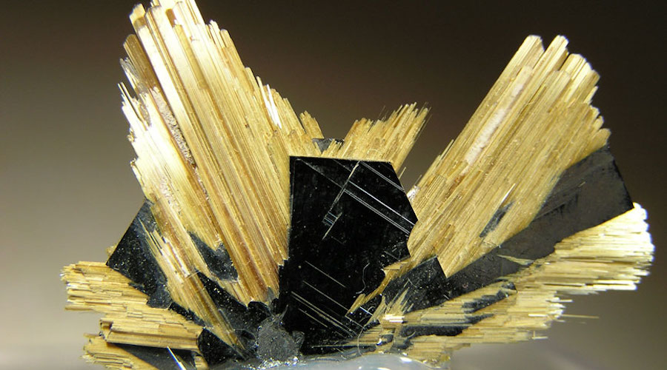
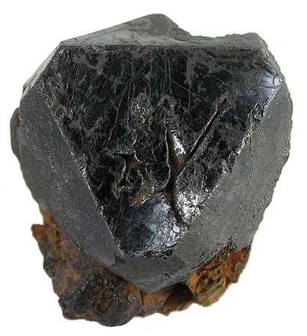
Titanium Ores
Only found as oxides
Rutile TiO2 Ilmenite FeTiO3

Slide 9
Mineral Properties
MINERAL | RUTILE | ILMENITE
COMPOSITION | TiO2 | FeTiO3
CRYSTAL STRUCTURE | PRISMATIC ACICULAR STRIATED | TRIGONAL RHOMBOHEDRAL
FORM | GRANULAR MASSIVE | GRANULAR MASSIVE
LUSTRE | VITREOUS TO SUBMETALIC | METALIC TO SUBMETALIC
COLOUR | BROWN , RED, ORANGE,YELLOW BLACK | BLACK/GREY WITH BROWNISH TINT
STREAK | PALE BROWN OR YELLOWISH | BLACK
CLEAVAGE | GOOD IN 2 DIRECTIONS | NONE
FRACTURE | CONCHOIDAL | CONCHOIDAL TO SUBCONCHOIDAL
HARDNESS | 6-6.5 | 5-6
SG | 4.23 | 4.7
UNUSUAL FEATURES | RUTILATED QUARTZ | WEAKLY MAGNETIC

Slide 10
Titanium Ore Deposits
 | RUTILE | ILMENITE
GEOLOGICAL FORMS | Beach sands, Accessory mineral igneous & metamorphic rocks | Mineral sand deposits often costal. Accessory mineral intrusion in granite, pegmatites First found in Cornwall in a black sand stream in 1791 but was named after deposits in Ilmensky Mountains in Russia
TITANIUM DIOXIDE CONTENT % | 93 - 96 | 44 - 70
MAJOR PRODUCERS % | AUSTRALIA 48 SOUTH AFRICA 23 SIERRA LEONE 12 UKRAINE 10 | CHINA 35 SOUTH AFRICA 13 MOZAMBIQUE 12 AUSTRALIA 6
MINES | PLACER MINES (69%), OPEN CAST, CONVENTIONAL SHAFT (MOST EXPENSIVE)
PROVEN RESERVES | ????????? | 4-600 MILLION TONNES

Slide 11
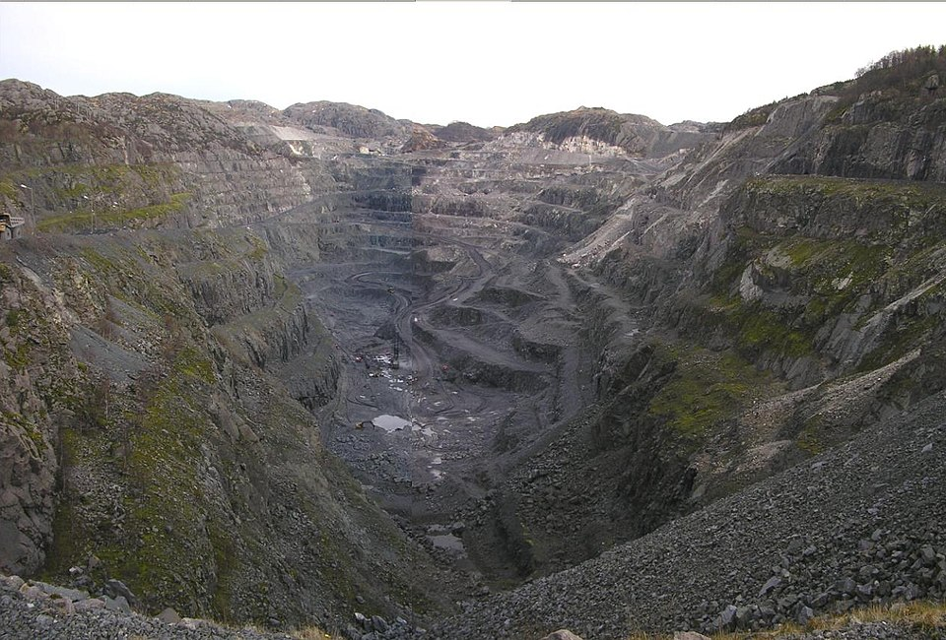
Ilmenite open cast mining, Norway

Slide 12
Ore Processing For Feedstock
Sandy deposits from placer mines require least processing - often merely physical and gravity separation.
Consolidated deposits from open cast and conventional mines may require multiple stages of crushing, separation and grinding to produce a commercial purity of product. Physical, gravity, flotation and magnetism are all used as separation methods, potentially producing significant waste products. Generally energy intensive and large scale.

Slide 13
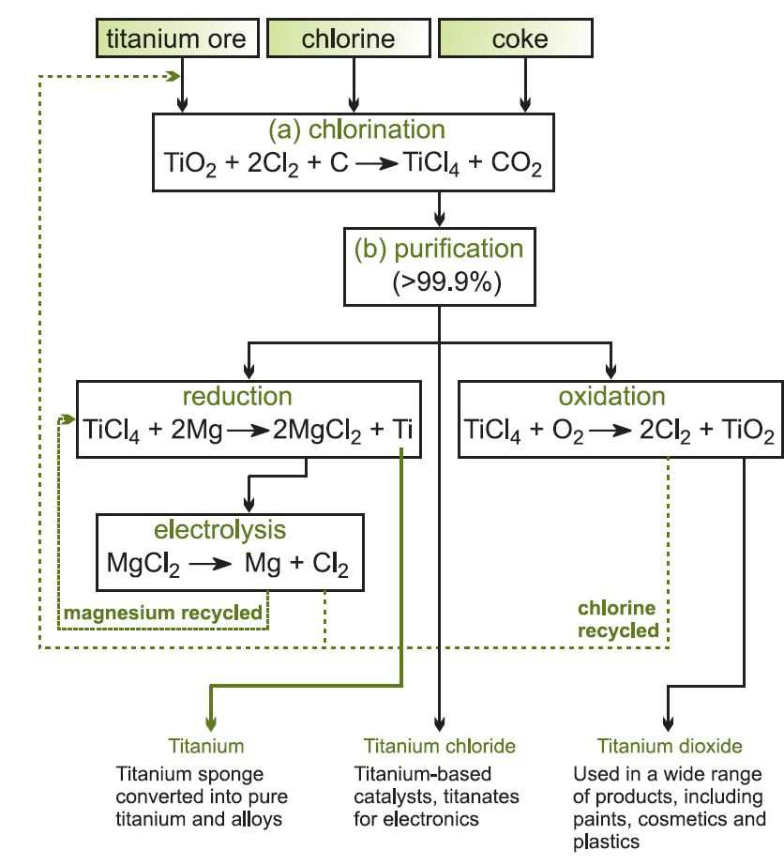
The Chloride process for Titanium Metal and
TiO2 from Rutile.
First you have to tickle it
Rutile
Coke
Chlorine
Chloride or Kroll Process
The ore is converted to TiCl4, “tickle” in industry parlance to allow deep purification
Distillation produces 99.9% pure TiCl4
To convert TiCl4 to metal, it is reduced using magnesium powder in a fluidised bed. Magnesium chloride is removed using dilute HCl. producing a Titanium Sponge
To convert TiCL4 to TiO2 pigment, oxygen is added causing an instantaneous reaction
Although both processes employ significant recycling, they are very energy intensive
Titanium
TiCl3&4
TiO2

Slide 14
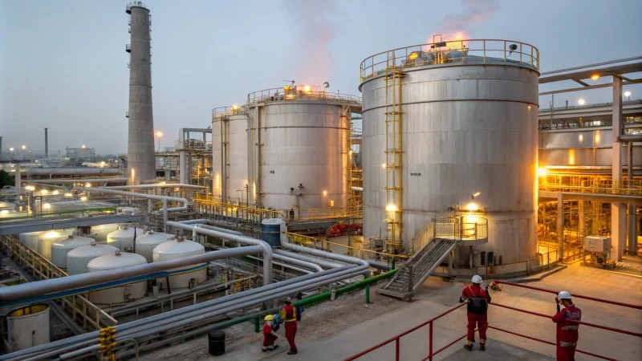
Chloride process production plant

Slide 15
TiO2 from Ilmenite or Rutile using the Sulphate Process
Sulphuric acid is used to dissolve impurities in the finely divided ore
Ilmenite generally contains 40-60% TiO2, the remainder being iron
The iron is converted to Iron Sulphate using sulphuric acid, allowing the removal of purer TiO2
This can be utilised as lower grade pigment or further purified
Often known as synthetic Rutile, it can be used as a feedstock for the Chloride process to produce purer Titanium or TiO2 pigment
Rutile can be processed via the Sulphate process, producing significantly less waste product

Slide 16
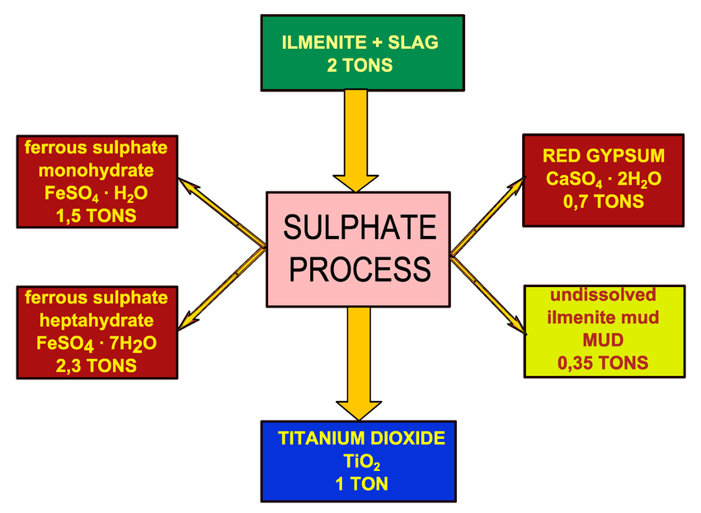
Sulphate
process wastes
Illustrative. Ilmenite as the feedstock. Waste production is heavily dependent upon ilmenite ore purity

Slide 17
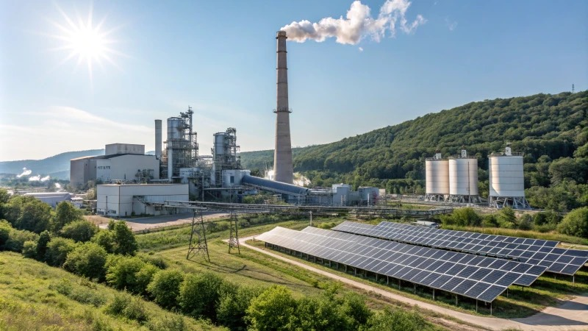
Sulphate process
production plant

Slide 18
Chloride Process Pro’s and Con’s (vs Sulphate)
PRO’S
Energy consumption is lower (450-600kwh/tonne vs 600-800)
Less waste - only used with higher purity feedstock
Higher quality products can be obtained.
CON’s
Larger investment,
Complicated equipment structure,
Material requirements, high temperature resistance, corrosion resistance,
Difficult to repair
Lower feedstock flexibility

Slide 19
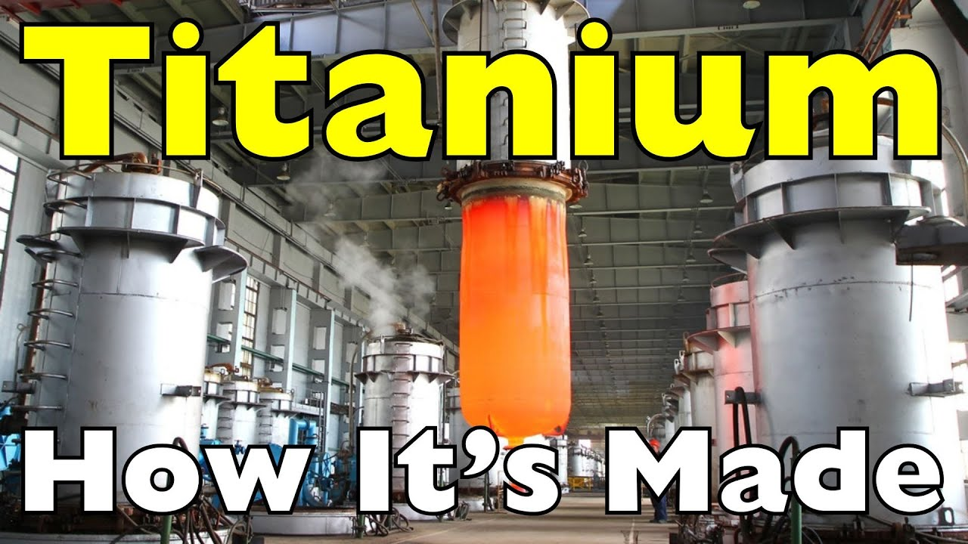
Titanium metal manufacture

Slide 20
Summary
Titanium is the 9th most abundant element in the earth’s crust and is found in oxide forms as the ores Ilmenite and Rutile.
It is predominantly mined from placer deposits and via open cast mining. Just under 9 million tonnes were mined in 2022
The major use is in the production of TiO2, widely used white pigment.
The Chloride and Sulphate processes are used to produce the pigment. The newer chloride process has environmental and product quality advantages but is generally only used with the higher purity rutile or or derivatives
Titanium metal requires the production of TiCl4 via the chloride process, followed by reaction with Magnesium to produce sponge Titanium
245,000 tones of Titanium metal were produced in 2022 for use in aircraft manufacture, medical prosthetics, process equipment and sporting goods

